Slide 1
WF on NR Positioning UE requirements (RAN4#94-e email thread #56)
3GPP TSG-RAN WG4 Meeting # 94-e
Electronic Meeting, Feb 24-March 06, 2020
Agenda: 8.8.2.1
R4-2002277
Qualcomm Inc

Slide 2
PRS-RSTD side conditions
Side condition for PRS-RSTD reference cell in FR1 to be PRS Es/Iot = -6 dB
Side condition for PRS-RSTD in FR2 to be:
Option 1: Same as FR1
Option 2: PRS Es/Iot = -3 dB for reference cell and PRS Es/Iot = -10 dB for neighbor cells

Slide 3
PRS-RSTD report mapping table(s)
PRS-RSTD report mapping table(s) are FFS.
RAN4 to continue discussion on PRS-RSTD report mapping table(s) in the next meeting considering e.g. the following aspects:
Uniform vs. non-uniform granularity
Number of report mapping tables
Parameter k ($T=T_{c}2^{k})$where k is a configuration parameter
Whether UE always can follow signaled k or may need to adjust k
FFS: whether UE can report its capability of k to NW
Min/max values of k, and whether they depend on FR1/FR2 and center/edge mapping
Note: other relevant aspects are not precluded

Slide 4
Intra-frequency vs. inter-frequency RSTD
RAN4 to define intra-frequency and inter-frequency RSTD measurements and the corresponding requirements
Candidate options for definition of intra-/inter-frequency:
Option 1. Intra-frequency RSTD measurement is defined as when the neighbor DL PRS resource and the reference DL PRS resource belong to the same positioning frequency layer. Otherwise, the RSTD measurement is inter-frequency.
Option 2. Intra-frequency RSTD measurement is defined when neighbor DL PRS resource and reference DL PRS resource belong to the same positioning frequency layer and the BW of the positioning frequency layer is within the BW of UE’s active DL BWP. Otherwise, the RSTD measurement is inter-frequency.
Option 2a: Intra-frequency RSTD measurement is defined when the BW of the positioning frequency layer is within the BW of UE’s active DL BWP and SCS of PRS is same as the SCS of UEs’s active DL BWP. Otherwise, the RSTD measurement is inter-frequency.
Option 3. Intra-frequency RSTD measurement: the center frequency of PRS BW is the center frequency of an serving cell SSB and has the same SCS as that of the serving cell SSB, otherwise it is inter-frequency. (NOTE: for RSTD, the above conditions are met for both reference and the other DL links)
Option 4. Intra-frequency RSTD measurement is defined if the PRS resources to be measured are in the same positioning frequency layer, or the PRS resource to be measure are not in the same positioning frequency layer but have the same SCS and center frequency, and the bandwidth are all within the active BWP. Otherwise, the RSTD measurement is inter-frequency

Slide 5
PRS-RSTD measurement period
PRS-RSTD measurement period is FFS
The RSTD measurement period under handover depends on the number of serving cell changes and on the handover interruption time

Slide 6
PRS-RSTD reporting criteria
Ecat for PRS-RSTD is FFS.
Option 1: In DL-TDOA positioning, each PRS-RSTD measurement reporting criterion corresponds to one frequency layer with Ecat = 1 indicating $N_{RSTD,total}$ PRS-RSTD measurement reports according to signaled capabilities.
Option 2: Ecat=1 for
intra-frequency RSTD measurements, 1 report capable of RSTD measurements and PRS-RSRP measurements (when configured together with the RSTD) on at least TBD PRS resources, per intra-frequency layer.
inter-frequency RSTD measurements, 1 report capable of RSTD measurements and PRS-RSRP measurements (when configured together with the RSTD) on at least TBD PRS resources, per inter-frequency layer.
Option 3 Ecat = 1 for RSTD measurement per positioning session.
Option 4. Other options are not precluded.

Slide 7
Measurement reporting capability
For PRS-RSTD, PRS-RSRP, and UE Rx-Tx time difference:
FFS whether RAN4 defines minimum measurement capabilities
Option 1. RAN4 does not define any minimum measurement capability
Option 2. RAN4 defines at least some minimum measurement capability (Details FFS)

Slide 8
PRS-RSRP side conditions
Side conditions for neighbor cells:
Option 1. Same as side condition for neighbor cell in PRS-RSTD
Option 2. Not needed
Side conditions for serving cell:
Option 1. Needed, e.g., in DL-AoD and multi-RTT or when not configured with RSTD or UE RxTx, and proposed to be -3 dB
Option 2. Needed and same as side condition for reference cell PRS-RSTD, i.e., -6 dB
Option 3. Not needed
Side conditions for reference cell:
Option 1. Needed when configured together with RSTD and proposed to be the same as that in PRS-RSTD
Option 2. Needed in all positioning methods and proposed to be the same as that in PRS-RSTD
Option 3. Not needed

Slide 9
Non-DRX requirements
PRS-RSRP measurement requirements will be defined for only non-DRX regardless of whether and which DRX configuration is configured for the UE.
UE Rx-Tx time difference measurement requirements will be defined for only non-DRX regardless of whether and which DRX configuration is configured for the UE.

Slide 10
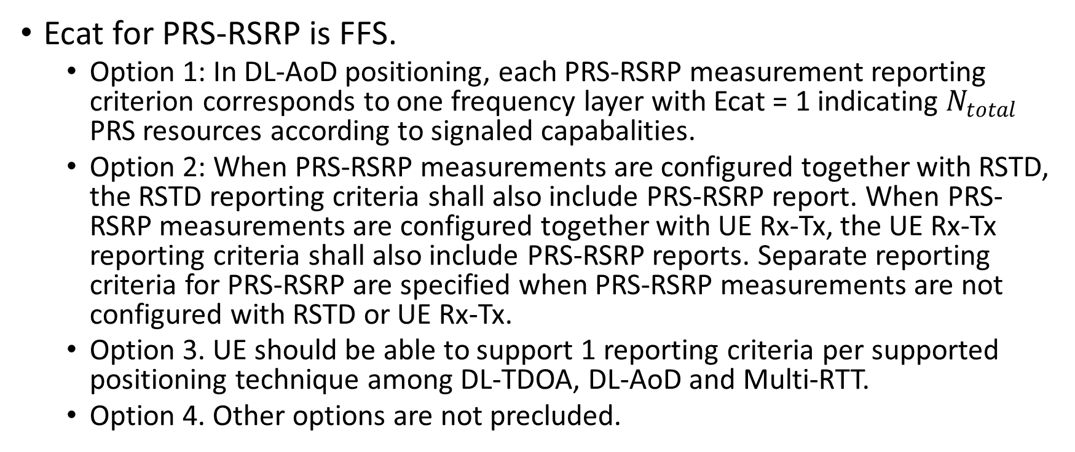
PRS-RSRP reporting criteria
Ecat for PRS-RSRP is FFS.
Option 1: In DL-AoD positioning, each PRS-RSRP measurement reporting criterion corresponds to one frequency layer with Ecat = 1 indicating $N_{total}$ PRS resources according to signaled capabalities.
Option 2: When PRS-RSRP measurements are configured together with RSTD, the RSTD reporting criteria shall also include PRS-RSRP report. When PRS-RSRP measurements are configured together with UE Rx-Tx, the UE Rx-Tx reporting criteria shall also include PRS-RSRP reports. Separate reporting criteria for PRS-RSRP are specified when PRS-RSRP measurements are not configured with RSTD or UE Rx-Tx.
Option 3. UE should be able to support 1 reporting criteria per supported positioning technique among DL-TDOA, DL-AoD and Multi-RTT.
Option 4. Other options are not precluded.

Slide 11
UE Rx-Tx time difference report mapping table(s)
UE Rx-Tx time difference report mapping table(s) are FFS.
RAN4 to continue discussion on UE Rx-Tx report mapping table(s) in the next meeting considering e.g. the following aspects:
Uniform vs. non-uniform granularity
Number of report mapping tables
Range in FR1 and FR2, Impact of parameter N_{TA,Offset}
Whether LMF needs to be aware of N_{TA,Offset}
Mapping with negative reported values for neighbor cell UE Rx-TX
Parameter k ($T=T_{c}2^{k})$where k is a configuration parameter
Whether UE always can follow signaled k or may need to adjust k
FFS: whether UE can report its capability of k to NW
Min/max values of k, and whether they depend on FR1/FR2 and center/edge mapping
Whether gNB needs to be aware of k
Note: other relevant aspects are not precluded

Slide 12
UE Rx-Tx time difference accuracy requirements
Accuracy requirements under cell change are FFS
Measurement period/UE behaviour/Accuracy requirements with TA adjustment are FFS

Slide 13
UE Rx-Tx time difference reporting criteria
Ecat for UE Rx-Tx time difference is FFS.
Option 1. 1 per positioning session
Option 2. In multi-RTT positioning, each UE Rx-Tx time difference measurement reporting criterion corresponds to one frequency layer with Ecat = 1 indicating $N_{total}$ UE Rx-Tx time difference measurement reports according to signaled capabilities
Option 3:
intra-frequency UE Rx-Tx measurements, 1 report capable of UE Rx-Tx measurements and PRS-RSRP measurements (when configured together with the UE Rx-Tx) on at least TBD PRS resources, per intra-frequency layer
inter-frequency UE Rx-Tx measurements, 1 report capable of UE Rx-Tx measurements and PRS-RSRP measurements (when configured together with the UE Rx-Tx) on at least TBD PRS resources, per inter-frequency layer
Other options are not precluded

Slide 14
Proximity of SRS and PRS in UE Rx-Tx time difference measurement
FFS:
whether the core measurement and performance requirements for UE Rx-Tx time difference applies if the configured SRS-Slot-offset and SRS-Periodicity parameters for SRS resource for positioning are such that any SRS transmission is within [-X, X] msec of at least one DL PRS resource from each of the TRPs in the assistance data.
Option 1: the above constraint is not needed, i.e., no limit on X
Option 2: the above constraint is needed, X is FFS

Slide 15
E-CID measurements
R15 core measurement requirements, measurement report mapping, and measurement accuracy requirements for SS-RSRP, SS-RSRQ, CSI-RS-RSRP and CSI-RS-RSRQ are applicable to E-CID positioning technique without any modification.
All existing measurement gap configurations in R15 applicable to RRM measurements to be applicable for E-CID measurements.
SINR measurements (SS-SINR, CSI-SINR)
Option 1: introduce SINR measurements for NR E-CID
Option 2: do not introduce SINR measurements for NR E-CID

Slide 16
Need for measurement gap and scheduling restrictions for PRS measurements
RAN4 to discuss the need for MG for PRS measurements in FR1 and FR2 in the next meeting considering the candidate options for intra-/inter-frequency PRS-RSTD, PRS-RSRP, UE Rx-Tx time difference
See also WF in R4-2002276
RAN4 to discuss scheduling restrictions for PRS measurements in FR1 in the next meeting considering the candidate options for intra-/inter-frequency PRS-RSTD, PRS-RSRP, UE Rx-Tx time difference

Slide 17
Number of configured positioning frequency layers within UE active DL BWP
FFS the need for a minimum maximum number K of positioning frequency layers within the active BWP, e.g., K=1

