Slide 1
WF on Tx EVM for UL MIMO
3GPP TSG-RAN WG4 Meeting #94-e
Online Meeting, 24 Feb-6 Mar 2019
Agenda: 6.5.4.5
Email Thread: #4
R4-2002726
Qualcomm

Slide 2
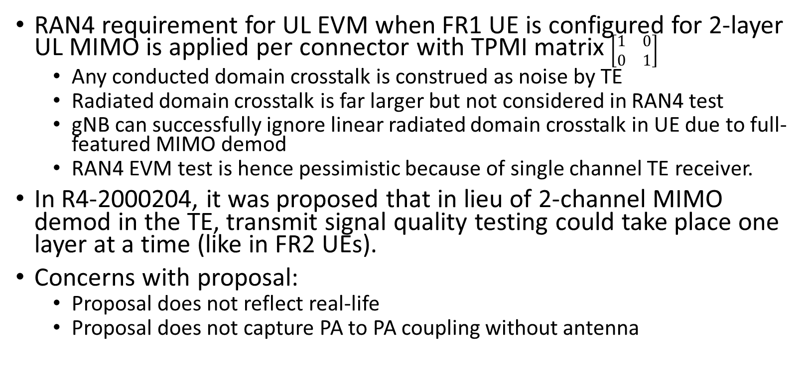
Background
RAN4 requirement for UL EVM when FR1 UE is configured for 2-layer UL MIMO is applied per connector with TPMI matrix $\left[\begin{matrix}1 & 0 \\ 0 & 1\end{matrix}\right]$
Any conducted domain crosstalk is construed as noise by TE
Radiated domain crosstalk is far larger but not considered in RAN4 test
gNB can successfully ignore linear radiated domain crosstalk in UE due to full-featured MIMO demod
RAN4 EVM test is hence pessimistic because of single channel TE receiver.
In R4-2000204, it was proposed that in lieu of 2-channel MIMO demod in the TE, transmit signal quality testing could take place one layer at a time (like in FR2 UEs).
Concerns with proposal:
Proposal does not reflect real-life
Proposal does not capture PA to PA coupling without antenna

Slide 3
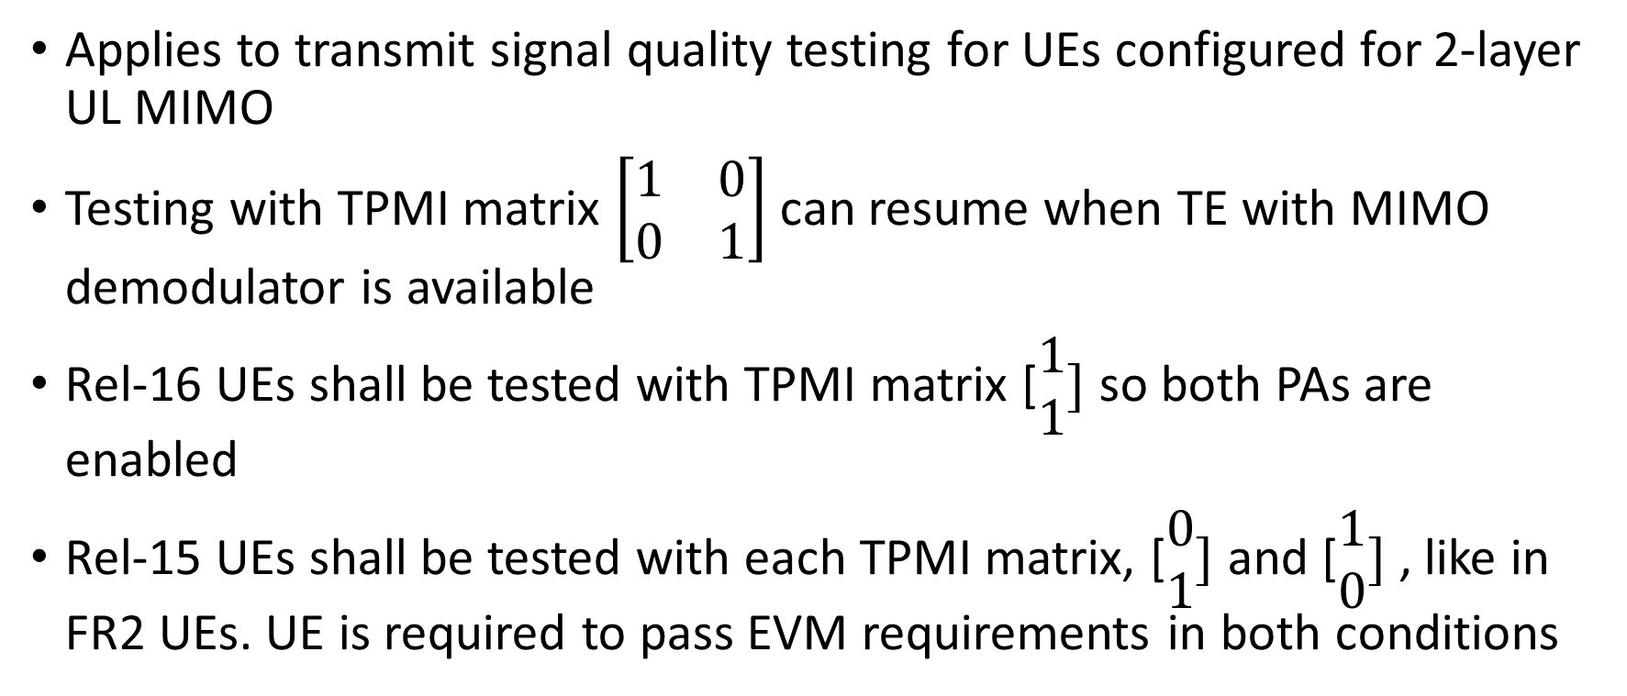
WF
Applies to transmit signal quality testing for UEs configured for 2-layer UL MIMO
Testing with TPMI matrix $\left[\begin{matrix}1 & 0 \\ 0 & 1\end{matrix}\right]$ can resume when TE with MIMO demodulator is available
Rel-16 UEs shall be tested with TPMI matrix [$\begin{matrix}1 \\ 1\end{matrix}]$ so both PAs are enabled
Rel-15 UEs shall be tested with each TPMI matrix, [$\begin{matrix}0 \\ 1\end{matrix}]$ and [$\begin{matrix}1 \\ 0\end{matrix}]$ , like in FR2 UEs. UE is required to pass EVM requirements in both conditions

