Slide 1
WF on WRC-19 resolutions
TSG RAN WG4 meeting: 94-e Electronic Meeting R4-2002729
Feb.24th – Mar.6th 2020
NTT DOCOMO, INC., T-Mobile USA, US Cellular, AT&T, …

Slide 2
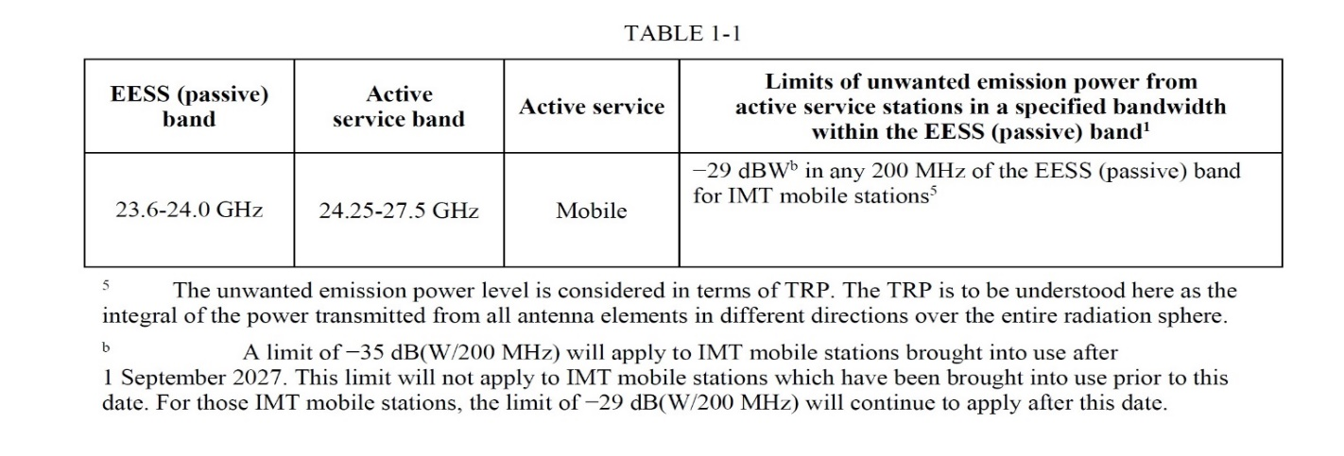
Background
This WF is only for existing bands for n257 and n258 which affected by WRC19. The WF addresses the following issues. The details on the WF are provided in the latter part of this WF.
#1: How to incorporate the following WRC19 decision.
UEs developed before Sep 1st ,2027 is allowed to use 1dBm/200MHz for EESS(23.6-24GHz) protection while UEs developed after that date has to meet -5dBm/200MHz.
So far 3GPP has had a corresponding requirement of -8dBm/200MHz.
n258 have used a dedicated NS for this while n257 has not.
In EU, the value for EESS(23.6-24GHz) is still under discussion while some countries such as Japan will adopt WRC19 decision as it is.
#2: Errors for NS_201 and NS_202 for n258 in the current spec.
n258 spec has dedicated NSs for each of the EU specific requirements such that EESS protection is for NS_201 and harmonics for NS_202.
However, the above two must be met simultaneously. Hence these must be fixed.

Slide 3
WF
The followings are package agreements.
For n257, at least the following requirement is added to n257
1dBm/200MHz @23.6-24GHz is defined for NS_200 (#1)
Note: No A-MPR is required regardless of Power classes: See [2].
For n258,
1dBm/200MHz @23.6-24GHz is defined for a new NS as additional requirement(#1)
Note: Necessary amount of A-MPR will be captured accordingly. See [2].
For both n257 and n258
-5dBm/200MHz @23.6-24GHz is captured as additional requirement if requested(#1)
-8dBm/200MHz @23.6-24GHz stays in the spec until EU decides the limit.
The current requirements, however, shall be fixed as they shall have been.
NS_201 and 202 is merged and A-MPR is generated to meet them simultaneously. Also, -8dBm/200MHz protection for n257 from UE to UE co-existence table is removed.
A feature for “UE” to report supporting NS is introduced based on WF of [6].
#1: No combination with harmonic requirement

Slide 4
Detailed reasons for each of the bullets(2/2)
1. n257: 1dBm/200MHz with NS_200
The original proposed value was -5dBm/200MHz with NS_200. Some operators have already commenced their pre-service with NS_200. Changing being used NS impacts on their service. To mitigate concern on A-MPR necessity due to future, possible requirement of -5dBm/200MHz, the proponent accepts 1dBm/200MHz. The value is used regardless of EU’s decision.
2. n258: 1dBm/200MHz as additional requirement with a new NS
This is needed for US operators now [1]. The value is used regardless of EU’s decision.
3. n257/n258: -5dBm/200MHz as additional requirement with a new NS
For operators who will use 1dBm/200MHz until 2027 Sep 1st, introduction of -5dBm/200MHz right now generate an issue that right after 2027 Sep 1st , legacy UEs suddenly starts to use bigger A-MPR to fulfil 6dB tighter requirement though the legacy UEs developed before 2027 Sep 1st are OK to keep meeting 1dBm/200MHz even after 2027 Sept 1st. Thus, if not necessary, it is better not to add this to the spec now. If, however, there are operators who need to use -5dBm/200MHz right now, the request should be reflected in the spec.
4. n257/n258: -8dBm/200MHz as additional requirement with a new NS
The value of -8dBm/200MHz is still under discussion. Thus we keep the value as it is until the decision is made [4]. If the decision will be reflected accordingly if it is made.

Slide 5
Detailed reasons for each of the bullets(1/2)
5. A feature for UE to report supporting NSs
As elaborated in [5], the feature is required for a network to distinguish UEs supporting currently specified NSs from UEs supporting new NSs to be added to.
For SA, attach procedure is addressed by using NR-NS Pmax but handover procedure cannot be addressed with it.
For NSA, attach procedure is not a problem but handover procedure needs to distinguish which NSs UE can deal with.

Slide 6
Example of NS table(Details are decided in the next meeting)
NR Band | Value of additionalSpectrumEmission
 | 0 | 1 | 2 | 3 | 4 | 5 | 6 | 7
n257 | NS_200 | NS_20A | [NS_20B]
Requirement to be added | Note1 | -8dBm/200MHz + Harmonic | -5dBm/200MHz
NR Band | Value of additionalSpectrumEmission
 | 0 | 1 | 2 | 3 | 4 | 5 | 6 | 7
n258 | NS_200 | [NS_20A] | NS_20B | NS_20C | [NS_20D]
Requirement to be added | Nothing new | -8dBm/200MHz | -8dBm/200MHz + Harmonic | 1dBm/200MHz | -5dBm/200MHz
Note 1: 1dBm/200MHz @23.6-24GHz is captured in UE to UE co-existence table
Note 2: Exact NS numbering can be discussed later. For instance, for n258, if -8dBm/200MHz without harmonic is still necessary, NS_201 may be kept and NS_202 may be modified to incorporate -8dBm/200MHz on top of harmonics.

Slide 7
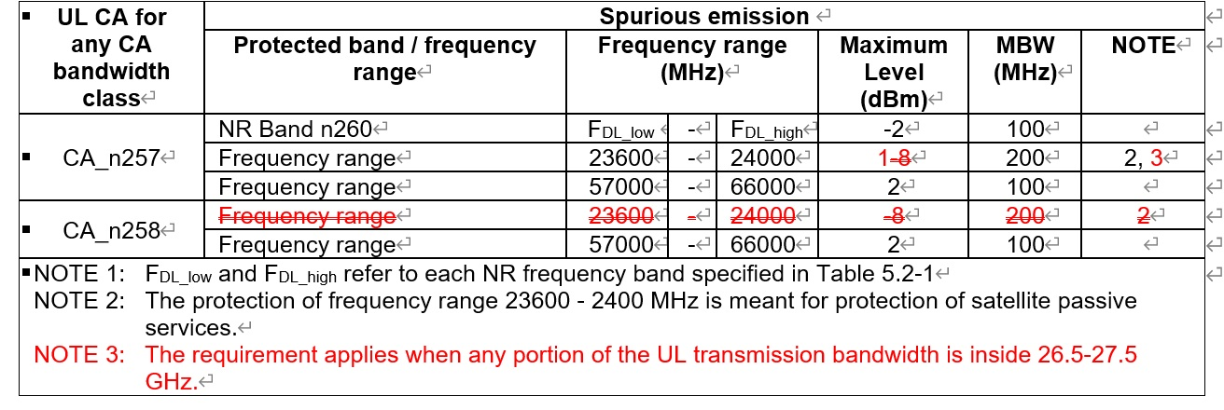
Example of UE to UE coexistence table

Slide 8
Reference
[1] R4-2000409: On 3GPP band n258 and WRC-19 EESS unwanted emission limits, T-Mobile USA, AT&T, U.S. Cellular
[2] R4-2000216: Impact of WRC19 resolutions on FR2, Qualcomm Incorporated
[3] R4-2000230: EESS protection from n257, NTT DOCOMO, INC.
[4] R4-2001775: On FR2 EESS protection emission requirement, Huawei, Hisilicon
[5] R4-2000220: Necessity of signaling supported NS values, NTT DOCOMO, INC.
[6] R4-2002737: WF on Signaling supported NS values, NTT DOCOMO, INC.

