Slide 1
WF on adding 30KHz SCS for n40 SSB
3GPP TSG-RAN WG4 Meeting #94-e
Electronic Meeting, Feb.24th – Mar.6th 2020
R4-2002717
Huawei, HiSilicon

Slide 2
Background
Use cases where 30KHz data SCS is needed or preferable
Larger channel bandwidth than 50MHz is deployed
30KHz data SCS on n40 is more preferable for Band X + Band n40 CA, where X is with the bandwidth larger than 50MHz
If 15KHz data SCS is used on Band n40, then some UE may not support such CA configuration, because support of simultaneous reception of with different numerologies in CA is optional.
Channel bandwidth of UE for n40
Channel bandwidth of BS for n40

Slide 3
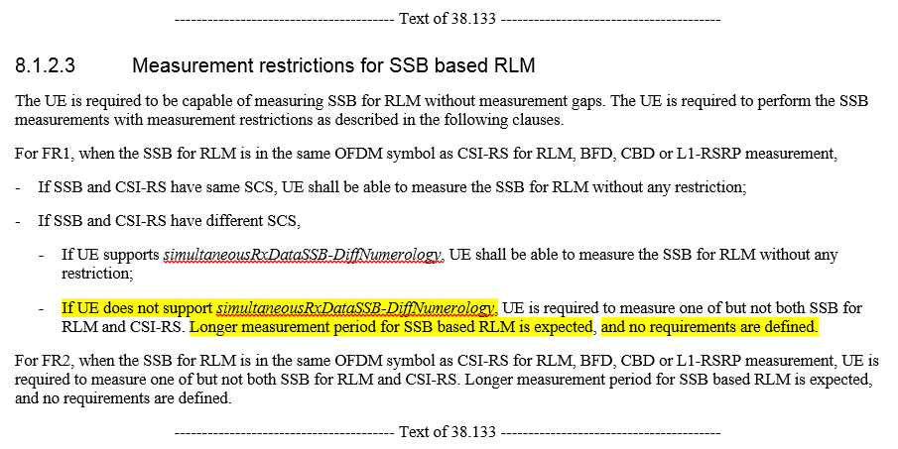
Background
Drawbacks using 15KHz SCS SSB and 30KHz SCS data
Loss of spectrum efficiency due to guard band between SSB and data, because SSB with 15KHz SCS is not orthogonal to data with 30KHz SCS.
Worse RRM measurement performance would be expected and part of RRM requirement is missing, because concurrent intra-frequency measurement and reception of data is an option feature (simultaneousRxDataSSB-DiffNumerology)
simultaneousRxDataSSB-DiffNumerology :
Indicates whether the UE supports concurrent intra-frequency measurement on serving cell or neighbouring cell and PDCCH or PDSCH reception from the serving cell with a different numerology as defined in clause 8 and 9 of TS 38.133
If UE cannot support simultaneousRxDataSSB-DiffNumerology, then poor performance is expected and no requirement is defined. One example in TS 38.133 is shown below.

Slide 4
Background
Analysis of non-backward compatibility (NBC)
No change to ASN.1 is needed
The change from Rel-16 on n40 will cause the NBC issue
Rel-15 UE supporting only 15KHz SCS SSB cannot access Rel-16 network using 30KHz SCS SSB.
15KHz SCS and 30KHz SCS have already been supported in some FR1 bands
For existing band n5, n41, n66, n90, both 15KHz SCS and 30KHz SCS are supported for SSB.

Slide 5
Way forward
Add 30KHz SSB SCS for n40 in Rel-15

