Slide 1
WF on emission requirement for intra-band contiguous UL CA
3GPP TSG-RAN WG4 #94e
Feb 24th – Mar 06th, 2020
emeeting
R4-20XXXX
Huawei, HiSilicon,[ ]…

Slide 2
Background
In R4-1910273, we used to have agreement on SEM requirement for intra-band contiguous CA which takes the approach as for intra-band EN-DC:
Δf_{OOB} (MHz) | Spectrum emission limit(dBm) | MBW
± 0 - 1 | Max(Round(10*log(0.15/BW_{channel_CA})),-24) | 30kHz
± 1 - 5 | -10 | 1MHz
± 5 – BW_{channel_CA} | -13 | 1MHz
±BW_{channel_CA}- BW_{channel_CA}+5 | -25 | 1MHz
Note 1: BW_{channel_CA}=nominal channel spacing+Foffset,high + Foffset,low, where the nominal channel spacing, Foffset,high and Foffset,low refers to subclause 5.4A.1 and subclause 5.3A.3.
In RAN4 #94e meeting, the problem that IMD3 falls into offset 0-1MHz makes large MPR was raised, the summary can be summarized as below:
Since nominal channel space for CA are specified relative large and fixed with numerology which ensures there is a channel space entry less than or equal to the nominal channel space for any CC configurations, with the assumption on ACLR MBW=BW_{Channel_CA} – 2*max(GB(low),GB(high)) and BW_{Channel_CA}= nominal channel space+ F_{offset,high} + F_{offset,low,} the different solution on SCS adoption for each CC may lead to:
BW_{Channel_CA} > CBW1+CBW2 if adopts the SCS defined in 5.3A.1 of TS 38.101
The wanted signal may not be captured within the MBW if adopts the SCS defined in 5.4A.1 of TS 38.101
WF | type | CC1 | CC2 | Limit1 | BO1 | Limit2 | BO2
CP-OFDM | NC | 1RB105 | 1RB51 | SEM -13dBm/1% BW_{channel_CA} | 2.3 | SEM -24dBm/30kHz | 6.3
 |  | 1RB70 | 1RB35 |  | 5.9 | SEM -24dBm/30kHz | 6.9
 |  | 1RB85 | 1RB63 |  | 6.4 | SEM -24dBm/30kHz | 12.3

Slide 3
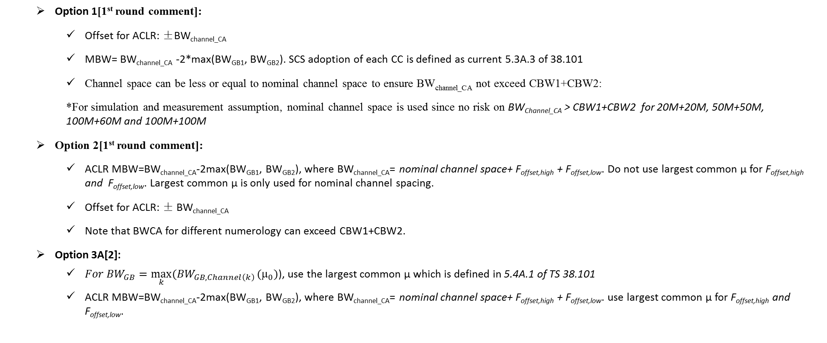
ACLR MBW
Option 1[1st round comment]:
Offset for ACLR: ±BW_{channel_CA}
MBW= BW_{channel_CA} -2*max(BW_{GB1}, BW_{GB2}). SCS adoption of each CC is defined as current 5.3A.3 of 38.101
Channel space can be less or equal to nominal channel space to ensure BW_{channel_CA} not exceed CBW1+CBW2:
*For simulation and measurement assumption, nominal channel space is used since no risk on BW_{Channel_CA} > CBW1+CBW2 for 20M+20M, 50M+50M, 100M+60M and 100M+100M
Option 2[1st round comment]:
ACLR MBW=BW_{channel_CA}-2max(BW_{GB1}, BW_{GB2}), where BW_{channel_CA}= nominal channel space+ F_{offset,high} + F_{offset,low}. Do not use largest common µ for F_{offset,high} and F_{offset,low}. Largest common µ is only used for nominal channel spacing.
Offset for ACLR: ± BW_{channel_CA}
Note that BWCA for different numerology can exceed CBW1+CBW2.
Option 3A[2]:
${For BW}_{GB}=\max_{k}{({BW}_{GB,Channel\left(k\right)}}(μ_{0})$), use the largest common µ which is defined in 5.4A.1 of TS 38.101
ACLR MBW=BW_{channel_CA}-2max(BW_{GB1}, BW_{GB2}), where BW_{channel_CA}= nominal channel space+ F_{offset,high} + F_{offset,low}. use largest common µ for F_{offset,high} and F_{offset,low}.

Slide 4
SEM offset and measurement bandwidth
1. The MBW for ∆f_{OOB} 0-1MHz
use 1% BW_{channel_CA} until 40MHz aggregated channel bandwidth, 400kHz thereafter, the equation is as below:
-13 dBm/Min(0.01*BW_{channel_CA}, 0.4) [MHz]
2. The starting frequency point for OOB domain:
Option 1: ± BW_{channel_CA}/2 with the condition that BW_{channel_CA} less than or equal to CBW1+CBW2

Slide 5
F_{offset,high} and F_{offset,low}
Align the F_{offset,high} and F_{offset,low} specified in TS 38.101 and TS 38.104
In TS 38.104:
F_{offset,low} = (N_{RB,low}*12 + 1)*SCS_{low}/2 + BW_{GB} (MHz)
F_{offset,high} = (N_{RB,high}*12 - 1)*SCS_{high}/2 + BW_{GB} (MHz)
BW_{GB, low} and BW_{GB, high} are the minimum guard band defined in subclause 5.3.3for lowest and highest assigned component carrier, while N_{RB,low} and N_{RB,high} are the transmission bandwidth configurations according to Table 5.3.2-1 or Table 5.3.2-2 for the lowest and highest assigned component carrier, SCS_{low} and SCS_{high} are the sub-carrier spacing for the lowest and highest assigned component carrier respectively.
In TS 38.101:
F_{offset,low} = (N_{RB,low}*12 + 1)*SCS_{low}/2 + BW_{GB} (MHz)
F_{offset,high} = (N_{RB,high}*12 - 1)*SCS_{high}/2 + BW_{GB} (MHz)
BW_{GB} = max(BW_{GB,Channel(k)})
How to align?
Decide in the next RAN4 meeting

Slide 6
Reference
[1] R4-1910273,”RF requirement of intra-band UL CA”, RAN4 #92, Huawei, HiSilicon
[2] R4-1912422 ,”RF requirement of intra-band contiguous UL CA”, RAN4 #92bis, Huawei, HiSilicon
[3] R4-2000712, “[NRULCA] Definition of Intra-band Contiguous UL CA Bandwidths”, RAN #94e, Skyworks
[4] R4-2001385, “Problems with CA channel arrangement”, RAN4 #94e, Nokia
[5] R4-2002691, “email discussion_#18_NR_RF_FR1_Part_1”, RAN4 #94e, Huawei, HiSilicon

