Slide 1

RAN4#114bis meeting schedule
3GPP TSG-RAN WG4 Meeting #114bis
Wuhan, Hubei, China 07th - 11th April, 2025
Agenda Item: 2
RAN4 Chair: Xizeng Dai
Vice Chair: Gene Fong, Shan Yang

Slide 2
Monday
Venue Time | RAN4 Main | RAN4 RRM | RAN4 BDaT | Ad hoc room
9:00-9:20 | 1. Opening of the meeting 2. Meeting agenda, arrangement, and meeting report 3. RAN4 Chair Elections Announcement of RAN4 Chair elections 4. Incoming LS
9:30-10:30 | Rel-19 Spectrum [105] HPUE_NR_bands (4) [107] HPUE_Basket_EN-DC (4) [108] HPUE_Basket_CADC_SUL (17) [109] LTE_NR_Other_basket (13) | Rel-19 [205] NR_IoT_NTN_req_test_enh (18) [202] NR_FR1_lessthan_5MHz_BW_Ph2 (13) | Rel-19 Demod [321] NR_demod_Ph5_Part1_General_BS (22) | RRM Ad-hoc: [210] FS_NR_AIML_Mob, Chaired by Fahad Syed Muhammad (Nokia)
11:00-13:00 | [103] NR_Baskets_Part_2 (n5-n8 simultaneous Rx-Tx, R4-2503812,3339,3482,3692,3973,4116,4117,4124) [110] NR_IoT_NTN_Bands (28) [111] NR_mmWave_protect (17) [115] NR_SL_intraB_CA_ITS_part1 (3) | [213] NR_duplex_evo (29) [209] NR_RRM_Ph5_Part2 (37) | [322] NR_demod_Ph5_Part2_UE (17) [320] NR_SCM (35) | BDaT Ad-hoc: SBFD [306] NR_duplex_evo_General [307] NR_duplex_evo_BSRF Chaired by Jackson Wang (Samsung) and Xiang Gao (Huawei)
13:00-14:30 | Lunch break
14:30-16:30 | Rel-19 non-spectrum [130] A-IoT_BSCW (19) [129] A-IoT_device (25) | [208] NR_RRM_Ph5_Part1 (24) Coffee break: [204] NR_LBCA_Sw, Chaired by Jerry | [320] NR_SCM (35) cont NGSO testing [323] NTN_testing_NGSO_channel_model (16) Rel-19 BSRF [303] NR_BS_RF_Part2_CLTA_SE (10) | Main Ad-hoc : [114] NR_ENDC_RF_Ph4_part3 Chaired by Andrey (Intel)
17:00-18:00 | [115] NR_SL_intraB_CA_ITS_part1 (1) [117] NR_FR1_5MHz_BW_Ph2 (2) [122] NR_FR1_7MHz_BW (25) | [206] NR_NTN_Ku_bands (8) | [303] NR_BS_RF_Part2_CLTA_SE (10) (cont) [305] NR_ATG_enh (12) | Main Ad-hoc(16:30~18:00): [113] NR_ENDC_RF_Ph4_part2 Chaired by Tina(Yuanyuan) Zhang (Samsung)
18:00-19:30 | Main Ad-hoc: [126] NR_AIML_air_part1 Chaired by Vali (Qualcomm) | RRM Online: [203] NonCol_intraB_ENDC_NR_CA_Ph2 (9) [207] NR_ATG_enh (22) | BDaT Ad-hoc: Rel-19 BSRF [302] NR_BS_RF_Part1_E_EIRP [304] NR_BS_RF_Part3_OTA_TRP (9) [303] NR_BS_RF_Part2_CLTA_SE (10) Chaired by Fei Xue (ZTE) and Michal Szydelko (Huawei) | RRM Ad-hoc: [211] [212] NR_MIMO_Ph5, Chaired by Yanze Fu (Samsung)

Slide 3
Tuesday
(RAN4 Chair election)
Venue Time | RAN4 Main | RAN4 RRM | RAN4 BDaT | Ad hoc room
8:30-10:30 | [114] NR_ENDC_RF_Ph4_part3 (31) [113] NR_ENDC_RF_Ph4_part2 (32) | [225] Reply_LS (7) [218] NR_Mob_Ph4_Part1 (26) Coffee break: [207] NR_ATG_enh, Chaired by Shiyuan | Rel-19 UE RF NTN [309] NR_NTN_Ph3_General_UE_SAN_RF (18) [310] NR_IoT_NTN_less_than_5MHz_UERF (17) [311] NR_IoT_NTN_less_than_5MHz_BSRF (2) | RRM Ad-hoc: [217] NR_LPWUS, Chaired by Xusheng (vivo)
11:00-13:00 | [112] NR_ENDC_RF_Ph4_part1 (25) [120] NR_PC2_RedCap_UE (10) | [219] NR_Mob_Ph4_Part2 (12) RRM Ad-hoc (12:00 - 13:00) [213] NR_duplex_evo, Chaired by Yanze Fu (Samsung) | [315] IoT_NTN_Ph3 (9) Rel-19 IoT NTN [316] IoT_NTN_TDD_UE_SAN_RF (7) | BDaT Ad-hoc: SCM [320] NR_SCM, chaired by Alexander Hamilton (Nokia)
13:00-14:30 | Lunch break 14:00 RAN4 Chair election RD#1 results announcement in main session
14:30-16:30 | [121] NR_LBCA_Sw (31) Start from 15:30 [131] NR_LPWUS_UERF (35) | [210] FS_NR_AIML_Mob (50) Coffee break: [210] FS_NR_AIML_Mob, Chaired by Fahad | Ku band [314] NR_NTN_Ku_Band_UE_SAN_RF (14) [312] NR_NTN_Ku_Band_General (12) [313] NR_NTN_Ku_Band_Coexistence (7) | BDaT Ad-hoc LPWUS (14:30~15:30) [308] NR_LPWUS, Chaired by Leo (Huawei) BDaT Ad-hoc (15:30 – 16:30) [322] NR_demod_Ph5_Part2_UE Chaired by Karsten Petersen (Nokia)
17:00-18:00 | [131] NR_LPWUS_UERF (Cont.) 18:10 RAN4 Chair election RD#2 results announcement (Planned) in main session | [204] NR_LBCA_Sw (13) | 5G Broadcast TN and NTN [317] 5G_Broadcast_bands (4) [318] 5G_Broadcast_GSO_NTN_band (8) | Main Ad hoc (16:30~18:00): [119] FS_NR_DL_Frag_Carrier Chaired by Henry Fu (Mediatek)
18:30-20:30 | Social Event | RRM Ad-hoc: [217][218] NR_RRM_Ph5, Chaired by Jerry Cui (Apple) | BDaT Ad-hoc: Ku band [313] NR_NTN_Ku_Band_General, Chaired by Moray Rumney (Eutelsat) | BDaT Ad-Hoc: Demod Maintenance [320] Demod_Maintenance_Part1 chaired by Axel Mueller (Nokia) [321] Demod_Maintenance_Part2 chaired by Manasa Raghavan (Apple)
    1st Round Ballot:
  April 08 (Tuesday) 09:00~13:45 (GMT+8, Beijing time). The announcement of results will be held at 14:00 in main session
    2nd Round Ballot (planned)
  April 08 (Tuesday) 14:10~18:00 (GMT+8, Beijing time). The announcement of results will be held at 18:10 in main session

Slide 4
Wednesday
Venue Time | RAN4 Main | RAN4 RRM | RAN4 BDaT | Ad hoc room
8:30-10:30 | [126] NR_AIML_air_part1 (51) [127] NR_AIML_air_part2 (19) | [215] Netw_Energy_NR_enh_Part1 (17) [216] Netw_Energy_NR_enh_Part2 (25) | Rel-19 OTA [329] NR_FR2_OTA (6) [328] TRP_TRS_MIMO_OTA_Ph3 (28) | Main Ad-hoc: [129/130] A-IoT Chaired by Xiaoran Zhang
11:00-13:00 | [119] FS_NR_DL_Frag_Carrier (33) | [217] NR_LPWUS (31) | Rel-19 BSRF [302] NR_BS_RF_Part1_E_EIRP (16) | RRM Ad-hoc: [218] [219] Rel-19 NR_Mob_Ph4, Chaired by Qiming Li (Apple)
13:00-14:30 | Lunch break
14:30-16:30 | [118] NonCol_intraB_ENDC_NR_CA (16) [128] NR_MIMO_Ph5_UE (9) [125] NR_ATG_enh (11) | Add topics for Thursday Ad-hoc [201] NR_ENDC_RF_Ph4 (2) [221] NR_NTN_Ph3_Part1 (13) [222] NR_NTN_Ph3_Part2 (12) | [308] NR_LPWUS (9) [304] NR_BS_RF_Part3_OTA_TRP (9) [331] BSRF_Simplify_CoLo_Coex (14) | RRM Ad-hoc: [220] NR_XR_Ph3, Chaired by Rafael Paiva (Nokia)
17:00-18:30 | Main Ad-hoc: [127] NR_AIML_air_part2 Chaired by Tom (Ericsson) | RRM Ad-hoc： [215] [216] Netw_Energy_NR_enh, Chaired By Zhixun Tang (Ericsson) | BDaT Ad-hoc: OTA (17:00 – 18:00) (cont) [328] TRP_TRS_MIMO_OTA_Ph3 chaired by Ruixin Wang (vivo) | Main Ad hoc: [131] NR_LPWUS_UERF Chaired by Ruixin Wang (vivo) [112] NR_ENDC_RF_Ph4_part1 Chaired by Leo(Ye) Liu (Huawei)
18:30-20:30 | Group dinner

Slide 5
Thursday
Venue Time | RAN4 Main | RAN4 RRM | RAN4 BDaT | Ad hoc room
8:30-10:30 | Rel-19 NTN [123] NR_IoT_NTN_HPUE_part1 (29) [124] NR_IoT_NTN_HPUE_part2 (15) | [214] Ambient_IoT_Solutions (8) [220] NR_XR_Ph3 (19) | Rel-19 SBFD [306] NR_duplex_evo_General (25) [307] NR_duplex_evo_BSRF (17) | RRM Ad-hoc: Reserved
11:00-13:00 | Rel-19 basket WI [102] NR_Baskets_Part_1 (39) [103] NR_Baskets_Part_2 (75) [104] LTE_Baskets (5) Maintenance [132] NR_reply_LS_UE_RF (4) [101] R19_UERF_maintenance_TEI (31) | [222] NR_NTN_Ph3_Part2 (12) Cont. [223] IoT_NTN_Ph3 (5) [224] IoT_NTN_TDD (6) | Rel-19 Demod [324] NR_IoT_NTN_less_than_5MHz_demod (3) [325] NR_ENDC_RF_Ph4_Demod_6Rx (10) [326] NR_less_than_5MHz_Ph2_demod (6) [332] NR_ATG_enh_demod (5) | Main Ad hoc: [123/124] NR_IoT_NTN_HPUE_part1/2 Chaired by Runsen Tang (Samsung)
13:00-14:30 | Lunch break
14:30-16:30 | Rel-19 non-spectrum [126] NR_AIML_air_part1 (Cont.) [127] NR_AIML_air_part2 (Cont.) | [211] NR_MIMO_Ph5_Part1 (12) [212] NR_MIMO_Ph5_Part2 (13) |  | BDaT Ad-hoc: Ku band [314] NR_NTN_Ku_Band_UE_SAN_RF (14) chaired by Tank (CHTTL) [313] NR_NTN_Ku_Band_Coexistence (7) chaired by Manook (Intelsat)
17:00-18:00 | Early Return to Rel-19 selected topics | Rel-18 TEI (R4-2504080 3Tx switching) Early Return to | Early return to (if any) | Main Ad-hoc: (16:30~18:00) [112] NR_ENDC_RF_Ph4_part1 Chaired by Leo(Ye) Liu (Huawei) [131] NR_LPWUS_UERF Chaired by Ruixin Wang (vivo)
18:00-19:30 | Main Ad hoc [101] R19_UERF_maintenance_TEI (selected topics), Chaired by Haijie Qiu (Xiaomi) | RRM Ad-hoc: [208][209] NR_RRM_Ph5, Chaired by Jerry Cui (Apple) | BDaT Ad-hoc: TBD | BDaT Ad-hoc: TBD

Slide 6
Friday
Venue Time | RAN4 Main | RAN4 RRM | RAN4 BDaT | Ad hoc room
8:00-10:30 | Return to (no NTN topic) | Return to | Return to [309] NR_NTN_Ph3_General_UE_SAN_RF [314] NR_NTN_Ku_Band_UE_SAN_RF [310] NR_IoT_NTN_less_than_5MHz_UERF [315] IoT_NTN_Ph3 [316] IoT_NTN_TDD_UE_SAN_RF Return to (Other topics)
11:00-13:00 | Return to (start with NTN topics) | Return to | Return to [328] TRP_TRS_MIMO_OTA_Ph3 [329] NR_FR2_OTA Return to (Other topics)
13:00-14:00 | Lunch break
14:00-15:00 | Return to (final round) | Return to (final round) | Return to (final round)
15:00 (or earlier time) -16:00 | 12 New or revised Rel-19 WID/SID 13 Any other business Event for outgoing RAN4 Chair 14 Close of the meeting

Slide 7
Appendix

Slide 8
General Aspects
The face-to-face meeting will take place during April 07th ~ 11th, 2025.
  Three sessions in three separate rooms: Main, RRM, BDaT(BSRF_Demod_test). 1-Way GoToWebinar (GTW) conference calls will be set each session and 1-way MS teams will be set for ad hoc in the best effort way. A number of ad hoc sessions will be arranged (refer to meeting schedule).
  Moderator will be designated to provide the summary for a topic before the meeting. In online discussions, session chairs will handle topics based on the moderator summary. Moderator does not need update the summary by collecting comments during the meeting.
  Deadline for Tdoc request & submission deadline: March 28th (Friday) 2025, 23:59 UTC.
  Other deadlines can be found in the following slides.
RAN4 Chair election on Tuesday (April 08) via voting tool: Morning 1st RD, afternoon 2nd RD. (#24/25)
For chairs
For moderator
For delegates
Pre-meeting (March 31~April 4)
Quiet Period
1st round (April 07~10)
2nd round (Apr 10, 11)
Quiet Period
Post-meeting process (April 14~17)
Mon
Tue
Wed
Thu
Fri
Sat/Sun
Mon
Tue
Wed
Thu
Fri
Sat/Sun
Mon
Tue
Wed
Thu
NWM flag process Slide #16
Moderators trigger nwm for maintenance before Sunday
Flag for maintenance @nwm
WF/CR template
Draft TS/TR
Slide #9
Slide #15
Pre-RAN Action
MCC 3GU parsing tool
Slide #10/11
Slide #18
Topic Moderator & summary: slide #5
Moderator assignment before Mon
Draft summary for topics
Summary review & comments
Formal tdoc of summary submission by Saturday
RAN4 Chair Elections
AM: 1st RD
PM: 2nd RD
Online discussions &
GTW conference call (US/China meeting)
Upload CR for maintenance 2:30pm on Thursday
TOHRU (US/China meeting)
Tdoc request (new&revision)
Upload tdocs (10.10.10.10) &
How to access contributions
List of email threads for post-meeting
Submission of tdoc of post-meeting
Comments
Approve tdocs for post-meeting
Slide #7
Slide #24/25
Slide #12
Post-meeting process: slide #14
Registration
Slide #13
Initial list for block approval for basket
Deadline for flag for block approval
Updated list for block approval
Slide #8
Slide #17
Tdoc number request & submission
Slide #3/4/23
Basket WIs Block approval: slide #6
Meeting schedule & Ad hoc chair assignment
Provided before meeting
Update of meeting notes per day
Tdoc allocation
Check-in
Slide #13
Slide #18/21
Slide #8
Slide #22
Meeting room
Quiet Period (0:00 am ~ 7:00 am meeting venue Local time
No email are expected in RAN4 reflector

Slide 9
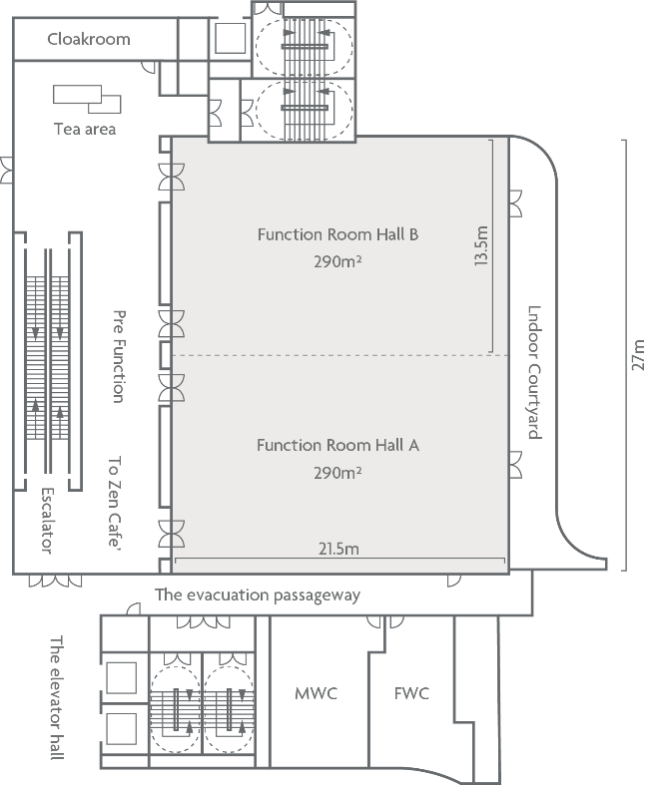
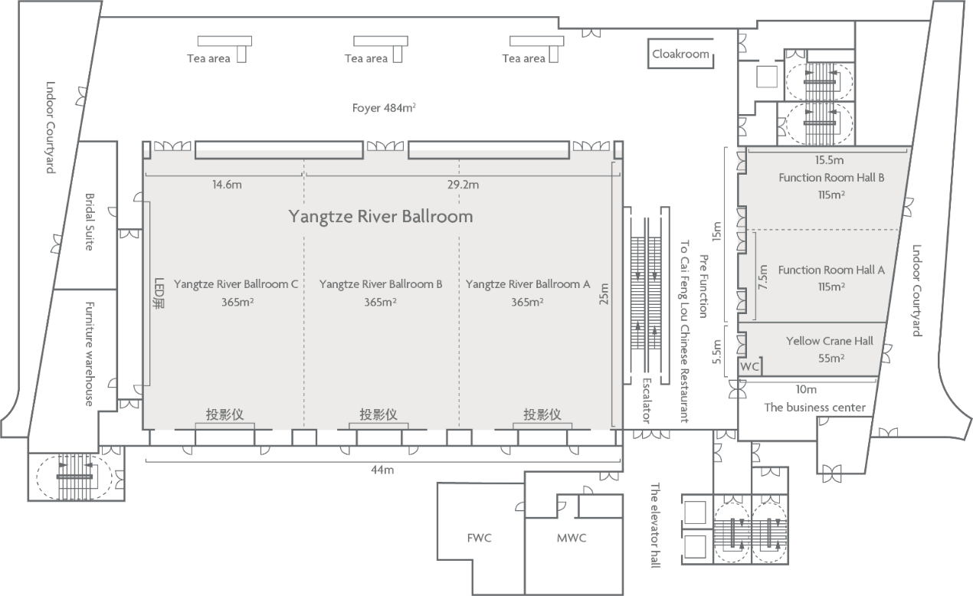
Meeting rooms information
    RAN4 meeting rooms:
  Main session: Yangtze River Grand Ballroom B+C（3F)/320
  RRM session: East Lake Function Room B (2F)/100
  BDaT: Yangtze River Grand Ballroom A (3F)/100
  Ad hoc session:Optics Valley Function Room A+B (3F)/100
Social Event on Tuesday evening
RRM session
Main session
BDaT session
Ad hoc session
2nd Floor Map
3rd Floor Map

Slide 10
RAN4 Chair Elections:
Guidance and arrangement
    Rule for WG chair elections:
  The rules concerning 3GPP elections and other votes can be found in the following 3GPP Working Procedure articles at https://www.3gpp.org/dynareport?code=elections-technical-votes
  Voting list can be found at https://portal.3gpp.org/VotingTool/Vote/VotingRights?groupID=382&meetingID=60592 and https://www.3gpp.org/ftp/tsg_ran/WG4_Radio/TSGR4_114bis/Reports
    Voting tool:
  The 3GPP voting tool will be used for casting the ballot for RAN4 Chair elections in RAN4#114bis (https://portal.3gpp.org/VotingTool/)
  To use voting tool, you first need use your EOL account to log in.
  Chair highly recommended that you cast your vote in RAN4 meeting rooms via voting tool.
    Candidates information:
  Please find the candidate information for RAN4 Chair elections at https://portal.3gpp.org/VotingTool/Vote/DetailList/1157
    Registration for casting a vote:
  The registration deadline for f2f participants and remote access is 31 Mar 2025 09:00 (GMT+08:00) Beijing time.
  Check-in (Annex H of 3GPP working procedure): An Individual Member is considered checked in if a delegate registered for that Individual Member is checked in at the time the ballot closes.
  Please make sure that you register and check-in on time for casting a vote.
    1st Round Ballot:
  April 08 (Tuesday) 09:00~13:45 (GMT+8, Beijing time). The announcement of results will be held at 14:00 in main session
    2nd Round Ballot (planned, Other additional round ballot might be needed, if candidate number is more than 2.)
  April 08 (Tuesday) 14:10~18:00 (GMT+8, Beijing time). The announcement of results will be held at 18:10 in main session

Slide 11
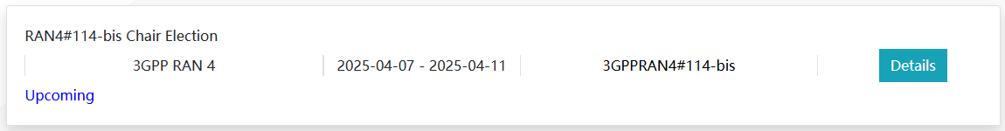
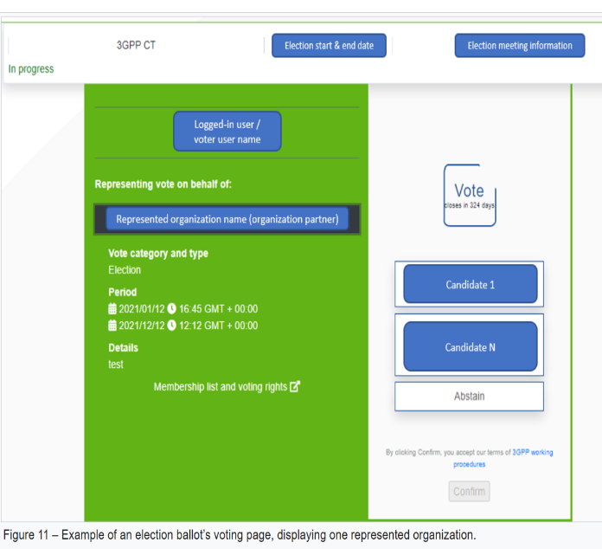
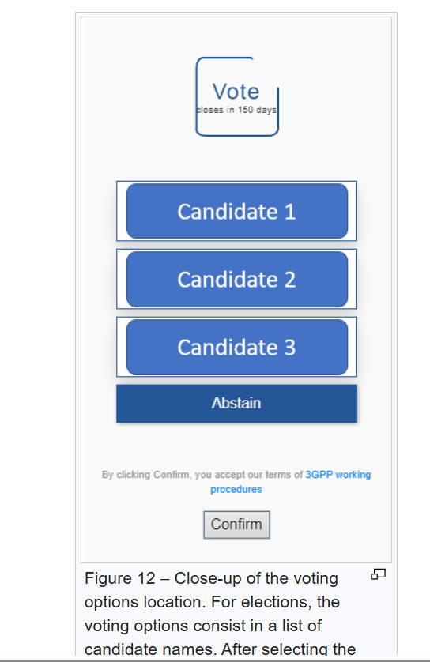
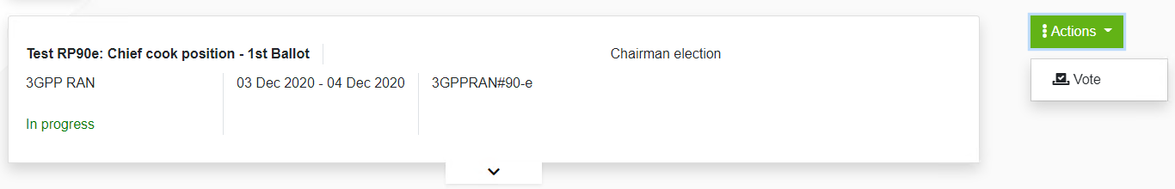
RAN4 Chair Elections:
Additional guidance of voting tool
    How to cast a vote?
  To cast a vote, the logged-in user shall be registered and checked in at the meeting (provided the vote is not done by correspondence), access the voting page, and proceed as follows:
    1. Select the voting member organization on behalf of which the user wants to cast a vote, from the options visible in Figure 1
    2. Select the desired voting option on the right (i.e., a candidate name or “abstain” for elections) The possible voting options are displayed in Figure 2.
Figure 1
Figure 2
    It will read “In progress” during the election period, and “closed” after the election is over
    Example is provided above. And please click Action → Vote

Slide 12
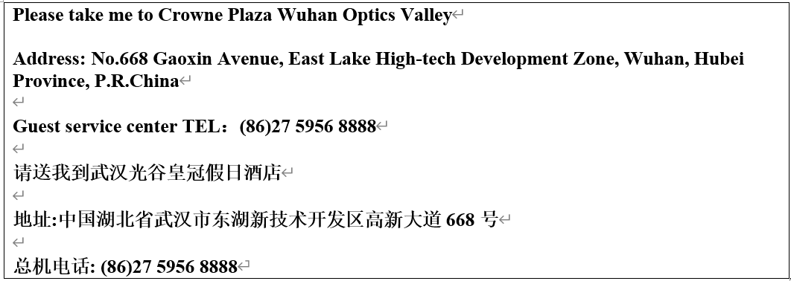
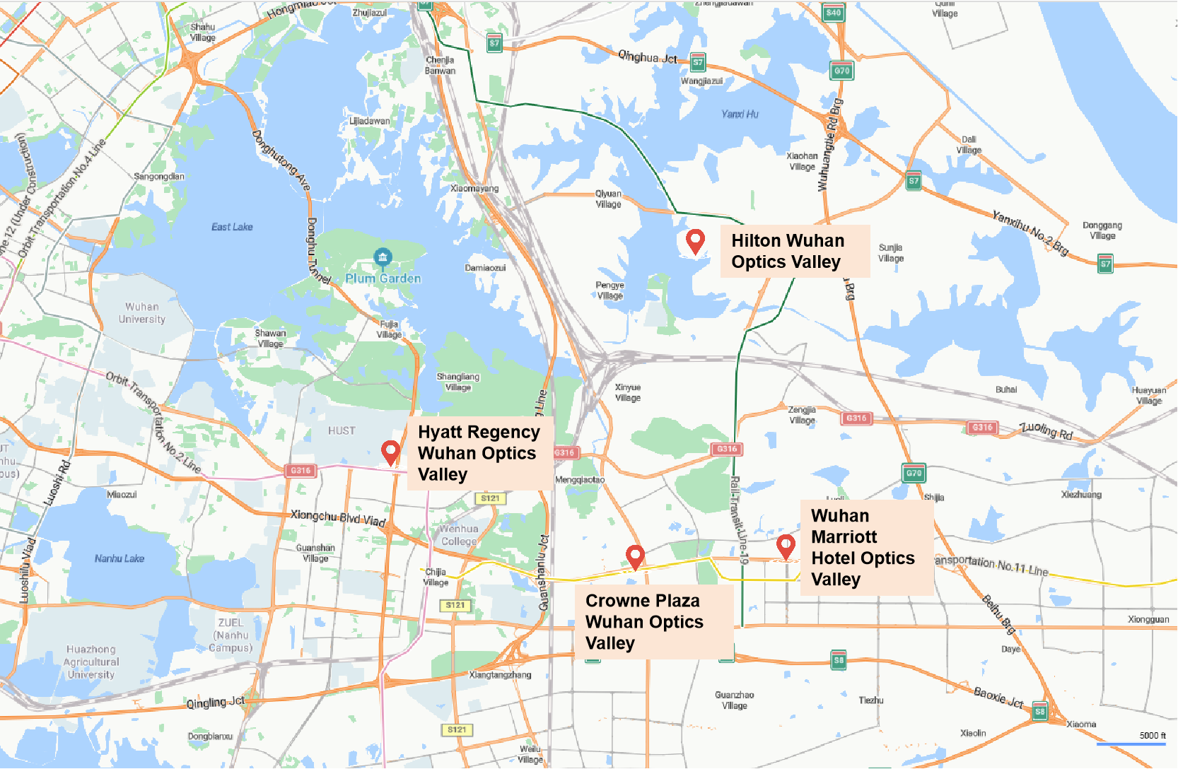
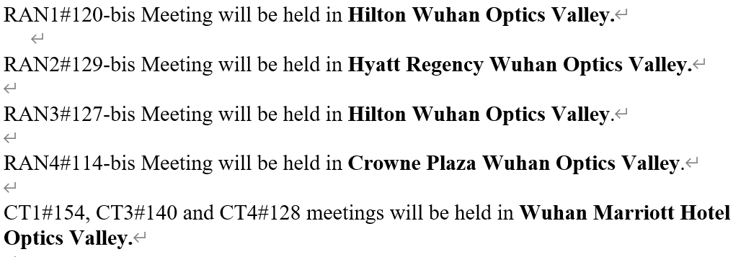
RAN4 meeting hotel
    RAN4 meeting hotel: Crowne Plaza Wuhan Optics Valley

Slide 13


