Slide 1
RAN4#112 meeting schedule
3GPP TSG-RAN WG4 Meeting #112
Maastricht, Netherlands, 19th – 23rd August, 2024
Agenda Item: 2
RAN4 Chair: Xizeng Dai
Vice Chair: Gene Fong, Shan Yang

Slide 2
Monday
Venue Time | RAN4 Main | RAN4 RRM | RAN4 BDaT | Ad hoc room
9:00-9:20 | 1. Opening of the meeting 2. Approval of the agenda 3. Letters / reports from other groups / meetings Emphasize the submission rule (Tdoc number cap for Rel-19 agenda; Title for maintenance CR starting with ( ) rather than [ }; WI code for TEI)
9:30-10:30 | Rel-19 spectrum related [112] LTE_NR_Other_basket (22) [113] NR_LTE_TN_Bands (97) | Rel-18 [207] NR_Mob_enh2 (35) | Rel-18 Demod [318] RF_FR1_enh2_Demod (11) [319] NR_FR1_lessthan_5MHz_BW_demod (4) [320] NR_demod_enh3_Part1 (11) | RRM Ad-hoc: [210][211][212] Rel-18 NR_pos_enh2, Chaired by Iana Siomina (Ericsson)
11:00-12:30 | [113] NR_LTE_TN_Bands (Cont) [115] NR_n28_PC2_40MHz (19) [114] NR_IoT_NTN_Bands (27) | Rel-18 [204] NR_RRM_enh3 (20) [206] NR_NTN_enh (30) | Rel-18 Demod [321] NR_NTN_enh_SAN_UE_demod (14) [322] NR_cov_enh2_demod (7) [323] NR_MIMO_evo_DL_UL_demod (7) | BDaT Ad-hoc: (SBFD) [307] NR_duplex_evo_General [308] NR_duplex_evo_BSRF Chaired by Jackson Wang (Samsung) and Xiang Gao (Huawei)
12:30-14:00 | Lunch break
14:00-15:30 | Rel-19 RAN4-led non-spectrum [127] NR_IoT_NTN_HPUE (42) | Rel-18 [205] NR_MG_enh2 (30) [208] NR_MIMO_evo_DL_UL (17) Coffee break: [209] Rel-18 Netw_Energy_NR, Chaired by Zhongyi Shen (Huawei) | Rel-18 Demod [324] NR_redcap_enh_demod (4) [325] NR_mobile_IAB_demod (4) [326] NR_DSS_enh (4) [317] Papers on PRACH format 1 for HAPS Rel-18 OTA [331] NR_FR1_TRP_TRS_enh (9) [332] NR_MIMO_OTA_enh (3) | Main Ad-hoc: [119/120] FS_NR_IMT Chaired by Thomas Chapman (Ericsson)
16:00-18:00 | [117] NR_ENDC_RF_Ph4_part2 (37) [116] NR_ENDC_RF_Ph4_part1 (33) | Rel-19 [222] Netw_Energy_NR_enh (15) Rel-18 [209] Netw_Energy_NR (28) | Rel-18 BSRF [302] NR_NTN_enh_SAN_RF (4) [303] NR_NTN_enh_SysParams_Coex_UERF (13) [304] NR_netcon_repeater_RF (34) | Main Ad-hoc: [131/132] FS_Ambient_IoT_solutions_part1 Chaired by Xiaoran Zhang
18:00-19:30 | Main Ad-hoc: [129] NR_AIML_air #1 Chaired by Vali (Qualcomm) | RRM Ad-hoc: [210][211][212] Rel-18 NR_pos_enh2, Chaired by Iana Siomina (Ericsson) | BDaT Ad-hoc: (Rel-19 BSRF) [305] NR_BS_RF, Chaired by Fei Xue (ZTE) | RRM Ad-hoc: [203] Rel-18 FR2_multiRx, Chaired by Qian Yang (vivo)

Slide 3
Tuesday
Venue Time | RAN4 Main | RAN4 RRM | RAN4 BDaT | Ad hoc room
8:30-10:30 | [118] NR_ENDC_RF_Ph4_part3 (48) [126] NR_PC2_RedCap_UE (10) | Rel-19 [223] NR_LPWUS (25) [213] NR_ENDC_RF_Ph4 (3) Coffee break: [214] Rel-19 NR_FR1_lessthan_5MHz_BW_Ph2, Chaired by Meng Zhang (Intel) | Rel-19 BS RF [305] NR_BS_RF (18) [306] NR_ATG_enh (4) [309] NR_LPWUS (7) | RRM Ad-hoc: [207] Rel-18 NR_Mob_enh2, Chaired by Qiming Li (Apple)
11:00-12:30 | [108] HPUE_Basket_Intra-CA_TDD (5) [109] LTE_NR_HPUE_FWVM (3) [110] HPUE_Basket_EN-DC (10) [111] HPUE_Basket_Intra-CA_TDD (27) | Rel-19 [215] NonCol_intraB_ENDC_NR_CA_Ph2 (7) [221] NR_duplex_evo (12) | Rel-19 SBFD [307] NR_duplex_evo_General (21) [308] NR_duplex_evo_BSRF (18) | BDaT Ad-hoc: Rel-18 TRP TRS [331] NR_FR1_TRP_TRS_enh, Chaired by Ruixin Wang (vivo) BDaT Ad-hoc: [314] NR_NTN_Ku_Band_General, Chaired by Moray Rumney (Eutelsat)
12:30-14:00 | Lunch break
14:00-15:30 | Rel-19 Other WG-led non-spectrum [119] FS_NR_IMT_part1 (19) [120] FS_NR_IMT_part2 (33) | Rel-19 [217] NR_ATG_enh (7) [214] NR_FR1_lessthan_5MHz_BW_Ph2 (7) Coffee break: [223] Rel-19 NR_LPWUS, Chaired by Xusheng Wei (vivo) | Rel-19 NTN [329] NTN_testing_NGSO_channel_model (6) [310] NR_NTN_Ph3_General_SAN_RF (7) [313] NR_IoT_NTN_less_than_5MHz_BSRF (5) | Main Ad-hoc: [116] NR_ENDC_RF_Ph4_part1 Chaired by Leo(Ye) Liu (Huawei)
16:00-18:00 | [131] FS_Ambient_IoT_solutions_part1 (29) [132] FS_Ambient_IoT_solutions_part2 (23) | Rel-19 [218] NR_RRM_Ph5_Part1 (30) [219] NR_RRM_Ph5_Part2 (12) | Rel-19 NTN (cont) [313] NR_IoT_NTN_less_than_5MHz_BSRF (5) [314] NR_NTN_Ku_Band_General (24) [315] NR_NTN_Ku_Band_UE_SAN_RF (8) (SAN part) | RRM Ad-hoc: [210][211][212] Rel-18 NR_pos_enh2, Chaired by Andrey Chervyakov
18:00-19:30 | Main Ad-hoc: [105] NR_Baskets_Part_1 Chaired by Iwo Angelow Reserved for ad hoc or continue main session if delay | RRM Ad-hoc: [202] Maintenance_R18 Chaired by Yang Tang (Apple) | BDaT Ad-hoc: [317] Demod_Maintenance, Chaired by Axel Mueller (Nokia) | Main Ad-hoc: [117] NR_ENDC_RF_Ph4_part2 Chaired by Tina(Yuanyuan) Zhang (Samsung)

Slide 4
Wednesday
Venue Time | RAN4 Main | RAN4 RRM | RAN4 BDaT | Ad hoc room
8:30-10:30 | [129] NR_AIML_air (60) | Rel-19 [220] NR_MIMO_Ph5 (7) Rel-18 [203] FR2_multiRx (31) | Rel-19 NTN UE RF [315] NR_NTN_Ku_Band_UE_RF (8) (UE part) [311] NR_NTN_Ph3_UE_RF (15) [312] NR_IoT_NTN_less_than_5MHz_UERF (18) | RRM Ad-hoc: [201] Maintenance_up_to_R17, Chaired by Li Zhang (Huawei)
11:00-12:30 | [133] NR_LPWUS_UERF (33) | Up to Rel-17 [201] Maintenance_up_to_R17 (201) | Rel-19 NTN UE RF (cont) [316] IoT_NTN_Ph3 (7) | RRM Ad-hoc: Rel-18 NR_MIMO_evo_DL_UL Chaired by Yanze Fu (Samsung)
12:30-14:00 | Lunch break
14:00-15:30 | [130] NR_MIMO_Ph5_UE (9) Rel-19 RAN4-led non-spectrum [125] FS_NR_DL_Frag_Carrier (22) | Rel-19 [224] NR_Mob_Ph4 (16) | Rel-19 OTA [333] TRP_TRS_MIMO_OTA (30) | Main Ad-hoc: [105] NR_Baskets_Part_1 Chaired by Iwo Angelow Main Ad-hoc: [106] NR_Baskets_Part_2 Chaired by Per Lindell
16:00-18:00 | [121] NR_SL_ intraB_CA_ITS_part1 (9) [122] NR_SL_ intraB_CA_ITS_part2 (6) [123] NR_FR1_5MHz_BW_Ph2 (13) [124] NonCol_intraB_ENDC_NR_CA (29) [128] NR_ATG_enh (18) | Rel-18 [210][211][212] NR_pos_enh2 (82) [202] Maintenance_R18 (48) | Rel-19 OTA (cont) [333] TRP_TRS_MIMO_OTA (30) (cont) [334] NR_FR2_OTA (7) | 16:00 – 17:30 Main Ad-hoc: [118] NR_ENDC_RF_Ph4_part3 Chaired by Ron (AT&T)
18:00-19:00 | Continue main session if delayed | RRM Ad-hoc: [205] Rel-18 NR_MG_enh2, Chaired by Ato Yu (MediaTek) | BDaT Ad-hoc: [314] NR_NTN_Ku_Band_General, Chaired by Moray Rumney (Eutelsat) | 17:30 – 19:00 Main Ad hoc: [133] NR_LPWUS_UERF Chaired by Ruixin Wang (vivo)
Cricket on Wednesday

Slide 5
Thursday
Venue Time | RAN4 Main | RAN4 RRM | RAN4 BDaT | Ad hoc room
8:30-10:30 | Rel-19 basket WI [105] NR_Baskets_Part_1 (21) [106] NR_Baskets_Part_2 (73) [107] LTE_Baskets (4) | Rel-19 [225] NR_XR_Ph3 (17) [229] RRM_Spec_Improvement (17) | Rel-19 Demod [327] NR_SCM (15) [328] NR_demod_Ph5 (22) | RRM Ad-hoc: Reserved
11:00-12:30 | Maintenance [134] NR_reply_LS_UE_RF (1) [135] UERF_Spec_Improvement (16) [101] Upto_R17_UERF_maintenance (104) | Rel-19 [227] IoT_NTN_Ph3 (10) [216] NR_IoT_NTN_req_test_enh (9) | Maintenance [301] BSRF_Maintenance (28) [330] OTA_Maintenance (4) | Main Ad hoc: [127] NR_IoT_NTN_HPUE Chaired by Haijie Qiu
12:30-14:00 | Lunch break
14:00-15:30 | [102] R18_UERF_maintenance_Part1 (71) [103] R18_UERF_maintenance_Part2 (23) | Rel-19 [226] NR_NTN_Ph3 (13) | Maintenance (cont) [317] Demod_Maintenance (51) | Reserved for BDaT session
16:00-18:00 | Early Return to Rel-19 topics | Early Return to Rel-18 topics | Early return
18:00-19:30 | Main Ad-hoc: [129] NR_AIML_air #2 Chaired by Vali (Qualcomm) | RRM Ad-hoc: [218][219] Rel-19 NR_RRM_Ph5, Chaired by Jerry Cui (Apple)

Slide 6
Friday
Venue Time | RAN4 Main | RAN4 RRM | RAN4 BDaT | Ad hoc room
8:30-10:30 | Return to | Return to | Return to [315] NR_NTN_Ku_Band_UE_RF [311] NR_NTN_Ph3_UE_RF [312] NR_IoT_NTN_less_than_5MHz_UERF [317] IoT_NTN_Ph3 Return to (Other topics)
11:00-12:30 | Return to | Return to | Return to [331] NR_FR1_TRP_TRS_enh [332] NR_MIMO_OTA_enh [333] TRP_TRS_MIMO_OTA [334] NR_FR2_OTA Return to (Other topics)
14:00-16:00 | Return to (final round) | Return to (final round) | Return to (final round)
16:00-17:00 | 12 New or revised Rel-19 WID/SID 13 Any other business 14 Close of the meeting

Slide 7
Appendix

Slide 8
General Aspects
The face-to-face meeting will take place during August 19th ~ 23rd, 2024.
  Three sessions in three separate rooms: Main, RRM, BDaT(BSRF_Demod_test). 1-Way GoToWebinar (GTW) conference calls will be set each session and 1-way MS teams will be set for ad hoc. A number of ad hoc sessions will be arranged (refer to meeting schedule).
  Moderator will be designated to provide the summary for a topic before the meeting. In online discussions, session chairs will handle topics based on the moderator summary. Moderator does not need update the summary by collecting comments during the meeting.
  Deadline for Tdoc request & submission deadline: August 9th (Friday) 2024, 23:59 UTC.
  Other deadlines can be found in the following slides.
Please find one picture for meeting flow below and details in the corresponding slides.
For chairs
For moderator
For delegates
Pre-meeting (August 12~16)
Quiet Period
1st round (August 19~22)
2nd round (May 22, 23)
Quiet Period
Post-meeting process ( May 26~29)
Mon
Tue
Wed
Thu
Fri
Sat/Sun
Mon
Tue
Wed
Thu
Fri
Sat/Sun
Mon
Tue
Wed
Thu
NWM flag process Slide #16
Moderators trigger nwm for maintenance before Sunday
Flag for maintenance @nwm
WF/CR template
Draft TS/TR
Slide #9
Slide #15
Pre-RAN Action
MCC 3GU parsing tool
Slide #10/11
Slide #18
Topic Moderator & summary: slide #5
Moderator assignment before Mon
Draft summary for topics
Summary review & comments
Formal tdoc of summary submission by Saturday
Online discussions &
GTW conference call (US/China meeting)
Upload CR for maintenance 2:30pm on Thursday
TOHRU (US/China meeting)
Tdoc request (new&revision)
Upload tdocs (10.10.10.10) &
How to access contributions
List of email threads for post-meeting
Submission of tdoc of post-meeting
Comments
Approve tdocs for post-meeting
Slide #7
Slide #12
Post-meeting process: slide #14
Registration
Slide #13
Initial list for block approval for basket
Deadline for flag for block approval
updated list for block approval
Slide #8
Slide #17
Tdoc number request & submission
Slide #3/4
Basket WIs Block approval: slide #6
Meeting schedule & Ad hoc chair assignment
Provided before meeting
Update of meeting notes per day
Tdoc allocation
Check-in
Slide #13
Slide #18/21
Slide #8
Slide #22
Meeting room
Quiet Period (0:00 am ~ 7:00 am meeting venue Local time
No email are expected in RAN4 reflector

Slide 9
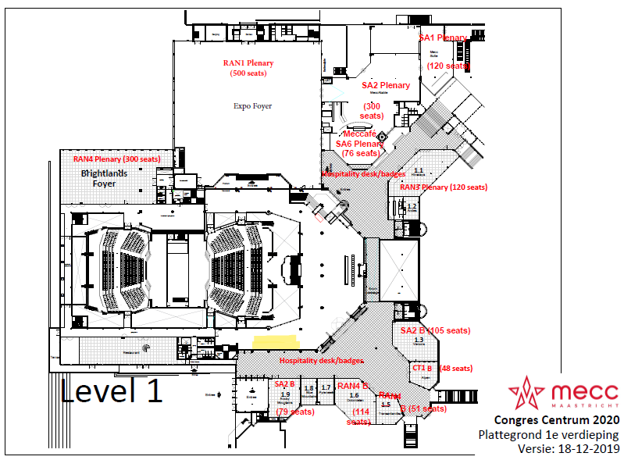
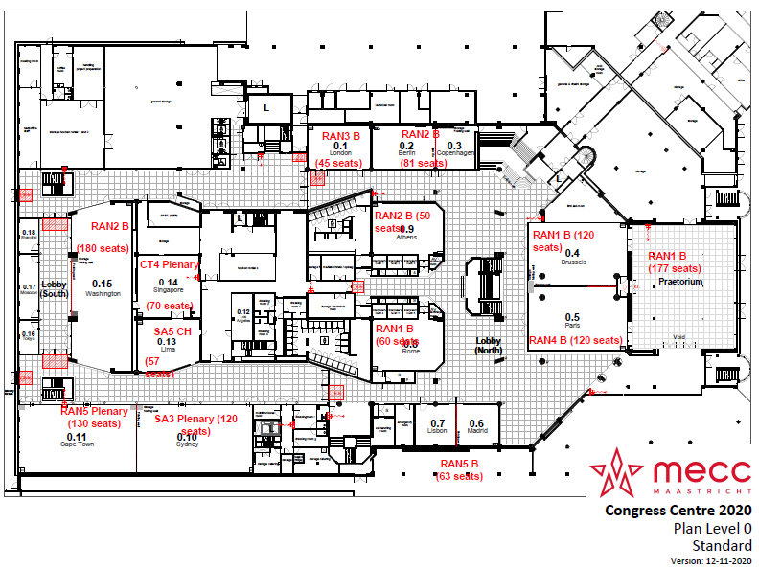
Meeting rooms
    RAN4 meeting rooms:
  Main session: Brightlands Foyer, level 1 (300)
  RRM session: 0.5 Paris (120)
  BDaT: 1.6 Dolomites (114)
  Ad hoc session: 1.5 Transantarctic (51)
Level 1
Level 0
Main session
Ad hoc room
RRM session
BDaT session

Slide 10
ALL: So esp. for TEI17 and TEI18 CRs please challenge the author of cat.F CRs (what was the corresponding TEIx cat.B CR that is corrected here?).

