Slide 1

CF3 has the pleasure of welcoming you to
3GPP RAN4#108-bis
09-13,October,2023,Xiamen,China

Slide 2
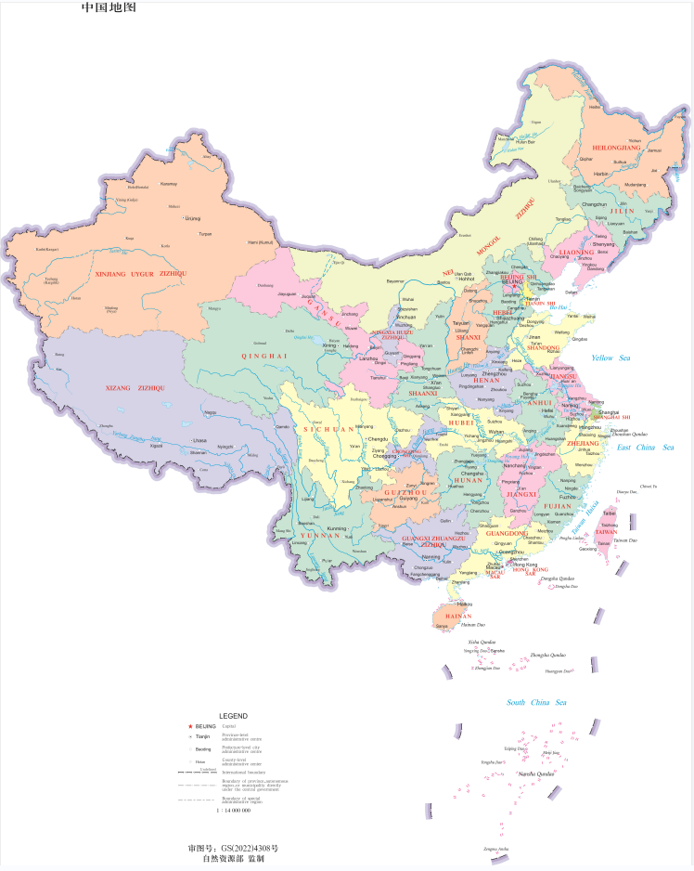
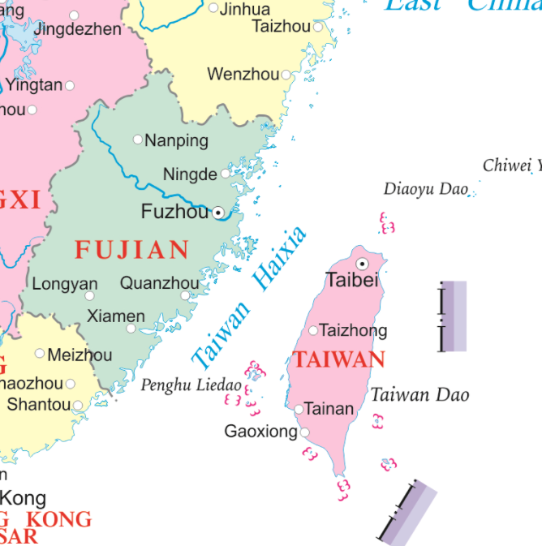

Xiamen’s Location in China Map

Slide 3
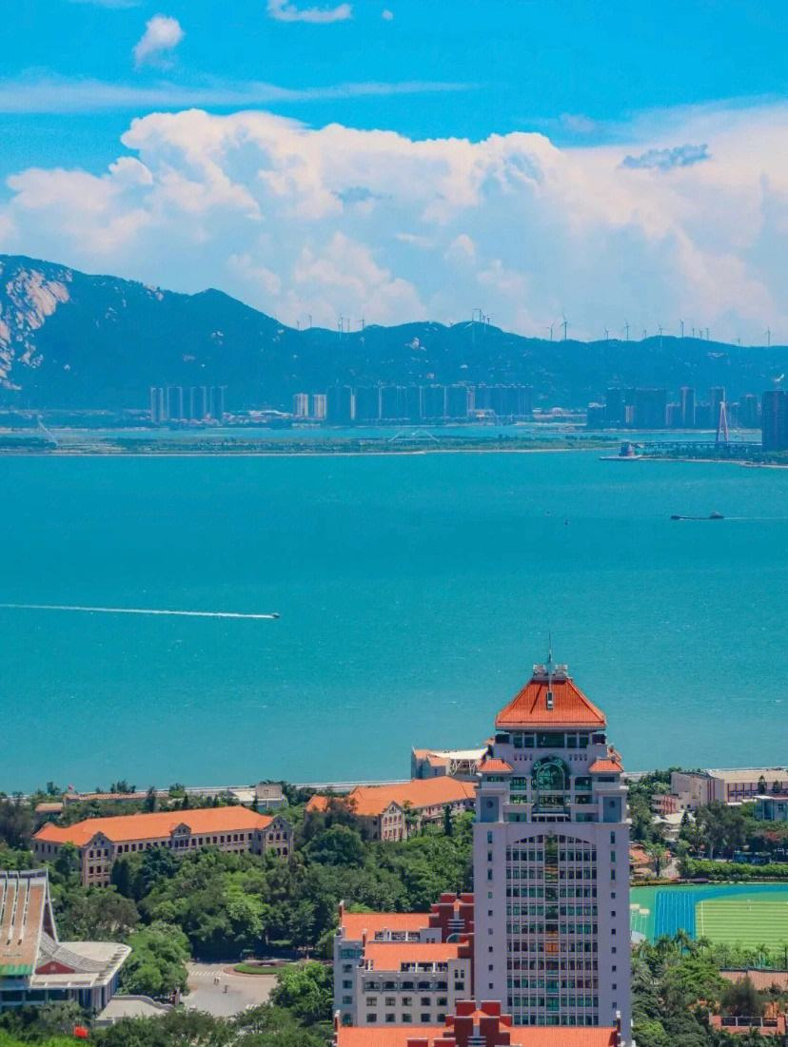
“Heron Island”
In ancient times, Xiamen Island was the habitat of egrets, so it was also called 'Heron Island '.
Established in 1394 a.d.
has won the UN Habitat Award.
Important central cities, ports and scenic tourist cities along the southeast coast of China.

Slide 4
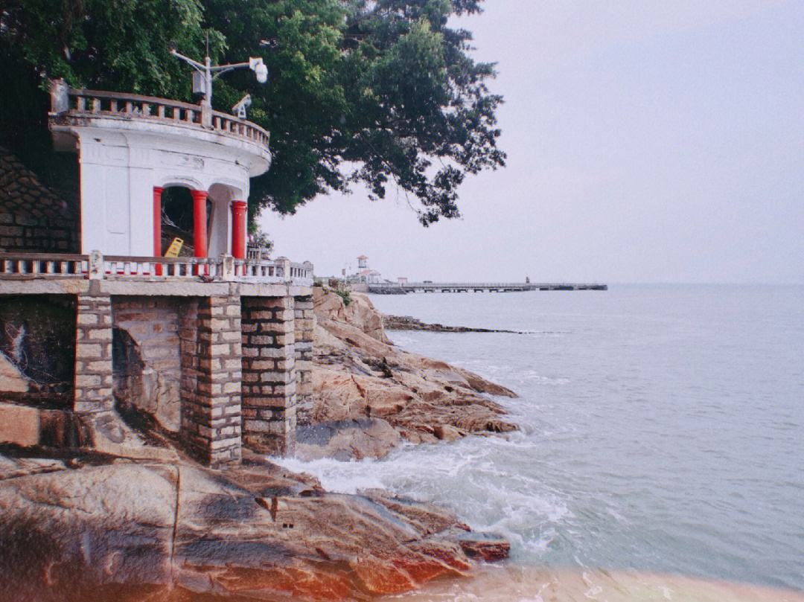

Xiamen’s Attractions
Gulang island
was selected as ' the head of the five most beautiful urban areas in China ' by the National Geographic Magazine, known as the ' sea garden '. Many buildings with Chinese and foreign architectural styles are well preserved on the island, which is known as the ' World Architecture Expo '. The residents of the island love music, and the piano has a high density and is praised as the island of Qin.
Southern Putuo temple
has a history of more than 1300 years. It is one of the Buddhist resorts in southern Fujian with beautiful scenery and magnificent momentum.

Slide 5
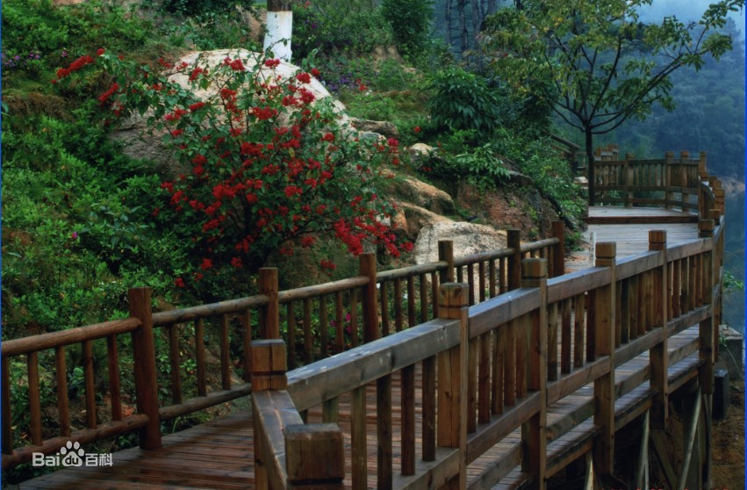
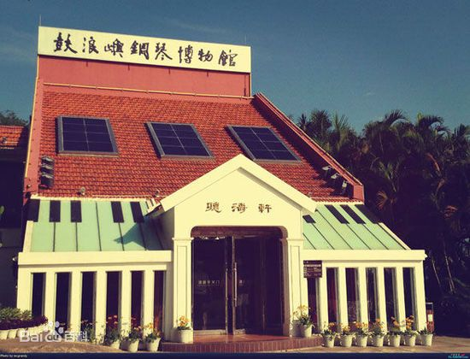
Xiamen’s Attractions
Tianzhu Mountain Forest Park
There are more than 200 kinds of forest plants and more than 40 kinds of wild animals in the garden. Precious wild animals include leopards, forest musk deer, fruit foxes, foxes, leopard cats, brocade chickens, sheep, cuckoos and so on.
Piano Museum
The museum displays more than 40 ancient pianos collected by Hu Youyi, a patriotic overseas Chinese, including rare and precious gold-plated pianos, the world 's earliest four-corner pianos and the earliest and largest vertical pianos. There are ancient hand-shaking pianos, pedal automatic pianos from a hundred years ago, and eight-footed ancient pianos.

Slide 6
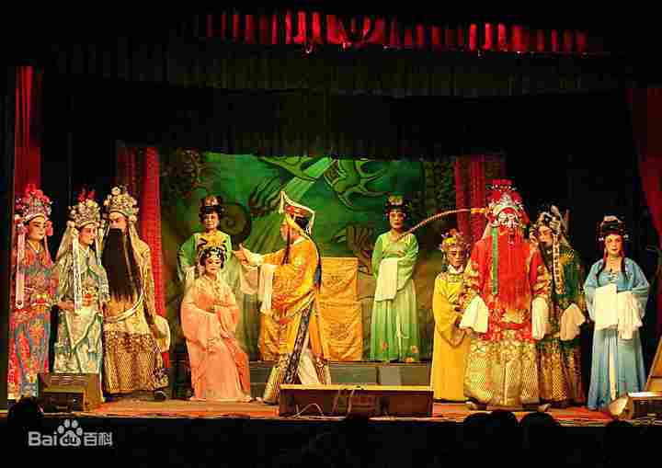
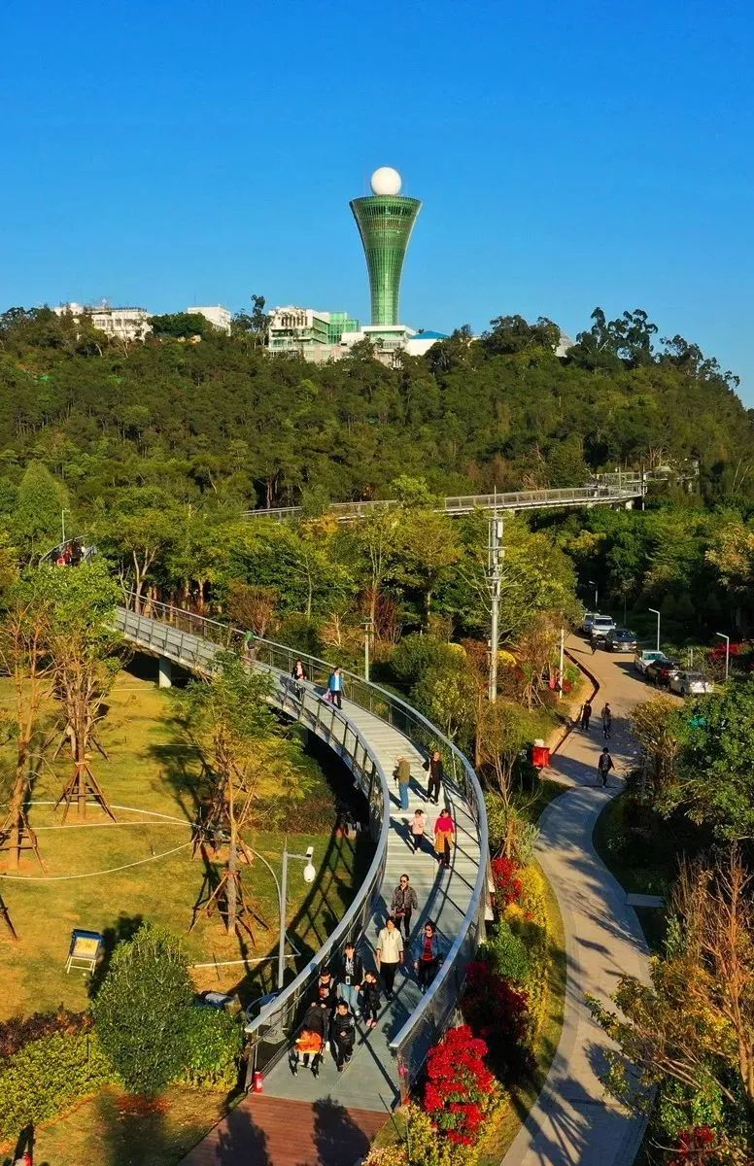
Entertainment
Gaojia Opera（高甲戏）
originated in Quanzhou, Fujian Province, also known as ' Gejia Opera ', ' Jiujiao Opera ', ' Daban ' and ' Tuban '.It is a local opera with the widest spread area and the largest audience among various operas in southern Fujian.It originated from a costume parade popular in rural areas of southern Fujian in the late Ming and early Qing Dynasties to dress up Liangshan heroes and perform martial arts techniques.
The Xiamen Mountains-to-Sea Trail（厦门山海健康步道）
The 23-kilometer pedestrian walkway runs between the cruise port at Dongdu and the beach near Guanyin Mountain, linking eight local hilltops (Huwei, Xianyue, Yuan, Xueling, Hutou, Jin, Huzai and Guanyin), as well as three waterways (Yundang Lake, Wuyuan Bay and Hubian Reservoir).

Slide 7
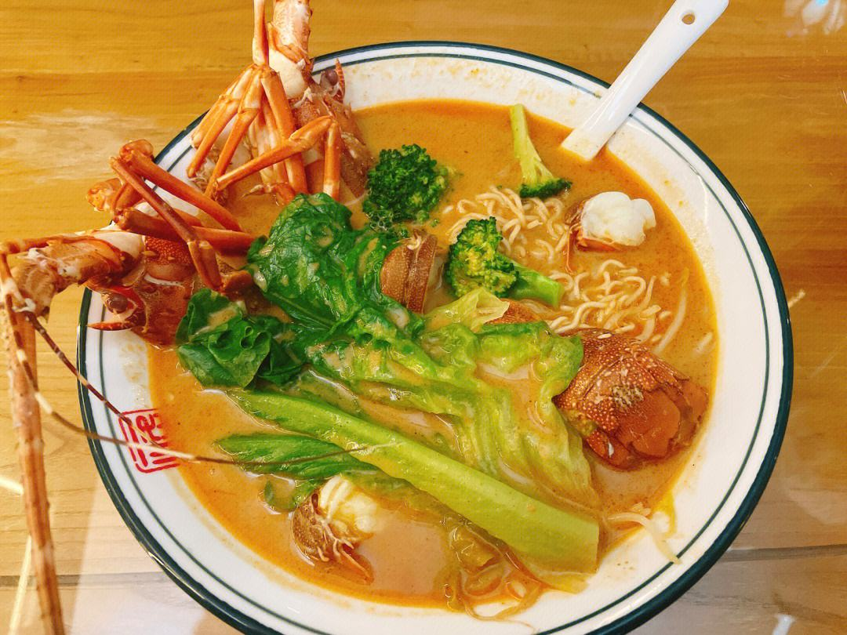
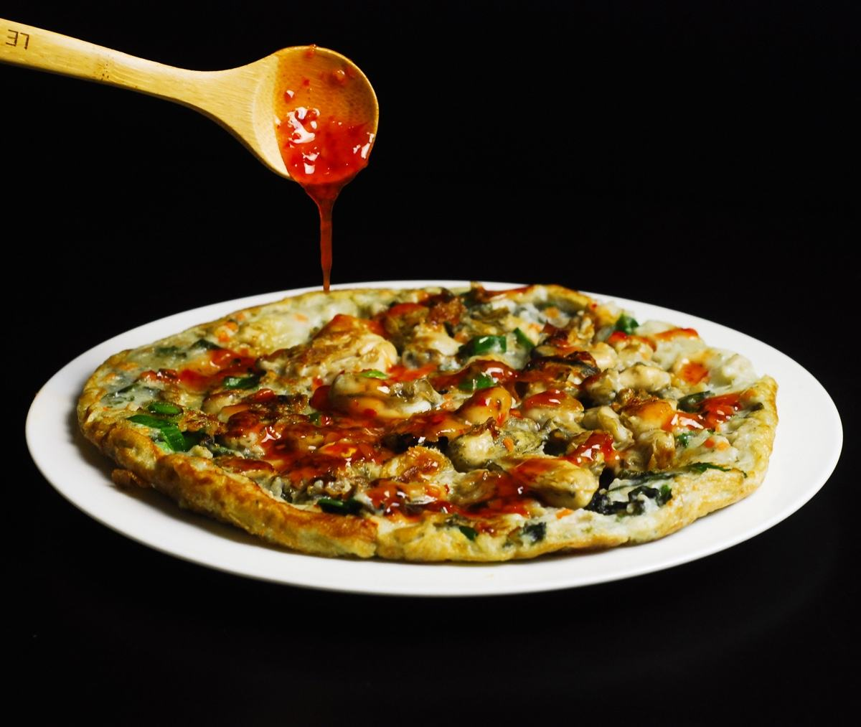
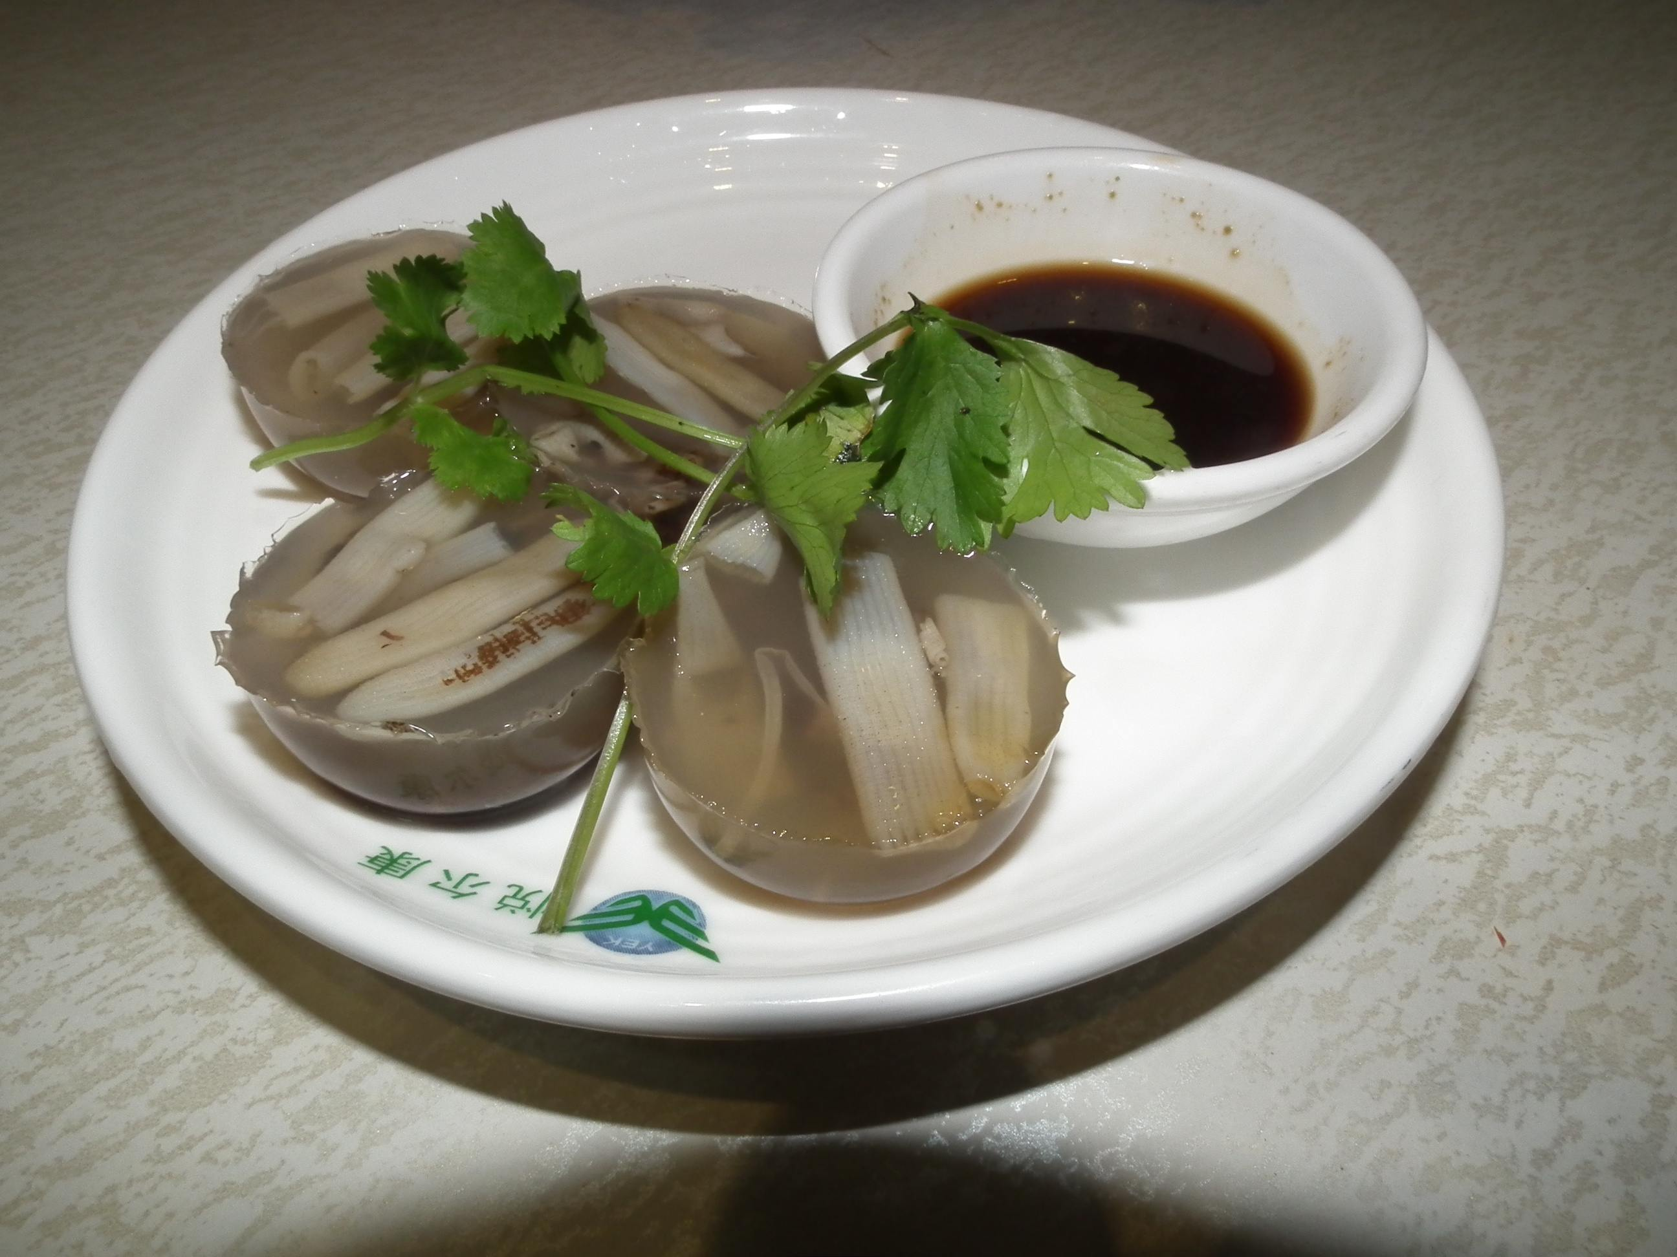
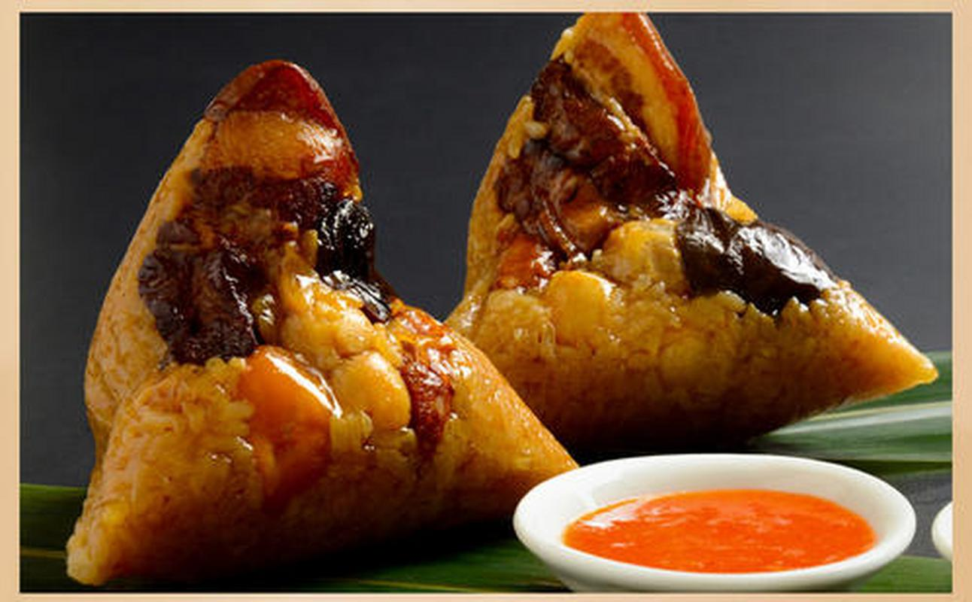
Local Food
Sand tea noodles（沙茶面）
Oyster frying（海蛎煎）
bamboo shoot jelly（土笋冻）
Burned meat dumplings（烧肉粽）

Slide 8
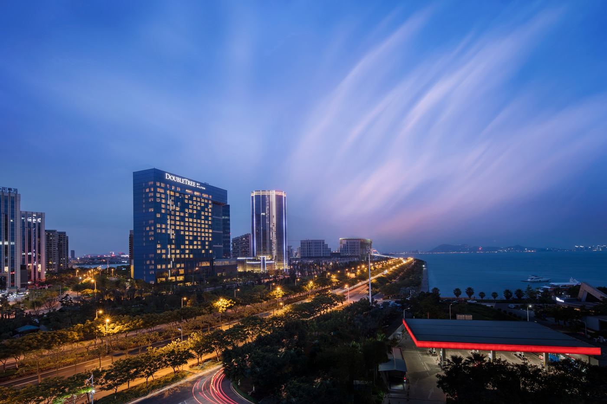
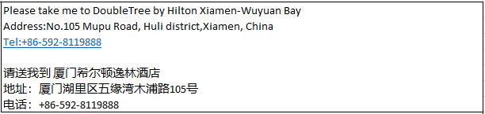
Hotel
DoubleTree by Hilton Xiamen-Wuyuan Bay
it is about 7km and 15 mins by car from Xiamen Gaoqi International Airport.
The fare for taxi from the Airport to the hotel is around CNY 25 per way. (Please take the taxi which can provide the invoice for your trip)
In case of taking a taxi, please print the following note which shows taxi driver the address of DoubleTree by Hilton Xiamen-Wuyuan Bay in both English and Chinese.

Slide 9
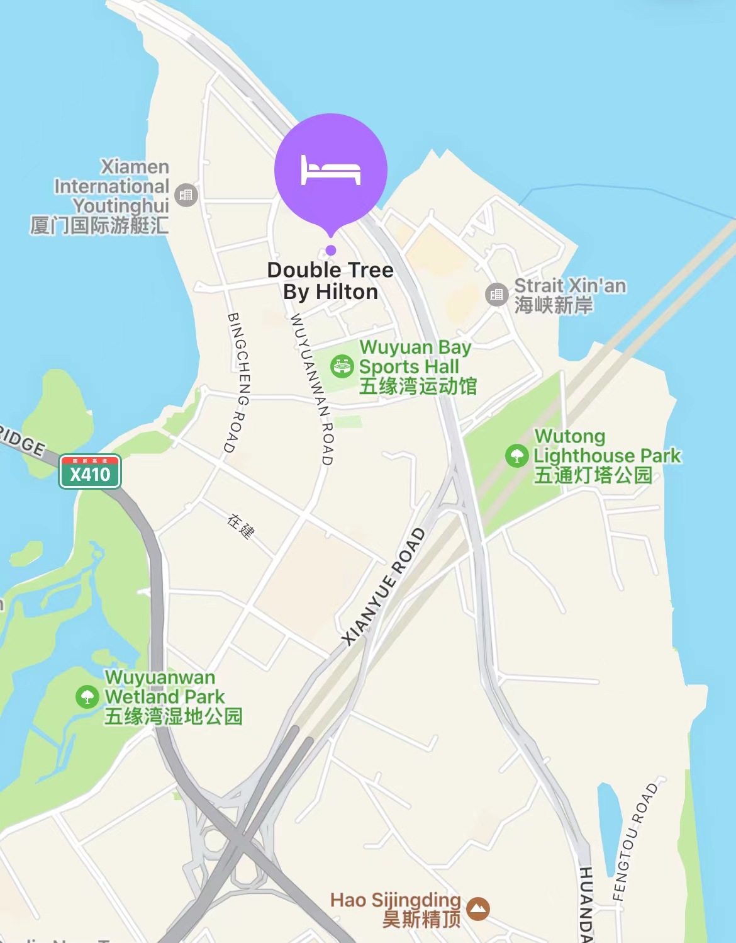
Hotel Location

Slide 10
Meeting Room Allocation-MON
Date | Time | Event | Function room/Capacity
9th Oct (MON) | 9:00-20:00 | RAN4-1、RAN4-2 | Tianyuan Ballroom+Hengyuan Ballroom (2F)/300
 | 8:00-20:00 | RAN4-3 | Qingyuan Ballroom (2F)/100
 | 8:00-20:00 | RAN4-4 | Function Room Riyuan+Yueyuan+Xingyuan (2F)/100
 | 8:00-20:00 | RAN4-5 | Hengan Meeting Room (2F)/50
 | 10:30-11:00/ 16:30-17:00 | Coffee Break | Foyer

Slide 11
Meeting Room Allocation-TUES
Date | Time | Event | Function room/Capacity
10th Oct (TUES) | 8:00-20:00 | RAN4-2 | Tianyuan Ballroom+Hengyuan Ballroom (2F)/200
 | 8:00-20:00 | RAN4-3 | Qingyuan Ballroom (2F)/100
 | 8:00-20:00 | RAN4-4 | Function Room Riyuan+Yueyuan+Xingyuan (2F)/100
 | 8:00-20:00 | RAN4-5 | Hengan Meeting Room (2F)/50
 | 10:30-11:00/ 16:30-17:00 | Coffee Break | Foyer

Slide 12
Meeting Room Allocation-WED
Date | Time | Event | Function room/Capacity
11th Oct (WED) | 8:00-20:00 | RAN4-2 | Tianyuan Ballroom+Hengyuan Ballroom (2F)/200
 | 8:00-20:00 | RAN4-3 | Qingyuan Ballroom (2F)/100
 | 8:00-20:00 | RAN4-4 | Function Room Riyuan+Yueyuan+Xingyuan (2F)/100
 | 8:00-20:00 | RAN4-5 | Hengan Meeting Room (2F)/50
 | 10:30-11:00/ 16:30-17:00 | Coffee Break | Foyer

Slide 13
Meeting Room Allocation-THUR
Date | Time | Event | Function room/Capacity
12th Oct (THUR) | 8:00-20:00 | RAN4-2 | Tianyuan Ballroom+Hengyuan Ballroom (2F)/200
 | 8:00-20:00 | RAN4-3 | Qingyuan Ballroom (2F)/100
 | 8:00-20:00 | RAN4-4 | Function Room Riyuan+Yueyuan+Xingyuan (2F)/100
 | 8:00-20:00 | RAN4-5 | Hengan Meeting Room (2F)/50
 | 10:30-11:00/ 16:30-17:00 | Coffee Break | Foyer

Slide 14
Meeting Room Allocation-FRI
Date | Time | Event | Function room/Capacity
13th Oct (FRI) | 08:00-17:00 | RAN4-2 | Tianyuan Ballroom+Hengyuan Ballroom (2F)/300
 | 08:00-16:00 | RAN4-3 | Qingyuan Ballroom (2F)/100
 | 08:00-16:00 | RAN4-4 | Function Room Riyuan+Yueyuan+Xingyuan (2F)/100
 | 08:00-16:00 | RAN4-5 | Hengan Meeting Room (2F)/50
 | 10:30-11:00/ 16:30-17:00 | Coffee Break | Foyer

Slide 15
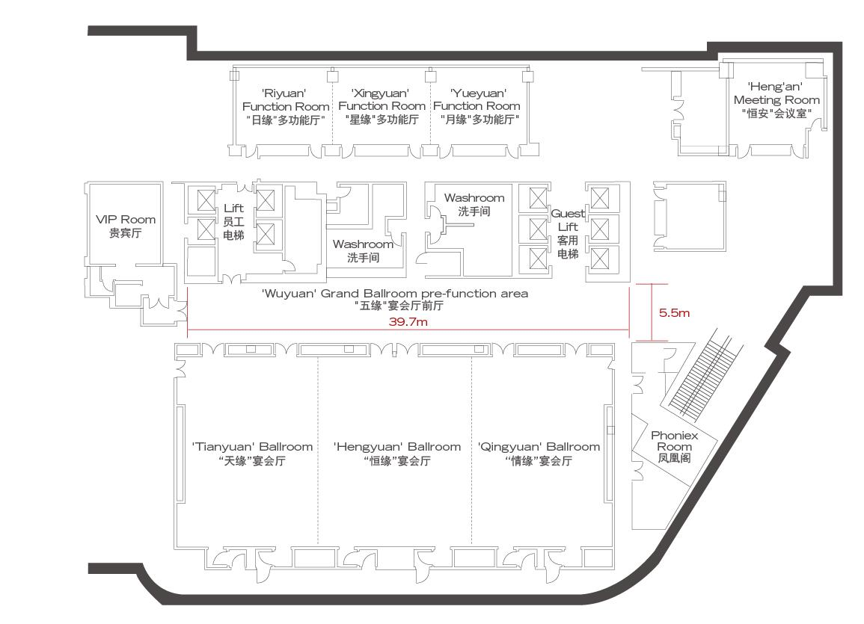
Floor Plan-2nd

Slide 16

Time: 19:00-21:00,10, Oct. 2023 Venue：TBD
Welcome Reception

Slide 17
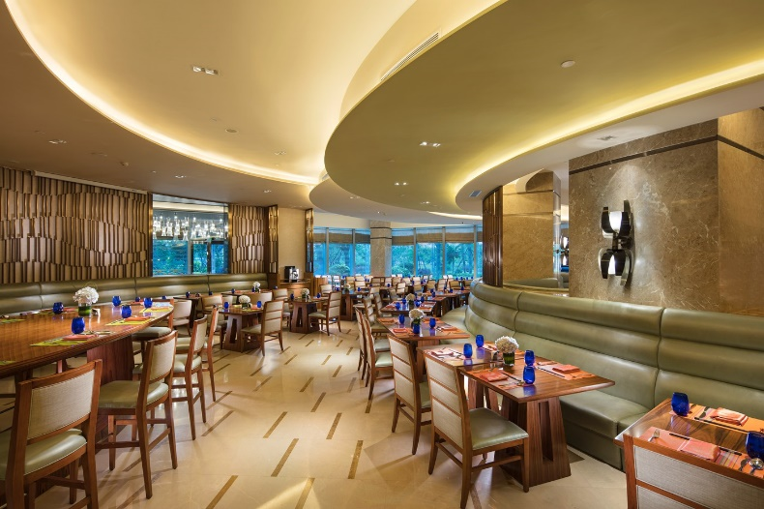
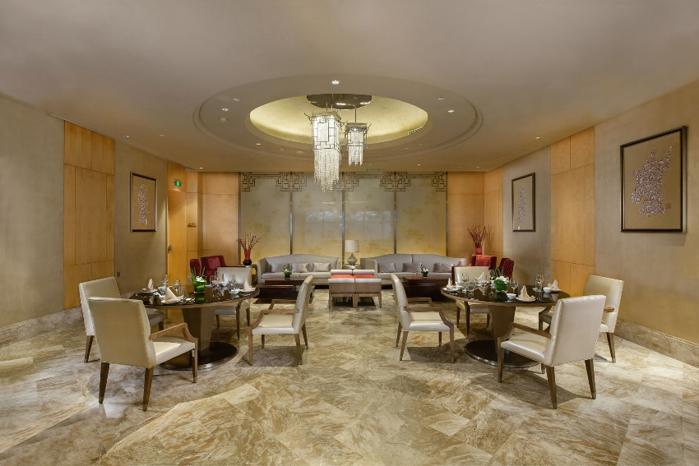
Restaurants in hotel
酒店圆聚自助餐厅（Circle Buffet Restaurant）
自助午餐 Buffet Lunch：RMB 168
自助晚餐 Buffet Dinner：RMB 218
粤茗湾中餐厅（Yue Ming Bay Chinese Restaurant）
单人套餐Single set：RMB 128/set
双人套餐Set Menu for two：RMB 399/set

Slide 18
Restaurants near hotel
尊宝披萨店（Zun Bao Pizza Restaurant）
肯德基餐厅（KFC Restaurant）
星巴克 (Starbucks)
真馍坊西安面馆（Zhen Mo Fang Noodle Restaurant）
白水洋餐厅（Bai Shui Yang Chinese Restaurant）
知鱼小馆中餐厅（Zhi Yu Chinese Restaurant）
港式茶餐厅（Hong Kong-style Restaurant）
遇见巧妈闽南餐厅（Yu Jian Qiao Ma Xiamen Food Restaurant）
同龙堂面馆（Tong Long Tang Chongqing Noodle Restaurant）
闽南猪脚饭餐厅（Min Nan Chinese Restaurant）
春江潮餐厅（Chun Jiang Chao Cantonese cuisine Restaurant）

Slide 19


How to Use Alipay and WeChat Pay
Alipay and WeChat Pay are two important payment methods in China. Learning how to use them will make your travel to China much easier. Click on the PDF link below to learn more.

Slide 20
Meeting Staff
If you need any assistance during your stay, you may go to staff at the Information desk outside the meeting room.For any emergency please contact us at:
Mr. Shizhuo ZHAO (+86-13671348485)

Slide 21
Have a successful meeting and enjoy your stay in Xiamen!

