Slide 1
RAN4#108bis meeting Arrangements and Guidelines
3GPP TSG-RAN WG4 Meeting #108bis
Xiamen, China, October 09th – 13th , 2023
Agenda Item: 2
R4-23xxxxx
RAN4 Chair: Xizeng Dai
Vice Chair: Gene Fong, Shan Yang

Slide 2
General Aspects
The face-to-face meeting will take place during October 09th ~ October 13th, 2023.
Three sessions in three separate rooms: Main, RRM, BSRF_Demod_test. GoToWebinar (GTW) conference calls will be set each session. And the remote participant can be supported. TOHRU will be used. A number of ad hoc sessions will be arranged (see Slide #7).
Moderator will be designated to provide the summary for a topic before the meeting. In online discussions, session chairs will handle topics based on the moderator summary. Moderator does not need update the summary by collecting comments during the meeting.
Deadline for Tdoc request & submission deadline: September 27th (Wednesday) 2023, 23:59 UTC.
Other deadlines can be found in the following slides.
One picture of meeting flows. See details in the corresponding slides.
For chairs
For moderator
For delegates
Inactive period
1st round (October 9 ~12)
2nd round (Oct 12~13)
Quiet Period
Post-meeting process (October 16~19)
Pre-meeting (September 28 ~ October 08)
Thu (28th)
Fri (29th)
Sat/Sun
Mon~Thu
Fri
Sat/Sun
Mon
Tue
Wed
Thu
Fri
Sat/Sun
Mon
Tue
Wed
Thu
Tdoc number request & submission September 27th
Slide #3/4
NWM flag process Slide #16
Chairs trigger nwm: feedback maintenance & spectrum related
Flag maintenance & spectrum @nwm
WF/CR template
Draft TS/TR
Slide #9
Slide #15
Pre-RAN Action
MCC 3GU parsing tool
Slide #18/21
Slide #10/11
Slide #18
Topic Moderator & summary: slide #5
Moderator assignment on Friday (29th)
Draft summary for topics on Friday (29th)
Summary review & comments
Formal tdoc of summary submission by Sunday (Oct 8th)
Online discussions &
GTW conference call
TOHRU
Tdoc request (new&revision)
Upload tdocs (10.10.10.10) &
How to access contributions
Slide #7
List of email threads for post-meeting
Submission of tdoc of post-meeting
Comments
Approve tdocs for post-meeting
Slide #12
Slide #8
Post-meeting process: slide #14
Initial list for block approval for basket on Wed (Oct 4th)
Deadline for flag for block approval on Fri (Oct 7th)
updated list for block approval
Slide #17
Basket WIs Block approval: slide #6
Check-in
Slide #13
Registration Mon (Oct 2nd)
Meeting schedule & Ad hoc chair assignment
Provided before meeting
Update of meeting notes per day
Tdoc allocation
Meeting room: Slide #22
Slide #13
Slide #8
Quiet Period (0:00 am ~ 7:00 am meeting venue Local time
No email are expected in RAN4 reflector

Slide 3
Tdoc number request & submission
The tdoc request and submission deadline is September 27th (Wednesday) 2023, 23:59 UTC. Tdoc which is requested and/or submitted after deadline will not be treated. (the following guidance applies if the corresponding agenda(s) are set)
Please refer to RAN4 Meeting Efficiency Improvements (R4-2114691) for tdoc submission and handling, where the principle is applied for Rel-18.
Draft CRs/Draft big CRs/TPs are allowed this meeting. Please follow additional restrictions in the frozen agenda.
In the ordinary meeting preceded by a bis meeting, if further change(s) were needed on top of the agreed CR/endorsed draft CR in the bis meeting, the new CR/draft CR should be based on the latest version of specifications and to capture the agreed CRs/endorsed draft CRs in the previous bis meeting with change marks in the new CR.
There is no Rel-15/16/17/18 maintenance agendas in this meeting, except for the agendas corresponding to the incoming LS from other working groups, which may belong to the closed Rel-15/16/17/18 WIs.
For Rel-18 on-going SI/WI in this meeting
For Rel-18 WIs, the limit of submitted tdoc follows the principle in RAN4 Meeting Efficiency Improvements (R4-2114691)
Maximum one discussion paper per lowest level agenda item (AI) per company/organization.
For Rel-18 WIs, the draft big CR is allowed. Companies shall follow work split and draft big CRs shall be submitted by sourcing companies only.
Please use title starting with "Draft Big CR" when you reserve a Tdoc number for a draft big CRs to facilitate work of moderator.
Draft CR/CR handling for RF and RRM core part
It is encouraged that companies discuss and agreed on the work splitting first.
In principle, no draft CR and draft TP/TP are allowed except for Rel-18 WIs which will be closed in this quarter and spectrum related WIs.
Draft CR/CR handling for performance part (RF conformance, RRM test and demodulation performance) for all WIs
It is encouraged that companies discuss and agreed on the work splitting first.
In principle, no draft CR and draft TP/TP are allowed except for Rel-18 WIs which will be closed in this quarter and spectrum related WIs.

Slide 4
Tdoc number request & submission (cont.)
For Rel-18 on-going SI/WI
For all non-spectrum SI/WIs, rapporteur shall provide RAN4 work plan for each of RF/RRM/Demod sessions prior to the start of the actual work.
The details can be found in RAN4 Meeting Efficiency Improvements (R4-2114691).
For WIs/SIs to be closed in the following-up RAN plenary, rapporteur needs reserve the tdoc numbers for draft TR/TS, if needed, to merge all the agreement.
For Rel-18 on-going basket SI/WI in this meeting
No revised WID/big CRs are expected.
TPs/draft CRs/draft big CRs/updated draft TR are allowed.
No formal request for a new band combination request will be handled.
Same deadline as RAN4 Tdoc submission, if the proponents want to submit.
The request is just for information and offline discussions.

Slide 5
Topic Moderator & summary
List of topics will be provided by session chair
A number will be assigned for each topic, e.g., [108bis][10x] XXX for main session, which is similar to the number of email thread
The intention is to facilitate the online/offline discussions
MCC will create the sub-folder for each topic in /inbox/drafts
Topic Moderator will be designated to provide the summary for a topic before the meeting
Before September 29 (Friday): Session chairs will provide the list of topics with moderator assignments.
September 29 (Friday), 17:00 UTC: Moderators provide the initial summary for a topic
October 5 (Thursday), 17:00 UTC: Deadline for companies review of initial summary
October 8 (Sunday), 17:00 UTC: Moderators submit the formal tdoc of summary for a topic
October 8 (Sunday): Session chairs share the initial meeting notes trying to take moderators summary in consideration
NOTE: For moderators located in Korea, it is appreciated that you could share the draft summary before October 5th and more review time will be allowed for those topic threads. The holiday in Korea starts from September 28th.
In online discussions, session chairs will handle topics based on the moderator summary.
Online discussions will be organized based on the moderator summary topic by topic + presentation of the selected contributions
Delegates do not need write comments in the summary document and moderator does not need update the summary during the meeting.

Slide 6
Basket WIs Block approval
Draft CRs/TPs for basket WIs (AI 6.1 for LTE, AI 4.3 – 4.13 for NR) will be handled following procedures/timelines below.
Procedures and timelines
October 4 (Wednesday): Basket WI moderator will provide a list of contributions for flagging.
October 7 (Saturday), 17:00 UTC: Flag deadline. Companies can use the basket email thread title and specific reason(s) for flag in the email, e.g.,
October 9 (Monday): Basket WI moderator will provide the updated list of contributions in which
Those that were not flagged will be considered as "agreeable”.
Those that were flagged will be revised. The authors are encouraged to share the revisions as soon as possible for further comments.
October 10 ~ October 13 (Tuesday ~ Friday): The flagged tdocs will be discussed during the meeting.
Ad hoc session(s) may be scheduled pending on Chair arrangement
Online time slots will be scheduled for discussions and to make decisions for each flagged tdoc
if the revision is agreeable by addressing received comments).
August 17 (Tuesday), 17:00 UTC: Updated TRs/draft TSs need be available for post-meeting email process.
No technique discussions are expected during post-meeting process.
Tdoc | Title | Reason for discussion | Source company
R4-2xxxxxx | xxxx | xxxx | xxxx

Slide 7
Online discussion & GTW conference call
During three online sessions, the two-way GTW conference calls will be set. For ad hoc session, MS teams may be provided.
Remote participating with two-way GTW is allowed and supported and two-way remote participants will be able to listen and comment.
No official objection from remote participants
Please register timely to be eligible to take part in the GTW conference calls.
During online discussions
Session chairs will organize discussions based on the moderator summary topic by topic + presentation of the selected contributions
Tdocs for approval including draftCR/TP/draft TS/draft TR/LSout will be handled online
WF will be allocated by session chair during the online discussions
Please not reserve Tdoc number for WF before the meeting
Ad hoc sessions
Ad hoc sessions will be scheduled by session chairs for detailed technique discussions for (a) specific topic(s)
Ad hoc chairs will be designated by session chairs and the ad hoc minutes with recommendation or WF can be provided after ad hoc sessions
The two-way GTW or other type of conference calls may not be provided for ad hoc sessions
Offline discussions
The sub-folder for each topic will be created by MCC in the inbox folder, which is similar to those for email threads in e-meeting
Companies can use the sub-folder to upload the new tdocs and/or revised tdocs, including WF/draft CR/TPs…
No official email discussion will be arranged for this topic
When authors of WF/draft CR/LSout or other delegates trigger the offline discussions by email, please use the subject of [108bis][xxx] XXX for Main/RRM/BSRF_Demod_Test sessions, where XXX corresponds to topic name

Slide 8
Tdoc request & allocation
During the meeting, the tdoc number for revision or new tdoc will be allocated by session chairs according to the requests
Based on the online discussions, session chairs with help of MCC will allocate tdoc numbers
During coffee break, the delegates can request the tdoc in person from session chairs
Email thread like“[1xx][X00] XXX_Session - tdoc request”WON´T be used for tdoc request and allocation, because it is difficult for session chairs to handle email during face-to-face meeting.
For basket WIs or other special topics, session chairs will allocate the Tdoc number for revision or new Tdocs based on the recommendation in the topic moderators´ summary.
(Not applicable in this meeting) For TEI, if you plan to trigger a new topic which has no corresponding WI code and have to submit CR(s) with TEI-xx as the work item code for this topic, please contact session Chairs first, because TEI topics are under monitoring by RAN
Please submit the CRs by providing a TEI identifier and include it in the title of CRs.
Example of TEI identifier: [n77 Canada]
The first CRs of one TEI topic to introduce a new should be prepared as Cat-B CRs. The CRs which correct the specification for the previous TEI topics should be submitted as Cat-F or Cat-A.
Please refer to RP-222624 for the rule of TEI.

Slide 9
CR/WF template
The latest CR-Form template can be found at
https://www.3gpp.org/ftp/tsg_ran/WG4_Radio/TSGR4_108bis/Template
By using the official CR coversheet template you ensure that only official 3GPP styles go into your CR (For an insight into the styles please review the latest 3GPP drafting rules 21.801).
3GU tool
There is a tool in 3GU which allows you to use the 3GU automatic pre-filled coversheet, so no need to fill in by hand all the CR details every time:
If you go to the tdoc listing in 3GU (not the Excel Tdoc list but the "online" listing of Tdocs), and select a CR (the spectacles logo), and if that CR is not yet uploaded, there is a small logo next to the "Status: reserved" field which says "(Download prefilled cover page)".
Using the 3GU automatic pre-filled coversheet can also make sure your data in 3GU must match your coversheet data.
New clauses
You are encouraged to used "other comments" on the CR coversheet to provide additional information for where you would like a new clause to be placed in the spec, if you have a preference.
Others
Companies are encouraged to write the CR based on the sequential order of clauses affected.
Please use the appropriate bullet styles
The WF template is provided in the server https://www.3gpp.org/ftp/tsg_ran/WG4_Radio/TSGR4_108bis/Templates
The clean version of final formal WF Tdoc is expected.
No green highlighted is expected

Slide 10
Correctly preparation for TR and TS
Capture the new TR/TS in the table for “New specifications” in the approved WID/SID
Keep the TS/TR number as 3Y.XXX, e.g., 38.xxx for NR
Usually for SID, the title of TR is the same as the title of SID
Rapporteur and numbers for TR/TS
Please contact with WG Chair to decide the rapporteur for TR/TS
Please contact WG secretary for TR/TS number after the WID/SID capturing the new TS/TR is approved in RAN
Update draft TR/TS in WG meetings
Before formally approved in RAN plenary, the draft TR/TS is maintained by rapporteur in WG. TP is expected to be used to add or change technique contents for draft TR/TS.
The rapporteur of draft TR/TS is expected to merge all the approved TPs and provide the updated draft TR/TS in the next meeting.
The version number for the draft TR/TS should start with v.0.X.0, e.g., v.0.1.0, and X will increase meeting by meeting
Submission and formally approve TR/TS to RAN plenary
According to the target date, the draft TR/TS is expected to be submitted to RAN plenary for information and/or approval.
Only the rapporteur of TR/TS is able to reserve tdoc number and upload tdoc for RAN plenary.
Before submitting TR/TS to RAN plenary, please provide the drafts to RAN MCC to perform 3GU upload checker
When submitting TR/TS, please use the template provided by RAN secretary. The template includes both presentation cover and specifications. Please put presentation cover and specifications in one zip file with proper tdoc number.
Please find example in 3GPP_TS-TR_Template.zip and Spec_Submit.zip (presentation cover)
Please use version number v1.0.0 for the firs time submission to RAN plenary (for information or for one-step approval), and use version number v.2.0.0 for the second time (e.g., for formal approval after submission for information in the previous RAN)

Slide 11
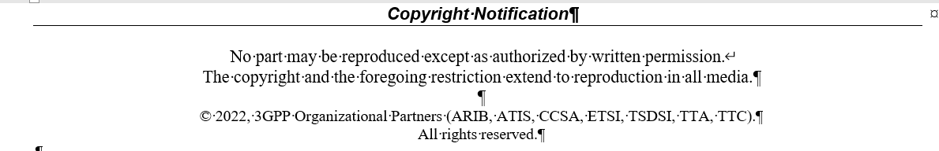
Correctly preparation for TR and TS (cont.)
CR for formally approved TR/TS
After formally approved, TR/TS is under control of MCC. Please use CR for any kinds of change for TR/TS.
Update of copyright date in draft TR/TS
Please update the date of draft TR/TS. The example is given below.
2023

Slide 12
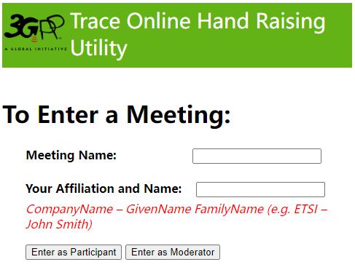
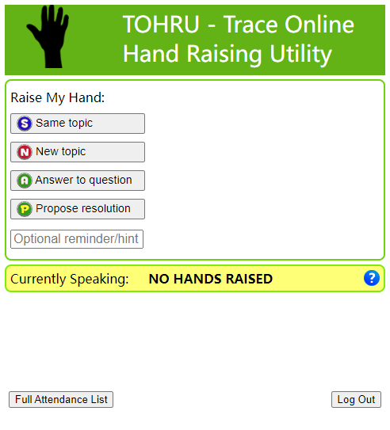
Guidance of TOHRU for GTW
TOHRU (Trace Online Hand Raising Utility) will be used
3GPP TOHRU will be used in this meeting for three online sessions
Hyperlink: https://tohru.3gpp.org/
Together with the invitation for the GotoWebinar MCC provides you with a "Meeting name" individually after your registeration
Meeting name (TOHRU Meeting IDs):
Main session: RAN4_Main
RRM session: RAN4_RRM
BSRF_Demod_testing session: RAN4_BSRF
NOTE: Ad hoc session: MS teams may be provided
Enter your name
<represented company>, <first name> <family name> e.g.: XY Telecom - Peter Mustermann
Need to manually push "Refresh Queue" or use "Automatically refresh queue every 3 seconds", since this is different from the original TOHRU tool.
The other buttons are similar as the previous external TOHRU tool
Please find references at
https://www.3gpp.org/ftp/tsg_ran/WG4_Radio/TSGR4_108bis/Invitation

Slide 13
Register and check-in
The registration deadline is October 2nd 2023 (Monday), 07:00 UTC
Changes to the working procedures and please refer to updated 3GPP working procedure (especially F.2) for more details
Attendance at ordinary e-meetings now counts towards accrual and maintenance of voting rights
The new rules apply for future meetings starting from meetings after TSG#95-e. Past e-meetings do not count towards voting rights
A delegate is deemed to have attended a given meeting if they confirm their participation by check in. If a delegate does not check in during the meeting, it shall be assumed that the individual did not attend.
Please note that the delegates need to check in themselves between the start and the end of the meeting.
For face-to-face (ordinary) meeting, please check in via 10.10.10.10 during the meeting by using token received by email
Remote participants will not be able to check in for RAN4 meeting when it is a face-to-face (ordinary) meeting
No voting rights will be accrued through remote participants
For e-meeting, please follow the guidance below to check in
Option 1: Through registration email, click the direct link (only if you registered after the deadline of registration for this meeting)
Option 2: Through registration email, copy/paste token into the registration link (if you registered after the deadline of registration for this meeting)
Option 2-Bis: Through registration email, copy/paste token into the registration link (if you registered before the deadline of registration for this meeting)
Option 3: Through the 3GU portal (You need to be logged in)
Click on the meeting you wish to check-in to
then, click on “Presence Token” link
Note: although the date of registration to a given meeting is not the cut-off date when the new rules start to apply, it is still expected for delegates to register before the deadline of registration to be eligible to take part in the GTW conference calls.

Slide 14
Post-meeting email process procedures/timelines
Tdocs under post-meeting email process:
Draft big CRs for Rel-18 on-going WIs
Draft big CRs/draft TRs for Rel-18 basket WIs
Other tdocs based on Chairs guidance
Procedures and timelines:
October 16 (Monday), 17:00 UTC: Session chairs will provide the list of tdocs for post-meeting email process.
October 17 (Tuesday), 17:00 UTC: Authors of tdocs need share the drafts and submit them into inbox for review.
October 19 (Thursday), 13:00 UTC: Companies provided comments if any and author should provide necessary revisions
October 19 (Thursday), 17:00 UTC: Based on the summary, session chair will announce decisions.
Other guidance:
We would like to remind all delegated to upload all Cat A draft CRs/CRs timely. In case Cat A draft CRs/CRs are not available before close of meeting on October 13 (Friday) 17:00 (UTC+8), the respective Draft CRs/CRs may be postponed and not implemented.
Delegates are strongly encouraged to participate in review on Tdocs during post-meeting email process procedures

Slide 15
Pre-RAN action (TS/TR/SR review) after ordinary meeting (not applicable)
Please WI/SI rapporteurs share draft SR(status report) and revised WID (RAN4 led WIs）if any in RAN4 reflector no later than XXX xx (Thursday) 17:00 UTC ；Guidance from MCC for SR and revised WID submission
1. WIs with target September 2023 and % complete <100% mean a request to stop the WI,
In such a case CRs will be requested to de-implement changes already in the specs and introduced under this WI
2. Status report target dates have to match the target dates submitted in rev WIDs to the same TSG meeting
3. Revised WIDs have to show revision marks relative to the last approved WID
Please do not submit the formal SR/revised WID to upcoming RAN plenary, before RAN4 Chair(s) check the draft SR and revised WID and send the feedback, to facilitate the treatment in RAN
NOTE: According to offline feedback from MCC, it is suggested to clarify the rule that all the fallback modes for each proposed band combinations should be finalized before the work on those band combinations is done in the Rel-18 basket WIDs
For draft TS/TR which planned to be submitted to RAN plenary for approval, please share the draft version to Carolyn for pre-check no later than XXX xx (Tuesday) 17:00 UTC
If you want to close a item, please make sure that you submit all the necessary documents including TS/TR to RAN plenary.

Slide 16
NWM flag process (not applicable)
Because a large numbers of CRs/contributions are submitted for early release maintenance and some spectrum related topics, we would like to improve the efficiency to handle those tdoc-s in face-to-face meeting
Previously only after tdocs are handled online in the first round, the proponents can know who have comments. And there may be no comments for some CRs, which can be directly endorsed/agreed and actually no online time would be needed.
For those tdocs on which companies have comments, earlier offline discussions would be helpful to save online time in face-to-face meeting.
The proponent(s) should know which companies have comment and then have offline discussion with them earlier.
So we would like to provide a scheme to help the proponents/moderators identify which companies will have comments or concerns.
NWM flag process: Use NWM tool to trigger early offline discussions
Before XXX xx (Sunday): Session chairs will provide a list of existing topic threads which need NWM flag process based on moderators’input
Before XXX xx (Monday): Session chairs or designated moderators will provide the NWM link which captures the tdocs/CRs to be flagged
NWM flag process is just for maintenance and some spectrum related items with many CRs
Format of NWM would be simple
Only the tdoc numbers and titles are listed
By XXX xx (Tuesday), 18:00 (UTC+x): Delegates flag the tdocs in the list
Flag process would be simple
Just fill in the feedback form like “Company A flag R4-23xxxxx”，and depending on delegate the delegate name who flags tdoc can also be provided like “Company A Aaron flags R4-23xxxxx”.
The purpose is to let the proponents know who they need to talk to.
In RAN4#1xx flag process is not mandated. Companies who miss flagging can also provide comments during online treatment.
During the online treatment, session chairs will treat those tdocs as usual manner and can directly treat the revision(s).

Slide 17
How to upload and access contributions
Upload/download tdocs during the meeting
10.10.10.10 as local server in F2F, which will be sync-up by MCC to https://www.3gpp.org/ftp/Meetings_3GPP_SYNC/RAN4
Folder access | Before the meeting | Up to end of Pre-meeting, during the F2F meeting, and post-meeting | Comments
https://www.3gpp.org/ftp/tsg_ran/WG4_Radio/TSGR4_108bis/Inbox/ | Used for the upload of documents (same as during an e-meeting) | Used the same as during an e-meeting for pre-meeting and post-meeting contributions | As usual, the meeting contributions are to be uploaded to 3GU till Deadline For the pre-meeting contributions, the FTP server can be used for uploading Topic summaries, etc. into the inbox MCC will backup all available files from FTP server to the local FTP server (10.10.10.10) and provide the credentials required to access the local FTP server remotely when they become available by ETSI IT. The FTP server should be used again during post-meeting. MCC will backup all available files from local FTP server (10.10.10.10) to the FTP server after the F2F meeting close and before the 3GPP local WIFI have been dismantled.
FTP local server (10.10.10.10) |  | Used by F2F participants in the meeting location. | The local FTP server (10.10.10.10) is used by both F2F delegates (once connected to the 3GPP local WIFI) and remote participants (note: not until the credentials required to access the local FTP server remotely becomes available by ETSI IT) The upload of any documents during the F2F meeting should be done using the local FTP server (10.10.10.10)
The credentials that is required to access the local FTP server 10.10.10.10 remotely to remote participants. |  | Should only be used by remote participants.
https://www.3gpp.org/ftp/Meetings_3GPP_SYNC/RAN4/ |  | Used for any delegate who would like to only read contributions | Please note that the Meetings_3GPP_SYNC/RAN4 server is always provided as read only and delegates are not able to upload contributions to this server. The RAN4 sync server has a delay and occurs around every 10 minutes Access to the RAN4 sync server does not start until the meeting set-up have been done by ETSI IT. The RAN4 sync server access starts before the start of the meeting. The RAN4 sync server stops after the meeting close and the 3GPP local WIFI have been dismantled

Slide 18
MCC 3GU parsing tool
MCC 3GU parsing tool will be used to identify the problem of CR, especially for CR cover page. The CR which does not pass the MCC 3GU parsing tool will not be included in the CR pack for RAN plenary formal approval.
Before the meeting starts, the author and MCC will receive the feedback of checking via MCC 3GU parsing tool, and based on the information shared by author or MCC the Session chairs or MCC will handle the problem identified by the tool
The revision may or may not be needed to fix the problem depending on the Session chairs guidance.
For some draft CRs, the revision may not be urgent before the online treatment.
During the meeting, session chairs may not have information on whether the revised CRs pass the MCC 3GU parsing tool or not, so the problem of CR parsing will be fixed in the post-meeting email process.
At the begninig of the post-meeting process, the Session chairs will provide the list of the revised CRs which did not pass the MCC 3GU parsing tool checking and need be further revision.

Slide 19
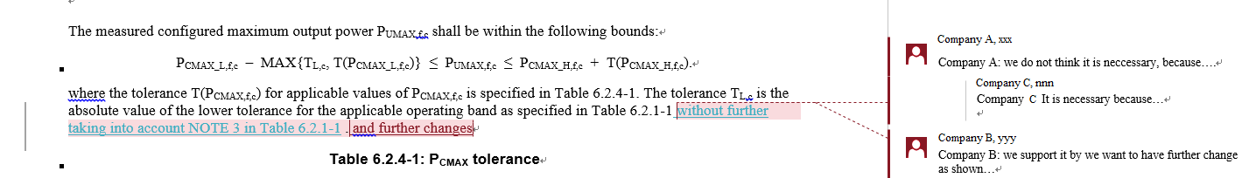
Other guidelines
Notes on email
Each email thread needs to use a clear and consistent thread title for easy tracking (the thread title will be announced)
E.g., if not done appropriately, after a while an email thread may become something like:
RE: xxxx
RE: RE: xxxx
回复:RE: xxxx
[External] RE: xxxx … etc.
which makes it very hard to track. PLEASE fix it to RE: xxxx!
Some instruction how to get“RE:”in word:
https://www.extendoffice.com/documents/outlook/4495-outlook-reply-subject-prefix.html
Please follow above naming nomenclature when providing your comments on Tdoc for revised WFs/CRs/LS, …for other easy tracking.
For CR/draft CR, provide comments for CRs by adding New comments and suggested changes with Markup in revised CRs

Slide 20
Other guidelines (cont.)
Role of moderators
Moderator is a neutral technical competent facilitator of discussion and is expected to provide summaries timely and impartially, and try their best way to drive progress.
Moderator is expected to drive the progress based on the consensus and continue organizing the discussions in the 2nd round if there are concerns received from companies.
Feedback on moderator performance is expected to be given privately to the Chair.
Tdoc of a moderator summary is sourced as “Moderator (company name)”.
(not applicable) NWM
Please refer to the following document for NWM tool at https://www.3gpp.org/ftp/tsg_ran/WG4_Radio/TSGR4_108bis/Invitation/
To facilitate the GTW and future face-to-face meeting arrangement, it is highly encouraged that experts do not cover multiple areas across Main, RRM and BSRF_Demod_Test sessions
Sessions chairs will try to do proper schedule to avoid conflict of sessions for experts, but with more and more delegates covers multiple areas it is challenging for session chairs to do it.

Slide 21
Other guidelines (cont.)
Guidance for Tdoc “type”, ”For”and other information when you request a tdoc
Tdoc to be requested | Type | For | Other information
Discussion paper | Discussion | Discussion
Paper with proposals to be approved | Other | Approval
Way forward | Other | Approval
(Reply) LS on …. | LS out | Approval | Release, Related WIs, Reply to (if available), to, CC
CR on… | CR | Agreement | Release, Spec (latest version), Version, Related WIs, Is revision of (if it is a revision of previous agreed CR), CR category
Big CR on … | CR | Agreement | Release, Spec (latest version), Version, Related WIs, Is revision of (if it is a revision of previous agreed CR), CR category
Draft CR on… | draftCR | Endorsement | Release, Spec (latest version), Version, Related WIs, CR category
Draft big CR on … | draftCR | Endorsement | Release, Spec (latest version), Version, Related WIs, CR category
TP for … | pCR | Approval | Release, Spec (latest version), Version, Related WIs
TR 3x.xxx… | draft TR | Agreement | Release, Spec (latest version), Version, Related WIs
(New) TS 3x.xxx | draft TS | Agreement | Release, Spec (latest version), Version, Related WIs

Slide 22
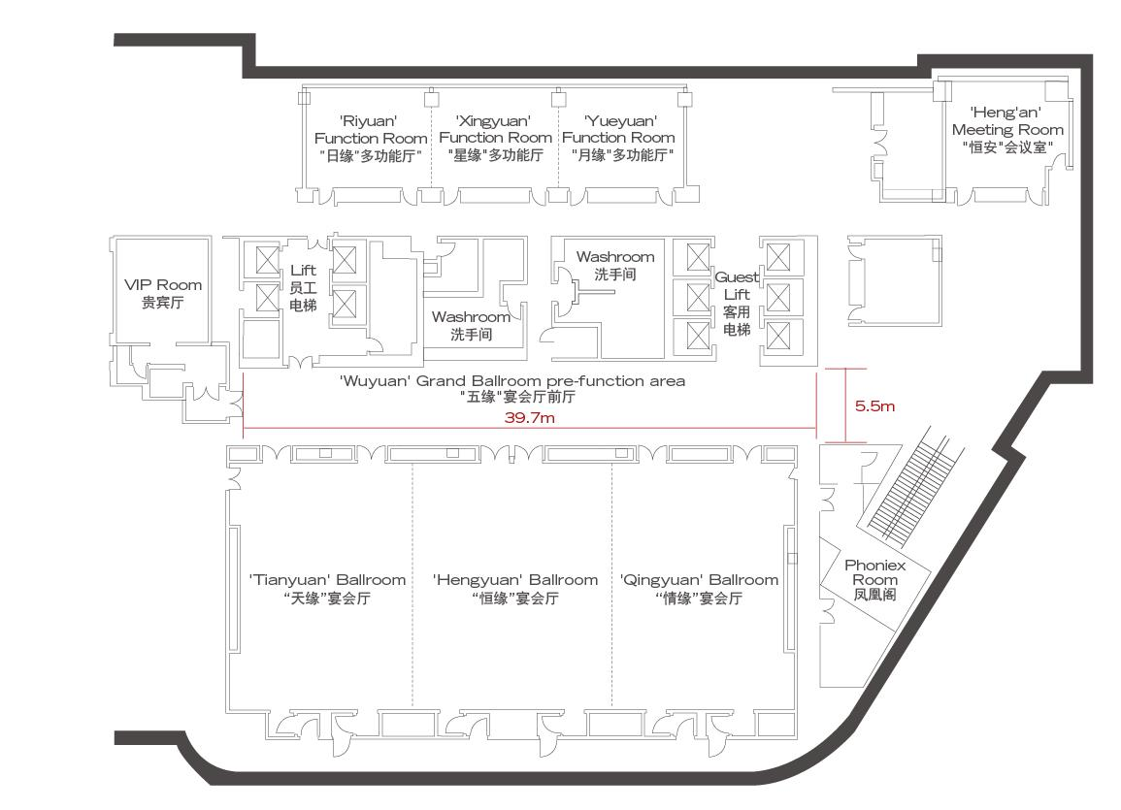
Meeting rooms
RAN4 meeting rooms: @ DoubleTree by Hilton Xiamen-Wuyuan Bay
Main Session:
Tianyuan Ballroom + Hengyuan Ballroom (300)
RRM Session:
Function Room Riyuan+Yueyuan+Xingyuan (100)
BSRF_Demod_test:
Qingyuan Ballroom (100)
RRM session
Ad hoc
RAN4 ad hoc meeting room: @ DoubleTree by Hilton Xiamen-Wuyuan Bay
Ad hoc room:
Hengan Meeting Room (50)
Main session
BS session

Slide 23
Thanks!
Wish a successful RAN4 meeting

