Slide 1
RAN4#104-bis-e Main session GTW schedule
Week 1
Meeting day | Topics | Duration
October 11 / Tuesday 3:00-6:00 UTC | [104-bis-e][125] FS_NR_700800900 | 60 min
 | [104-bis-e][126] FS_SimBC | 45 min
 | [104-bis-e][138] FS_NR_pos_UERF | 60 min
 | [104-bis-e][102] NR_ext_to_71GHz | 15 min
October 12 / Wednesday 3:00-6:00 UTC | [104-bis-e][123] LTE_terr_bcast_bands_UERF | 45 min
 | [104-bis-e][135] NR_HST_FR2_enh_UERF | 45 min
 | [104-bis-e][139] NR_MC_enh_UERF | 60 min
 | [104-bis-e][103] NR_cov_enh_maintenance | 30 min
October 13 / Thursday 3:00-6:00 UTC | [104-bis-e][132] FR2_multiRx_UERF_part1 [104-bis-e][133] FR2_multiRx_UERF_part2 | 90 min
 | [104-bis-e][130] FR2_enh_req_Ph3_part1 [104-bis-e][131] FR2_enh_req_Ph3_part2 | 90 min
October 14 / Friday 3:00-6:00 UTC | [104-bis-e][127] FR1_enh2_part1 [104-bis-e][128] FR1_enh2_part2 [104-bis-e][129] FR1_enh2_part3 | 90 min
 | [104-bis-e][141] NR_cov_enh2_part1 [104-bis-e][142] NR_cov_enh2_part2 | 90 min
Week 2
Meeting day | Topics | Duration
October 17 / Monday 13:00-16:00 UTC | [104-bis-e][136] NR_ATG_UERF_part1 [104-bis-e][137] NR_ATG_UERF_part2 | 45 min
 | [104-bis-e][140] NR_NTN_enh_UERF | 30 min
 | [104-bis-e][143] LTE_NBeMTC_NTN_UERF | 60 min
 | [104-bis-e][134] NonCol_intraB | 45 min
October 18 / Tuesday 13:00-16:00 UTC | [104-bis-e][118] NR_600MHz_APT_part1 [104-bis-e][119] NR_600MHz_APT_part2 | 45 min
 | [104-bis-e][120] NR_unlic_enh | 45 min
 | [104-bis-e][124] FS_NR_eff_BW_util | 45 min
 | [104-bis-e][145] RAN_task_UERF_part1 [104-bis-e][146] RAN_task_UERF_part2 | 45 mim
October 19 / Wednesday 13:00-16:00 UTC | Return to [146], [102], [103], [123], [126], [127], [132], [138], [143], [144] | 180 min
Notes:
[104-e][109] NRSL_enh_maintenance 60min
[104-e][104] NR_6 GHz_licensed 20min

Slide 2
Email discussion procedures/timelines
Pre-meeting
1st round (Oct 10~13)
2nd round (Oct 14~19)
Quiet Period
2nd round (Oct 14~19)
00:00 UTC
Thu
Fri
Sat/Sun
Mon
Tue
Wed
Thu
Fri
Sat/Sun
Mon
Tue
Wed
Companies need feed back if tdoc is submitted in wrong agenda or tdoc is missing from email summary
Quiet period 3:00 Sat-23:00 Sun UTC
kicks off 2nd no later than 3:00 UTC
Quiet period 3:00 Sat-23:00 Sun UTC
Final checking window
(check if final Tdoc is agreeable)
Mon 19:00 ~ Tue16:00 UTC
Comments on initial summary, checking agenda
3:00 UTC
GTW session
3:00-6:00 UTC
GTW session
3:00-6:00 UTC
GTW session
3:00-6:00 UTC
GTW session
3:00-6:00 UTC
Chair update report & Tdoc number
4:00 UTC on Sat
Extended discussions for controversial topics
08:00 UTC
Please do not upload the formal tdocs before the end of checking window
Meeting starts
8:00 UTC
1st round comments & responses
8:00 UTC
Companies need provide drafts & revisions as early as possible
2nd round draft summary
08:00 UTC
2nd round formal summary
8:00 UTC
12:00 UTC
GTW session
13:00-16:00 UTC
GTW session
13:00-16:00 UTC
GTW session
13:00-16:00 UTC
Due to Holiday in China and other regions, the initial summary deadline is October 9th. For moderators located in other regions, appreciate if you could provide it earlier
16:00 UTC
Window closes &final comments
16:00 UTC
Initial summary
October 9th 17:00 UTC
Companies need provide comments as early as possible
2nd round comments & responses
17:00 UTC
2nd round final formal Tdoc submission
17:00 UTC
Meeting closes
17:00 UTC
Strict deadline for new tdoc number request
Update 2nd round draft Tdoc
19:00 UTC
24:00 UTC
1st round formal summary
23:59 UTC
2nd round initial drafts & revisions (deadline for new tdoc# request)
23:59 UTC
Chair announce which topics will continue
23:59 UTC
Timeline for moderator
Deadline for comments and tdoc
GTW session
(main, RRM, BS)
Note 1: Comments and tdocs submitted after the deadlines will not be considered
Note 2: Basket WIs Email discussion procedures/timelines are not included.
Note 3: During quiet periods, no email should be sent out.

Slide 3
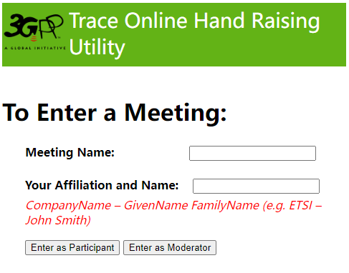
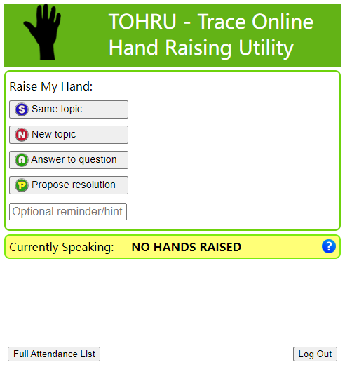
Guidance of TOHRU for GTW
TOHRU (Trace Online Hand Raising Utility) will be used for GTW
3GPP TOHRU will be used in this meeting
Hyperlink: https://tohru.3gpp.org/
Together with the invitation for the GotoWebinar MCC provides you with a "Meeting name" individually after your registeration
Meeting name (TOHRU Meeting IDs):
Main session: RAN4_Main
RRM session: RAN4_RRM
BSRF_Demod_testing session: RAN4_BSRF
Enter your name
<represented company>, <first name> <family name> e.g.: XY Telecom - Peter Mustermann
Need to manually push "Refresh Queue" or use "Automatically refresh queue every 3 seconds", since this is different from the original TOHRU tool.
The other buttons are similar as the previous external TOHRU tool
Please find references at
https://www.3gpp.org/ftp/tsg_ran/WG4_Radio/TSGR4_104-bis-e/Invitation

