Slide 1

Virtual Celebration
Completion of 3GPP Release 17
3GPP RAN3
- May 2022 -

Slide 2
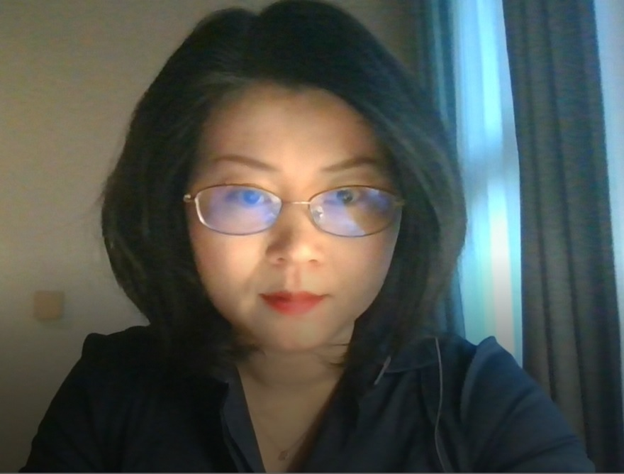
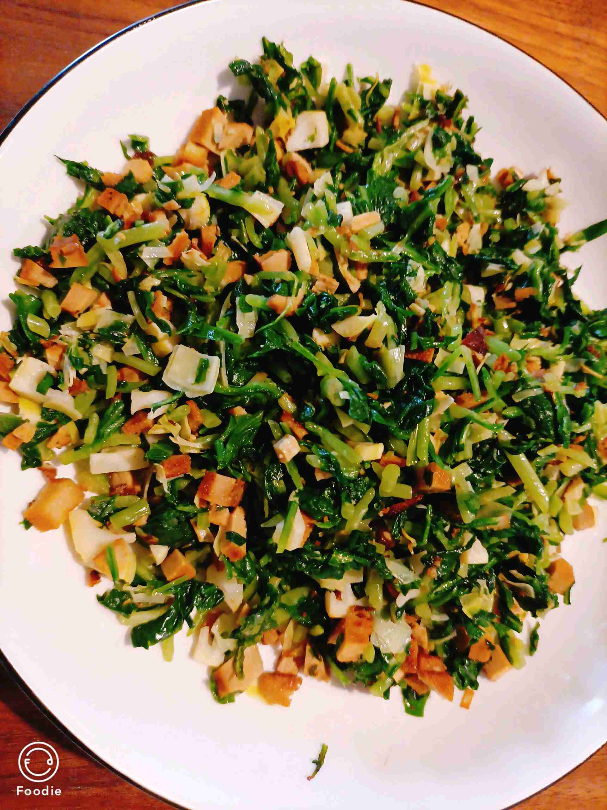
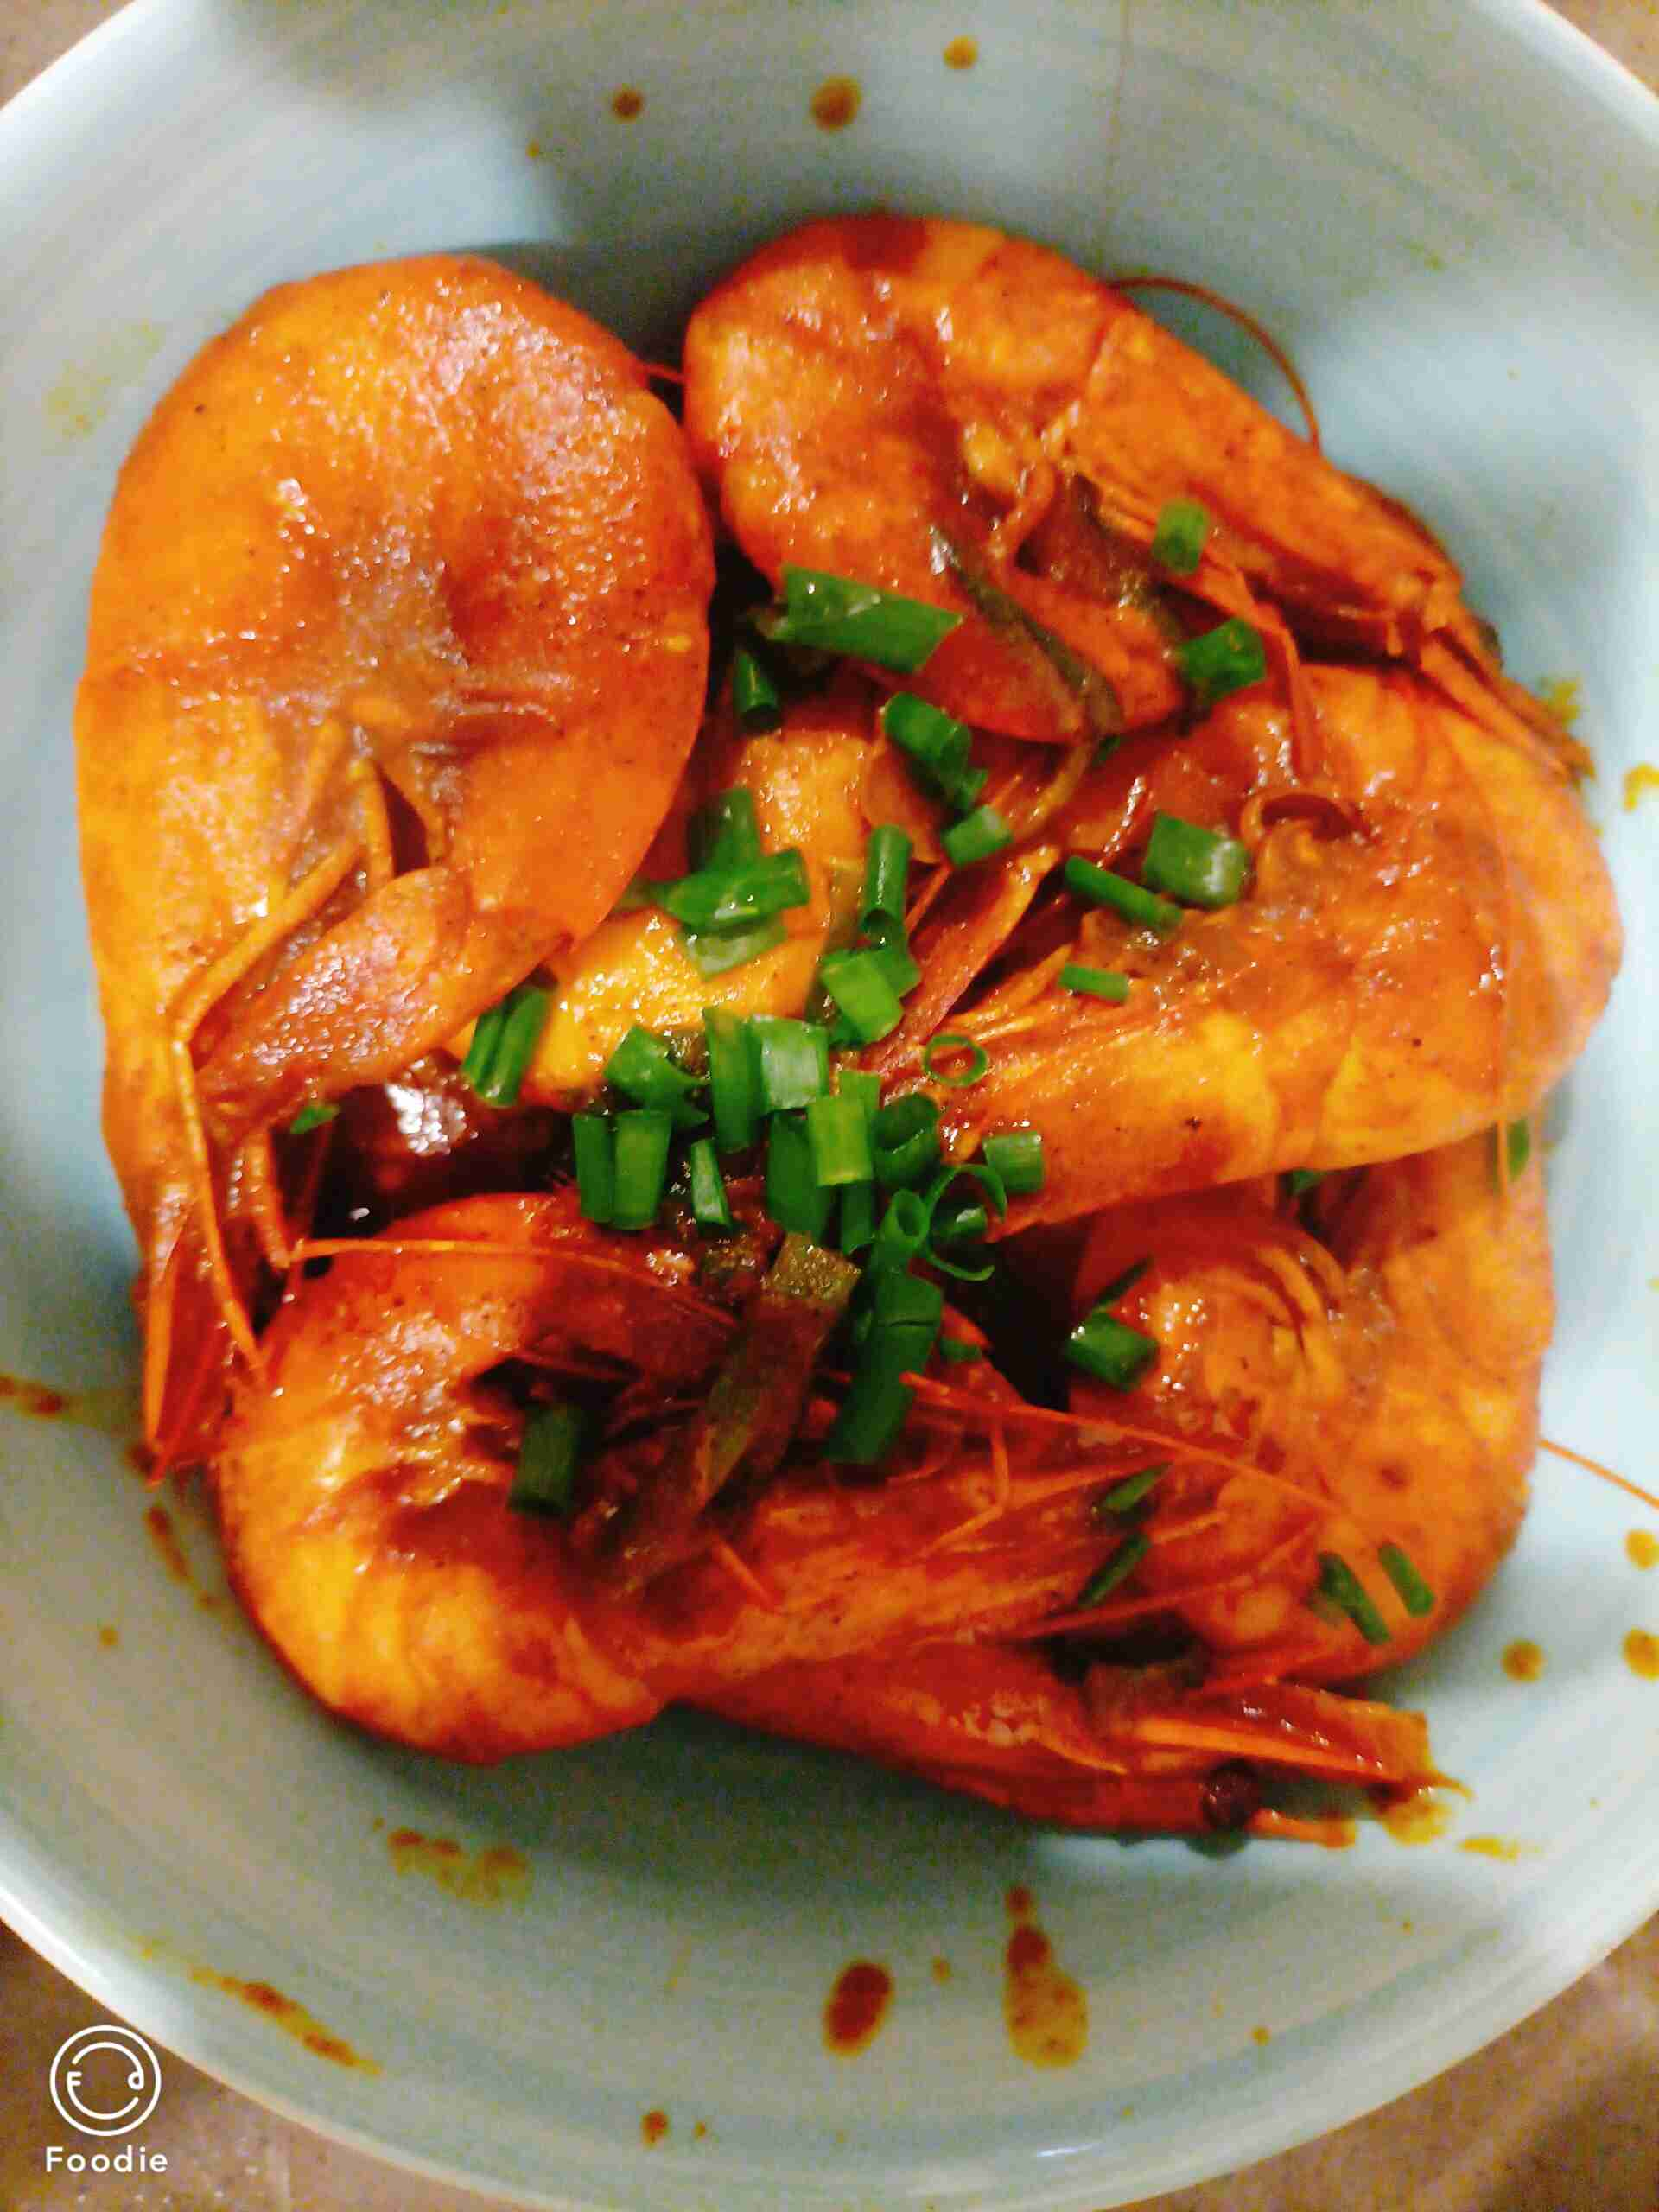
Thank You All for Great Effort to complete R17!
Yin Gao – RAN3 Chair
RAN3 started R17 work under the leadership of Gino since 2020, and the new leadership was elected in May last year. We also faced the challenge of Covid19, an efficient working model for RAN3 e-meetings was established which brought people to home office while still kept all talented and passionate people connected. You all deserve this celebration for the hard work that got you to this moment!
I enjoyed the team work with all of you, with home office, the achievements in last two years is not only our world-class R17 specifications, but also my cooking skills, as shown in the figure left :)
This celebration event is a sentimental time of looking back and looking forward. Cheers!
Home office

Slide 3
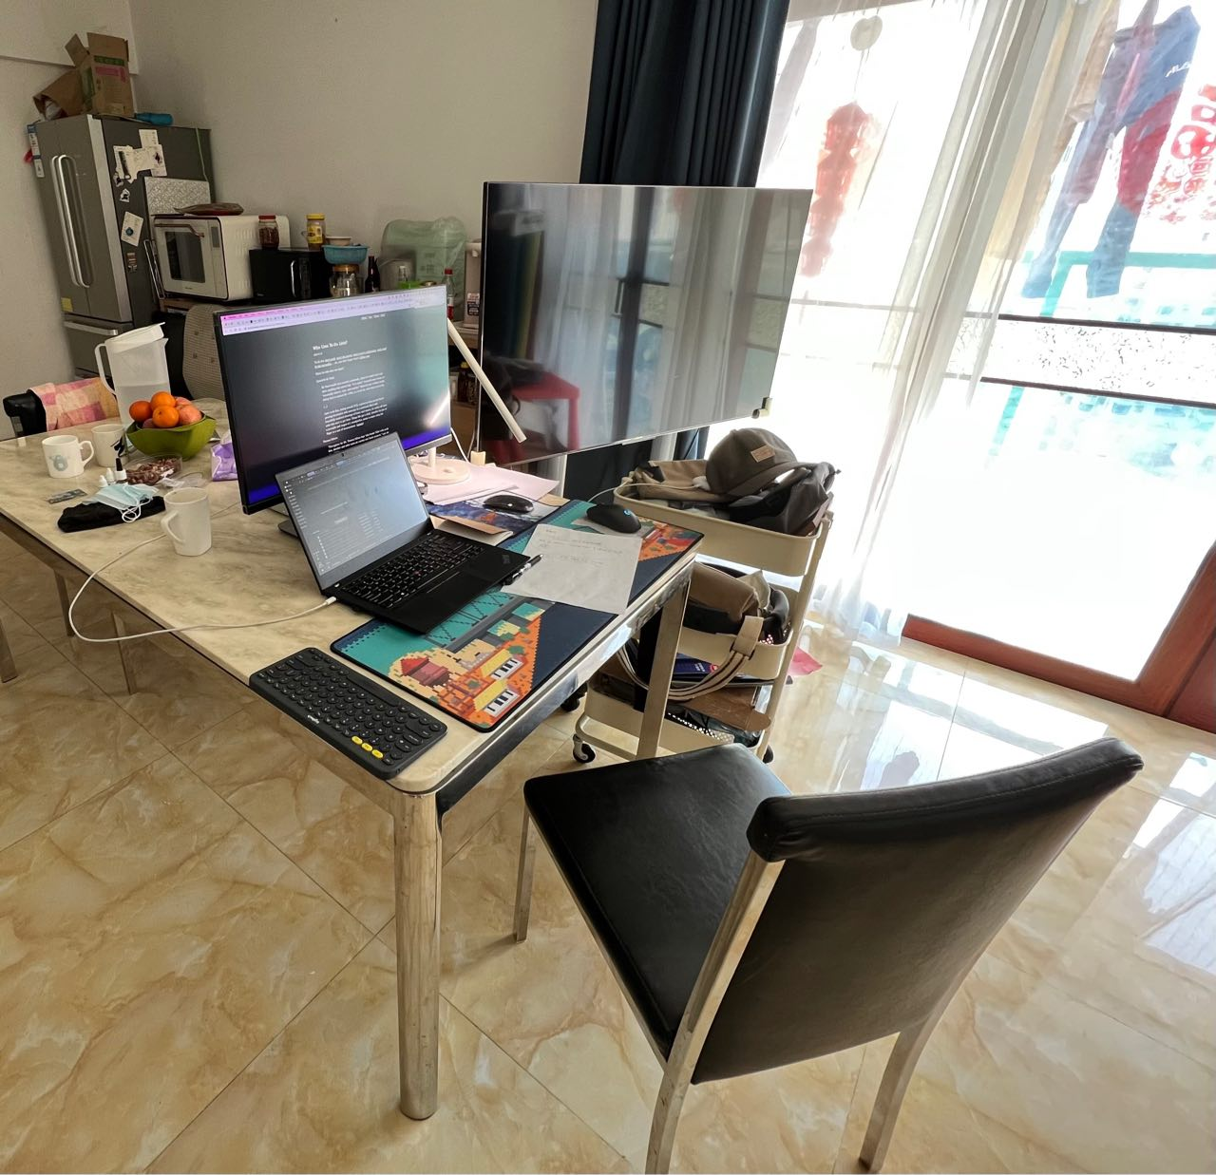
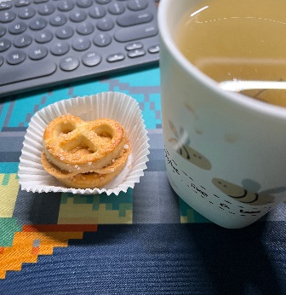
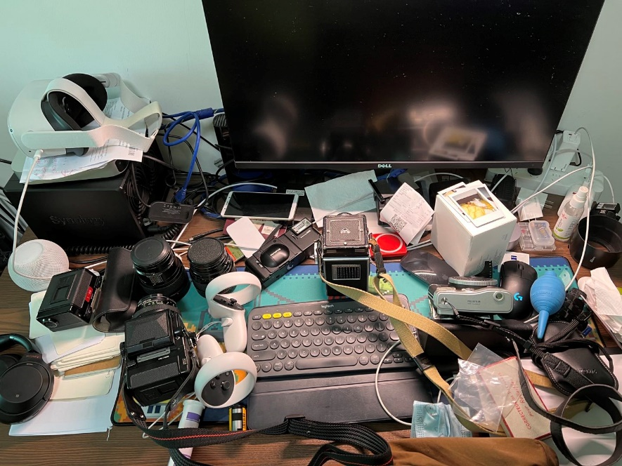
Unexpected journey to be purely online, and feeling grateful
tao – ZTE
1/ this is my first journey as 3GPP RAN3 delegate, did not expect it to be a purely on-line experience. I was felling reluctant to meet and argue with people, so good to start with online without not seeing each other?
2/ I have learnt a lot from you guys in the WI of NR MBS which is not an easy one (e.g., organize a CB, arguing in email, and other working procedures stuff..), great thanks to Yin, Gino, Xipeng, Aijuan, Philip, Yan, and Alex of course.
3/ it was challenging for me (and you too I am sure) to work from home, and sometimes midnight here in China in the bedroom with a totally mess on my desk. I have to move to the living room on the dining table for work.
4/ meanwhile it is also good to WFH, as you can always enjoy your fav cookie and tea anytime you want. And you can spend more time with your family too.
5/ never been so eager to go back to F2F to talk to people I have never met, but at the same time I am sure people will miss the days we spent online.

Slide 4

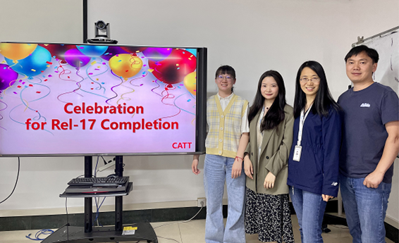
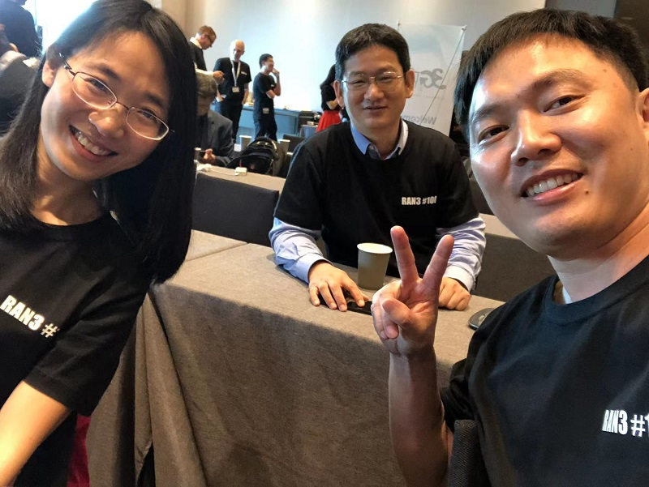
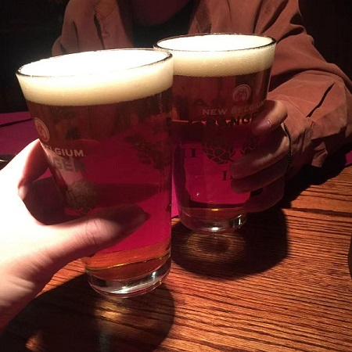
Add picture here
Add picture here
Our new faces: Ziqiao Liu, Jiaying Sun
CATT - Congratulations to RAN3, A Talent Team
We come from different countries, different nations, different companies, but we are a team, a talent team. It’s not easy for us to complete the Rel-17 work in time all by the online meetings, it’s a great success. Cheers 3GPP~ Cheers, RAN3~
Some of us often dreamed about our business trips all around the world, sight seeing, shopping, smiling and arguing, they’re really nice memories.
Expect to see you ASAP, our old friends and new friends.

Slide 5
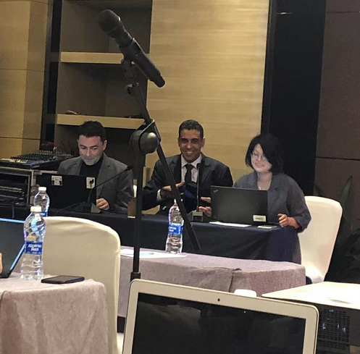
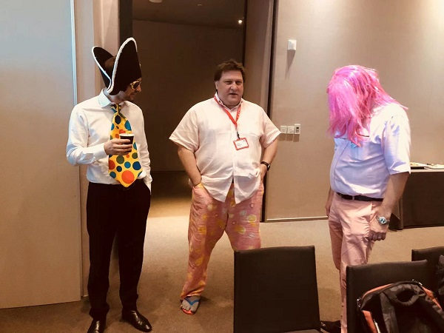
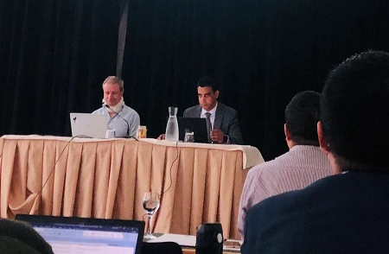
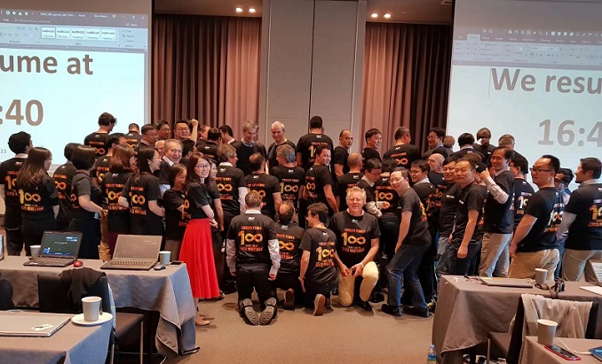
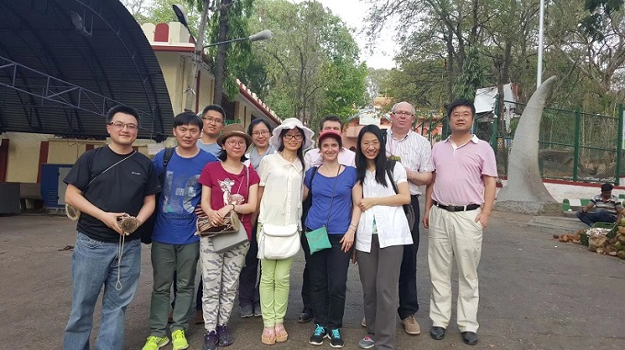

Slide 6
Another template provided
Name – Company
Please share your words about Release 17 in this textbox, including but not limited to your feelings, your experience and your wishes to 3GPP. You can replace the picture in the left side with a photo of your own, for example, when your are working from home.
Add picture here
Title
Name – Company
The ‘Title’ and ‘Name – Company’ are not needed if it is the same person using the whole slide to share words and pics (of course it is completely welcome).
You can replace the picture in the right side with a photo of your own which you would like to share.
Add picture here

Slide 7
Another template provided
Name – Company
Please share your words about Release 17 in this textbox, including but not limited to your feelings, your experience and your wishes to 3GPP. You can replace the picture in the right side with a photo of your own, for example, when your are working from home. More than one photo are also welcome. You can arrange the photos in the way you like.
Add picture here

Slide 8
The last template provided
Add picture here
Add picture here
Name – Company
Please share your words about Release 17 in this textbox, including but not limited to your feelings, your experience and your wishes to 3GPP. You can replace the picture in the upside with photo(s) of your own, for example, when your are working from home.

Slide 9

The great ending and a fresh new start!

