Slide 1

CF3 has the pleasure of welcoming you to
3GPP RAN2#123-bis
09-13,October,2023,Xiamen,China

Slide 2
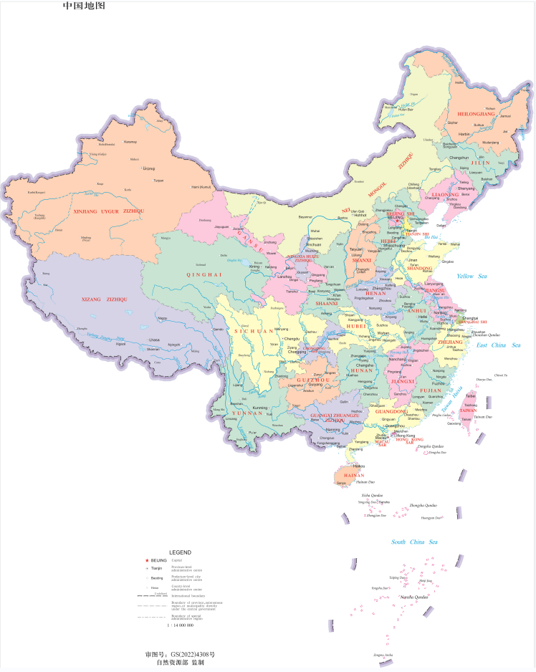
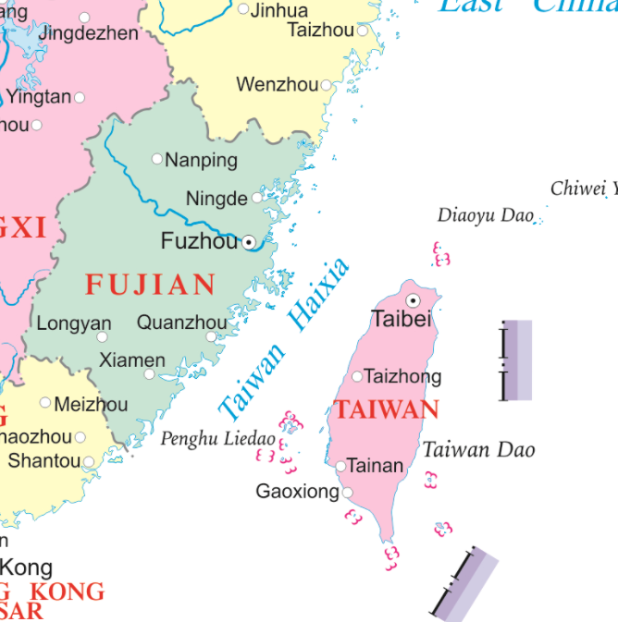

Xiamen’s Location in China Map

Slide 3
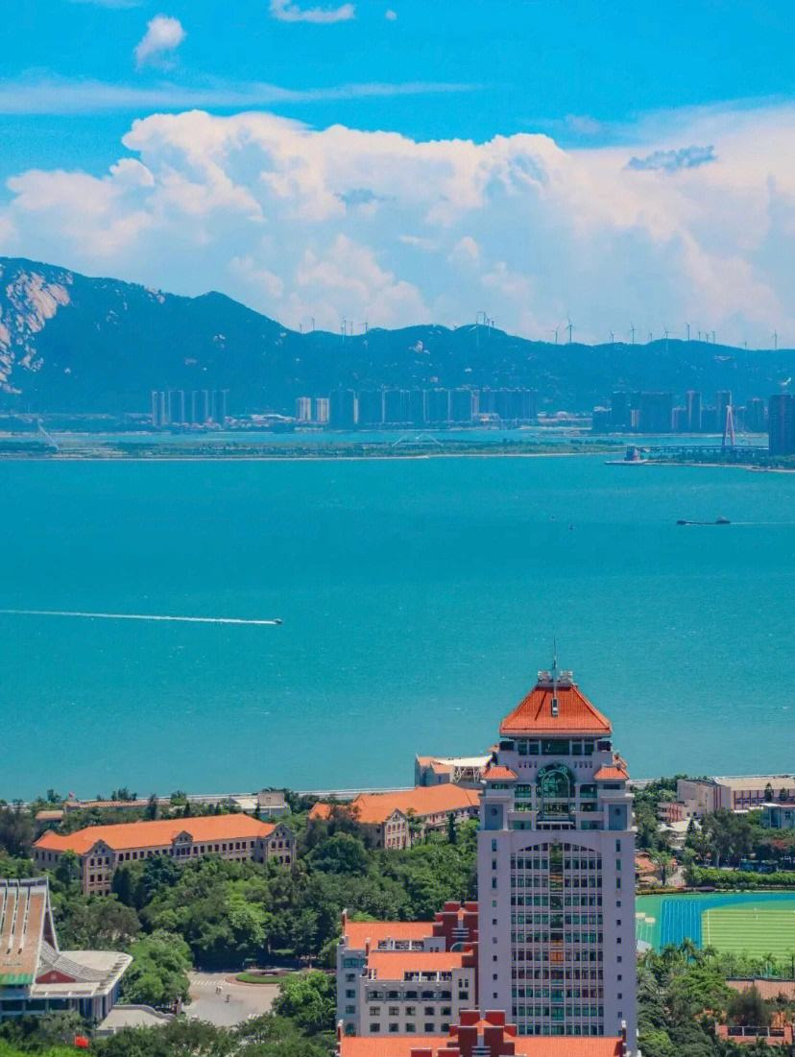
“Heron Island”
In ancient times, Xiamen Island was the habitat of egrets, so it was also called 'Heron Island '.
Established in 1394 a.d.
has won the UN Habitat Award.
Important central cities, ports and scenic tourist cities along the southeast coast of China.

Slide 4
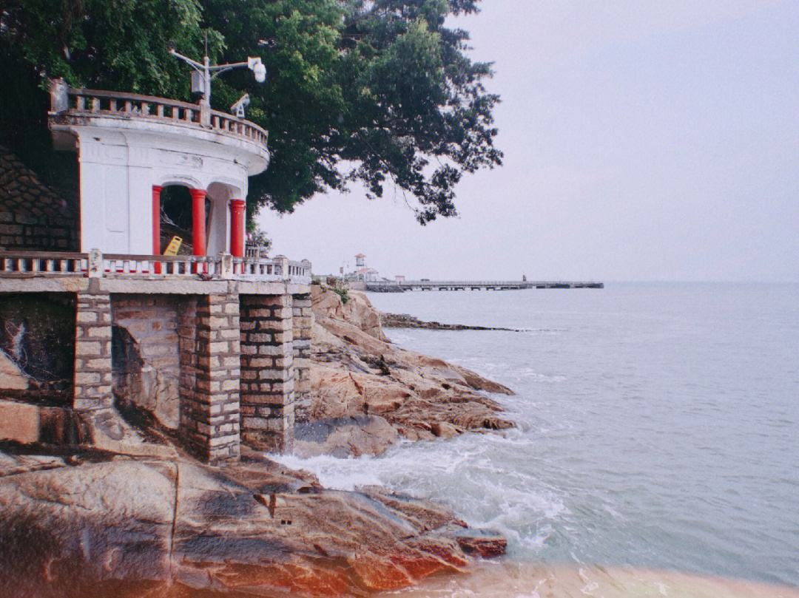
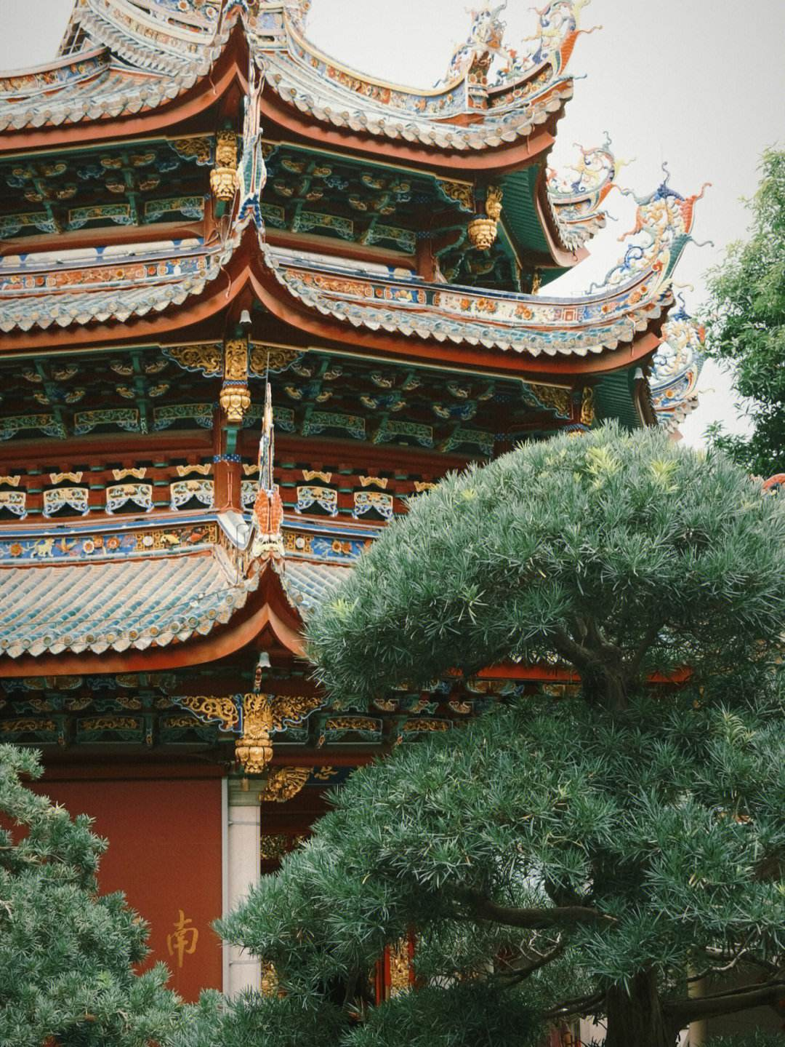
Xiamen’s Attractions
Gulang island
was selected as ' the head of the five most beautiful urban areas in China ' by the National Geographic Magazine, known as the ' sea garden '. Many buildings with Chinese and foreign architectural styles are well preserved on the island, which is known as the ' World Architecture Expo '. The residents of the island love music, and the piano has a high density and is praised as the island of Qin.
Southern Putuo temple
has a history of more than 1300 years. It is one of the Buddhist resorts in southern Fujian with beautiful scenery and magnificent momentum.

Slide 5
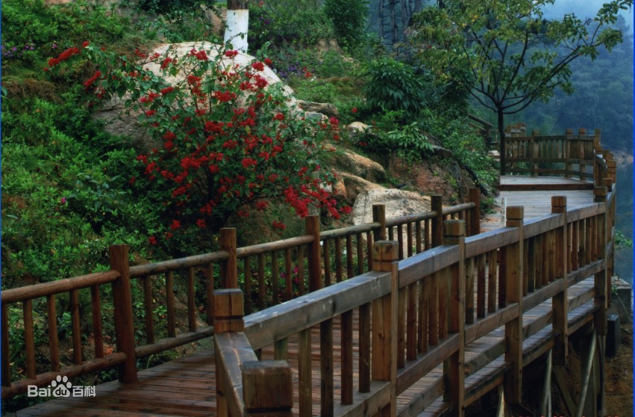
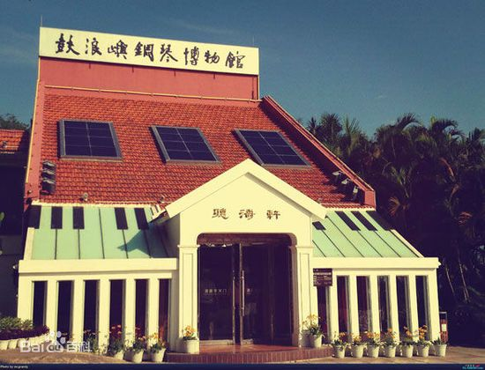
Xiamen’s Attractions
Tianzhu Mountain Forest Park
There are more than 200 kinds of forest plants and more than 40 kinds of wild animals in the garden. Precious wild animals include leopards, forest musk deer, fruit foxes, foxes, leopard cats, brocade chickens, sheep, cuckoos and so on.
Piano Museum
The museum displays more than 40 ancient pianos collected by Hu Youyi, a patriotic overseas Chinese, including rare and precious gold-plated pianos, the world 's earliest four-corner pianos and the earliest and largest vertical pianos. There are ancient hand-shaking pianos, pedal automatic pianos from a hundred years ago, and eight-footed ancient pianos.

Slide 6
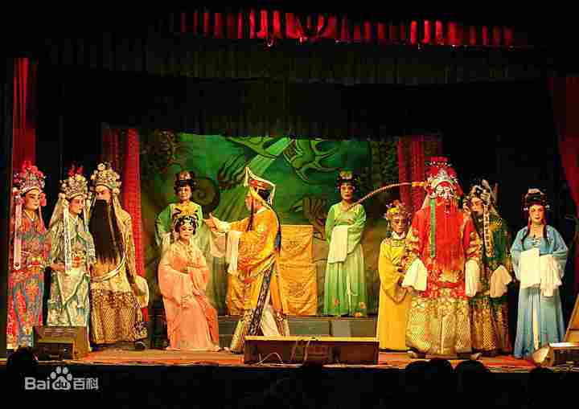
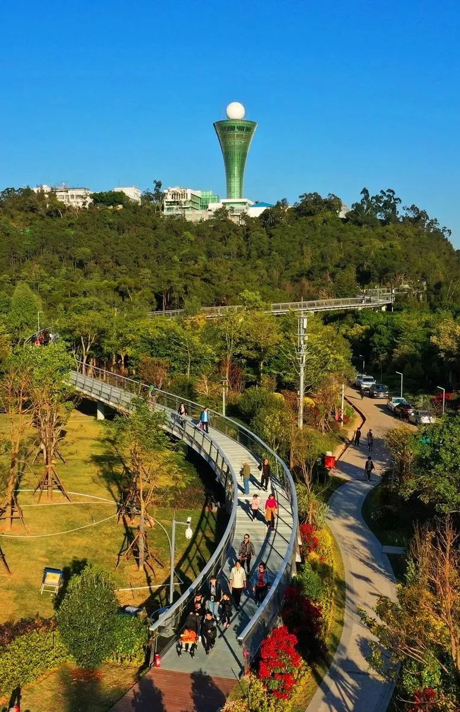
Entertainment
Gaojia Opera（高甲戏）
originated in Quanzhou, Fujian Province, also known as ' Gejia Opera ', ' Jiujiao Opera ', ' Daban ' and ' Tuban '.It is a local opera with the widest spread area and the largest audience among various operas in southern Fujian.It originated from a costume parade popular in rural areas of southern Fujian in the late Ming and early Qing Dynasties to dress up Liangshan heroes and perform martial arts techniques.
The Xiamen Mountains-to-Sea Trail（厦门山海健康步道）
The 23-kilometer pedestrian walkway runs between the cruise port at Dongdu and the beach near Guanyin Mountain, linking eight local hilltops (Huwei, Xianyue, Yuan, Xueling, Hutou, Jin, Huzai and Guanyin), as well as three waterways (Yundang Lake, Wuyuan Bay and Hubian Reservoir).

Slide 7
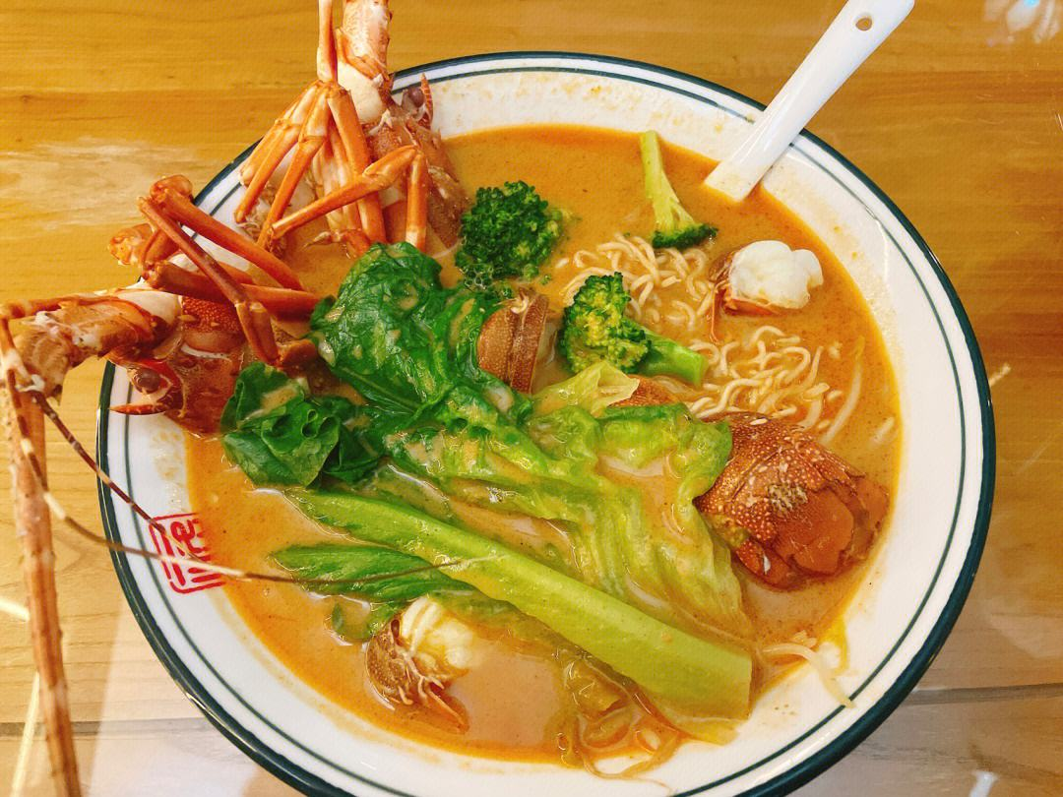

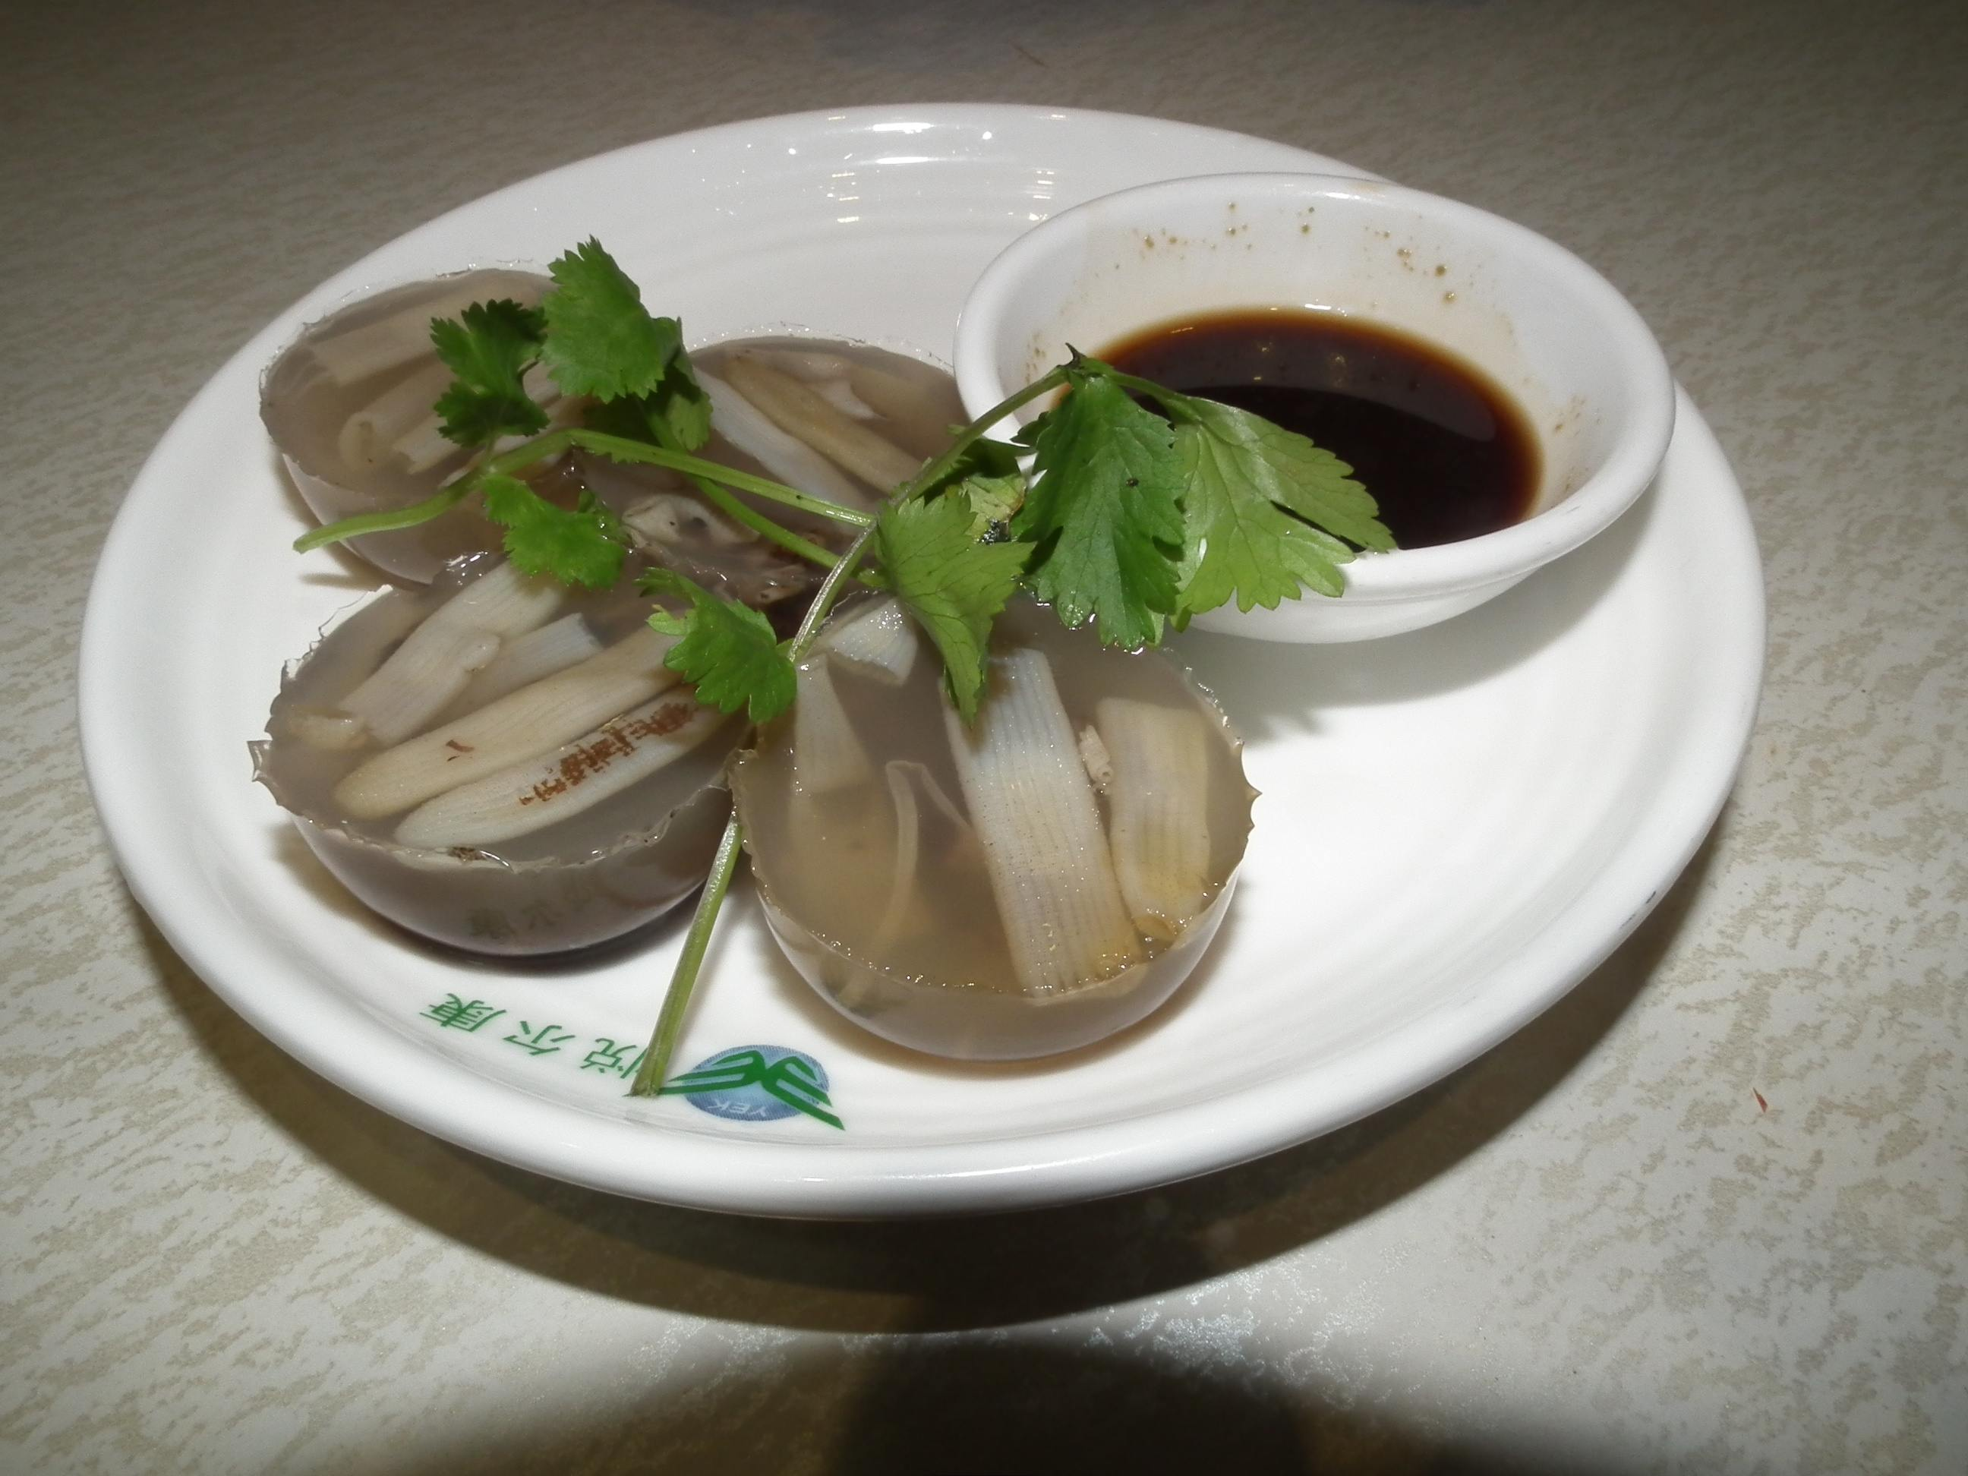

Local Food
Sand tea noodles（沙茶面）
Oyster frying（海蛎煎）
bamboo shoot jelly（土笋冻）
Burned meat dumplings（烧肉粽）

Slide 8
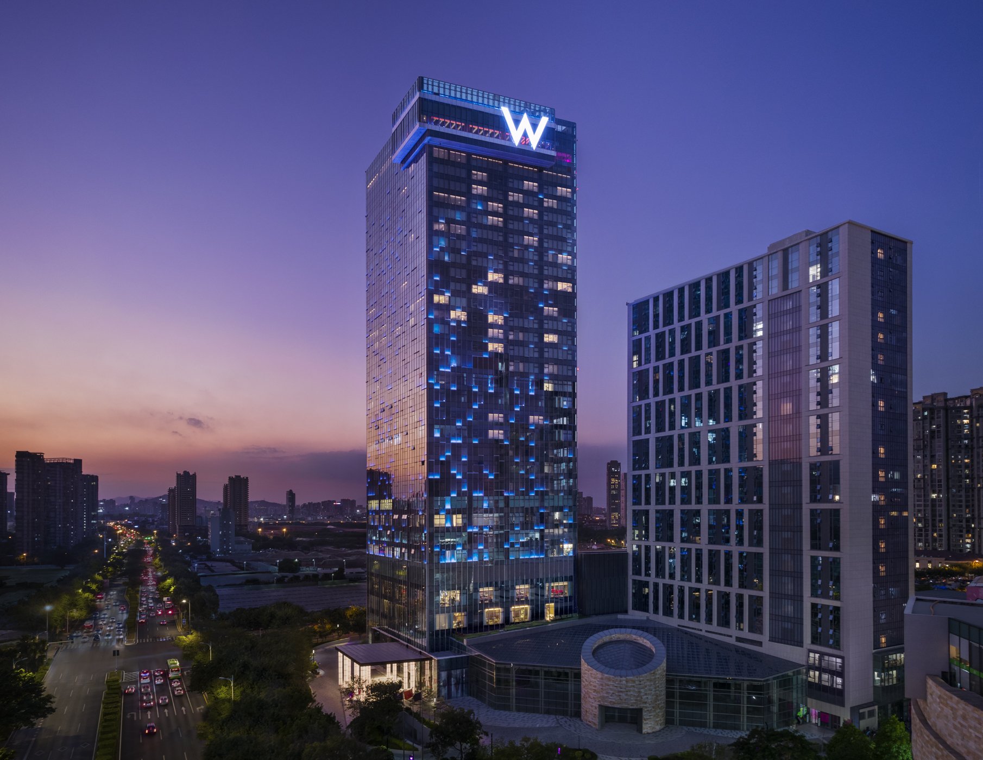
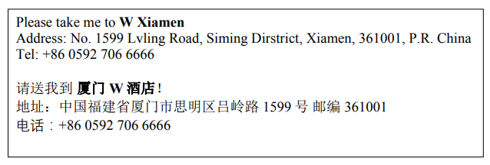
Hotel
W Xiamen
it is about 9 km and 25 mins by car from Xiamen Gaoqi International Airport..
The fare for taxi from the Airport to the hotel is around CNY 30 per way. (Please take the taxi which can provide the invoice for your trip)
In case of taking a taxi, please print the following note which shows taxi driver the address of W Xiamen in both English and Chinese.

Slide 9
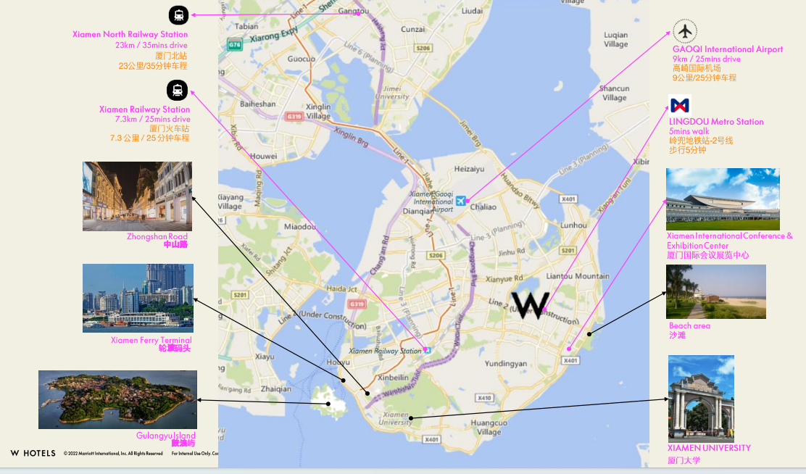
Hotel Location

Slide 10
Meeting Room Information (Monday 16th to Friday 20th October)
RAN 2 Meeting room | Time | Location/Capacity
Main room | Monday 9:00 – Friday 17:00 | Great room 1 / 190 seats*
Brk 1 | Monday 11:00** – Friday 13:00 | Great room 2 / 190 seats
Brk 2 | Monday 9:00 – Friday 13:00 | Studio 3 / 90 seats
Brk 3 | Monday 9:00 – Friday 13:00 | Studio 1 and 2 combined / 45 seats
*the capacity of RAN2 Main room is ~380 seats before 10:30 Monday and after Friday lunch time (i.e., combing Great room 1 and 2)
** Brk 1 room will be available after Monday morning coffee break due to need for rearrangement
 | Time | Location
Coffee break | Morning 10:30 – 11:00 (Monday to Friday) Afternoon 16:30-17:00 (Monday to Thursday) | Foyer (Outside Great room 1,2)

Slide 11
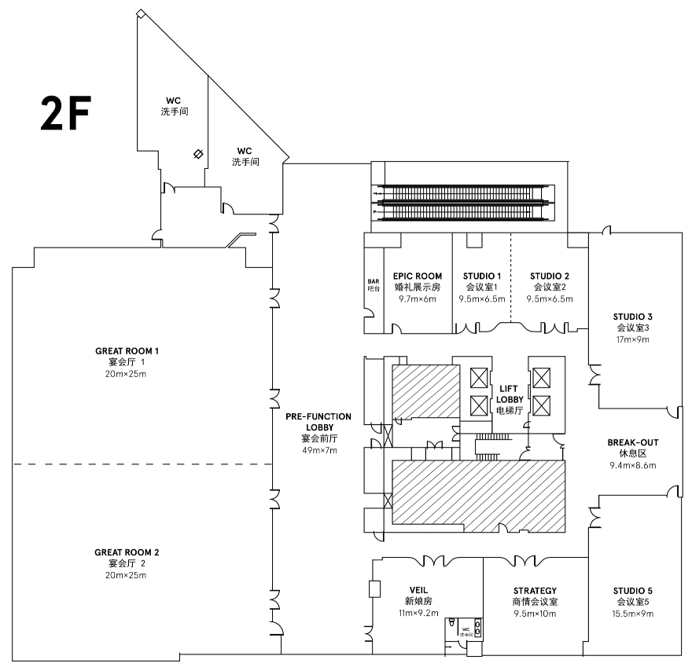
Floor Plan-2F
All RAN2 meeting rooms are on 2F of the W hotel

Slide 12
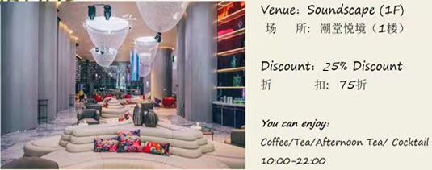
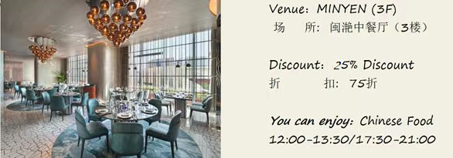
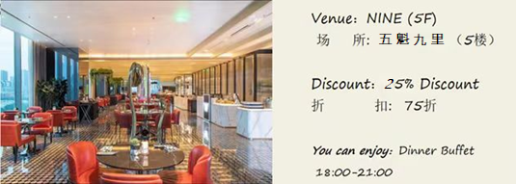

Restaurants in hotel
B&f DISCOUNT
FOR 3GPP Group

Slide 13

Time: 19:00-21:00,10, Oct. 2023 Venue： HEAT BAR, 35F （in the W hotel）
Welcome Social Event

Slide 14

Restaurants near hotel

Slide 15


How to Use Alipay and WeChat Pay
Alipay and WeChat Pay are two important payment methods in China. Learning how to use them will make your travel to China much easier. Click on the PDF link below to learn more.

Slide 16
Meeting Staff
If you need any assistance during your stay, you may go to staff at the Information desk outside the meeting room.For any emergency please contact us at:
Mr. Jiang FU (+86-13488771245)

Slide 17
Have a successful meeting and enjoy your stay in Xiamen!

