Slide 1
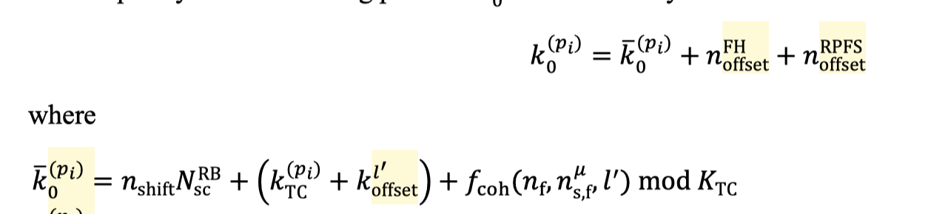
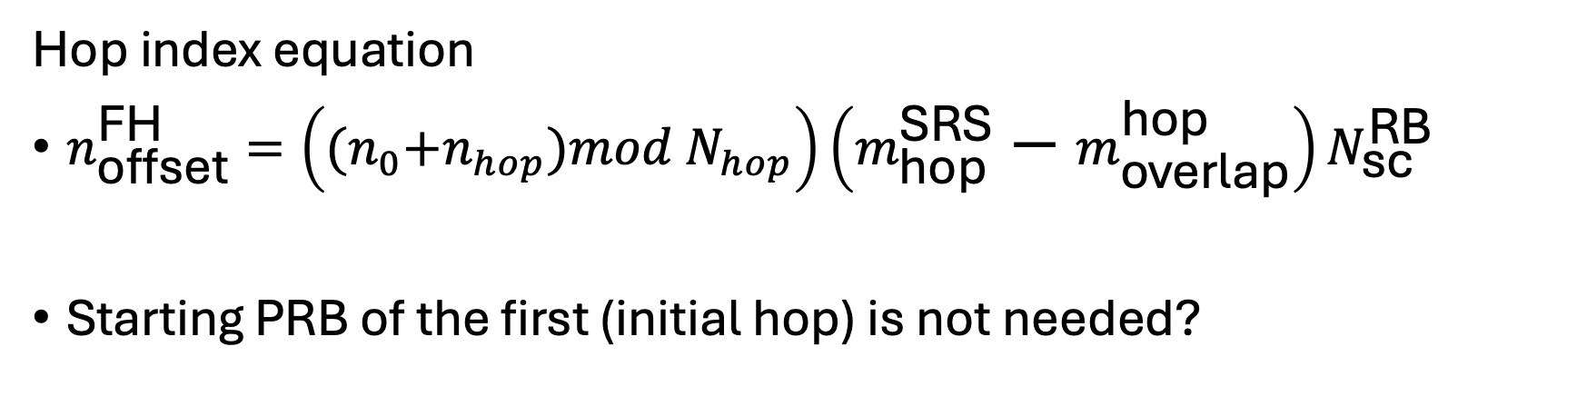
Solution 1a (hop index based)
Start position of bandwidth
Hop index equation
$n_{\text{offset}}^{\text{FH}}=\left({(n}_{0}+n_{hop})mod N_{hop}\right)\left(m_{\text{hop}}^{\text{SRS}}−m_{\text{overlap}}^{\text{hop}}\right)N_{\text{sc}}^{\text{RB}}$
Starting PRB of the first (initial hop) is not needed?

Slide 2
Solution 1a (hop index based)
SlotOffset
startSymbol
Other hops
4
3
BandwidthSize
2
startingPRBfirstHop
1
0
Start frequency of the hopping (nshift)
SlotOffset
startSymbol
First (initial) hop

Slide 3
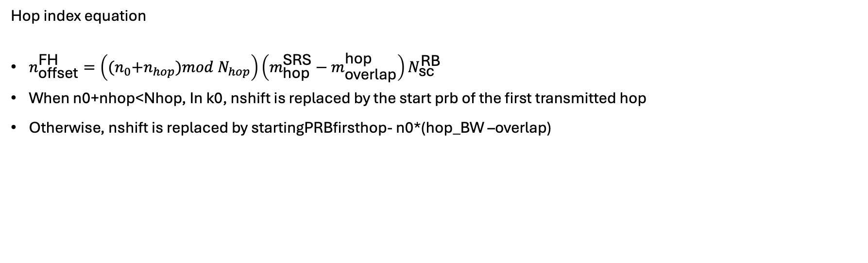
Solution 1b (hop index based)
Start position of bandwidth
Hop index equation
$n_{\text{offset}}^{\text{FH}}=\left({(n}_{0}+n_{hop})mod N_{hop}\right)\left(m_{\text{hop}}^{\text{SRS}}−m_{\text{overlap}}^{\text{hop}}\right)N_{\text{sc}}^{\text{RB}}$
When n0+nhop<Nhop, In k0, nshift is replaced by the start prb of the first transmitted hop
Otherwise, nshift is replaced by startingPRBfirsthop- n0*(hop_BW –overlap)

Slide 4





Solution 1b (hop index based)
SlotOffset
startSymbol
Other hops
4
3
$n_{hop}=2$
$n_{0}=2$
BandwidthSize
2
$n_{hop}=1$
startingPRBfirstHop
$n_{hop}=0$
1
0
$n_{hop}=4$
nshift can be computed
As startingPRBfirsthop- n0*(hop_BW –overlap)
$n_{hop}=3$
SlotOffset
startSymbol
First (initial) hop
Bandwidth start

Slide 5
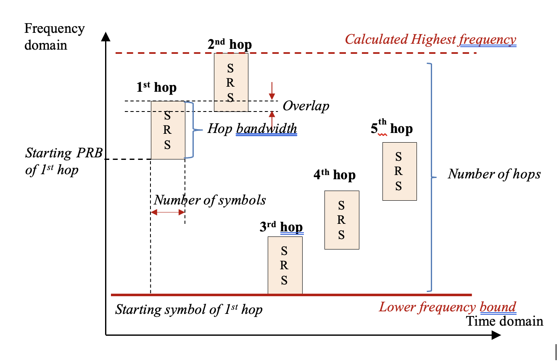
Solution 2: wraparound at the bandwidth edge
BandwidthSize
BandwidthPosition

Slide 6


Solution 1c (hop index based)
SlotOffset
startSymbol
Other hops
4
3
$n_{hop}=2$
$n_{0}=2$
BandwidthSize
2
$n_{hop}=1$
startingPRBfirstHop
$n_{hop}=0$
1
0
$n_{hop}=4$
Nshift in frequenydomainposition
$n_{hop}=3$
SlotOffset
startSymbol
First (initial) hop
Bandwidth start

Slide 7
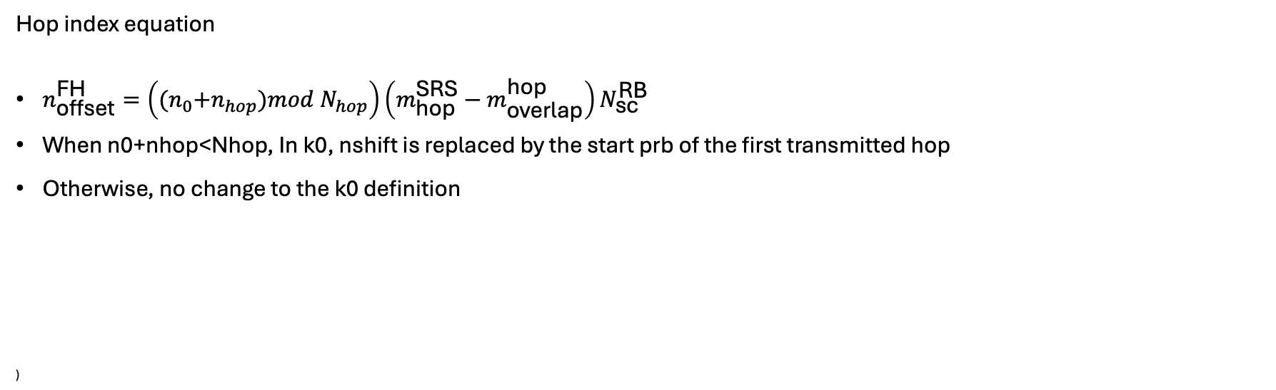
Solution 2 (configurable wraparound)
Start position of bandwidth
Hop index equation
$n_{\text{offset}}^{\text{FH}}=\left({(n}_{0}+n_{hop})mod N_{hop}\right)\left(m_{\text{hop}}^{\text{SRS}}−m_{\text{overlap}}^{\text{hop}}\right)N_{\text{sc}}^{\text{RB}}$
When n0+nhop<Nhop, In k0, nshift is replaced by the start prb of the first transmitted hop
Otherwise, no change to the k0 definition
)

