Slide 1

CF3 has the pleasure of welcoming you to
3GPP RAN1#114-bis
09-13,October,2023,Xiamen,China

Slide 2
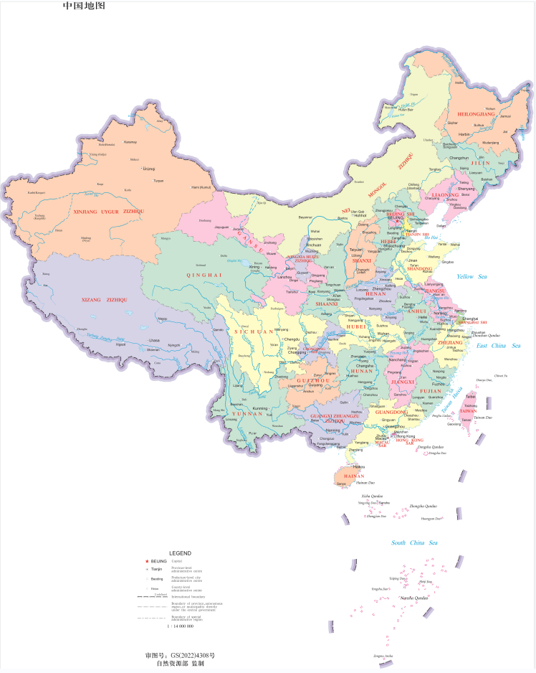
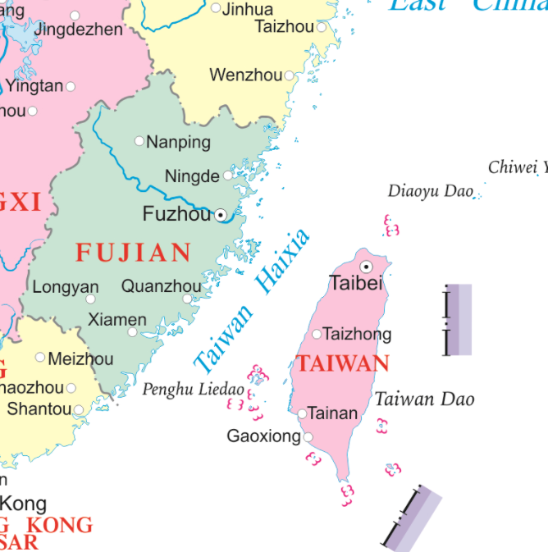

Xiamen’s Location in China Map

Slide 3
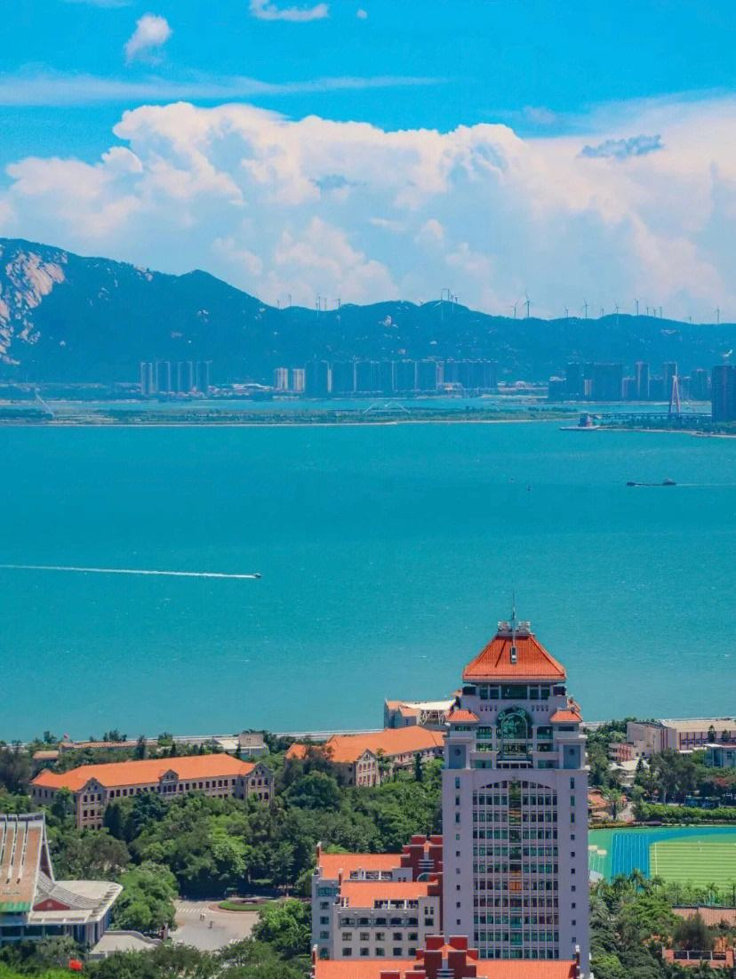
“Heron Island”
In ancient times, Xiamen Island was the habitat of egrets, so it was also called 'Heron Island '.
Established in 1394 a.d.
has won the UN Habitat Award.
Important central cities, ports and scenic tourist cities along the southeast coast of China.

Slide 4
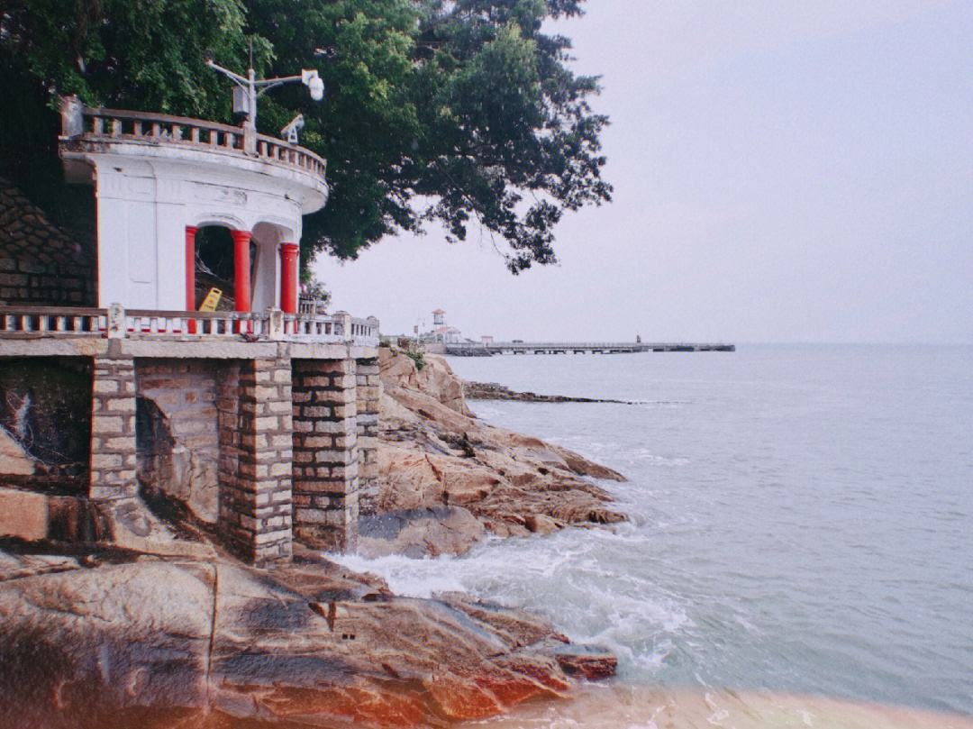
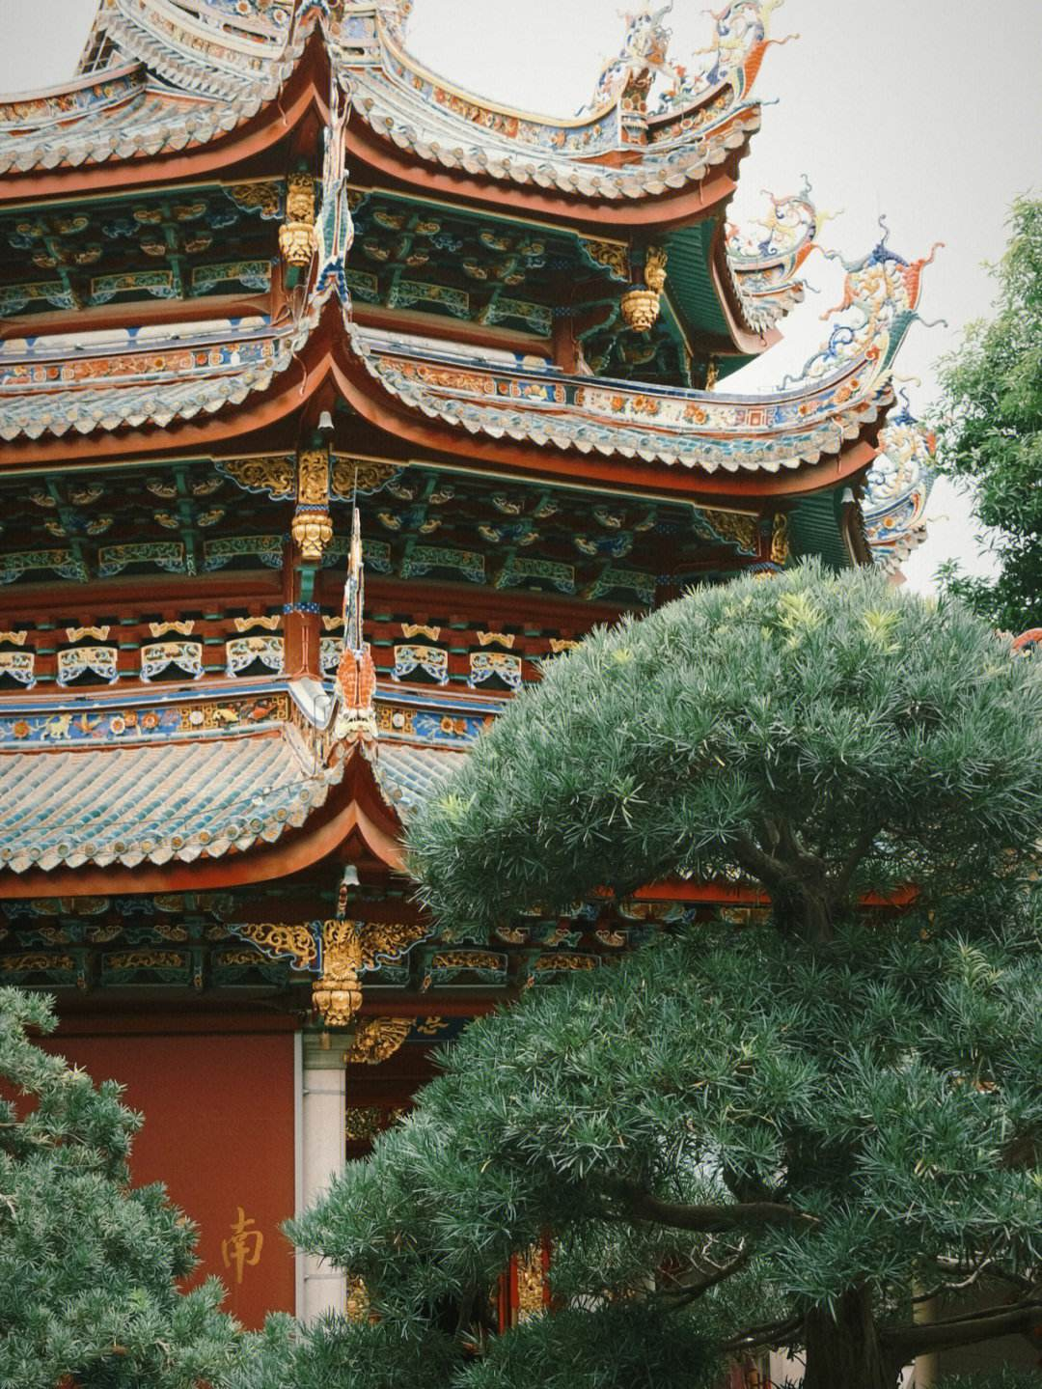
Xiamen’s Attractions
Gulang island
was selected as ' the head of the five most beautiful urban areas in China ' by the National Geographic Magazine, known as the ' sea garden '. Many buildings with Chinese and foreign architectural styles are well preserved on the island, which is known as the ' World Architecture Expo '. The residents of the island love music, and the piano has a high density and is praised as the island of Qin.
Southern Putuo temple
has a history of more than 1300 years. It is one of the Buddhist resorts in southern Fujian with beautiful scenery and magnificent momentum.

Slide 5
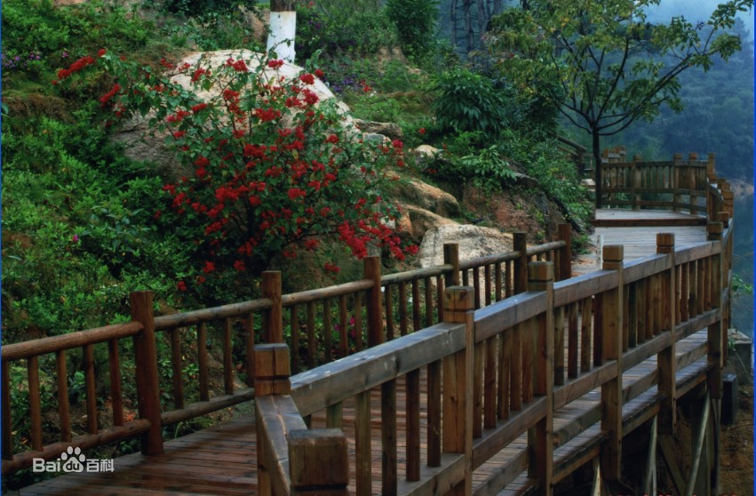
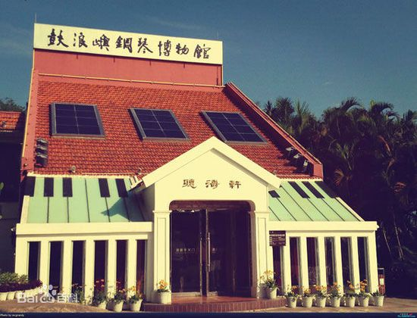
Xiamen’s Attractions
Tianzhu Mountain Forest Park
There are more than 200 kinds of forest plants and more than 40 kinds of wild animals in the garden. Precious wild animals include leopards, forest musk deer, fruit foxes, foxes, leopard cats, brocade chickens, sheep, cuckoos and so on.
Piano Museum
The museum displays more than 40 ancient pianos collected by Hu Youyi, a patriotic overseas Chinese, including rare and precious gold-plated pianos, the world 's earliest four-corner pianos and the earliest and largest vertical pianos. There are ancient hand-shaking pianos, pedal automatic pianos from a hundred years ago, and eight-footed ancient pianos.

Slide 6
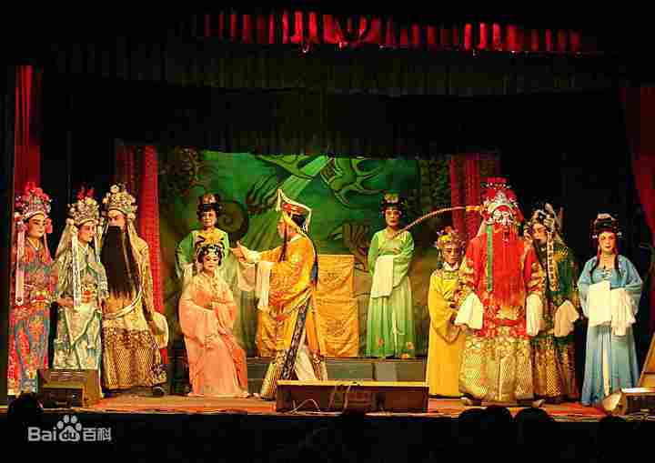
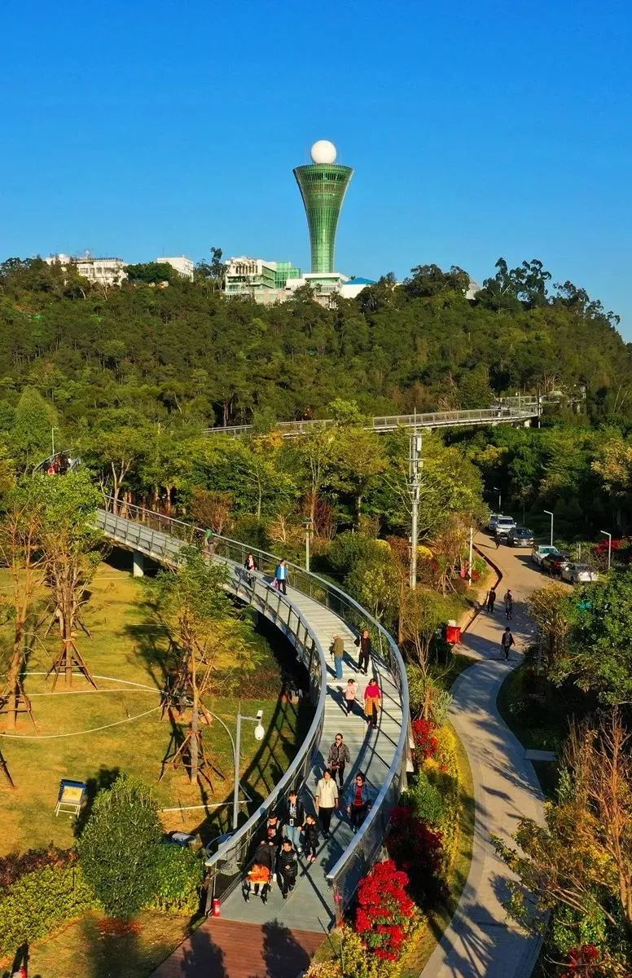
Entertainment
Gaojia Opera（高甲戏）
originated in Quanzhou, Fujian Province, also known as ' Gejia Opera ', ' Jiujiao Opera ', ' Daban ' and ' Tuban '.It is a local opera with the widest spread area and the largest audience among various operas in southern Fujian.It originated from a costume parade popular in rural areas of southern Fujian in the late Ming and early Qing Dynasties to dress up Liangshan heroes and perform martial arts techniques.
The Xiamen Mountains-to-Sea Trail（厦门山海健康步道）
The 23-kilometer pedestrian walkway runs between the cruise port at Dongdu and the beach near Guanyin Mountain, linking eight local hilltops (Huwei, Xianyue, Yuan, Xueling, Hutou, Jin, Huzai and Guanyin), as well as three waterways (Yundang Lake, Wuyuan Bay and Hubian Reservoir).

Slide 7
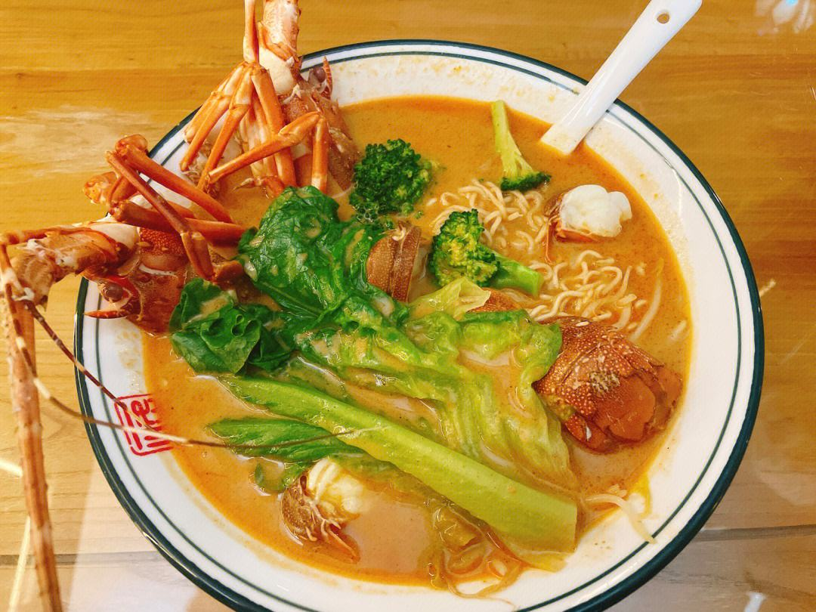
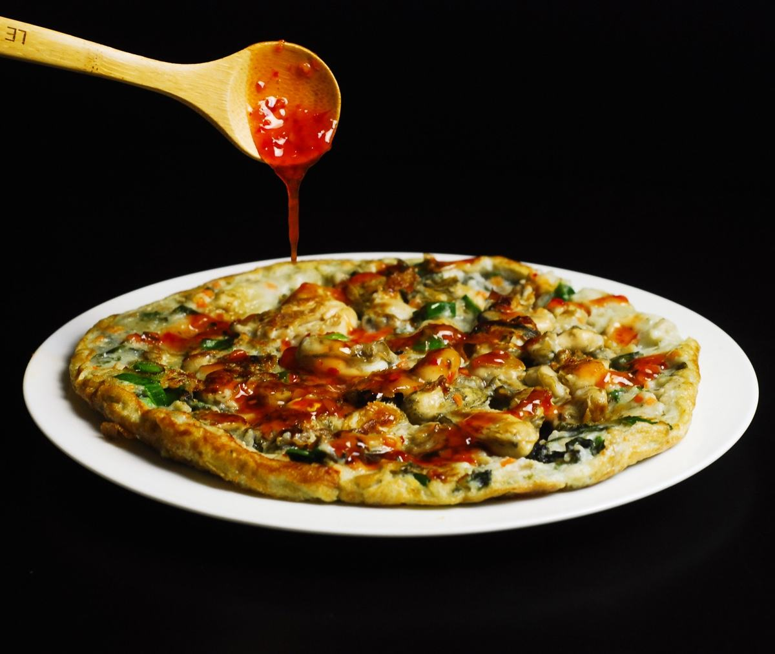
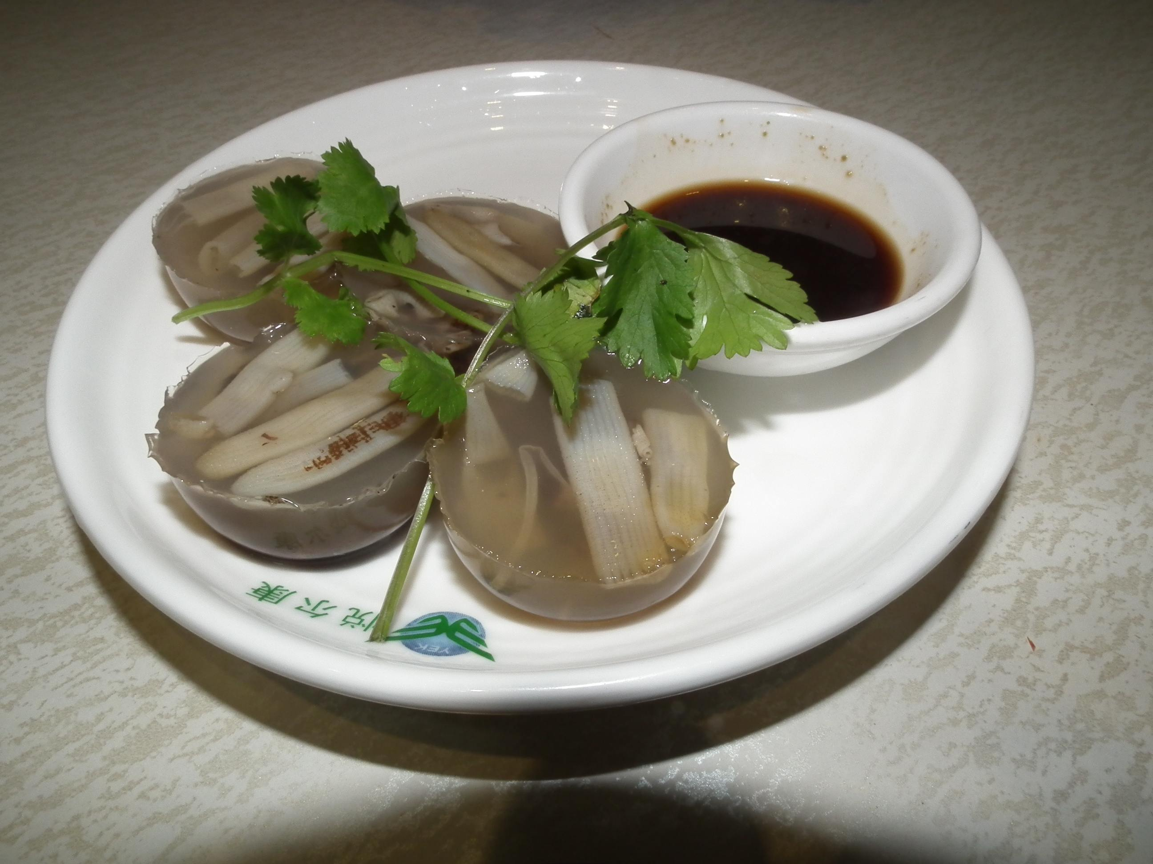
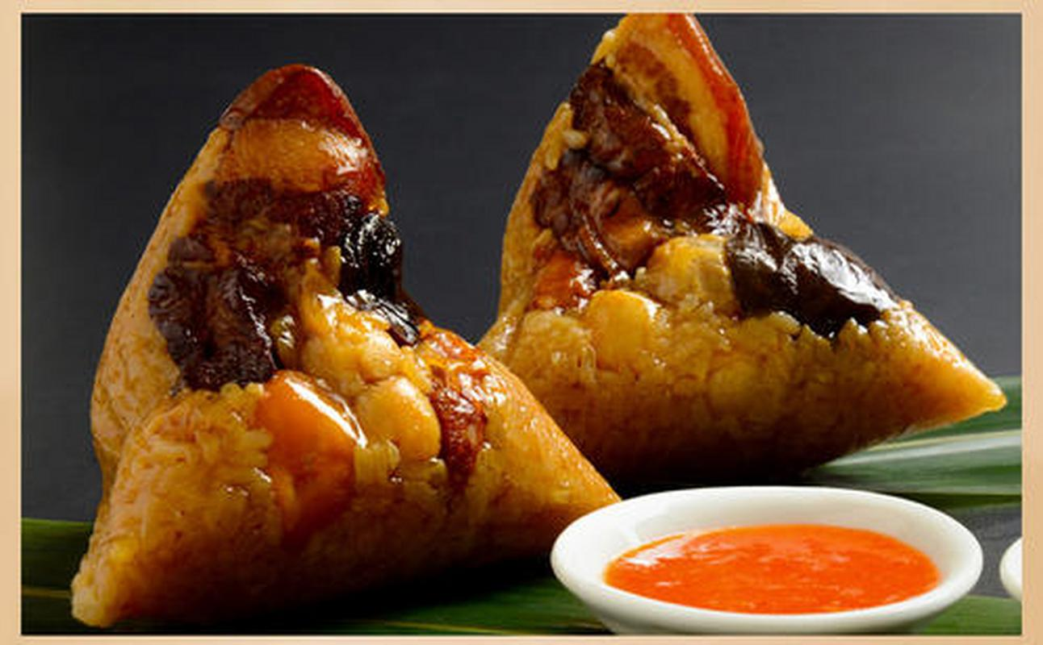
Local Food
Sand tea noodles（沙茶面）
Oyster frying（海蛎煎）
bamboo shoot jelly（土笋冻）
Burned meat dumplings（烧肉粽）

Slide 8
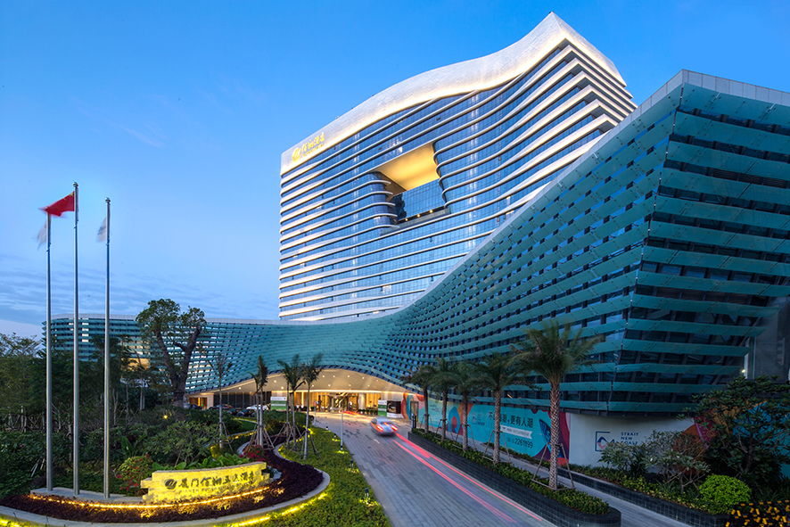
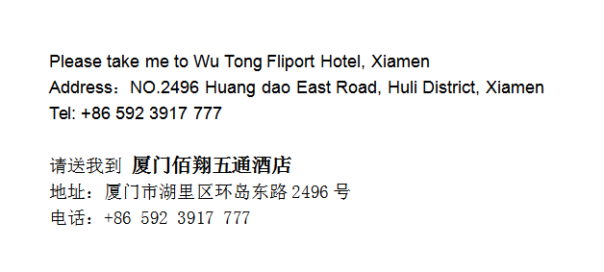
Hotel
WuTong Fliport Hotel, Xiamen
It is about 8 km and 15 mins by car from Xiamen Gaoqi International Airport.
The fare for taxi from the Airport to the hotel is around CNY 25 per way. (Please take the taxi which can provide the invoice for your trip)
In case of taking a taxi, please print the following note which shows taxi driver the address of WuTong Fliport Hotel, Xiamen, in both English and Chinese.

Slide 9
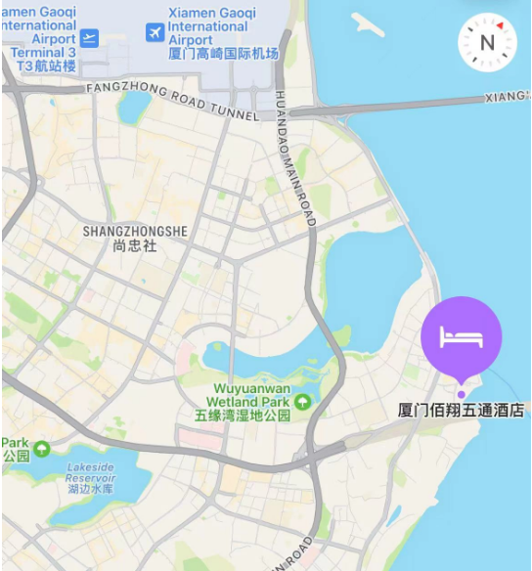
Hotel Location

Slide 10
Meeting Room Allocation-MON
Date | Time | Event | Function room/Capacity
9th Oct (MON) | 9:00-13:00 | RAN1—1 | Grand Ballroom A+B+C (2F)/600
 | 14:30-20:00 | RAN1—2 | Grand Ballroom C (2F)/200
 | 14:30-20:00 | RAN1—3 | Grand Ballroom B (2F)/150
 | 14:30-20:00 | RAN1—4 | Grand Ballroom A (2F)/150
 | 11:00-20:00 | RAN1—5 | Function Room A (2F)/50
 | 11:00-20:00 | RAN1—6 | Function Room B (2F)/50
 | 10:30-11:00/ 16:30-17:00 | Coffee Break | Foyer

Slide 11
Meeting Room Allocation-TUES
Date | Time | Event | Function room/Capacity
10th Oct (TUES) | 07:30-20:00 | RAN1—2 | Grand Ballroom C (2F)/200
 | 07:30-20:00 | RAN1—3 | Grand Ballroom B (2F)/150
 | 07:30-20:00 | RAN1—4 | Grand Ballroom A (2F)/150
 | 07:30-20:00 | RAN1—5 | Function Room A (2F)/50
 | 07:30-20:00 | RAN1—6 | Function Room B (2F)/50
 | 10:30-11:00/ 16:30-17:00 | Coffee Break | Foyer

Slide 12
Meeting Room Allocation-WED
Date | Time | Event | Function room/Capacity
11th Oct (WED) | 07:30-20:00 | RAN1—2 | Grand Ballroom C (2F)/200
 | 07:30-20:00 | RAN1—3 | Grand Ballroom B (2F)/150
 | 07:30-20:00 | RAN1—4 | Grand Ballroom A (2F)/150
 | 07:30-20:00 | RAN1—5 | Function Room A (2F)/50
 | 07:30-20:00 | RAN1—6 | Function Room B (2F)/50
 | 10:30-11:00/ 16:30-17:00 | Coffee Break | Foyer

Slide 13
Meeting Room Allocation-THUR
Date | Time | Event | Function room/Capacity
12th Oct (THUR) | 07:30-20:00 | RAN1—2 | Grand Ballroom C (2F)/200
 | 07:30-20:00 | RAN1—3 | Grand Ballroom B (2F)/150
 | 07:30-20:00 | RAN1—4 | Grand Ballroom A (2F)/150
 | 07:30-20:00 | RAN1—5 | Function Room A (2F)/50
 | 07:30-20:00 | RAN1—6 | Function Room B (2F)/50
 | 10:30-11:00/ 16:30-17:00 | Coffee Break | Foyer

Slide 14
Meeting Room Allocation-FRI
Date | Time | Event | Function room/Capacity
13th Oct (FRI) | 14:30-20:00 | RAN1—1 | Grand Ballroom A+B+C (2F)/600
 | 07:30-13:00 | RAN1—2 | Grand Ballroom C (2F)/200
 | 07:30-13:00 | RAN1—3 | Grand Ballroom B (2F)/150
 | 07:30-13:00 | RAN1—4 | Grand Ballroom A (2F)/150
 | 07:30-12:00 | RAN1—5 | Function Room A (2F)/50
 | 07:30-12:00 | RAN1—6 | Function Room B (2F)/50
 | 10:30-11:00/ 16:30-17:00 | Coffee Break | Foyer

Slide 15
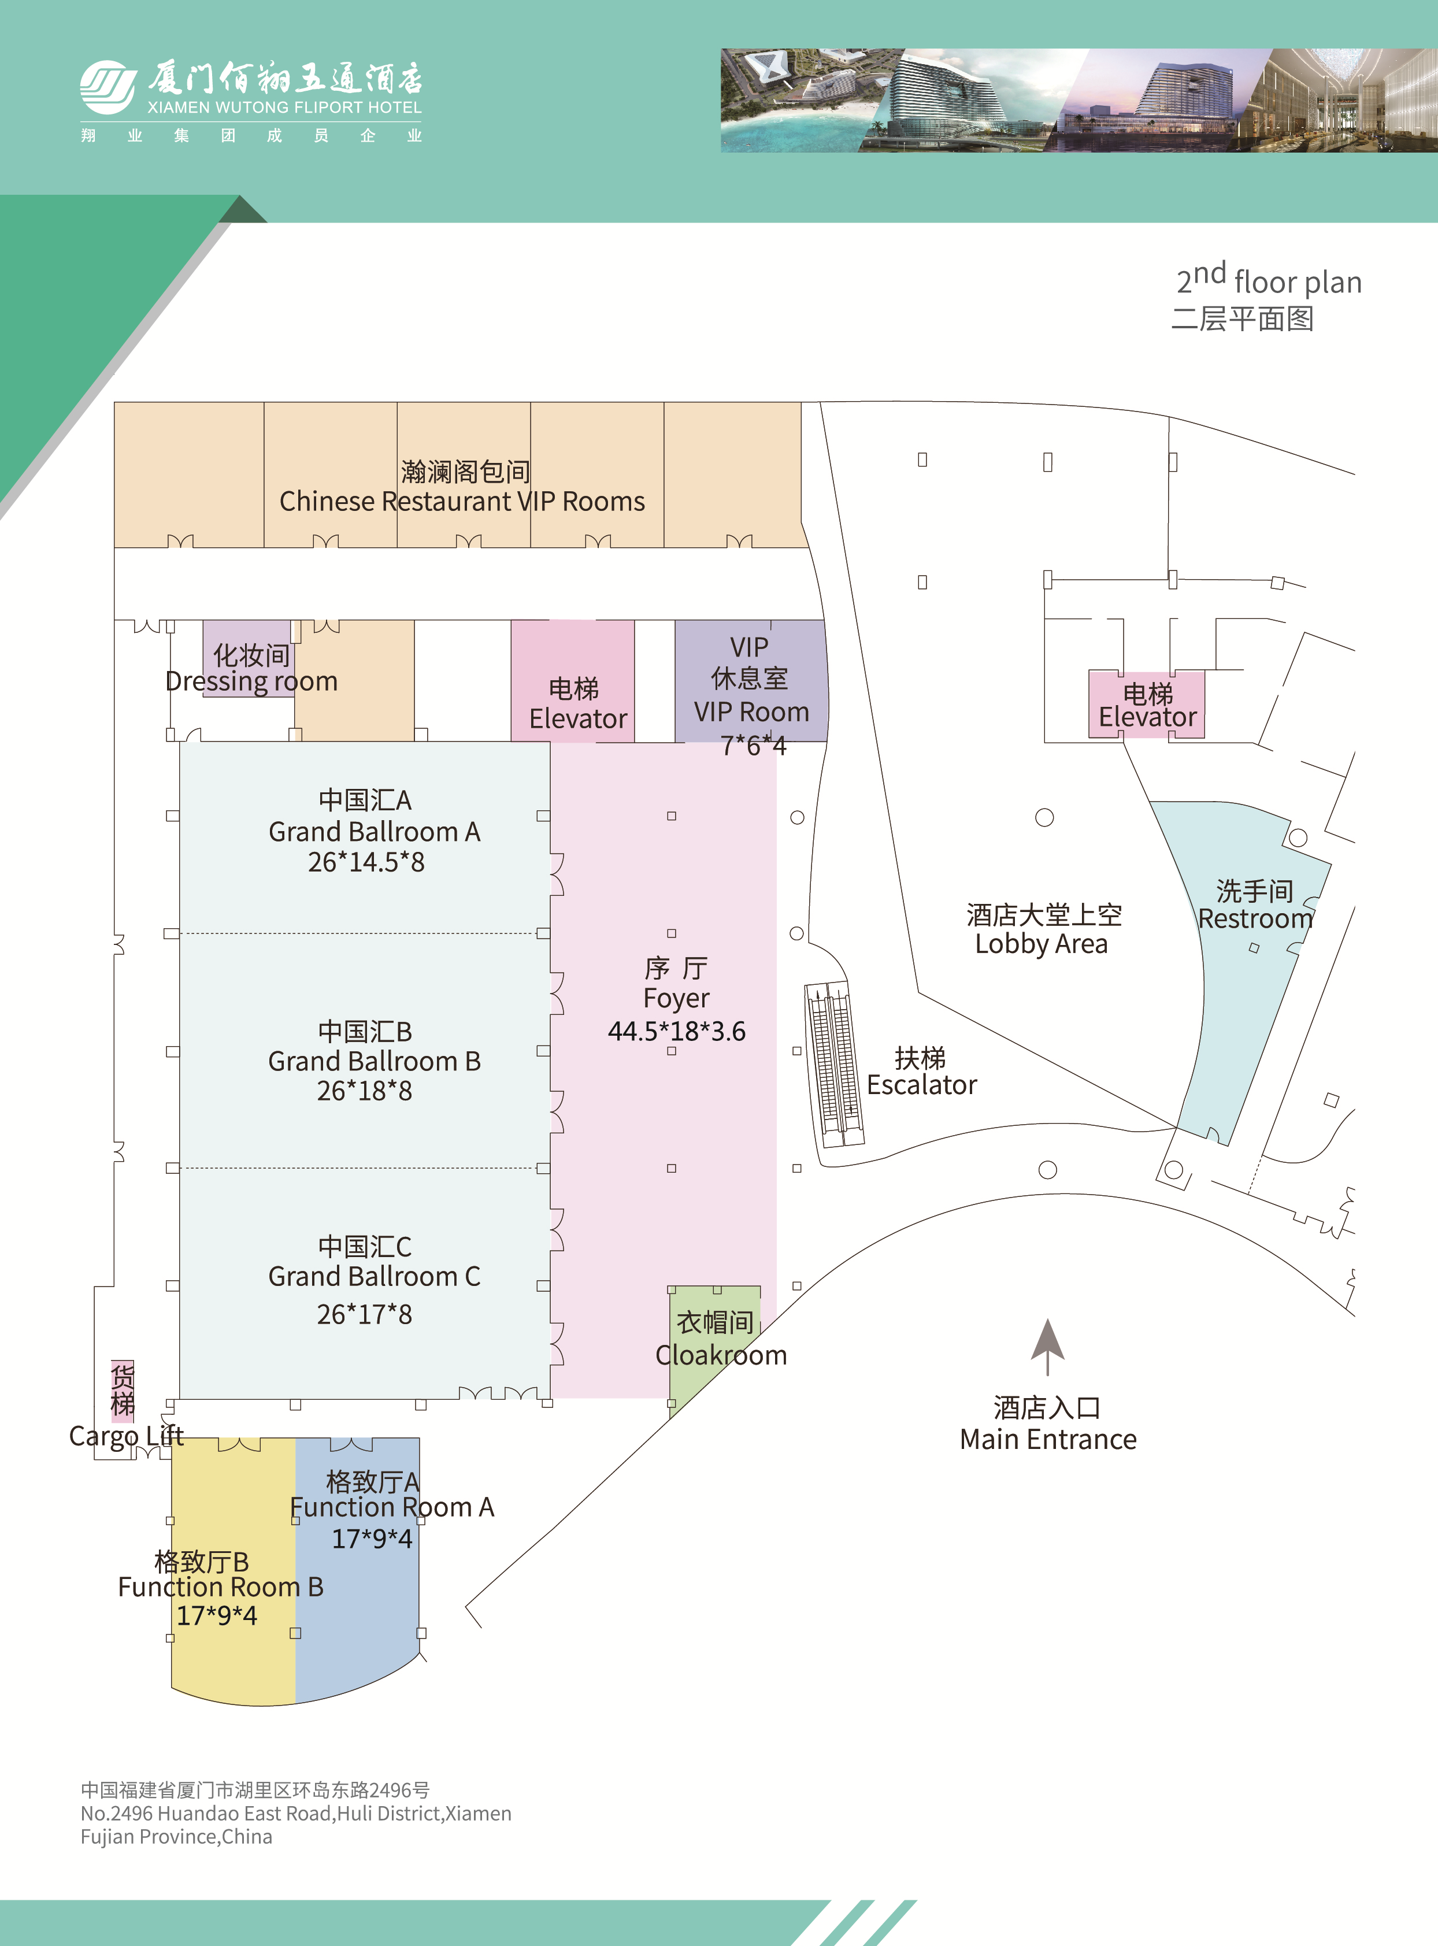
Floor Plan-2nd

Slide 16

Time: 19:00-21:00,10, Oct. 2023 Venue：TBD
Welcome Reception

Slide 17
Hotel restaurants
1F 若水日料餐厅 午餐：11:30-14:00 晚餐：17:30-21:00
Japanese restaurant Lunch：11:30-14:00 Dinner：17:30-21:00
1F 恰恰自助餐厅 晚餐：17:30-21:00
CHACHA Dinner Buffer：17:30-21:00
3F 瀚澜阁中餐厅 午餐：11:30-14:00 晚餐：17:30-21:00
Chinese restaurant Lunch：11:30-14:00 Dinner：17:30-21:00
CHACHA Lunch ：12:00-13:30 Reservation TEL：13959285539
套餐一 Package 1 168RMB
蔬菜沙拉
各式生菜组合，樱桃番茄，黄瓜，洋葱和香醋汁
Vegetables salad assorted garden green,cherry tomato, cucumber,
sliced red onion and vinaigrette
公司三明治 配薯条
扒烤鸡肉，烟肉，煎蛋，生菜，番茄
Club sandwich with chips toasted triple decker with char-grilled chicken breast,bacon, fried egg
软饮料 （任选一款）
Soft Drink(1 choice)
可口可乐 零度可乐 雪碧
Coca cola Coke zero Sprite
套餐二 Package2 208RMB
凯萨沙拉
罗马生菜，意大利芝士碎，蒜茸面包碎，
凯萨沙拉汁和烤鸡肉
Caesar salad romaine lettuce,shaved parmesan cheese,garlic crouton
and grilled chicken with caesar dressing
牛肉汉堡 配薯条
烟肉，芝士和西红柿，洋葱，酸黄瓜，生菜，牛肉
Beef burger with chips topped with bacon,cheese and tomato,onion, gherkin and Lettuce,beef patty
软饮料 （任选一款）
Soft Drink(1 choice)
可口可乐 零度可乐 雪碧
Coca cola Coke zero Sprite
套餐三 Package 3 238RMB
蔬菜沙拉
各式生菜组合，樱桃番茄，黄瓜，洋葱和香醋汁
Vegetables salad assorted garden green,cherry tomato,cucumber, sliced red onion and vinaigrette
奶油蘑菇汤
新鲜蘑菇，洋葱，淡奶油
Mushroom soup fresh mushrooms,onion,cream
番茄牛肉意面
牛肉碎，番茄酱和新鲜的香料
Spaghetti la Bolognese minced beef, tomato sauce and fresh herbs
时令水果
Seasonal fresh cut fruit
套餐四 Package 4 388RMB
凯萨沙拉
罗马生菜，意大利芝士碎，蒜茸面包碎， 凯萨沙拉汁和烤鸡肉
Caesar salad romaine lettuce,shaved parmesan cheese,garlic crouton and grilled chicken with caesar dressing
意大利蔬菜汤
蔬菜，意大利粉和香草酱
Minestrone al pesto tomato based soup with vegetables,pasta and pesto sauce
香煎澳洲谷饲肉眼牛排
配时蔬、胡椒酱和薯条
Char-grilled Australian grain-fed rib eye steak served with seasonal vegetable, black pepper sauce and chips
时令水果
Seasonal fresh cut fruit

Slide 18
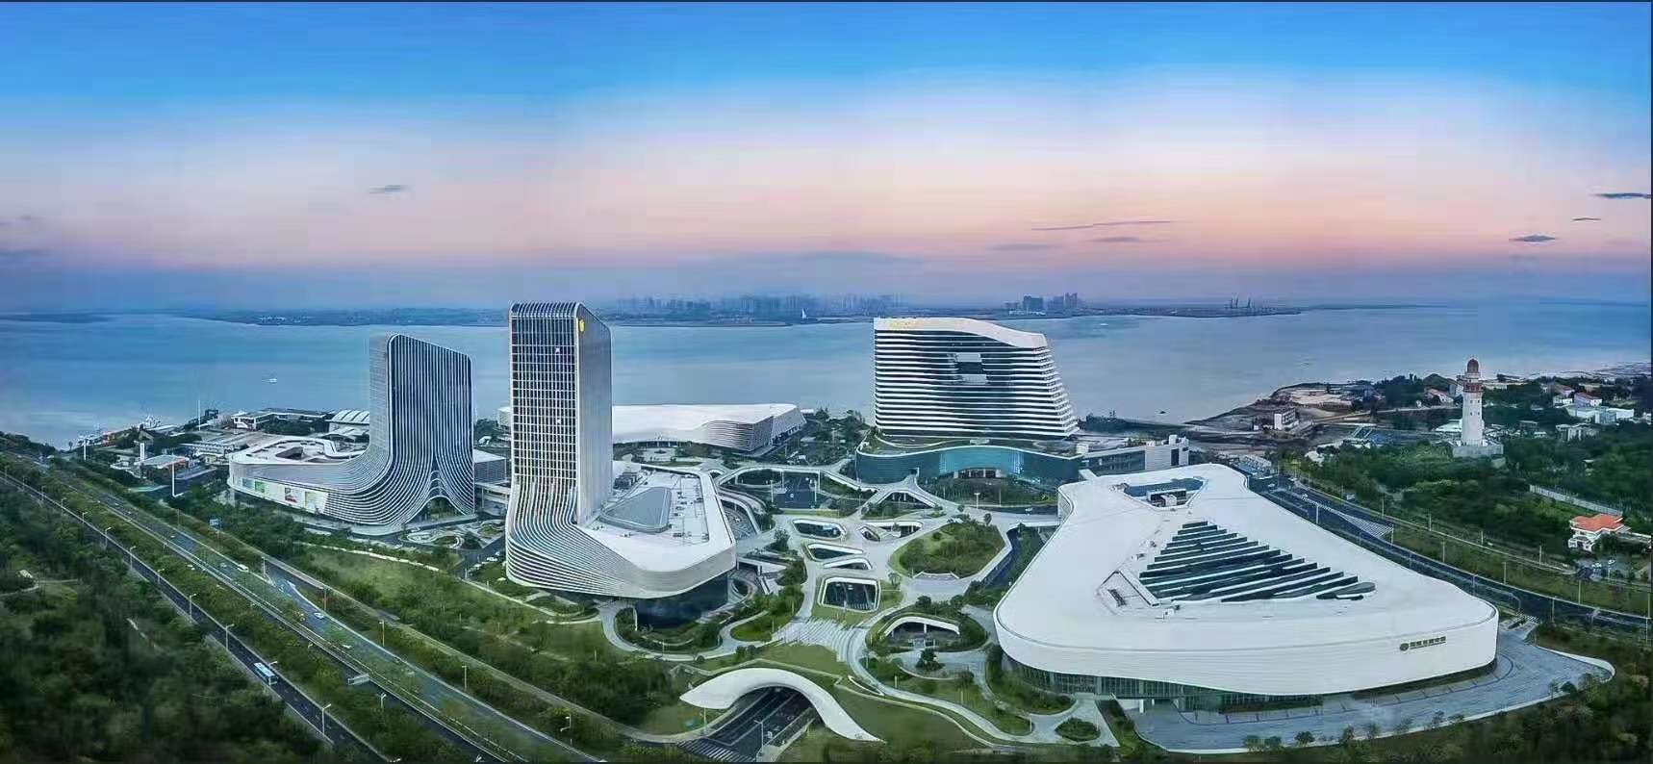
Restaurants near the hotel
Here is the Outlets Mall, there are many restaurants for everyone to choose from.

Slide 19


How to Use Alipay and WeChat Pay
Alipay and WeChat Pay are two important payment methods in China. Learning how to use them will make your travel to China much easier. Click on the PDF link below to learn more.

Slide 20
Meeting Staff
If you need any assistance during your stay, you may go to staff at the Information desk outside the meeting room.For any emergency please contact us at:
Mr. Shizhuo ZHAO (+86-13671348485)

Slide 21
Have a successful meeting and enjoy your stay in Xiamen!

