Slide 1
MONASTERY* coordination call
CT1 130e Conference call
Gkatzikis Lazaros
12-05-2021

Slide 2
Agenda
Discussion of Plugtest Issues and way forward (UPV/EHU, Firstnet and Nokia)
CRs on Support of call to Functional Alias in (emergency) private calls (Nokia)
Discussion of call forwarding flows (Kontron)
CRs on addressing editor’s note on FA resolution in First-to-Answer calls (Nokia)-Not addressed
MO and configuration corrections (only if time permits) -Not addressed
CRs on limiting of the number of simultaneous logins(Nokia) -Not addressed
Notes:
What is a Nokia presentation.? These are the three brand experience principles that should be expressed in your presentation and in all Nokia communications. Your presentation should be…
The third principle is extremely important. Cut out the extraneous

Slide 3
Plugtest identified issues & suggested response
Affiliation and FA subscription procedures differ only in the accompanying filters (9.2.1.3 vs 9A.2.1.3)
Proposal: extend mcptt-info with indication that the request is FA related
SIP PUBLISH to refresh FA interest
No issue identified as long as implementations do not automatically reject messages with a body.
Proposal: Rel.17 clarifications as per one of the following alternative options:
1) Add Note that refresh and remove may include body
2) Add condition in steps 2 and 6 in both subclauses that this step does not apply to refresh
Unclear specs on whether "status" attribute is to be included from participating to FA controlling server in status change procedure (clause 9A.2.2.2.6)
Not FASMO: At the FA controlling server (see 9A.2.2.3.3) we do not have any related handling and even if status was included, it will be simply ignored
Missing procedure for forwarding the FA subscription from originating to terminating participating server
Rel-15 correction adding procedure “Forwarding subscription to functional alias status towards another MCPTT user procedure”

Slide 4
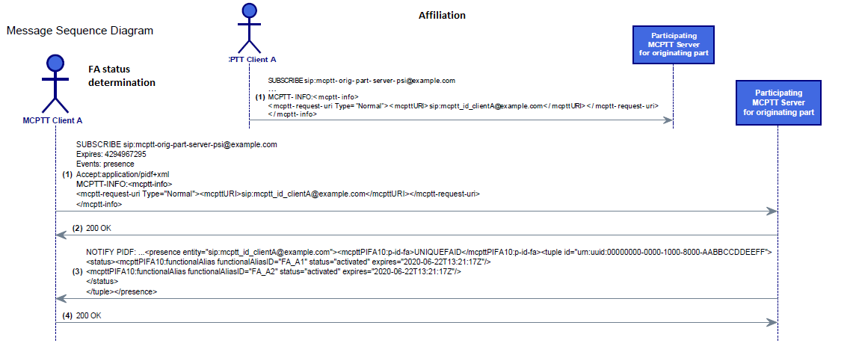
Problem 1: Affiliation and FA subscription
Problem statement:
Initial subscription for affiliation and FA subscription procedures cannot be distinguished at the MCPTT server (see 9.2.1.3 vs 9A.2.1.3)
Notify is ok since the accompanying filters clearly differ
Proposal: extend mcptt-info with optional indication that the request is FA related
Since this is the only identified problematic procedure, an FA indication is sufficient

Slide 5
Problem 1 detailed analysis
As per 24.379, the MCPTT server has no other means to identify that this is FA related (and not an affiliation subscription) but by the highlighted aspects of the filters.
“4) contains a <ns-binding> child element according to IETF RFC 4661 [63], of the <ns-bindings> element where the <ns-binding> element:
A) contains a "prefix" attribute according to IETF RFC 4661 [63], set to "mcpttPIFA10"; and
B) contains an "urn" attribute according to IETF RFC 4661 [63], set to the "urn:3gpp:ns:mcpttPresInfoFA:1.0" value; “
“9.2.1.3 Affiliation status determination procedure
6) shall include an Accept header field containing the application/pidf+xml MIME type; and
7) if requesting MCPTT groups where the MCPTT user is affiliated to at the MCPTT client, shall include an application/simple-filter+xml MIME body indicating per-client restrictions of presence event package notification information according to subclause 9.3.2, indicating the MCPTT client ID of the MCPTT client.“
Including an application/simple-filter+xml MIME body, mandated for "requesting MCPTT groups where the MCPTT user is affiliated to at the MCPTT client" (see 9.2.1.3 ).
Cases not covered
Discovering MCPTT groups which another MCPTT user is affiliated to
Functional alias procedures
Therefore, either we need to impose to include the simple filter MIME in any case, or we provide a clear FA indication.

Slide 6
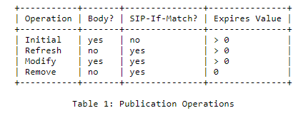
Problem 2: SIP PUBLISH to refresh FA interest
Problem statement
SIP PUBLISH requests for FA status change can be used
“to refresh indication of an MCPTT user interest in one or more functional aliases due to near expiration of the expiration time of a functional alias with the status set to the "activated" state received in a SIP NOTIFY request in subclause 9A.2.1.3; “
Analysis
RFC 3903 main points
SIP-If-Match header field, is the unique identifier of the target "event state"
Supported publication operations as per table
TS 24.379 states in subclause 9A.2.1.2
"In the SIP PUBLISH request, the MCPTT client:
2) shall include an application/vnd.3gpp.mcptt-info+xml MIME body. In the application/vnd.3gpp.mcptt-info+xml MIME body, the MCPTT client shall include the <mcptt-request-uri> element set to the MCPTT ID of the MCPTT user;….
6) shall include an application/pidf+xml MIME body indicating per-user functional alias information according to subclause 9A.3.1. In the MIME body, the MCPTT client:
Proposal: Add Notes that RFC operations refresh and remove are not applied as is.
Remark: The very same issue appears in affiliations i.e. subclause 9.2.1.2
"In the SIP PUBLISH request, the MCPTT client:…
2) shall include an application/vnd.3gpp.mcptt-info+xml MIME body. In the application/vnd.3gpp.mcptt-info+xml MIME body, the MCPTT client shall include the <mcptt-request-uri> element set to the MCPTT ID of the MCPTT user;….
6) shall include an application/pidf+xml MIME body indicating per-user affiliation information according to subclause 9.3.1. In the MIME body, the MCPTT client:"

Slide 7
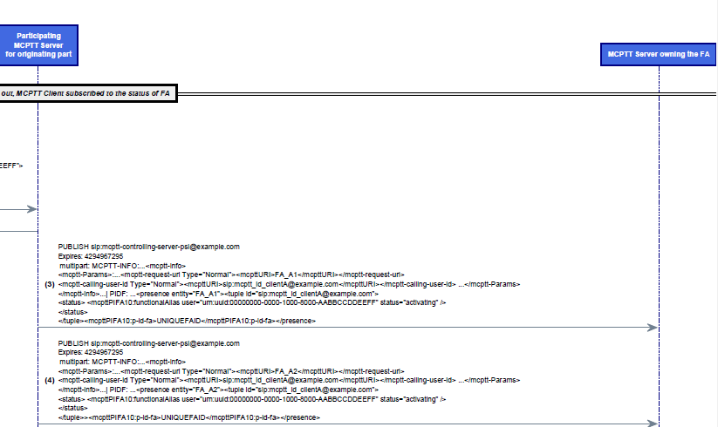
Problem 3: Use of "status" attributes
Problem statement
Ambiguity on whether the “status" attribute should be included
in the participating<=> FA controlling servers interface
Remark: “expires" is explicitly mentioned as removed.
Analysis
Clause 9A.2.2.2.6 states the conditions and the actions
“10) shall include an application/pidf+xml MIME body indicating per-functional alias status information constructed according to subclause 9A.3.1.2. The MCPTT server shall indicate all served MCPTT user IDs, such that:
a) the functional alias status is set to "activating" with or without "take-over" element or "activated", and the expiration time has not expired yet in a functional alias information entry with the functional alias ID set to the handled functional alias;”
Specs do not state that status is to be included.
What if the participating MCPTT server includes it?
the controlling would anyway ignore it,
the corresponding handling at the FA controlling server (see 9A.2.2.3.3) does not have any related handling and will simply ignore it
Proposal: Clarify that the <functionalAlias> element of the pidf+xml documents needs/does not need to include the “status” attribute.

Slide 8
Problem4: FA status determination of other user
Already addressed in CT1#128e (C1-211482)
Problem statement:
Missing procedure for forwarding the FA subscription from originating to terminating participating server
FA status determination of user served by other MCPTT server is not supported
Solution: Rel-15 correction adding procedure “Forwarding subscription to functional alias status towards another MCPTT user procedure”

Slide 9
Add generic support to Calling an FA
Stage-2 reqs
unclear on whether FAs need to reach destination
No procedural text, but mentioned in table
Stage-3 agreements:
the FA is carried up to the end
new element <called-functional-alias-URI> in application/vnd.3gpp.mcptt-info+xml MIME body
Proposal:
Resolved by reusing FA resolution mechanism,
but initiated by the client.
<called-functional-alias-URI> set by the Client at step 5
Information Element | Status | Description
MCPTT ID | M | The MCPTT ID of the calling party
Functional alias | O | The functional alias of the calling party
MCPTT ID | M | The MCPTT ID of the called party
Functional alias | O | The functional alias of the called party
Use floor control indication | M | This element indicates whether floor control will be used for the private call.
SDP offer | M | Media parameters of MCPTT client.
Implicit floor request | O | An indication that the user is also requesting the floor.
Table 10.15.2.2-1: MCPTT first-to-answer call request (MCPTT server to MCPTT client) information elements

Slide 10
Called FA added upon resolution (in first-to-answer call)
Editor’s Note: [eMONASTERY2, CR 0691] How the controlling MCPTT server adds and populates <called-functional-alias-URI> element for a first-to-answer-call is FFS.
No need to have the same e2e handling of FA resolution here
The FA is added to <called-functional-alias-URI> by the controlling server at resolution phase
“b) upon receipt of a SIP NOTIFY request generated as specified in subclause 9A.2.2.3.8,
i) shall set in the application/vnd.3gpp.mcptt-info+xml MIME body with the <mcpttinfo> element containing the <mcptt-Params> element the <called-functional-alias-URI> to the value of the called functional alias to be called.include an active functional alias SIP INVITE request, with the <functional-alias-URI> set to the URI of the used functional alias; and
ii) shall invite the MCPTT user(s) listed in the application/pidf+xml MIME body of the SIP NOTIFY request as specified in subclause 11.1.1.4.1;”

