Slide 1
Alignment of EDGE-9 & Mp3
3GPP
Samar Shailendra

Slide 2
Motivation
TR 23.700-98 Annex B has captured the following Editor’s Note:
Editor's note: Whether and how to enhance EDGE-9 or Mp3 is FFS.
Identify overlapping functionalities in EDGE-9 and Mp3.
Find any gaps in EDGE-9 required to align with Mp3.
Mapping of EDGE-9 to GSMA OP requirements.

Slide 3
Mapping between EES and MEC Platform
As per famous Annex C.2 of TS 23.558
  Both EES and MEC platform provide application support capabilities towards the application servers.
  Alignment of the EDGE-3 and Mp1 reference points and EDGE-9 and Mp3 reference points is implementation specific.

Slide 4
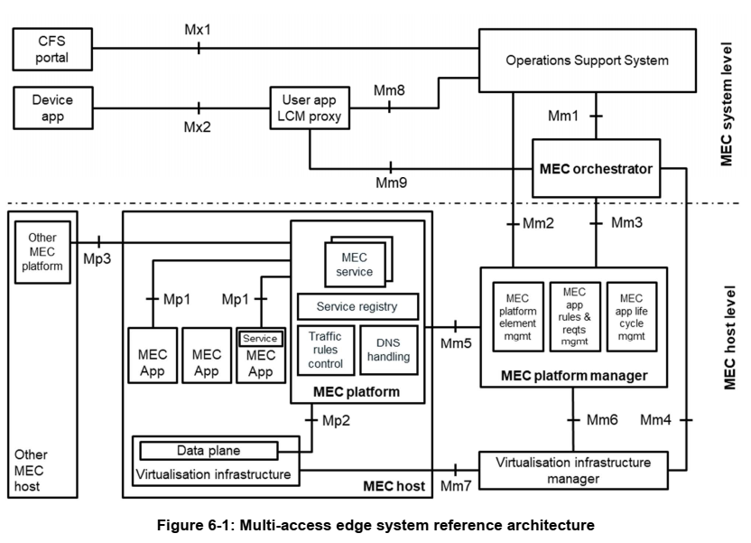
About Mp3
From ETSI gs MEC 003:
  Mp3 reference point between MEC platforms is used for control communication between MEC platforms.
  Inter MEC System communication
    A MEC platform should be able to discover other MEC platforms that may belong to different MEC systems.
    A MEC platform should be able to exchange information in a secure manner with other MEC platforms that may belong to different MEC systems.
    NOTE: It is for further study if MEC platforms in different MEC systems should be able to discover each other without the involvement of the MEC system level functional elements.

Slide 5
About EDGE-9 and correspondence to Mp3
EDGE-9 is used for interconnects between EES. (Clause 6.5.10)
  Corresponds to Mp3 between MEC Platform.
EDGE-9 supports
  Discovery of T-EAS info to support ACR (Clause 6.5.10a)
    Not clear whether Mp3 supports discovery of other MEC applications
    EEC Context Relocation Procedure (Clause 6.5.10b)
    Not in Scope of ETSI MEC !
  EDGE-9 cardinality: EES can communicate with 1 or more EES concurrently
  A MEC platform should be able to discover other MEC platforms that may belong to different MEC systems.

Slide 6
Requirements for alignment of EDGE-9 and Mp3
APIs supported over EDGE-9
API Name | Known Consumers | Corresponding EDGEAPP Structure | Corresponding API in ETSI MEC
Eees_TargetEASDiscovery | EES | EAS discovery request/response/filers EAS discovery subscription request/response/notification | Not clear from the existing ETSI MEC specs
Eees_EECContextPull | EES | - | Not relevant for ETSI MEC
Eees_EECContextPush | EES | - | Not relevant for ETSI MEC
APIs supported over Mp3
  Mp3 is not specified in ETSI MEC yet.

Slide 7
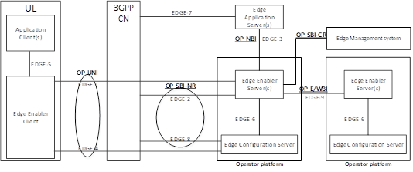
SA6 views on EDGE-9 and E/WBI
Mapping of EDGE-9 with E/WBI
  Currently 3GPP SA6 defines the EDGE-9 interface for the Operator Platforms to communicate with each other, as defined for E/WBI. (Clause A.2.2)

Slide 8
GSMA Views on E/WBI – From Federation PoV
Clause 1.4 – “Each partner hosts an OP and offers the resources through its E/WBI federation.”
Clause 3.5.4 - “The E/WBI is not exposed to the Application Providers and is primarily driven by the Federation Manager functionality within the OP.”
Clause 3.4.10 – “Network capabilities are accessed by the OP through the SBI-NR and consumed by the OP or exposed through the NBI (to the Application Provider) or E/WBI (to the Leading OP).”
Clause 3.3 describes the functionalities of Federation Management and is clarifying multiple times that E/WBI is the reference point used for the communication.

Slide 9
GSMA Views on E/WBI – From MNO PoV
Clause 2.1.4 – “there is a "separation of concerns" of the operators between each other and between OPs.” "Separation of concerns“ means they do not require knowledge of each other's internal workings and implementation details.
Clause 5.1.2.2 – “The E/WBI shall maintain the topology hiding policy between operators/players.” [..] They have a “Separation of concerns”.
Clause 3.5.4.2 - “The Availability Zone information shared over E/WBI shall provide a partner OP information about which zones are shared with that OP, where they provide coverage and what amount and type of compute they provide.” - the Availability Zone is specified as level of information shared among OPs (and not the network/cloud topology!):
Clause 3.4.3 defines a common data model for cloudlet, applicable for E/WBI (by the way, including FQDN and other info like storage and GPU support, but not topology-related info). On the other hand, more detailed info on cloudlet is transferred only via SBI (in other clauses, e.g., 3.4.12).
Similar concept of “separation of concerns” is also applied in NBI, toward the Application provider.
(Clause 3.5.1.1): - “An Application Provider shall not have visibility of the exact geographical locations of the individual Cloudlets and shall not be able to request deployment of its application on a specific Cloudlet. Instead, the OP shall offer to Application Providers the edge cloud service in Availability Zones. The OP chooses each Availability Zone's size and which and how many Cloudlets it would use to provide its edge cloud service in each Availability Zone.”

Slide 10
Conclusion
E/WBI as defined by GSMA OP should interconnect Federation Manager Roles.
  Direct communication between platforms does not fulfil OP E/WBI compliance?
    Further EDGE-9 enhancements cannot cover the OP requirements for the compliance !
The two reference points Mp3 and EDGE-9 can be aligned together. SA6 can take a lead to liaison with ETSI MEC ISG.
  The two reference needs to be aligned not necessarily be equivalent.

