Slide 1
Discussion about traffic control of SEALDD
Xiaohui Shi
China Mobile

Slide 2
Outline
Traffic control re quirements
Main Comments in last meeting
Requirements and Comments discussion
Summary

Slide 3
Traffic control requirements
1. VAL server limit
  VAL server has limited computing resources (e.g. Video rendering (DL), image recognition (UL))
  VAL server has limited data delivery resources (e.g. limited NIC bitrate, limited CPU/memory resource to decapsulate or encapsulate the packets)
2. User priority
  Some User has higher priority to be firstly guaranteed.
3. Service priority
  Different VAL services have different priorities, some services should be better served. (e.g. remote control service and video monitoring service should be guaranteed while services like file downloading or video record fetching can be delayed)
Requirements:
  1. How to allocate the limited bandwidth resource to the users with different priorities.
  2. How to allocate the limited bandwidth resource to the VAL services with different priorities.

Slide 4
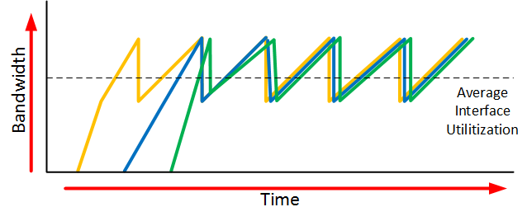
Main Comments in last meeting
1. SLA can be used to configure maximum bandwidth of VAL server
2. For BW control of an individual UE, existing capability in 3GPP CN for BW control (PCC) already support it
3. VAL should use prevailing mechanisms for load control and bandwidth management
Comments 1 and 2 are related to the first requirement.
Comment 3 is related to both of the two requirements.
For Comment 3:
  Existing mechanisms includes transport layer traffic control and application layer traffic control.
    Transport layer traffic control causes unstable jitter and bitrate degradation
    Application layer traffic control is more complexible and cost more resources, VAL servers are not always equipped with that functionality

Slide 5
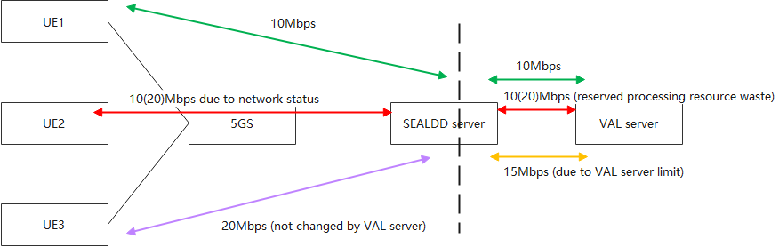
First requirement
How to allocate the limited bandwidth resource to the users with different priorities.
  1. SLA can be used to configure maximum bandwidth of VAL server.
    Agree. Maximum bandwidth can be a part of the SLA.
  2. For BW control of an individual UE, existing capability in 3GPP CN for BW control (PCC) already support it.
    Problem1: The 5GC does not know the VAL server’s bandwidth consuming status, this cannot be dynamically updated.
    Problem2: The 5GC BW control is UE/PDU Session/QoS flow granularity, not application service granularity.
    Problem3: The 5GC’s BW control mechanism is to drop the extra packets, which will cause Transport layer bitrate degradation.
  3. VAL should use prevailing mechanisms for load control and bandwidth management.
    Problem1: VAL server does not know the network status of the UE, reserved resources may be wasted.
    Problem2: The VAL server’s control mechanism cannot affect the VAL client. The VAL client may continue sending packets to VAL server even they will be dropped.
  Benefits of SEALDD server traffic control: SEALDD server can get the network information of the specific UE to allocate the resources efficiently.

Slide 6
Second requirement
How to allocate the limited bandwidth resource to the VAL services with different priorities.
  3. VAL should use prevailing mechanisms for load control and bandwidth management.
    Problem1: VAL server can only control the bandwidth between SEALDD server and VAL server, if the VAL server drops the packets from SEALDD Server, the transmission resource between UE and SEALDD server has already been wasted.
    Problem2: The VAL server’s control mechanism cannot affect the VAL client. .
  Benefits of SEALDD server traffic control: VAL server does not need to implement bandwidth control functionality.

Slide 7
Summary
SEALDD server can get the network information of the specific UE to allocate the resources efficiently.
If SEALDD service is used, VAL server does not need to implement bandwidth control functionality in application layer.

