Slide 1
MC Gateway UE Discussion
Jerry Shih, at&t

Slide 2
Outline
Security concerns
Simple principles
Connection request to MC GWUE
MCX service access
Conclusion

Slide 3
Security, security, security
No device outside the core network can be connected to the network without proper authentication and authorization.
MC Gateway UE connects to the MCX network with well-defined procedures.
To allow a non 3GPP device uses MC Gateway UE to connect to the MCX network for MCX services, the MC Gateway UE needs to perform proper authentication and authorization on the non 3GPP device.

Slide 4
Simple principles
An authorized user always uses the MC client to access MC services.
MC service access shall always follow clause 10.1.1.1 (23.280) time sequence from a device (UE) that hosts MC client.
When a non 3GPP device uses a MC GWUE:
  A secured mechanism to allow the non 3GPP device to access the MC GWUE needs to be defined
  When the non 3GPP device hosts a MC client, all MC application layer procedures (from beginning to end) are supported by its own MC client with the MC GWUE relay service.
  When the non 3GPP device (with no MC client) uses the MC GWUE MC client to access MC services:
    All MC application layer procedures are supported by the MC client on the MC GWUE
    The needed information (data/content) for the MC communications are provided by the non 3GPP device thru a persistent session connection between the non 3GPP device and the MC GWUE that is implementation specific.

Slide 5
MC ID and MC service ID
MC ID - The MC ID is the identity that an MC service user presents to the identity management server during a user authentication transaction. In general, since identity management is a common service it uses an identity which is linked to a set of credentials (e.g. biometrics, secureID, username/password) that may not necessarily be tied to a single mission critical service. The MC ID and the MC service ID may be the same. The MC ID uniquely identifies the MC service user to the identity management server.
MC service ID - The MC service ID is a globally unique identifier within the MC service that represents the MC service user. The MC service ID identifies an MC service user. The MC service ID may also identify one or more MC service user profiles for the user at the application layer. There are attributes associated with the MC service ID configured in the MC service that relate to the human user of the MC service.
A MC client needs to have the MC ID available (either configured or user provided) for the MC service authentication with the IdM server; the MC service ID(s) associated with the MC ID may be configured on the IdM server and may be returned to the MC client for MC service (i.e. download the user profile).
For non 3GPP device that doesn’t support MC client, there are two mode of operations:
Fixed association of the non 3GPP device (without MC client) to a MC user profile (i.e. a permanent assigned MC service ID), the MC ID needs to be made available on the non 3GPP device or the MC GWUE (if not on the non 3GPP device) and the IdM server.
For random use of MC service by a non 3GPP device (without MC client) that authorized by the MC GWUE, the MC GWUE will randomly select a MC ID from its available pool for IdM authentication as normal authentication procedure.

Slide 6
MC Gateway UE and non 3GPP device connection
Certain security credentials need to be provisioned on both MC Gateway UE and non 3GPP device (user) for connection authentication and authorization.
These credentials are used for mutual authentication to make sure the identities of both entities.
Once authenticated, the MC Gateway UE may authorize the non 3GPP device (user) to access the MCX network for MCX services.
The user on the non 3GPP device will need to use his/her/guest MCX service profile to access the MCX services using a MC client.
The MC client may reside on the non 3GPP device or on the MC Gateway UE.

Slide 7
Connection to use MC Gateway UE services
The non 3GPP device (user) makes a connection request (over the GW-local) to the MC GWUE. The ID and credential are provisioned for authentication. Service requested includes if the MC client hosting is needed and which MCX service(s) support is needed.
The MC GWUE authenticates the non 3GPP device (user) and authorizes the services requested (maybe a subset of requested MC services depending on available resources). The credentials could be used for mutual authentication.
As the non 3GPP device development is outside of our scope, the communication protocol is implementation specific to accommodate the flexibility of different device deployment.
Architectural requirements on MC GWUE (which is in scope) shall be clearly specified in our specification.

Slide 8
MCX service access (no MC client)
MC GWUE provisioning:
  A set of “guest” MC IDs is provisioned both on the MC GWUE and MCX Network (with associated MC user profiles). The number of “guest MC IDs” provisioned on the MC GWUE determines how many non 3GPP devices/connections can be supported simultaneously.
  Once authorized the MC GWUE will assign one “guest ” profile (MC ID) to one MC service request by the non 3GPP device.
  The MC ID is used to obtain the MC service ID from the IdM server. (cover by SA3) and store together for the life of the service session.
The non 3GPP device has been authorized to use MC GWUE.
MC GWUE instantiates the MC client to manage the non 3GPP device (user) requested MCX service.
The MC GWUE instantiated MC client uses the normal procedure (10.1.1.1) for user authentication (with provisioned guest ID) and MC service authorization (with the provisioned guest MC service ID) with the MC server. The (guest) user profile will be downloaded to the MC GWUE once the authentication and authorization is success.
The MC GWUE and the non 3GPP device use the GW-local reference point to communicate essential data (content) to allow the instantiated MC client on the MC GWUE to perform needed MCX service.
Once the service request completes by the non 3GPP device (user), the MC GWUE releases the guest MC ID back to the pool of available resources and ready for the next non 3GPP device to use.
NOTE: This use case is for dynamically assigned MC service ID.

Slide 9
MCX service access (with MC Client)
The non 3GPP device has been authorized to use MC GWUE.
The MC ID and/or MC service ID are provisioned on the non 3GPP device (to be used by the MC client) and the MCX Network (with associated user profile).
The non 3GPP device uses its own MC client to access MCX service with the MCX Network (with MC GWUE relay).
The MC GWUE will make sure the traffic relayed from non 3GPP device is what has been authorized.
The MC client uses the normal procedure (10.1.1.1) for user authentication (with provisioned MC ID) and MC service authorization (with the provisioned MC service ID) with the MC service server. The user profile will be downloaded to the non 3GPP device once the authentication and authorization is success.
Once the non 3GPP device completes its MCX service access, the relay function on MC GWUE is terminated and no more traffic will be relayed.

Slide 10
Conclusion
No need for the GW-global reference point.
There are two types of authentication and authorization:
  The connection request from non 3GPP device to the MC GWUE (our focus of work).
  The MC service request with the MC service server; business as usual.
Proper configuration needs to be provisioned on the non 3GPP device, the MC GWUE and the MCX network.
MC client (be on the non 3GPP device or on the MC GWUE) follows normal procedures defined in 23.280 to get access to MCX services.
MC GWUE routing described in 11.4 has no relevance to the application layer and should be handled by the CT groups; this needs to be very clear in our specification.
11.5.1.2.3, 11.5.1.3.3 procedures need to be updated.
Other 11.5.X procedures need to be reviewed as well.

Slide 11
Reference slides

Slide 12
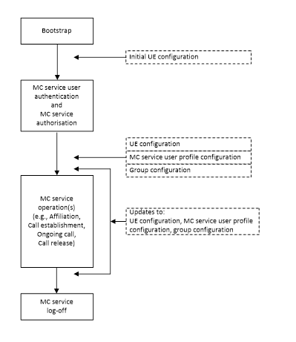
MC service configuration (10.1.1.1)

Slide 13
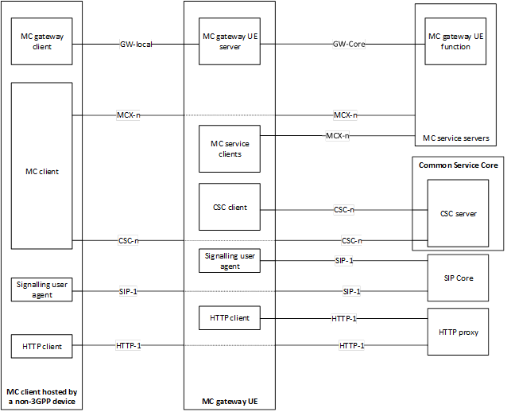
MC GWUE functional model

