Slide 1
AHGC on Multiple MC systems
Jerry Shih
AT&T

Slide 2
Outline
We discussed S6-223348 in SA6 #52 and conference call, still concerns were raised
In current TSs, there are mechanisms with architectural principles to solve this multisystem call.
A proposed solution that align with the existing architectural principles.

Slide 3
Concerns with solution in S6-223348
  Multiple focuses and controls; it is a departure of existing single focus and single control in a group communication
  No solutions proposed to handle floor control with multiple focuses and controls

Slide 4
Existing architectural principles
Single focus and control in a group communication
Inter-MC system (service server) communication

Slide 5
Single focus and control
Group regroup procedure in 23.379 10.6.2.4.2

Slide 6
Inter MC systems server communication
Inter MC systems service server communication in 23.280 10.16.3.3

Slide 7
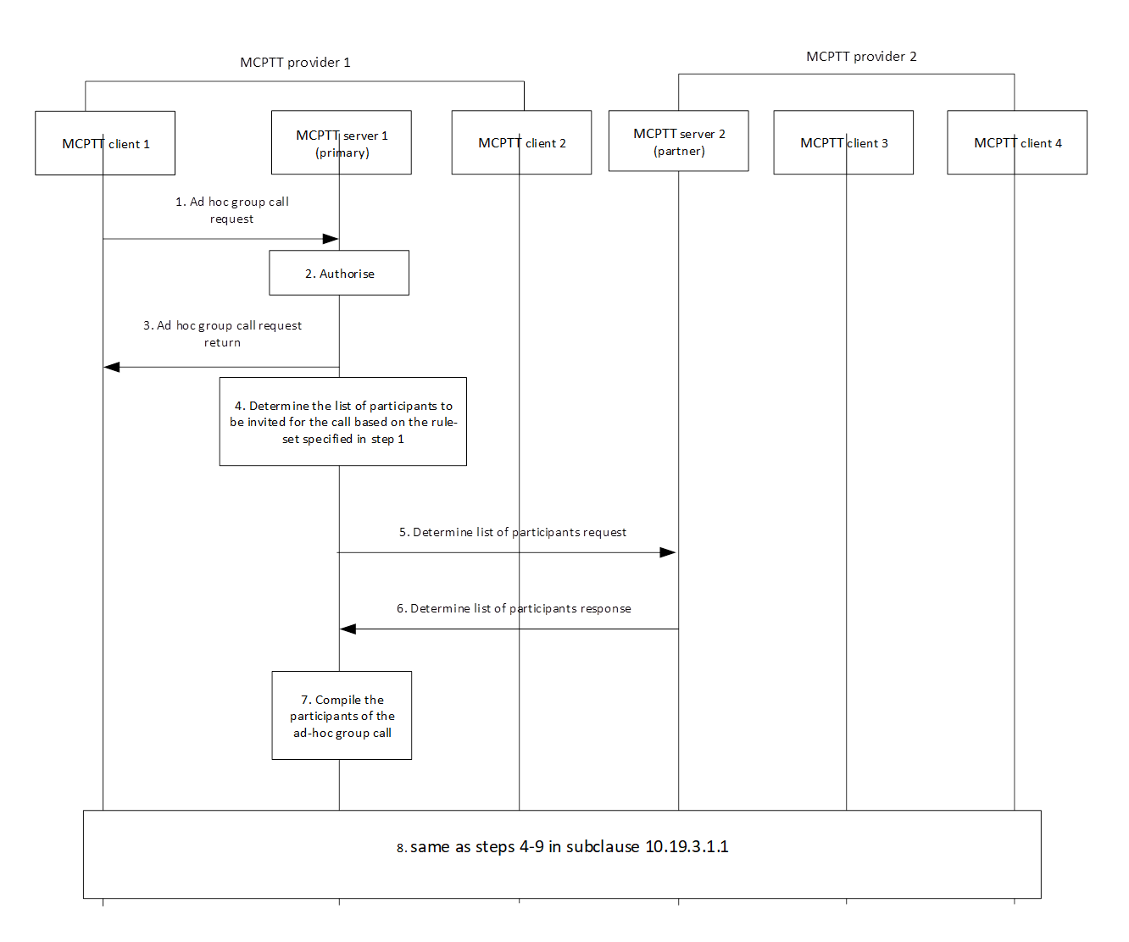
A new solution proposal
Inter MC systems communication
Single focus and control

