Slide 1
3GPP SA5 introduction on Autonomous Networks
Thomas Tovinger, 3GPP SA5 Chair (Ericsson)
Zou Lan, SA5 Vice Chair (Huawei)

Slide 2

Contents
Brief 3GPP introduction
3GPP SA5 ToR
Rel-16 5G management specifications
5G Service based Management architecture(SBMA)
Autonomous network relevant topics for pre-5G
Autonomous network relevant topics for 5G
Conclusions

Slide 3
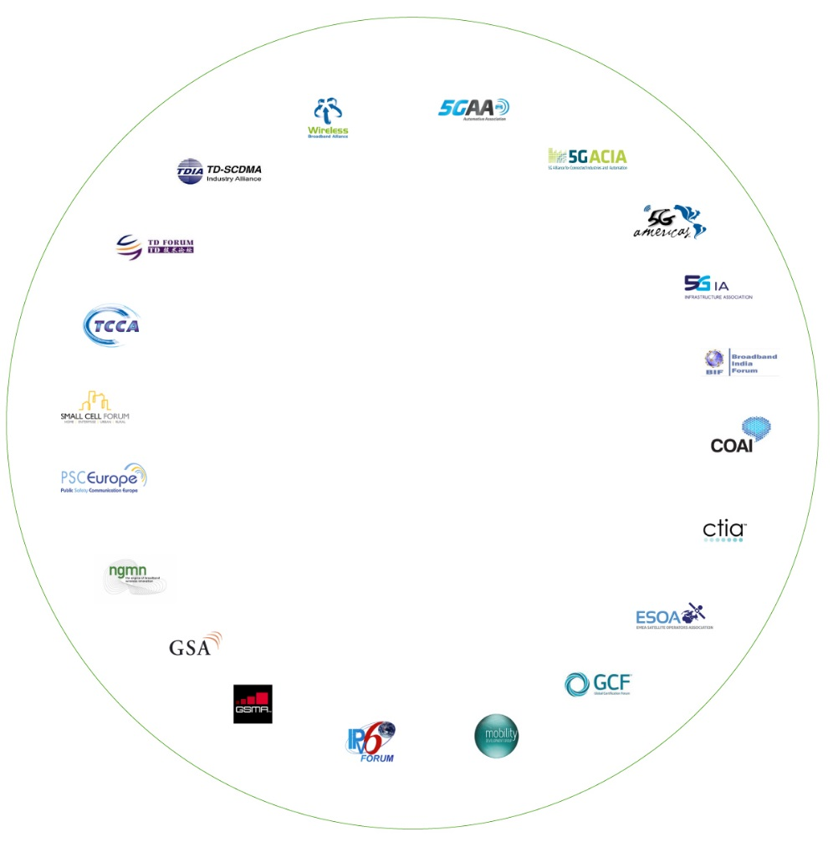
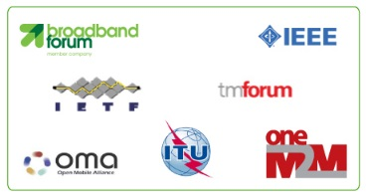
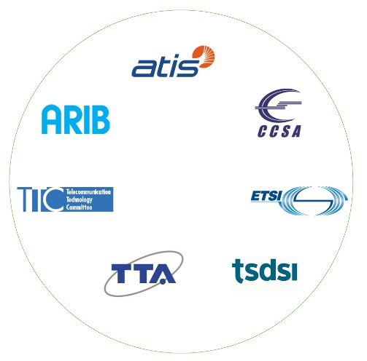


3GPP standards eco-system
Formal External
Liaisons
Participation in 3GPP is made possible by companies and organizations becoming members of one of the 3GPP Organizational Partners, the seven Standards Developing Organizations (SDOs) - from China, Europe, India, Japan, Korea and the United States.
Other Standards bodies
450 MHz Alliance
AISG
Bluetooth
Broadband Forum (BBF)
CableLabs
International Special Committee on Radio Interference (CISPR)
CTIA
Digital Video Broadcasting (DVB) Project
Ecma International
Expert Group for Emergency Access (EGEA)
Eurescom
COST 273
European Radiocommunications Committee (ERC)
Fixed Mobile Convergence Alliance (FMCA)
Global Certification Forum (GCF)
Global TD-LTE Initiative (GTD)
GPS Industry Council
GSM Association
HomeRF Forum
IDB Forum
IEEE
Internet Engineering Task Force (IETF)
IrDA
International Multimedia Telecomunications Consortium (IMTC)
Internet Streaming Media Alliance
ISO-ITU expert group
ISO MPEG / JPEG
ITU-T SG2
JAIN tm (Javatm APIs for Integrated Networks)
The Java Community Process (JCP)
Liberty Alliance Project
LTE/SAE Trial Initiative (LSTI)
Metro Ethernet Forum (MEF)
NENA
NGMN (Next Generation Mobile Networks)
oneM2M
OMA (Open Mobile Alliance )
Open Networking Foundation (ONF)
Open IPTV Forum
Object Management Group (OMG)
PCS Type Certification Review Board (PTCRB)
Portable Computer and Communications Association (PCCA)
Presence and Availability Management (PAM) Forum
RSA Laboratories
SDR Forum
Sun Micro Systems Inc
Steerco
SyncML Initiative
Trusted Computing Group (TCG)
TeleManagement Forum (TMF)
TCCA
TIA /TR45
TIA/TR47
TV-anytime Forum
Voice eXtensible Mark-up Language (VXML) Forum
Wi-Fi Alliance
Wireless Broadband Alliance (WBA)
WLAN Smart Card Consortium
Wireless World Research Forum (WWRF)
World Wide Web Consortium (W3C)
Specific inputs, in the form of market requirements may also come in to the Project via any of the twenty Market Representation Partners in 3GPP. These organizations have all signed up to the 3GPP Project scope and objectives.
Partners (OP & MRPs)
There is also a lot of external cooperation with other standards bodies and a broad variety of other groups, by way of formal Liaisons.
5G Projects
Certification Bodies

Slide 4
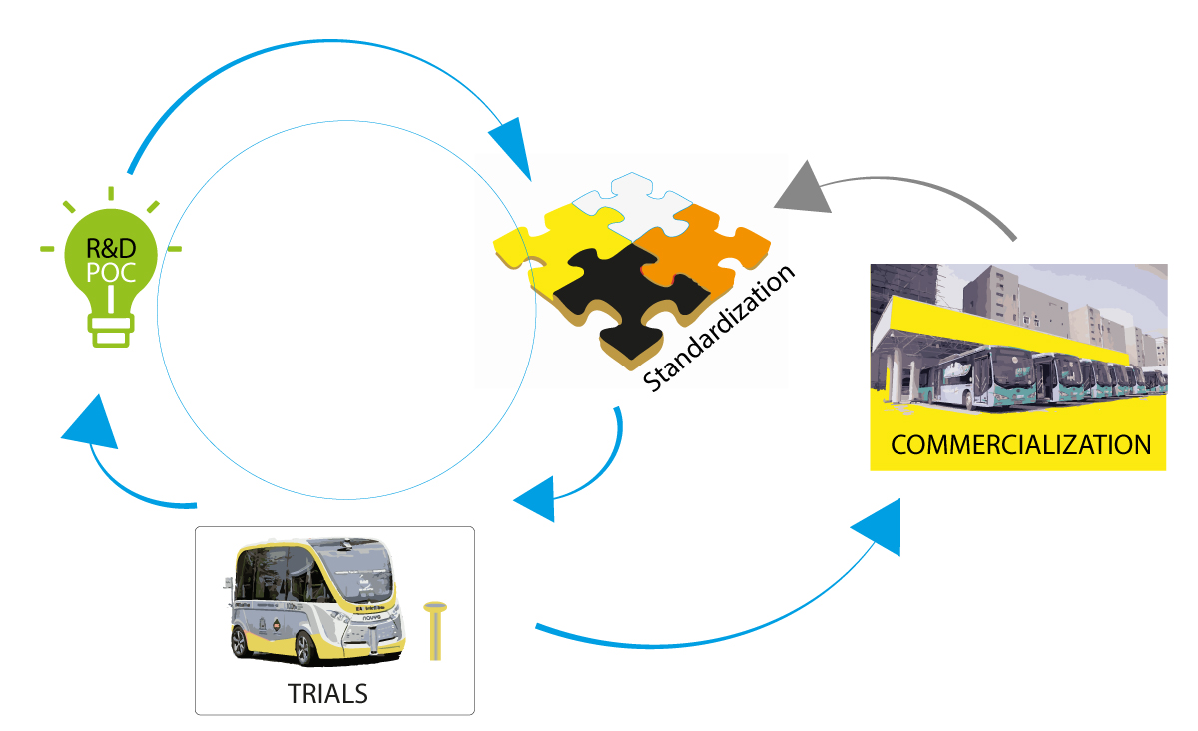
The role of 3GPP
3GPP is part of the invention, proof of concept, standardization, trials, commercialization …cycle
Its role is to specify and maintain a complete system description for mobile telecommunications
The system description is characterized by a number of standardized interfaces, not a description of standardized deployment
This standardization approach enables an interoperable, multi-vendor approach to deployment and generates mass market economies of scale, without stifling innovation

Slide 5

3GPP organization
Project Coordination Group (PCG)
TSG RAN Radio Access Network
RAN WG1 Radio Layer 1 spec
RAN WG2 Radio Layer 2 spec Radio Layer 3 RR spec
RAN WG3 lub spec, lur spec, lu spec UTRAN O&M requirements (Radio CN Interfaces)
RAN WG4 Radio Performance Protocol aspects
RAN WG5 Mobile Terminal Conformance Testing
RAN WG6 GSM EDGE Radio Access Network
TSG CT Core Network & Terminals
CT WG1 MM/CC/SM (lu) (end-to-end aspects)
CT WG3 Interworking with external networks
CT WG4 MAP/GTP/BCH/SS (protocols within the CN)
CT WG6 Smart Card Application Aspects
TSG SA Service & Systems Aspects
SA WG1 Services
SA WG2 Architecture
SA WG3 Security
SA WG4 Codec & Media
SA WG5 Telecom Management
SA WG6 Mission-Critical Applications
3GPP SA5 is responsible for management, orchestration and charging standards for 3GPP networks
Coordinates with all 3GPP working groups
Communicates with other SDOs and industry fora

Slide 6
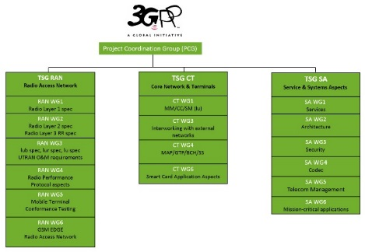
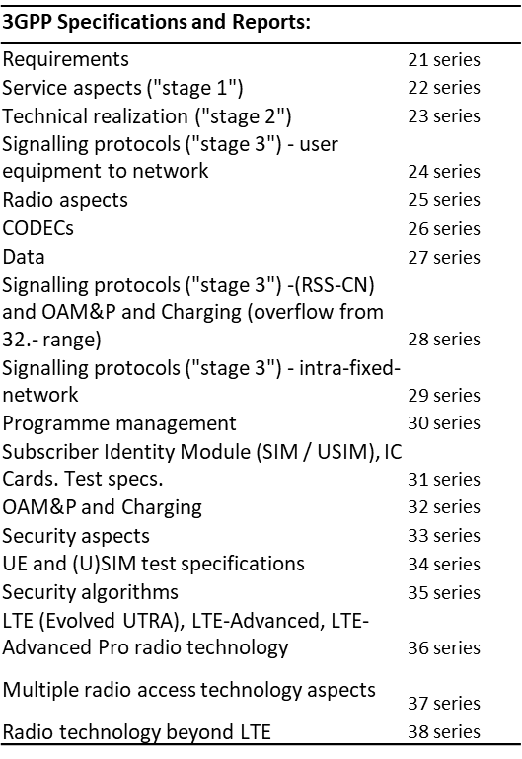
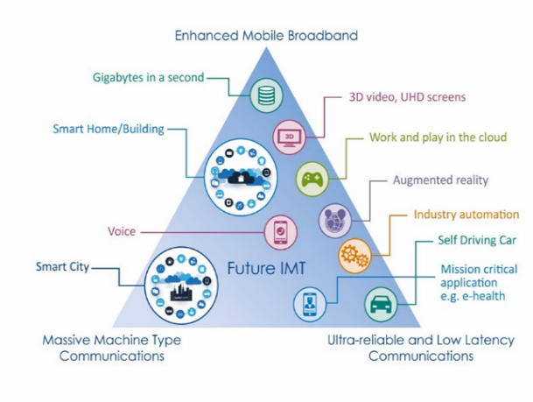
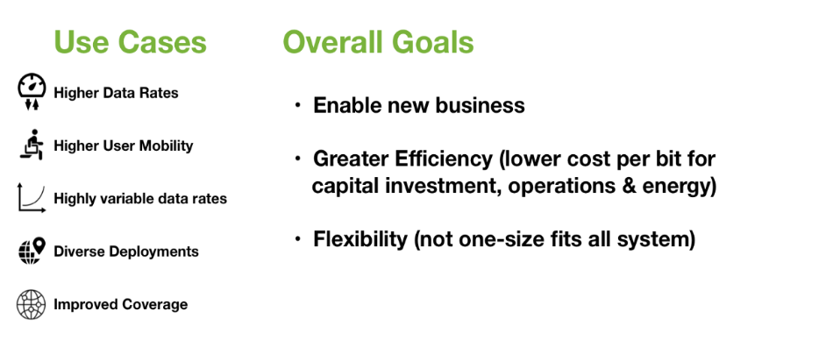
Bring the work in to the group

Slide 7
3GPP SA5 ToR introduction - 1
Overview
TSG SA WG5 is responsible for Telecom Management of the 3GPP network. This includes aspects such as operation, orchestration, assurance, fulfillment, automation and charging. Both functional and service perspectives are covered.
TSG SA WG5 specifies requirements, stage 2 and stage 3 solutions. The solutions include architecture, service definitions and data definitions. Management services includes services towards vertical industries. Charging service is used for billing or other analytics as well as customer care.
TSG SA WG5 also specifies design principles, guidelines and methodology for management, orchestration and assurance.
Scope of Responsibilities
TSG SA WG5 is responsible for all specification work pertinent to Telecom Management. Important areas where TSG SA WG5 is actively involved and developing specifications with full support of automation are:
Telecom management architecture framework.
Service Management, Network Management, Element Management (which includes management of Network Elements and Network Functions) and Charging Management.

Slide 8
3GPP SA5 ToR introduction-2
Management aspects of energy efficiency.
Exposure of management services to entities external to the network operator, e.g. verticals.
Data collection for Telecom Management. Examples of data being collected: alarms, performance measurements, KPIs, QoE, trace, MDT data and charging data.
Services and functions which support orchestration, assurance and analytics. Examples are (but not limited to):
Life Cycle Management (LCM), Fault Management, Configuration Management, Accounting Management, Performance Management and Security Management (FCAPS).
Management of autonomous networks, Self-Organizing Networks (SON), Intent driven management, Closed and open loop assurance and Data analytics.
Network Resource Models (NRMs), operations and notifications.
3GPP Management support for edge components deployed at MNO premises.
TSG SA WG5 is committed to engage in charging and management aspects of supporting new services for public and non-public networks.
TSG SA WG5 coordinates with other 3GPP WGs and all relevant Standards Developing Organizations (SDOs), industry fora and Market Representation Partners (MRPs) in the specification work pertinent to Telecom Management.
3GPP SA5 ToR URI: https://www.3gpp.org/specifications-groups/sa-plenary/sa5-telecom-management

Slide 9
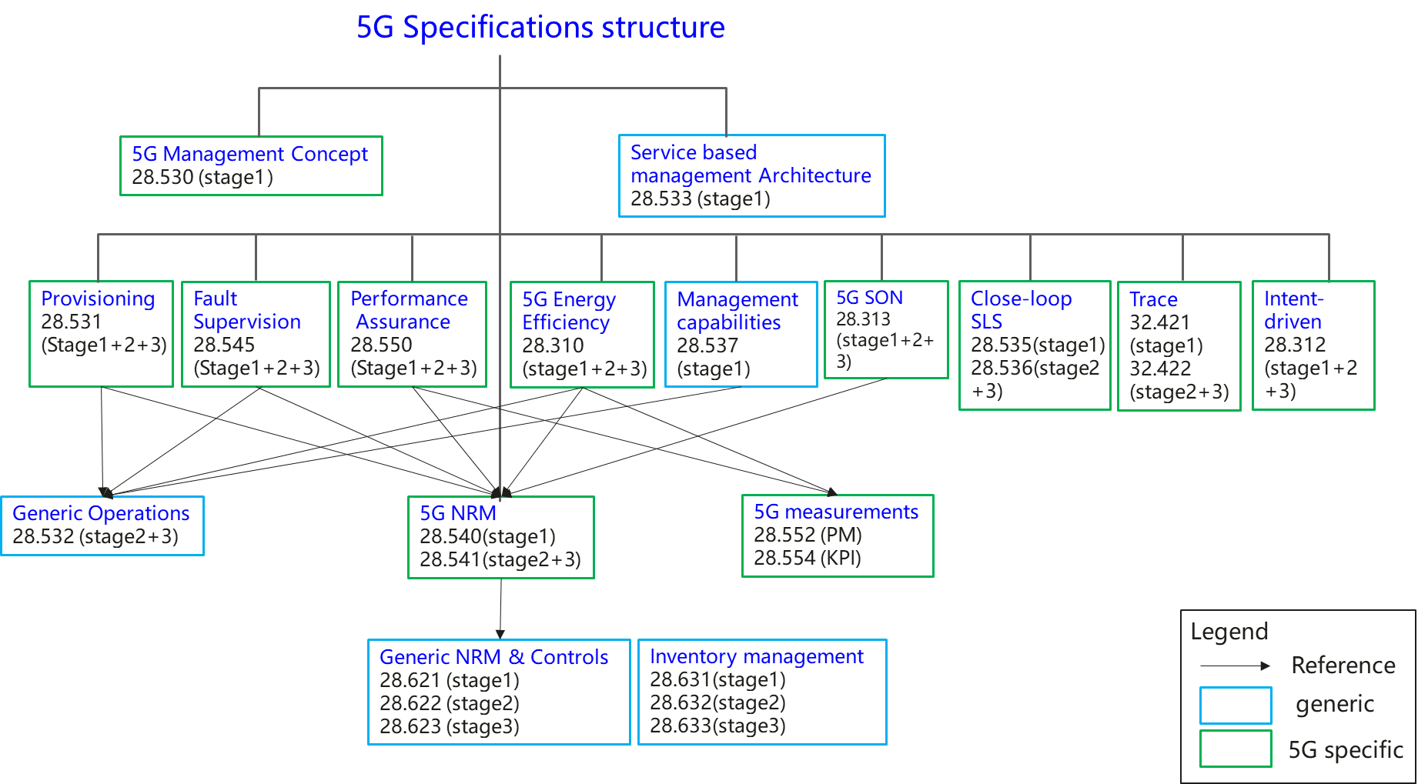
3GPP SA5 5G specifications (TS 32.103)
1 | Network and service management concept specification | TS 28.530[42]
2 | Network management service based management architecture specifications | TS 28.533[43]
3 | Network and Network slicing management related specifications
3.1 | Network and Network slicing provisioning | TS 28.531[44],TS 28.532[45],TS 28.540[46],TS 28.541[47]
3.2 | Network and Network slicing fault supervision | TS 28.545[48],TS 28.532[45]
3.3 | Network and Network slicing performance assurance | TS 28.550[49],TS 28.532[45],TS 28.540[46],TS 28.541[47],TS 28.552[50], TS 28.554[51]
3.4 | NRM | TS 28.540[46],TS 28.541[47]
4 | Energy efficiency related specifications | TS 28.310[52],TS 28.532[45],TS 28.552[50],TS 28.554[51]
5 | ONAP-3GPP integration | TS 28.532[45]
6 | Trace and MDT management | TS 32.421[37],TS 32.422[54]
7 | 5G SON management | TS 28.313[53],TS 28.541[47]
8 | SLA management | TS 28.540[46],TS 28.541[47]
9 | 5G management capabilities (Heart beat) | TS 28.537[54],TS 28.532[45]
10 | Close-loop SLS | TS 28.535[55], TS 28.536[56]
11 | Management service discovery | TS 28.530[42],TS 28.533[43]
12 | Management of tenant information | TS 28.530[42], TS 28.531[44],TS 28.533[43],TS 28.550[49],TS 28.552[50],TS 28.541[47]

Slide 10
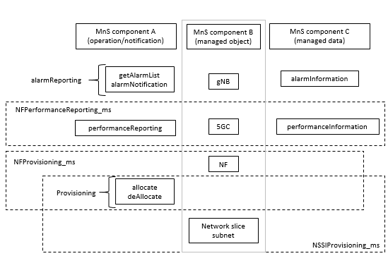

Service Based Management architecture(TS 28.533)
The fundamental building block of the Service Based Management Architecture (SBMA) is the Management Service (MnS). A MnS is a set of offered capabilities for management and orchestration of networks and services. An MnS producer offers its services via a standardized service interface composed of individually specified MnS components (i.e. MnS component type A, B,C ).
A Management Function (MnF) is a logical entity playing the roles of MnS consumer and/or MnS producer
MnS producer and MnS consumer
Example of Management Service and component type A, B and C
Example of Management Service deployment framework

Slide 11
Autonomous network related topics in LTE and 5G
LTE
5G
3GPP SA5 has been engaged in autonomous network relevant topics for LTE network. Self-Organizing Network (SON) for E-UTRAN including SON concepts and requirements, Self-configuration, Automatic neighbour relation (ANR), self-optimization and self-healing were standardized since 3GPP Rel-8 (in 2008).
Autonomous Network Level
Closed loop communication service assurance
Intent driven management service for mobile networks
Management Data Analytics Service
Self-Organizing Networks (SON) for 5G networks
Network Slicing
Centralised SON: SON solution where SON algorithms are executed in the OAM system. Centralised SON has two variants:
NM-Centralised SON: SON solution where SON algorithms are executed at the Network Management level.
EM-Centralised SON: SON solution where SON algorithms are executed at the Element Management level.
Distributed SON: SON solution where SON algorithms are executed at the Network Element level.
Hybrid SON: SON solution where SON algorithms are executed at two or more of the following levels: NE or EM or NM.

Slide 12
Autonomous Network Level Study - Introduction
In 3GPP Release 16, 3GPP SA5 has studied on concept, use case, requirements and solutions for levels of autonomous network (Corresponding contents have been captured in TR 28.810).
3GPP TR 28.810: “Study on concept, requirements and solutions for levels of autonomous network”
In 3GPP Release 17, 3GPP SA5 has started a new work item on normative work for levels of autonomous network (Corresponding contents will be captured in TS 28.100).
3GPP TS 28.100: “Management and orchestration; Levels of autonomous network”

Slide 13
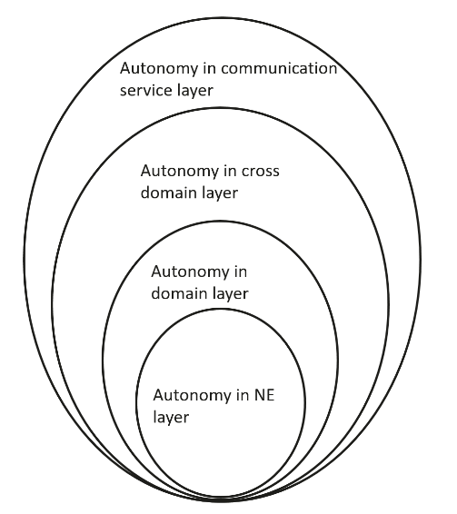
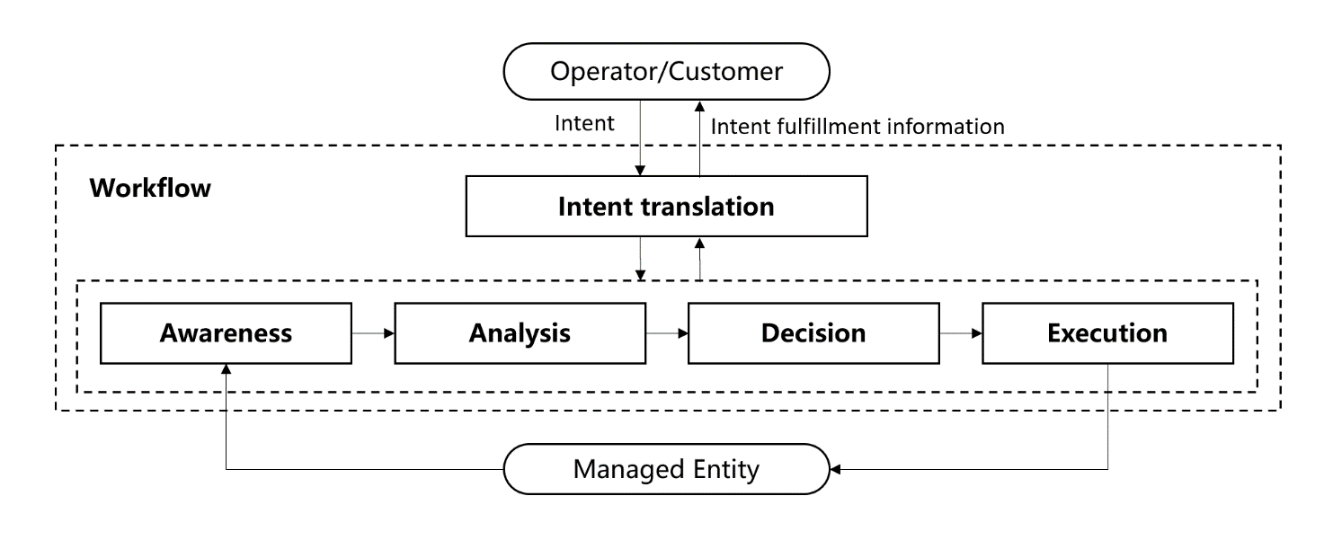
Autonomous Network Level Study (TR 28.810) - Concepts
Concept of network autonomy
Concept of network autonomy level
Network autonomy describes the telecom system (including management system and network) capability which is able to be governed by itself with minimal to no human intervention. Some features discussed in 3GPP are related to network autonomy. Following are some examples:
Self-Organizing Network (SON)
Management data analytics
Intent driven management
Close loop SLS assurance
Network autonomy level describes the level of application of autonomy capabilities in the network management workflow. The participation of the human and telecom system in the network management workflow are important factors to evaluate the network autonomy level. For each network autonomy level, which tasks can be performed by telecom system, which tasks can be performed by human, and which tasks can be performed by cooperation of human and telecom system needs to be clarified. For example, in the highest autonomy level, all tasks are performed by telecom system.
Potential dimensions for classification of network autonomy
Workflow
- Intent translation: The group of tasks which translate network or service intent from operator or customer into detailed management operations which may affect one or more of the following groups of tasks (i.e. awareness, analysis, decision, execution) and translate the detailed network and service information to intent fulfilment information (e.g. the intent is satisfied or not)..
Awareness: The group of tasks which monitor network information (including network performance, network anomaly, network event, etc).
Analysis: The group of tasks which analyse the collected information (e.g. information about network status, network issues and so on) or based on the historical data to further predict the future change trend of the above network status, and make recommendation for decision.
- Decision: The group of tasks which decide the necessary management operation for execution, e.g. network configuration or adjustment.
- Execution: The group of tasks which execute the management operations.
Management scope
Scenarios
Potential scopes of network autonomy:
- Autonomy in NE layer, which means the autonomy mechanism is executed in the NE.
- Autonomy in domain layer, which means the autonomy mechanism is executed in the MnF(s) in domain.
- Autonomy in cross domain layer, which means the autonomy mechanism is executed in the MnF(s) in cross domain.
- Autonomy in communication service layer, how to execute the autonomy mechanism in communication service layer is FFS.
The network autonomy can be implemented for different scenarios, the complexity of network autonomy depends on the detailed scenarios it applied. Also it will be more challenge for the telecom system to achieve the network autonomy for full scenarios than for certain scenarios. For example, autonomy applicability of network deployment will be more challenge for outdoor combine indoor scenario than only outdoor scenario.

Slide 14
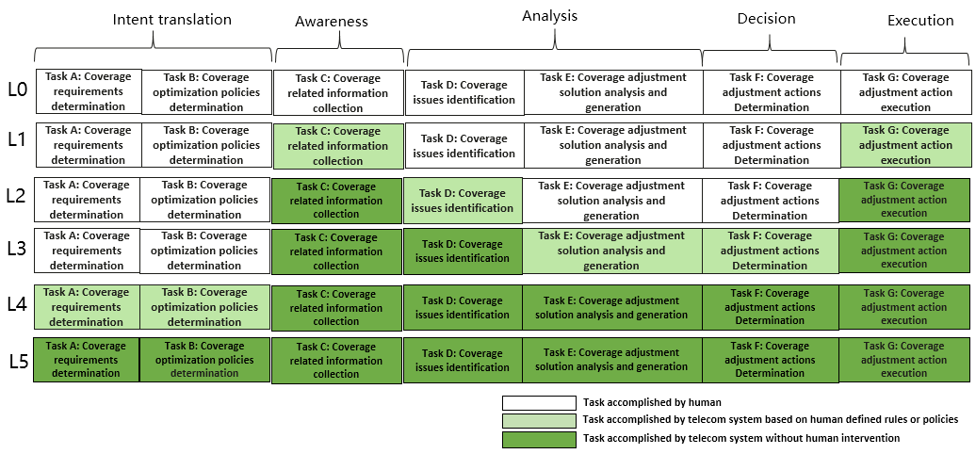
Autonomous Network Level Study (TR 28.810) - Classification
Framework approach for classification of autonomous network level
Level 3 intermediate autonomous network: All the execution and awareness tasks are accomplished automatically by telecom system itself. A part of the analysis and decision tasks are accomplished automatically by telecom system itself based on human defined policies. At this level, the telecom system can achieve the close loop automation based on the human defined close loop automation policies.
Level 4 advanced autonomous network: All the execution, awareness, analysis and decision tasks are accomplished automatically by telecom system itself. And intent translation tasks can be partly accomplished automatically by telecom system itself based on human defined intent translation policies. At this level, telecom system can achieve the intent driven close loop automation based on human defined intent translation policies, which means the telecom system can translate the intent to the detailed close loop automation and translate the detailed network and service information to intent fulfilment information (e.g. the intent is satisfied or not) based on human defined intent translation policies.
Level 5 fully autonomous network: The entire network autonomy workflow is accomplished automatically by telecom system without human intervention. At this level, telecom system can achieve the whole network autonomy.
Level 0 manual operating network: No categorization of the tasks is accomplished by telecom system itself.
Level 1 assisted operating network: A part of the execution and awareness tasks are accomplished automatically by telecom system itself based on human defined rules. At this level, telecom system can assist human to improve the execution and awareness efficiency.
Level 2 preliminary autonomous network: All the execution tasks are accomplished automatically by telecom system itself. A part of the awareness and analysis tasks are accomplished automatically by telecom system itself based on human defined policies. At this level, telecom system can assist human to achieve the close loop based on human defined policies.
Network autonomy level |  | Task categories
 |  | Execution | Awareness | Analysis | Decision | Intent translation
L0 | Manual operating network | Human | Human | Human | Human | Human
L1 | Assisted operating network | Human & Telecom system | Human & Telecom system | Human | Human | Human
L2 | Preliminary autonomous network | Telecom system | Human & Telecom system | Human & Telecom system | Human | Human
L3 | Intermediate autonomous network | Telecom system | Telecom system | Human & Telecom system | Human & Telecom system | Human
L4 | Advanced autonomous network | Telecom system | Telecom system | Telecom system | Telecom system | Human & Telecom system
L5 | Full autonomous network | Telecom system | Telecom system | Telecom system | Telecom system | Telecom system
Note 1: Human reviewed decision have the highest authority in each level if there is any confliction between human reviewed decision and telecom system generated decision. Note 2: The present of above five task categories does not reflect the workflow sequence.
Example: Classification of network autonomy for radio network coverage optimization

Slide 15
Autonomous Network Level Workitem (TS 28.100)
The following definition has been captured:
Autonomous Network: telecommunication system (including management system and network) with autonomy capabilities which is able to be governed by itself with minimal to no human intervention.
Autonomous Network Level: describes the level of autonomy capabilities in the autonomous network.
Note: The content of this slide is under discussion in the draft TS 28.100.

Slide 16
Closed loop communication service assurance- Introduction
In 3GPP Release 16, 3GPP SA5 has specified the concept for open control loops and closed control loops, as well as use cases, requirements and a model for closed loop communication service assurance (Corresponding contents have been captured in TS 28.535 and TS 28.536).
In 3GPP Release 17, 3GPP SA5 has started a new work item on enhanced closed loop SLS assurance.
TS 28.535: “Management and orchestration; Management services for communication service assurance; Requirements”
TS 28.536: “Management and orchestration; Management services for communication service assurance; Stage 2 and stage 3”

Slide 17
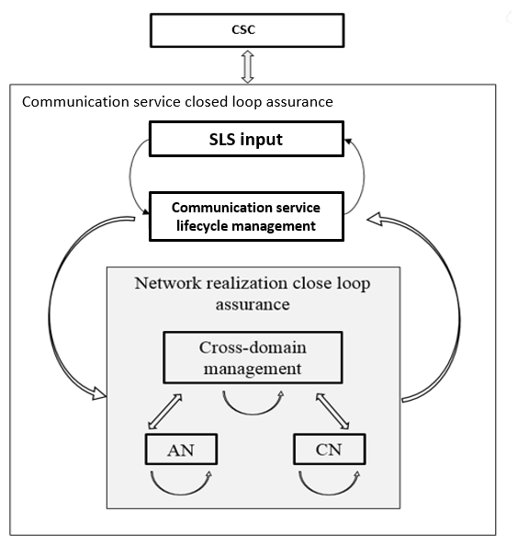
Closed loop communication service assurance (TS 28.535)
Communication service assurance applies to different phases in the life of communication services these lifecycle phases are; preparation, commissioning, operation and decommissioning.
Preparation
Commissioning
Operation
Decommissioning
For communication service assurance one can identify two interactions of management control loops:
Between the CSC and the CSP: In this case, the CSC provides the requirements for an assured communication service to the CSP, the CSP provides the corresponding communication service, the CSP also provides feedback to the CSC. The CSP adjusts the resources used by a communication service or the CSC adjusts the SLS continuously to achieve the assured requirements.
Between the CSP and the NSP: the communication service provided by CSP requires the network capabilities. For example, the CSP requires a certain network latency. The NSP management system adjusts the network or CSP adjusts the latency requirement continuously to satisfy the latency requirement.

Slide 18
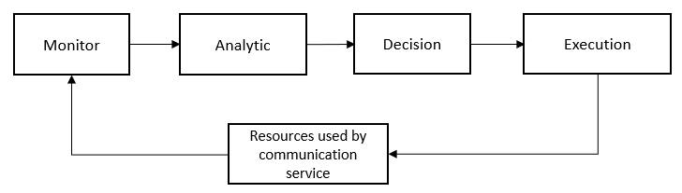
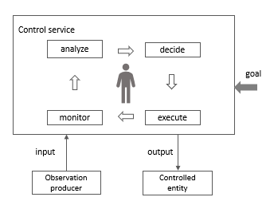
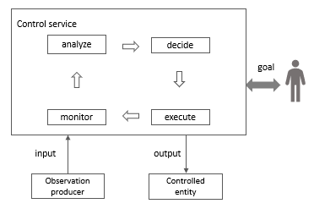
Closed loop communication service assurance (TS 28.535)
Overall process of communication service assurance using a management control loop
A control loop can be an open control loop in which case a human operator or other management entity intervenes inside the loop A control loop can be closed and operates without human operator or other management entity involvement inside the loop other than possibly the initial configuration of the measurement producer and configuration of control loop.
Open control loops
Closed control loops

Slide 19
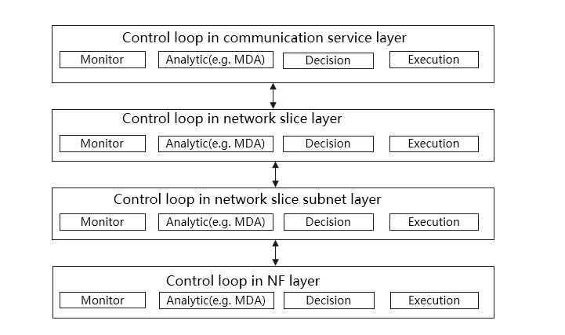
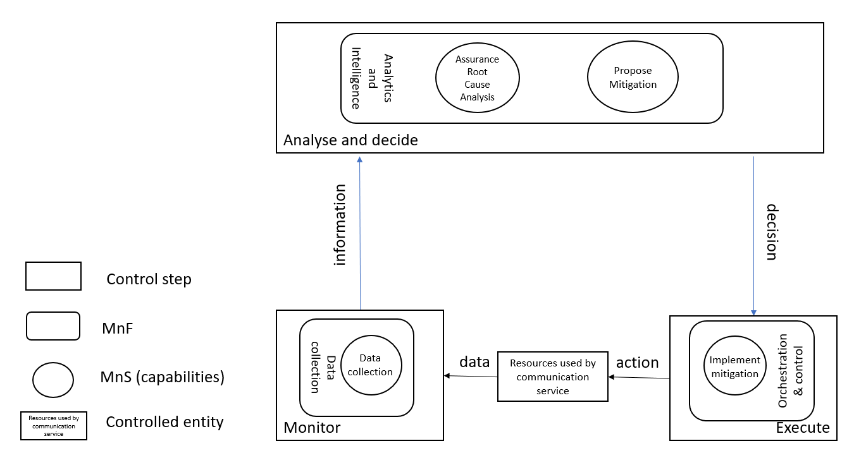
Closed loop communication service assurance (TS 28.536)
Control loop deployed in different layers
Communication service assurance relies on a set of management services that together provide the CSP with the capability to assure the communication service as per agreement with a CSC (e.g. enterprise).

Slide 20
Intent driven management for mobile networks - Introduction
In 3GPP Release 17, 3GPP SA5 has studied on concept, scenarios and solutions for intent driven management, which enable to simplify the management interfaces (Corresponding contents have been captured in TR 28.812). And the normative work for intent driven management has been started in 3GPP SA5 (Corresponding contents will be captured in TS 28.312).
3GPP TR 28.812: “Telecommunication management; Study on scenarios for Intent driven management services for mobile networks”
3GPP TS 28.312: ” Management and orchestration; Intent driven management services for mobile networks”

Slide 21
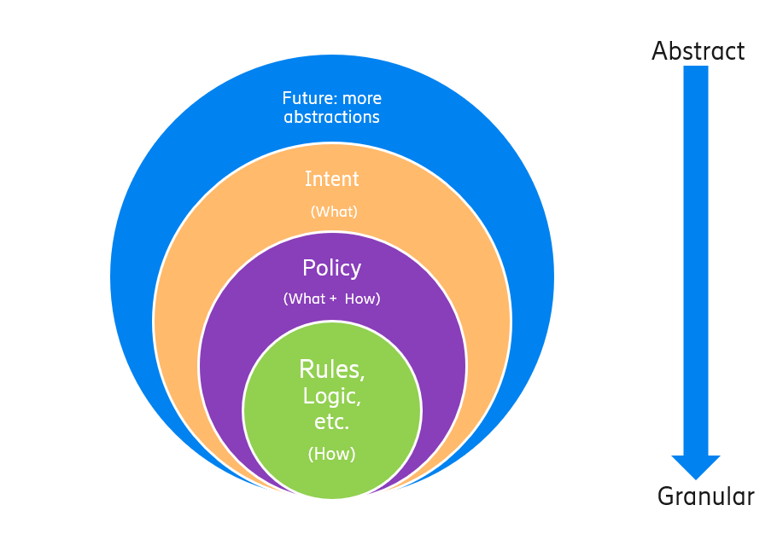
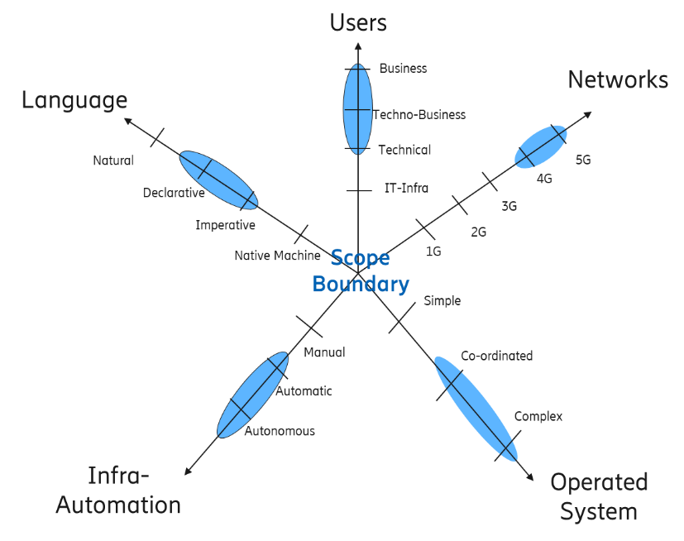
Intent driven management for mobile networks Study (TR 28.812) - Concepts
Intent driven management vs policy driven management
A policy is a function that governs the choices in behaviour of a system. It specifies the action(s) to be taken when specified condition(s) occur. More focus on “How” and less on “What” covering domain specific issues/aspects.
An intent defines to what position (in what state) we want as specific entity to be. More focus on “What”.
Dimensions of intent driven framework
Users
Network
Operated system
Language
Infra-Automation

Slide 22
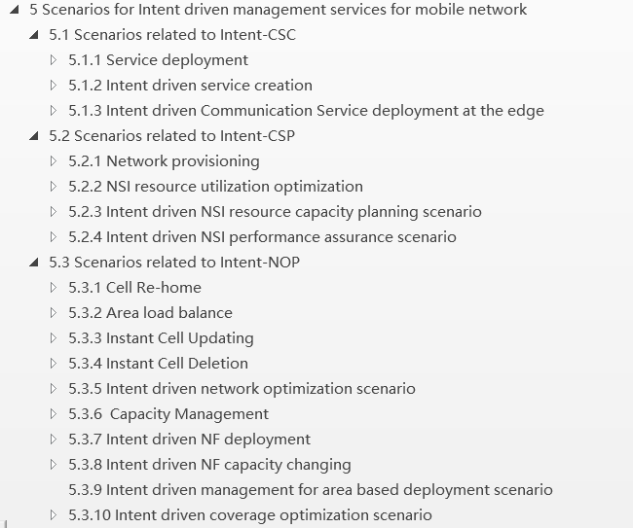
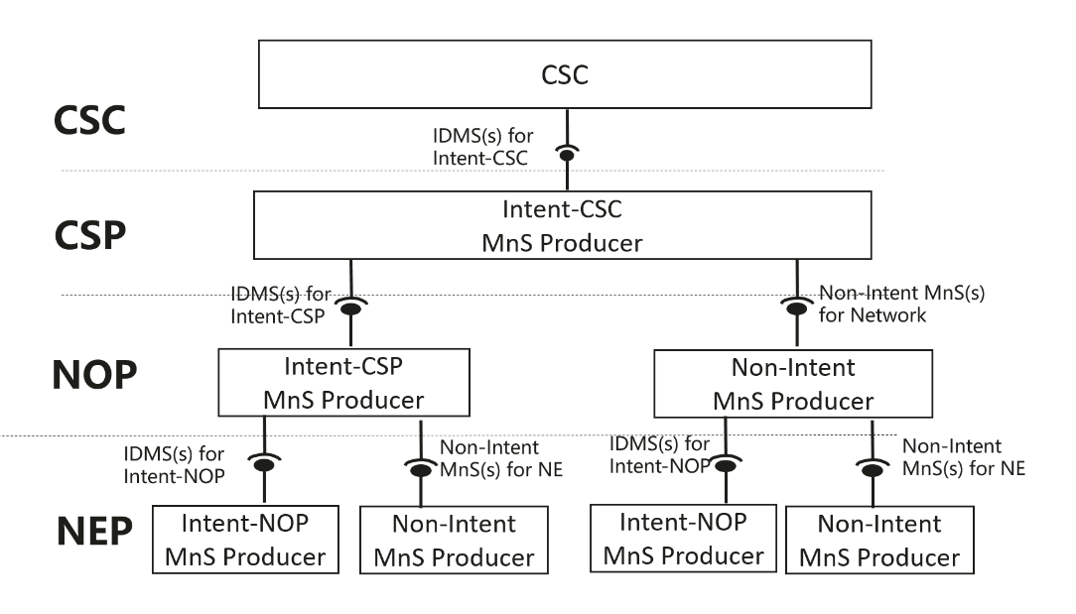
Intent driven management for mobile networks Study (TR 28.812) - Scenarios
Potential way to satisfy intent-CSC
Intent driven management scenarios

Slide 23
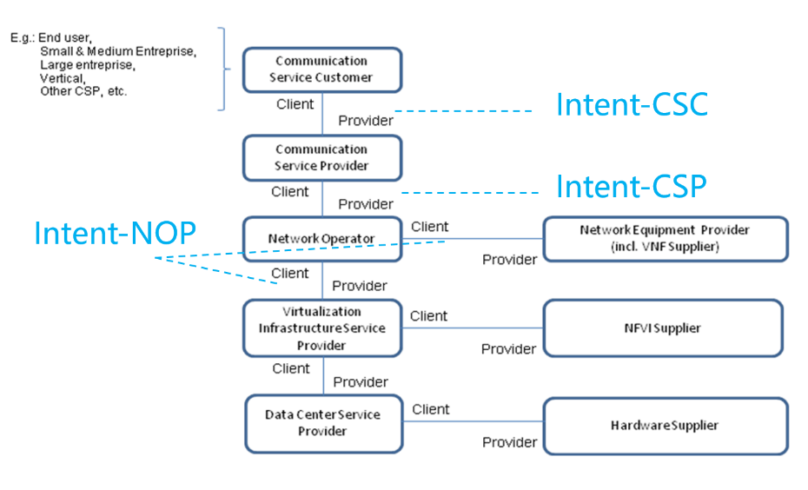
Intent driven management for mobile networks (TS 28.312)
Intent Definition: A desire to reach a certain state for a specific service or network management workflow.
Intent categorizes based on user types
Intent from Communication Service Customer (Intent-CSC)
Intent from Communication Service Provider (Intent-CSP)
Intent from Network Operator(Intent-NOP)
Intent categorizes based on management scenario types
Intent for network and service design/planning
Intent for network and service deployment
Intent for network and service maintenance
Intent for network and service optimization/assurance
Note: The content of this slide is under discussion in the draft TS 28.312.

Slide 24
Management Data Analytics Service - Introduction
In 3GPP Release 17, 3GPP SA5 has started the study on concept, use case, requirements and solutions for Management Data Analytics Service, which is in conjunction with AI and ML techniques, brings intelligence and automation to the network service management and orchestration (Corresponding contents will be captured in TR 28.809) .
3GPP TR 28.809: “Study on enhancement of management data analytics”

Slide 25
Management Data Analytics Service Study (TR 28.809)
MDA role in management loop
The MDA forms a part of the management loop (which can be open loop or closed loop, see TS 32.500 [10]), and it brings intelligence and generates value by processing and analysis of management and network data, where the AI and ML techniques may be utilized.
MDA process
There are two kinds of processes for MDA, the process for ML model training and the process for management data analysis.
Note: The content of this slide is under discussion in the draft TR 28.809.

Slide 26
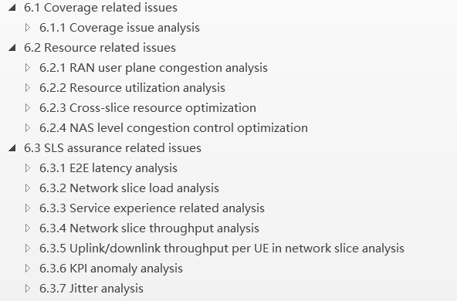
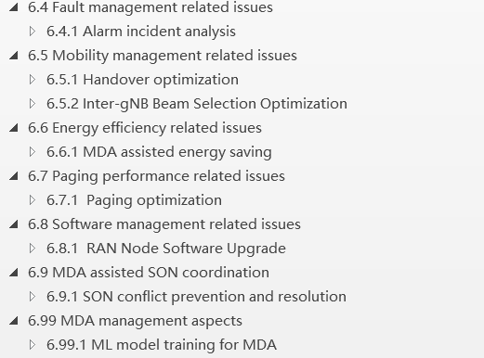
Management Data Analytics Service Study (TR 28.809)
MDA Use case
Note: The content of this slide is under discussion in the draft TR 28.809.

Slide 27
SON for 5G networks - Introduction
In 3GPP Release 16, 3GPP SA5 has specified the concepts, use cases, requirements and solutions for 5G SON, including ANR management, PCI configuration, RACH optimization, MRO and Energy Saving (Corresponding contents have been captured in TS 28.313 and TS 28.541). In 3GPP Release 17, 3GPP SA5 has started new work item(s) to continue specify the use cases, requirements and solutions for the 5G SON, including, Self-establishment of 3GPP NF, Centralized Capacity and Coverage Optimization, Load Balancing Optimization, NSI resource allocation optimization, MRO enhancement and Handover Optimization enhancement.
3GPP TS 28.313: “Self-Organizing Networks (SON) for 5G networks”
3GPP TS 28.541: ” Management and orchestration; 5G Network Resource Model (NRM); Stage 2 and stage 3”
Figure 4.1.1-1 Overview of SON Framework

Slide 28
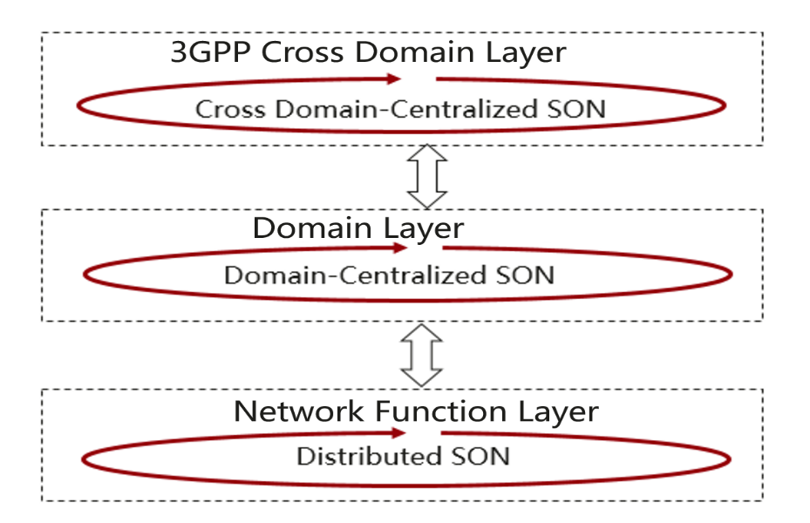
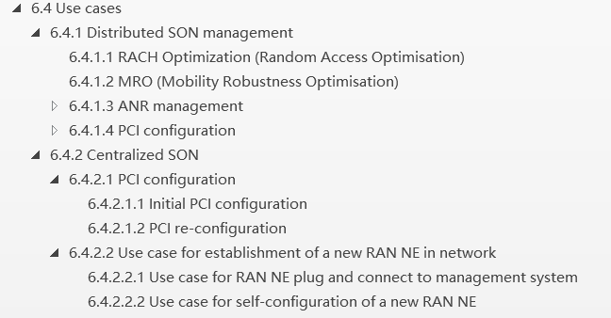
SON for 5G networks(TS 28.313)
Overview of SON Framework
SON Use case

Slide 29
Network Slicing - Introduction
3GPP SA5 has worked on the network slicing topics from Release 15. In Release 16, the SLA parameters related to network slicing have been documented as Service Profile in TS 28.541. SA5 just started a Rel-17 network slice management enhancement study and 5G SLA enhancement work item.
TS 28.530: “Management and orchestration; Concepts, use cases and requirements”
TS 28.531: “Management and orchestration; Provisioning”
TS 28.541: “Management and orchestration; 5G Network Resource Model (NRM); Stage 2 and stage 3”
TS 28.545: ” Management and orchestration; Fault Supervision (FS)”
TS 28.550: “Management and orchestration; Performance assurance”

Slide 30
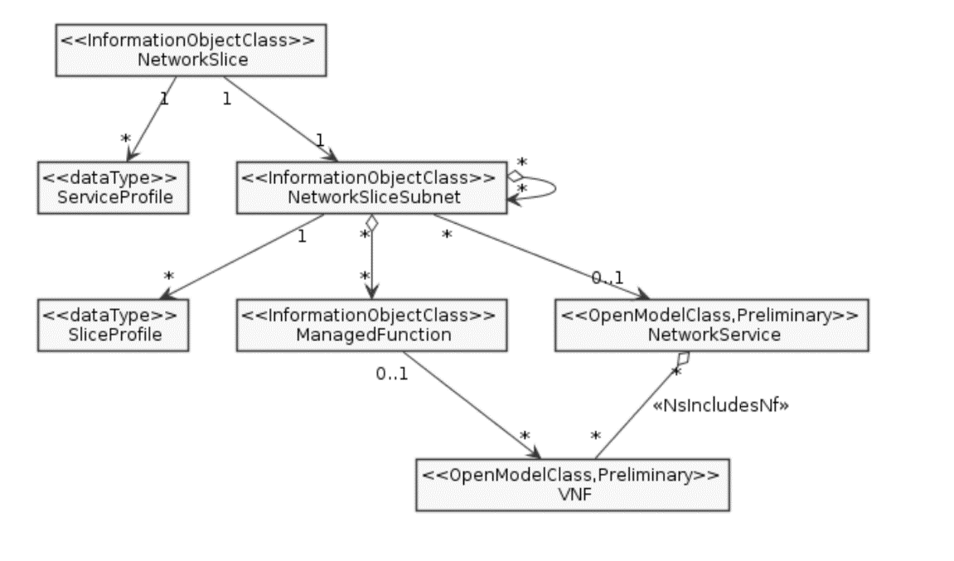
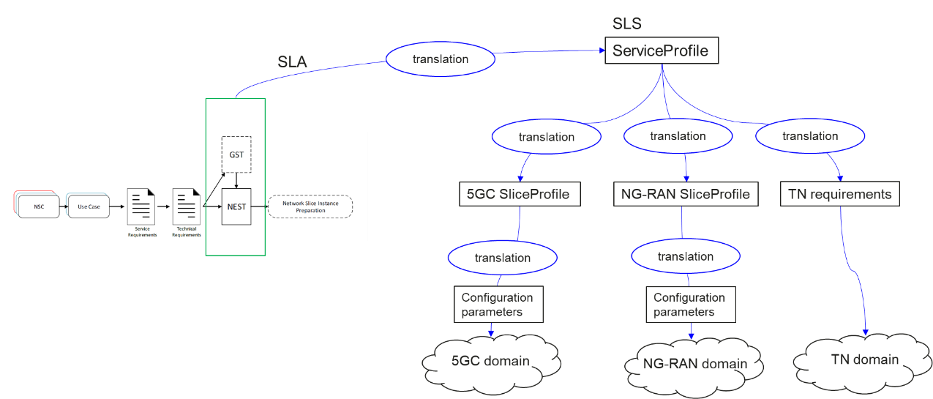
Network Slicing (TS 28.530 & 28.541)
Communication services using network slices
Network Slicing NRM
Relation between GSMA GST, ServiceProfile and SliceProfile

Slide 31
Conclusion
3GPP is an industry driven standardization activity with truly global reach.
Standardization of interfaces enables an interoperable, multi-vendor approach to deployment and generates mass market economies of scale.
3GPP SA5 has built up experience related to autonomous networks since 2008.
3GPP SA5 has already made some progress on autonomous networks and continues to deliver more features to support autonomous networks.
3GPP SA5 is actively involved and developing specifications with full support of automation.
3GPP SA5 is happy to cooperate with other SDOs on autonomous networks.

Slide 32

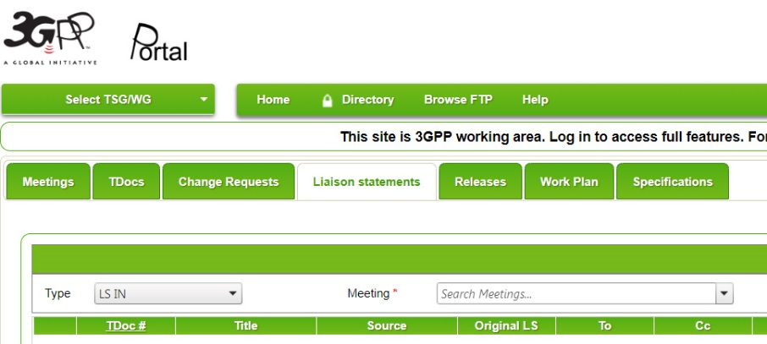

Thank you!
For more Information:
info@3gpp.org
thomas.tovinger@ericsson.com
zoulan@huawei.com
www.3gpp.org
portal.3gpp.org

