Slide 1

SA4#125 Social
August 24, 2023

Slide 2
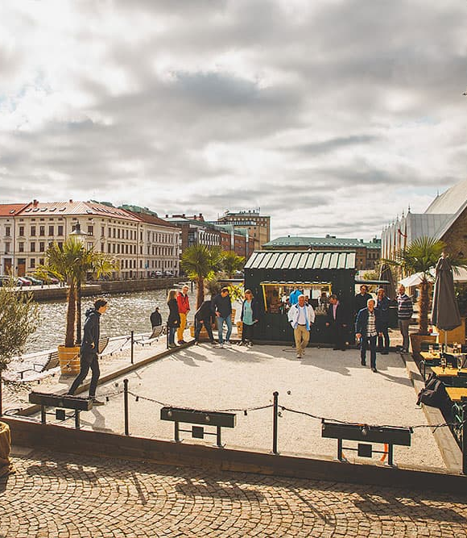
Dinner and Pétanque
to continue the good spirit of social gatherings, here is a proposal for another self-funded social event at SA4#125. Everyone is invited!
Boulebar Rosenlund offers to have dinner and then a round of plays. We will play with a guide that arranges a tournament and a prize ceremony in the end. The place is close to the meeting location (10min taxi, 30min walk).
Just a NOTE: Everyone can play Pétanque.
Date and Schedule:
  August 24, 2023
  Dinner: 20:15 - 21:30
  Pétanque: 21:45 - 23:30
Costs:
  2 course dinner SEK 390 + Tax: around 40 Euros
  Pétanque with guide and tournament: SEK 290 + Tax: around 30 Euro
  Total around 70 Euros + Drinks
  Payment on the spot, no cash and no AMEX.
Additional responses are welcome.

Slide 3

Signups (44+4)
Simon Gunkel | Tomas Toftgård
Thomas Stockhammer | Gilles TENIOU
Jan Holub | Andrei Stoica
Julien Lemotheux | elmira ramazanirend
Nikolai Leung | Gazi Illahi
Iraj | Andre Schevciw
Chris Steck & Margaret Steck | Srinivas Gudumasu
James Hu | Qi Pan
Waqar Zia | Thorsten Lohmar
Imed Bouazizi | Mary-Luc Champel (4)
Emmanuel Thomas | Yujian Yin
Nien Wu | Brian Lee
Yuan Gao | Ahmed Hamza
Wang Bin | Harald Pobloth
Jaeyeon Song | Liangping Ma
Serhan Gül | Saba Ahsan
Frédéric GABIN | stephane Onno
Gerhard Tech | Muhammed Coban
Erik Norvell | Eric Yip
Stefan Doehla | Jayeeta SAHA
Alexis Tourapis | Markus Multrus
Fredrik Stenmark | Alan Stein
https://forms.gle/BHBiytQRX5atWS5h8

Slide 4
Food
36 times regular meal
5 times fish option (Saba, Nik, …)
5 times vegetarian option
For the remaining 2, we will check how to handle

Slide 5
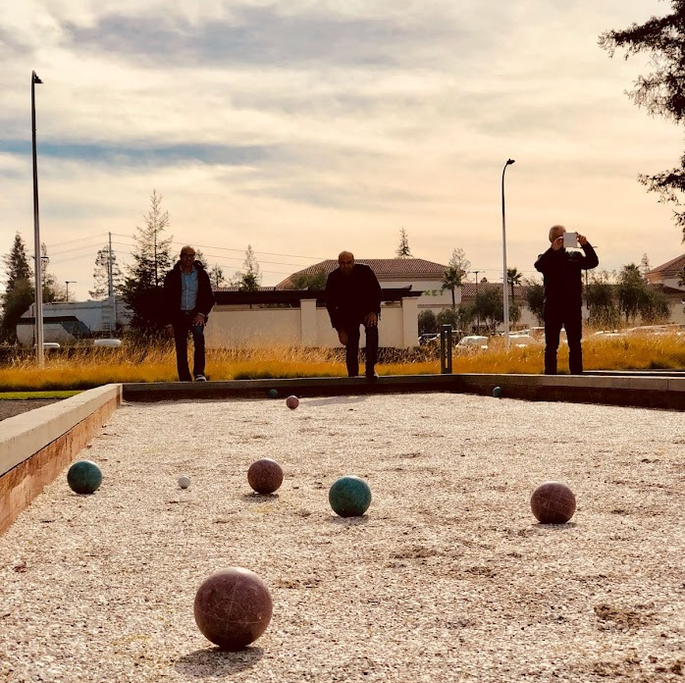
What is Pétanque?

Slide 6
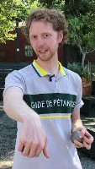
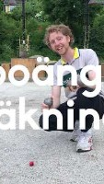
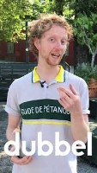

Slide 7
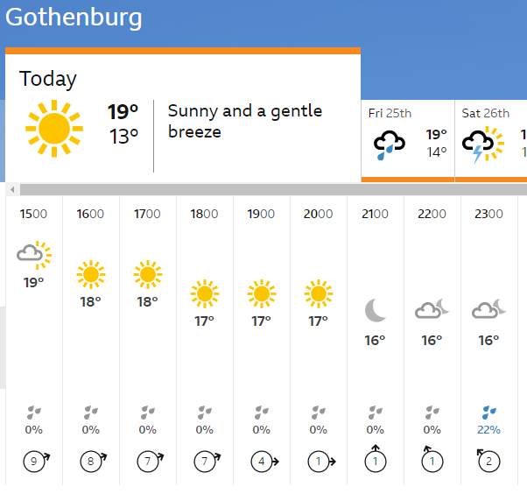
It will be outdoor – bring some warm clothes

Slide 8
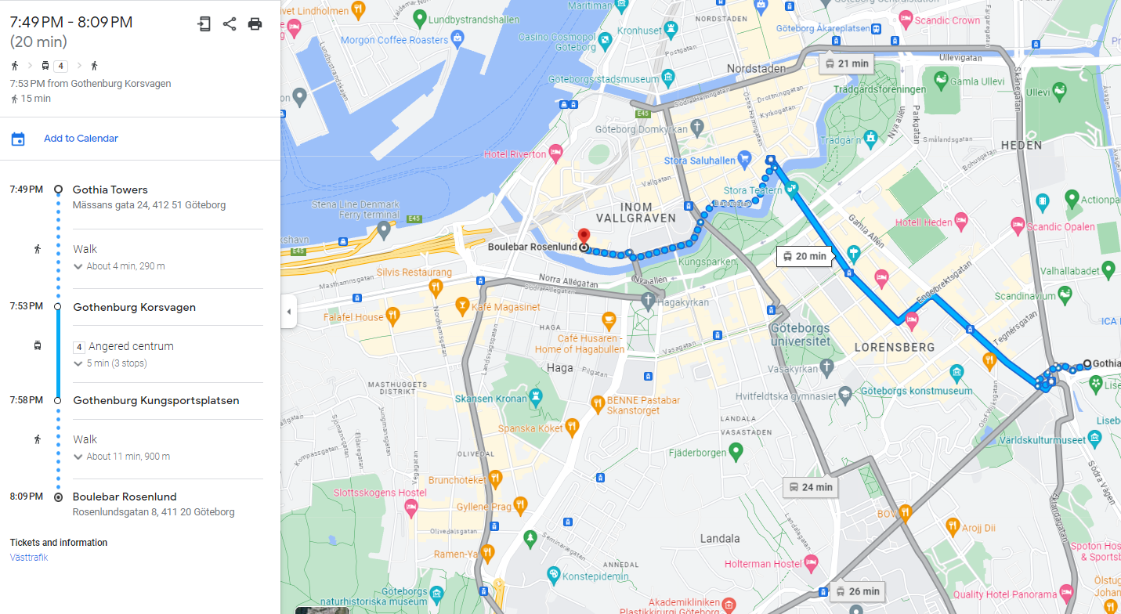
How to get there? Tram 4 (20min) or walk (30min) or Taxi (10min)
Boulebar Roselund
Rosenlundsgatan 8, 411 20 Göteborg

Slide 9
Questions?
Come by even if you did not sign up and just watch the fun

