Slide 1
Structuring work on iRTCW and FS_eiRTCW
S4-220xxx
April-12 2022
NTT (and QLC, FB)

Slide 2
Proposal
(Immersive Real Time Communication for WebRTC)
Between MNO and Application provider (i.e., OTT),
four collaboration scenarios should be investigated. Refer to 511.
Two realizations are currently proposed.
  Type 1: Based on 5GMS-AF, extension of streaming architecture.
  Type 2: Based on WebRTC-AF, representing WebRTC Signaling server. Refer to 420.
Architecture, call flows, and protocol stacks should be further investigated.
The following work structure is proposed.
  iRTCW (normative work) covers Type 1 realization.
  FS_eiRTCW (study) covers Type 2 realization.
  Outputs will be maintained by two Permanent Documents (PDs).
  This allows flexible consideration and progress for each realization. Later, the two should be checked.
NOTE:
  Proponents should watch the architecture discussion in 5G_AREA.
  A scenario for NPN (Non Public Networks) was also suggested. Specific requirements are invited.

Slide 3
Time plan –
Option #1 taken with two PDs
 | 4-6 (2022) | 7-9 | 10-12 | 1-3 (2023) | 4-6 | 7-9 | 10-12
R-18 |  |  |  | S2 freeze |  |  | S3 freeze
iRTCW |  |  |  |  |  |  | Complete
Study |  |  |  |  | Comp
Option 1) 5GMS-AF
CS1
CS2
CS3
Normative
TSs
Option 2) 5GMS-AF
CS1
CS2
CS3
WebRTC-AF
CS3
CS4
Informative
TR
Follow-up activity
In Rel-18/19?

Slide 4
Informative attachment

Slide 5
Two scenarios for iRTCW
(Immersive Real Time Communication for WebRTC)
Type 1) OTT is a primary service provider.
  WebRTC is one of the OTT’s services.
  MNO supports and assists OTT’s services indirectly.
    MNO doesn’t touch on WebRTC.
    MNO gets basic information (e.g., 5 tuples and QoS parameters) from UE and provides QoS enhancements.
  By providing an enabler, MNO is an actor behind an OTT.
  Simple scenario.
Type 2) MNO is a primary service provider.
  WebRTC is an MNO’s service.
  OTT and MNO can jointly provide the service.
  MNO plays the leading role.
  Advanced scenario.

Slide 6
General view of WebRTC
Control-plane is up to a provider.
An intermediary is usually used.
UE-A
Intermediary
UE-B
APP
APP/SigServ/ICE/MCU/SFU
APP
Media
Control
Control
Media
Control
Media

Slide 7
Two realizations around WebRTC
MNO
Type 1) MNO provides access to basic NW control via 5GMS-AF.
UE-A
Intermediary
UE-B
APP
APP/SigServ/ICE/MCU/SFU
APP
Media
Control
Control
Media
Control
Media
X
AF
X
X is embedded as an NW control entry point.
Features by X are primitive (not full SDP level).
PCF/NEF
Type 2) MNO provides entire session control by WebRTC signaling server (WebRTC-AF).
UE-A
Intermediary
UE-B
APP
APP/SigServ/ICE/MCU/SFU
APP
Media
Control
Control
Media
Control
Media
Traditional C-plane, but WebRTC-based
PCF

Slide 8
Discussion points on the second week
Two realizations; 5GMS-AF by QLC and native WebRTC by NTT
Clarification on call flow image
  CS#3 by 5GMS-AF, what does signaling mean?
Modeling; AF or AS? Confusing?
  AF(Application function)
    5GMS-AF
    P-CSCF/IMS type (WebRTC Signaling Server)
  AS(Application server)?
Time plan (one PD or two PDs?)

Slide 9
Collaboration scenarios (CS) and realizations
Realizations Collaboration Scenarios | Type 1: 5GMS-AF | Type 2: Native WebRTC-AF
CS1 (OTT) | Applicable
CS2 (ICE only) | Applicable
CS3 (One Signaling Server with one MNO) | Applicable (Not conferencing. Not call. Websocket + sub protocol) | Applicable (Typical conferencing)
CS4 (multiple Signaling Servers with MNOs) |  | Applicable

Slide 10
Q & A
Q. For 5GMS-AF, what is the relationship with WebRTC?? What does “signaling” mean?
A. QoS Control. WebRTC Signaling Server looks like an AS.
Q. 5GMS is MPEG-DASH only, not RTP?
Q. 5G_AREA (stage 2) generalizes 5GMS to support RTC. Control should be similar for both streaming and RTC. Media are different.
In 5GMS-AF, AF is an access entry to MNO’s infra control.
Modeling for WebRTC Signaling servers has two views: AS (with 5GMS-AF) or AF (as WebRTC -AF).
The modeling of the two AFs needs further refinement along with the progress.

Slide 11
Planning – Rel-18
Release 18 planning (no changes)
  SA Rel-18 Workshop September 2021 - completed
  Rel-18 Stage 1 100% complete by December 2021 (TSG#94) (with 80% completion at TSG#93)
  Rel-18 Stage 2 freeze March 2023 (TSG#99)
  Rel-18 Stage 3 freeze December 2023 (TSG#102)
  Rel-18 Protocol coding Freeze (ASN.1, OpenAPI), March 2024 (TSG#103)

Slide 12
Planning – Rel-19
Release 19 planning – SA1’s assumptions
  Rel-19 Stage 1 completion by September 2023 (TSG#101) (with 80% completion at TSG#100)
  Rel-19 Stage 2 freeze TBD
  Rel-19 Stage 3 freeze TBD
  Rel-19 Protocol coding Freeze (ASN.1, OpenAPI) TBD

Slide 13
backup

Slide 14
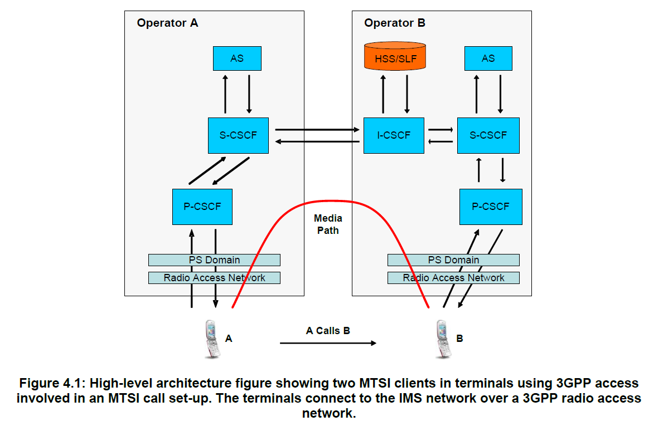
TS 26.114

Slide 15
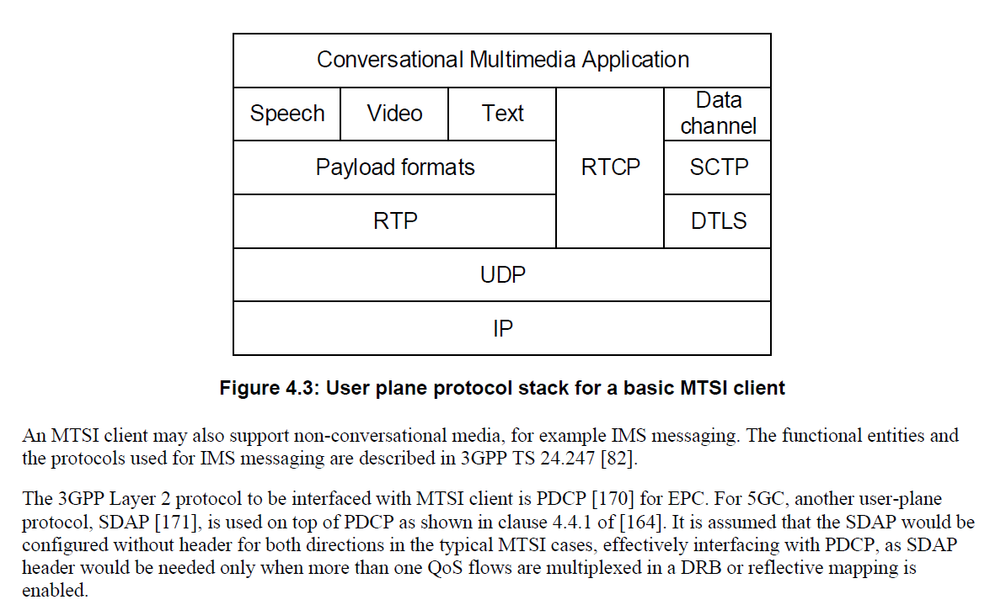
TS 26.114

Slide 16
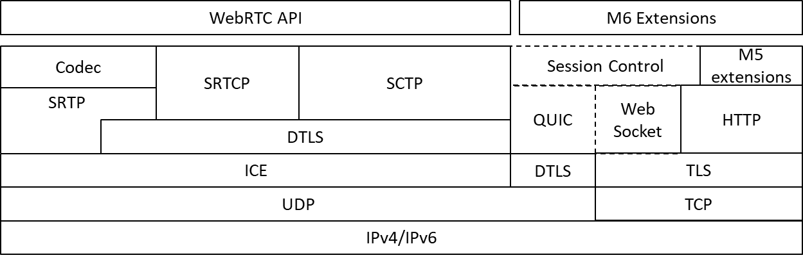
Proposal in 377

Slide 17
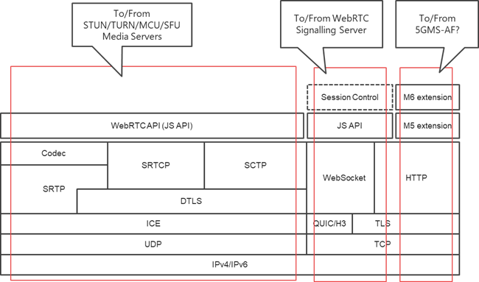
NTT’s idea

Slide 18
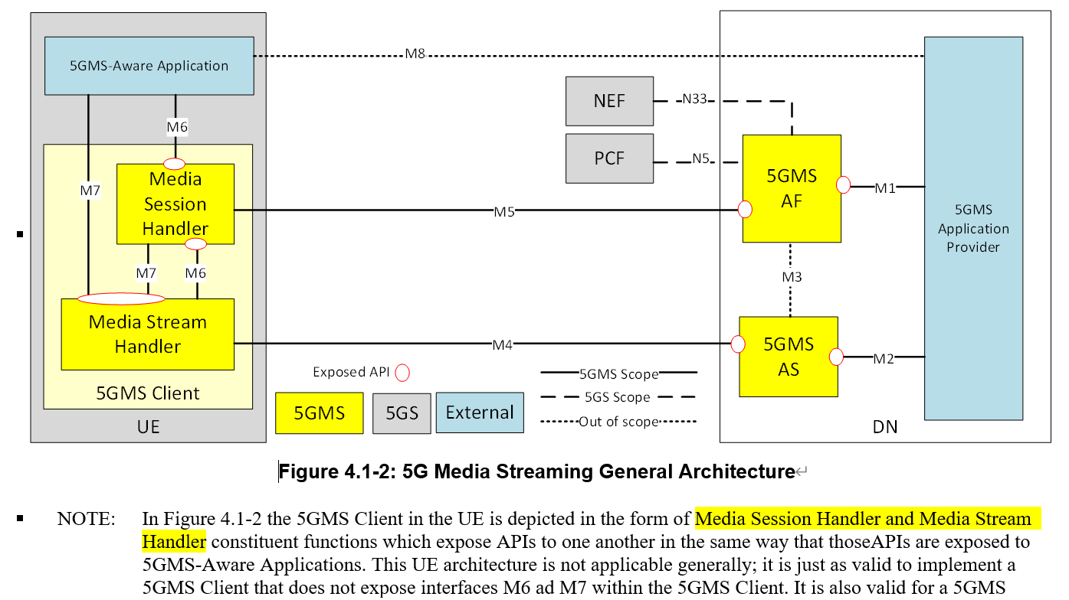
26.501

Slide 19
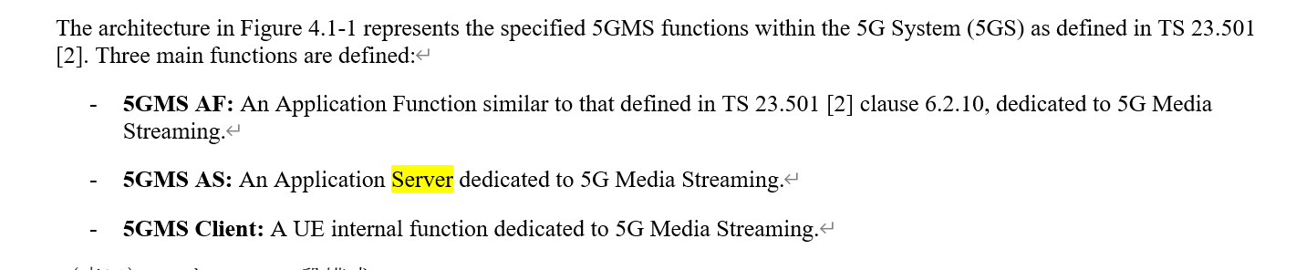

Slide 20
Different Models between RTC Work Items
To be updated
With specified C-plane, Operator-Assistance will provide interoperability
as IMS-based model while involving OTT-related elements.
OTT-related elements
iRTCW
(WebRTC-based
OTT model)
FS_eiRTCW
(WebRTC-based
Carrier Assistance model)
IBACS Expectation
(IMS model)
To be checked..
OTT-Data NW
Operator NW
OTT App
Operator NW
WebRTC
Signalling
Server
MCU/SFU
with ICE
WebRTC
Signalling
Server
AS
QoS
Control
(NBI?)
ISC
Mr’
OTT
C-Plane
U-Plane
QoS
Control
S-CSCF
MRFC
Operator
NW
NEF
Mw
Mp
PCF
OTT App
QoS
Control
PCF
Npcf
N7,
N4
N7,
N4
PCF
new WebRTC
C-Plane
MCU/SFU
with ICE
P-CSCF
MRFP
QoS
Tunnel
N7,N4
(R)AN / UPF
(R)AN / UPF
U-Plane
(R)AN
C-Plane
U-Plane
OTT proprietary
Client
OTT proprietary
Client
Various
Client
Various
Client
IMS Client
IMS Client

