Slide 1
RIS OSVP:
Rapid Industry Solutions
On-Set Virtual Production
13 October 2021
InterSDO Meeting
Barbara Lange

Slide 2

RAPID INDUSTRY SOLUTIONS
Provide a neutral, non-commercial platform to facilitate rapid industry solutions
Enlist Industry Advisory Group to guide the work to ensure SMPTE IS ACCOUNTABLE to the needs of the industry
SMPTE will curate these new deliverables, including development of education offerings and enabling systems interoperability (i.e., standards)
New flexible financial model to evaluate sustainability via project sponsorship, with proponents funding the initiative

Slide 3
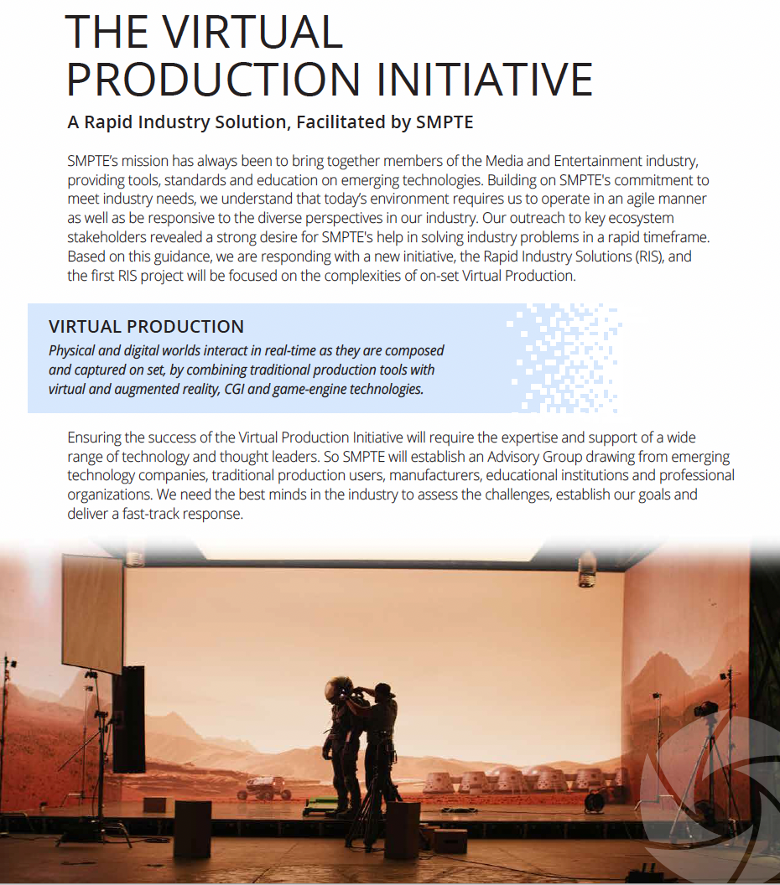
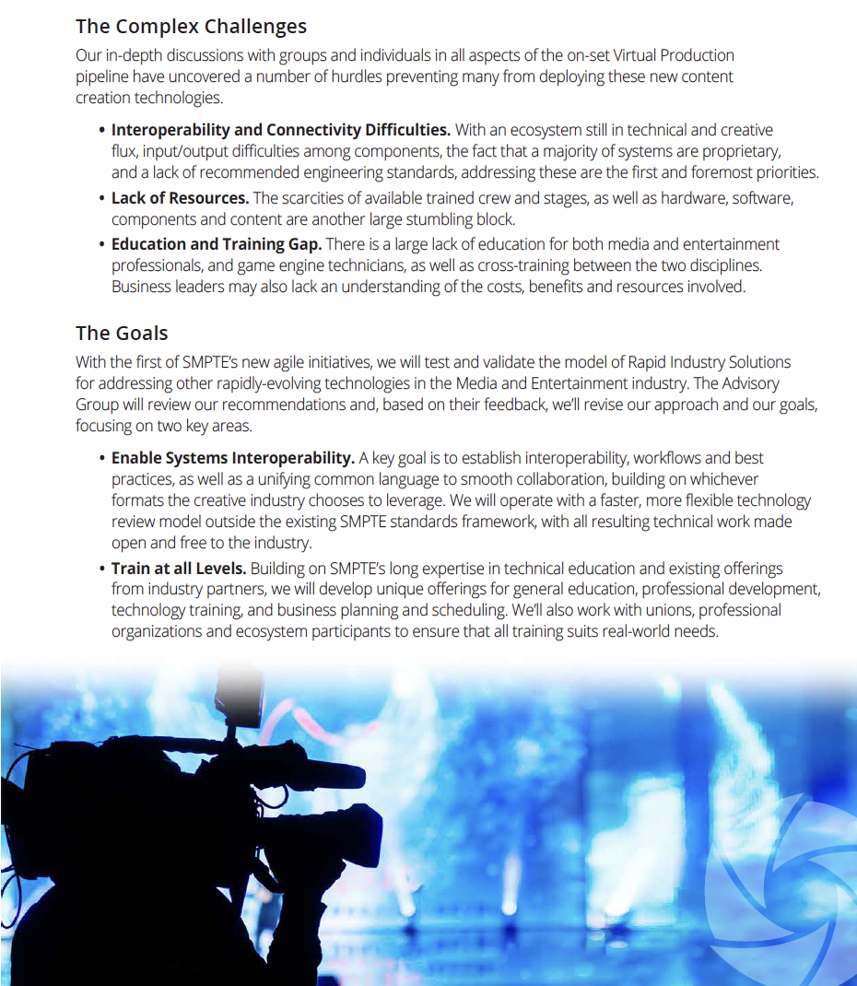

Slide 4


















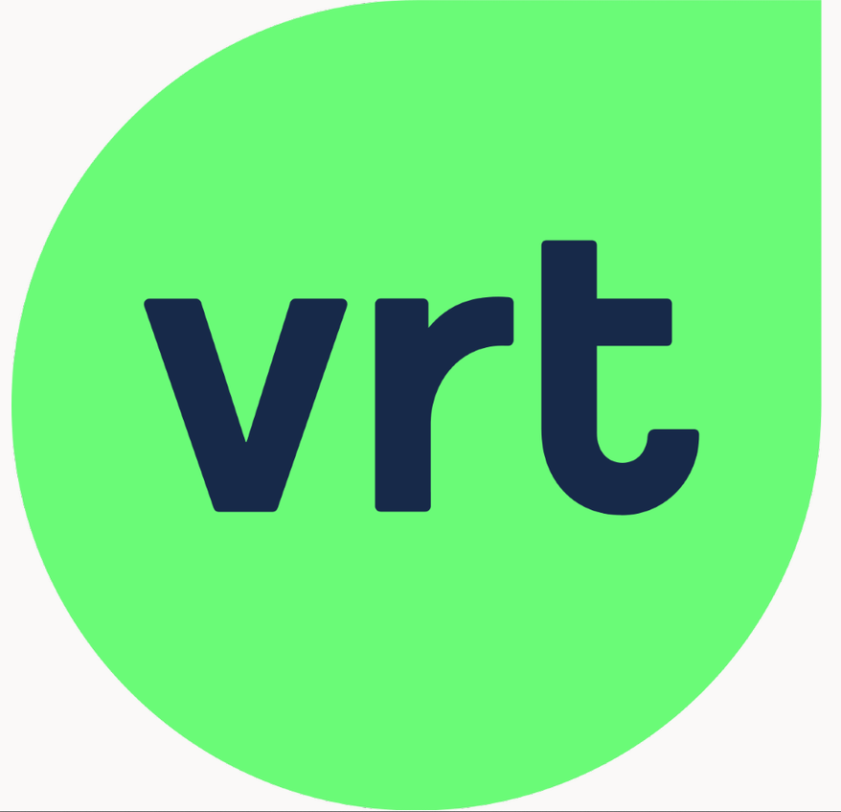






Slide 5

Industry Says We Need ....
Training and Education
  Leverage existing education offerings from Industry Partners
  Work with Advisory Group to develop unique offerings for General Education, Professional Development and Technical Training
To Enable Systems Interoperability
  Technology review model is different – faster and more flexible – than due process model
  Tech work will be made open to industry

Slide 6
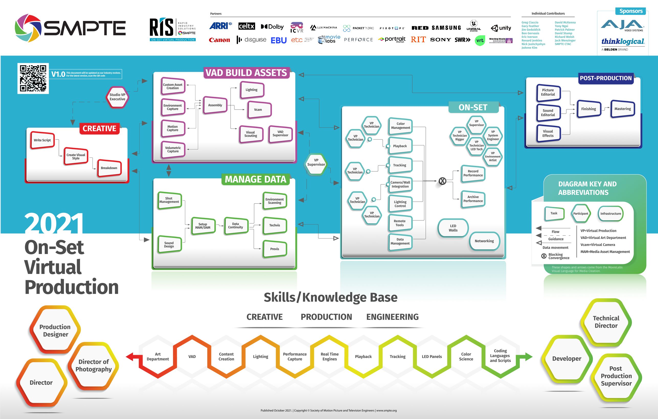
First Deliverable!
Wall chart to be published in October 2021 issue of SMPTE MIJ
Thanks to MovieLabs and ETC!
Plan is to make this a virtual wall-chart with real moving parts

Slide 7

Overview of Progress
Advisory Group
  Three meetings so far, regular monthly meetings scheduled
  Surveyed for top issues of concern
Workstreams
  Education
  Interoperability
  Outreach
Real Actions to Date
  ETC MOU signed
  Workstreams formed
  Engaged a business analyst intern
  Wallchart completed
  NAB Amplify, NAB FOCC and other sessions
  Focus on ATC and IBC for next public visibility
  Publicize planned deliverables for 2022

Slide 8
Extra slides

Slide 9



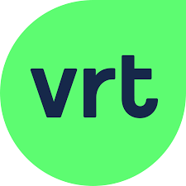


Interview Subjects
The home of media professionals, technologists, and engineers

Slide 10
Train and Educate the Industry
Crew
  Collaborate with Unions, Industry Organizations and Ecosystem participants to provide real world training
    Training already available from Epic/Unreal, Brompton, Disguise, Unity, NVIDIA
Business
  Collaborate with Professional Organizations for increased understanding of On Set Virtual Production and cost/resource benefits
    EBU, DTG, DPP, AMPAS, HPA, PGA, DGA, ASC, Movielabs, ETC, SIGGRAPH, VES, AIS
  Business planning and scheduling education to allow for multi-purpose use of virtual stages to offset expenses for Broadcasters, etc. (i.e., shared economy model)
Students
  RIT and Whistling Woods programs and other SMPTE Student Chapters
  Promote information sharing/collaboration between universities
    Good research and recruiting tool
**Interview feedback – add experiential programming to current educational offerings.
The home of media professionals, technologists, and engineers

Slide 11
Enable Systems Interoperability
File Interoperability
    Identify potential file format options for initial effort
    Will allow for universal use of 3D “stock footage”
    Allow for simplified IO between content created on multiple graphics programs into all systems
Establish storage and standard naming conventions for MAM/DAM
    Partner with Movielabs, Universal Project, ETC, Academy, VFX and Gaming
Technical solutions and interoperability
  LED walls
    Pixel pitch improvement recommendations
    Calibration requirements, measurement tools, color science
  Physical connections between components
    Move to an IP-based solution rather than SDI or HDMI
    Potentially expand upon ST 2110
    Connectivity pipeline for cameras and toolsets
Reimagine philosophy around “standards” to provide more guidelines and recommended workflows.
The home of media professionals, technologists, and engineers

