Slide 1
GMEC: pre-meeting Discussion
SA2#154AH-e

Slide 2
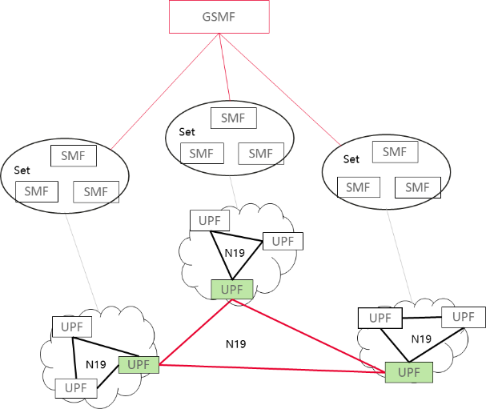
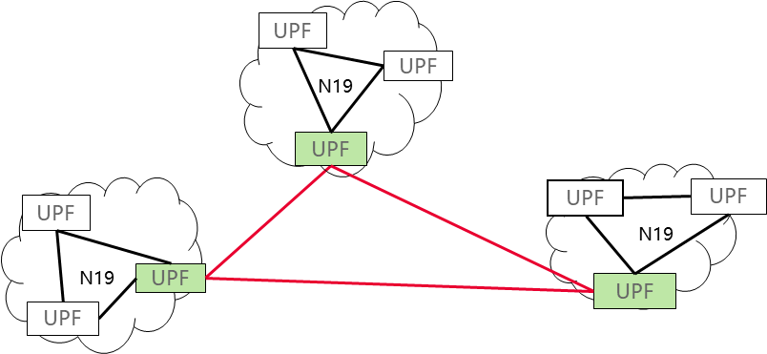
Key Issue #4 Conclusion
Stable Part:
  reliability of the 5G VN group communication: With the help of Set functionality - one or more SMF sets for a VN group
  Rel-16 compatibility issue: Proper configuration of the NRF profile (e.g. SMF(s), DNN, S-NSSAI, service area)
  5V VN group communication within a single SMF Set: N19-based forwarding, N6-based forwarding and local switch as per Rel-17 with NOTEs mentioning this is controlled by intra SMF set information exchange
5G VN group communication across different SMF Sets
  UPF topology: For each Set, only one “boarder UPF” connects to counterpart “boarder UPF” of other Sets
    Or any number of UPFs under a SMF Set can be “boarder UPF”?
  Static Connectivity between any two Border UPFs: OAM configured as tunnels using GTP-U or IETF protocols, details are out of SA2 scope
  Dynamic control of Connectivity between any two Border UPFs with SMF topology enhancement:
    N16a enhancements ?
    GSMF?
Border UPF?
N19?
Border UPF?
UPF topology
N16a extension
GSMF

Slide 3
KI#1
23.501 Structure
  1) new clause to capture the enhancements of LADN per DNN/S-NSSAI compared to 5.6.5 Support for Local Area Data Network;
    Or updates on existing clauses, e.g. 5.6.5?
  2) new clause to capture the main enhancements compared to 5.29.2 5G VN group management;
    Or capture the main updates in existing clauses, e.g. 5.29.2, 5.20 ?
23.502 Structure
  Extend the data type of 5G VN group data (using existing name or new name)
    The existing paras (except DNN, S-NSSAI) are only applicable to 5G VN groups
    The new paras (service area, QoS) that apply to both 5G VN group and non-5G VN groups
  Introduce a new data type: Session Characteristics parameters or different name?
    It is comprised of the paras that apply to both 5G VN group and non-5G VN groups
    This new data type is also added as one component in 5G VN group data table
  Specify a new data type (new generic group data”) that comprises the existing 5G VN group data and new paras?
    AF can choose whether to use “5G VN group data” or “new generic group data” depending what type of group it targets and the request parameters
23.503 Structure (for Group-MBR)
  new clause to capture the clarifications and mapping compared to Slice-MBR described in clause 6.1.4.1, 6.1.4.3 and 6.2.1.10.2

Slide 4
KI#3
New NEF service or enhance existing NEF service
  New NEF service (AF_request_for_QoS), make it separate from complex AFSessionWithQoS and generic for other use
  Enhance existing NEF service ?
    AFSessionWithQoS
    Service Specific Parameter
    Traffic Influence
    Parameter Provision (OUT)
Signaling Route
  For TSC case: AF->NEF->TSCTSF->PCF
    TSCTSF performs the Group<->members mapping, TSCAC container construction, delay pre-processing, store the AF requested QoS and status of the request, manages the time validity condition
  For non-TSC case: AF->NEF->UDR->PCF
    PCF performs the Group<->members mapping, store the status of the request
    UDR stores the AF requested QoS
    NEF or PCF: manages the time validity condition
  For non-TSC case: AF->NEF->TSCTSF->PCF?
    TSCTSF performs the Group<->members mapping, store the AF requested QoS and status of the request, manages the time validity condition
    TSCTSF doesn’t active handling for TSC QoS in this case

Slide 5
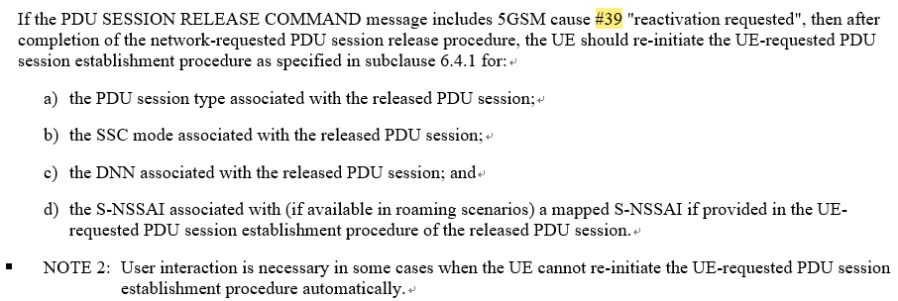
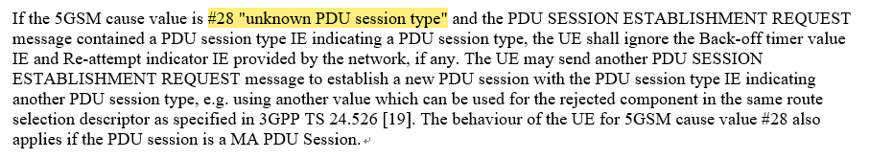
KI#3 (Con’d)
Handle AF-requested change of PDU Session Type associated with a group of UEs
  TR conclusion: PDU Session Release COMMAND for re-establishment of the PDU Session and URSP rules for the highest priority PDU Session Type of a group are used to change PDU Session Type of the PDU Session targeting the group for each group member within the group.
  Which NEF service to use: Traffic Influence + Service Specific Parameter
    Or Parameter Provision?
  Issue: TS24.501 specifies that the PDU Type will be set as the PDU type of the released PDU Session, so new URSP rules won’t be applied for reestablishment of PDU Session to the same DNN.
    Way Forward: Add cause #28 as new trigger for Network-requested PDU session release procedure？
TS 24.501

Slide 6
KI#3 (Con’d)
23.501 Structure
  new clause to capture the main enhancements for provisioning of traffic characteristics and monitoring of performance characteristics for a group of UEs
23.502 Structure
  New clause to capture the information flows and new service
  Capture the PDU Type for Traffic Influence + Service Specific Parameter
23.503 Structure
  new clause to capture the main enhancements for provisioning of traffic characteristics and monitoring of performance characteristics for a group of UEs

Slide 7
KI#5
23.501 Structure
  new informative annex

Slide 8
Summary

