Slide 1
Discussion on how to handle Dynamic Spectrum Sharing (DSS) Conformance Testing for B34/n34 and B39/n39
3GPP TSG-RAN5 Meeting #93-e R5-21XXXX
Electronic Meeting, 8 – 19 November 2021
CMCC, Huawei, Hisilicon, ZTE, Ericsson, CATT

Slide 2
Background - RAN4 DSS for B34/n34 B39/n39 WI Progress
2010- 2025 MHz was widely deployed as TD-SCDMA in China before, and started to refarm to LTE Band 34 in recent years. LTE Band 39 (1880-1920 MHz) is a widely deployed TDD band in China. There are also 5G NR band n34 and band n39, which has been specified in Rel-15. Enabling co-existence of existing LTE deployment along with a NR addition in same band is essential to allow operators to refarm the existing LTE band 34 and 39, and improve the spectrum efficiency.
A New RAN4 Rel-17 WI “LTE/NR spectrum sharing in Band 34/n34 and Band 39/n39” (DSS_LTE_B34_NR_Bn34_LTE_B39_NR_Bn39) has been set up in RAN#92-e. Please check the WID in RP-211509[1] and RP-211996[2].
The completion level of the 3GPP Rel-17 work item on LTE/NR spectrum sharing in Band 34/n34 and Band 39/n39 has achieved 100% at RP#93-e (Sep-2021). Please check the SR in RP-211995[3].
Observation 1: It is reasonable to introduce an associated RAN5 work item to enable UE conformance testing for LTE/NR spectrum sharing in Band 34/n34 and Band 39/n39 UEs.

Slide 3
Background - DSS Conformance Test for B34/n34 B39/n39
There is a need to introduce an associated RAN5 work item to enable UE conformance testing for LTE/NR spectrum sharing in Band 34/n34 and Band 39/n39 UEs. Please check the WID in R5-217505.
There are 2 capabilities and 1 feature being important for DSS testing
      Rate-matching around LTE CRS (rateMatchingLTE-CRS), mandatory TDD UE feature/capability since Rel-16 TS 38.101-4
  Alternative additional DMRS position for co-existence with LTE CRS (additionalDMRS-DL-Alt), optional TDD UE feature/capability since Rel-16 TS 38.101-4
  NR UL transmission with a 7.5 kHz shift to the LTE raster(frequencyShift7p5khz), madatory TDD UE feature since Rel-16 TS 38.101-1

Slide 4
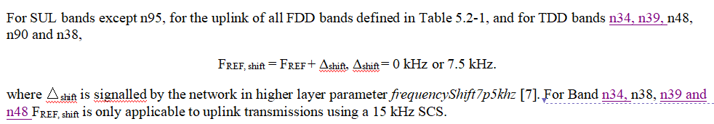
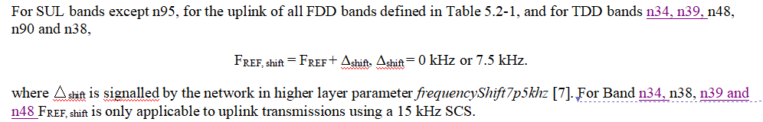
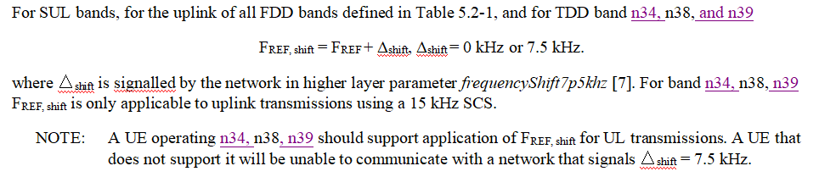
Background - RAN4 TS 38.101-1
As the outputs of this Rel-17 RAN4 “DSS on B34/n34 and B39/n39” WI, similar changes have been introduced into Section 5.4.2 “Channel raster” of TS 38.101-1 by 3 agreed CRs “Introduction of the UL 7.5kHz shift for NR TDD band n34 and n39” for Rel-17 (R4-2115088 [4]), Rel-16 (R4-2115087 [5]) and Rel-15 (R4-2114376 [6]) TS 38.101-1, respectively.
NO additional changes have been introduced into Section 6/7 of TS 38.101-1 so far.
Rel-17 Mandatory
Observation 2: “UL 7.5kHz shift” for NR TDD band n34 and n39 has been mandatory requirement since Rel-16 TS 38.101-1, and is optional in Rel-15 TS 38.101-1.
Rel-16 Mandatory
Rel-15 Optional

Slide 5
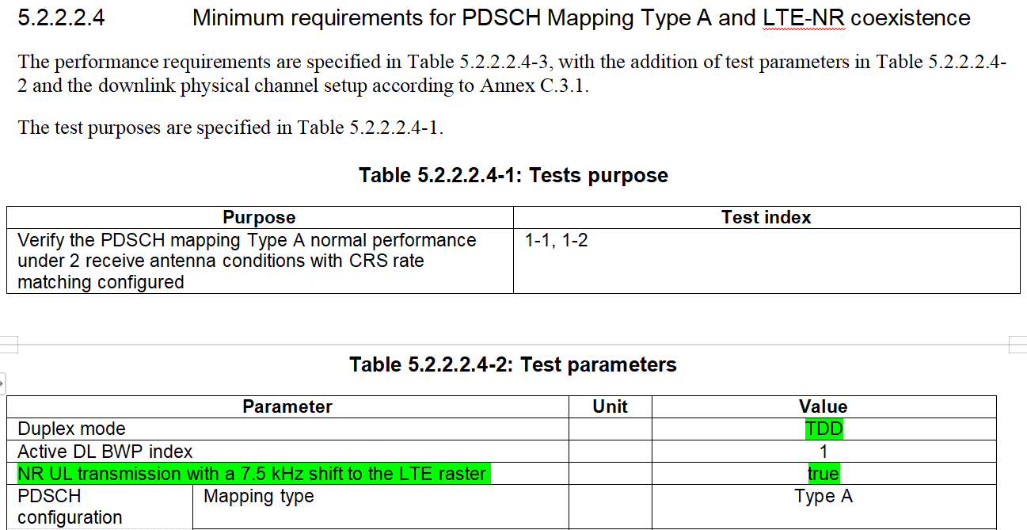
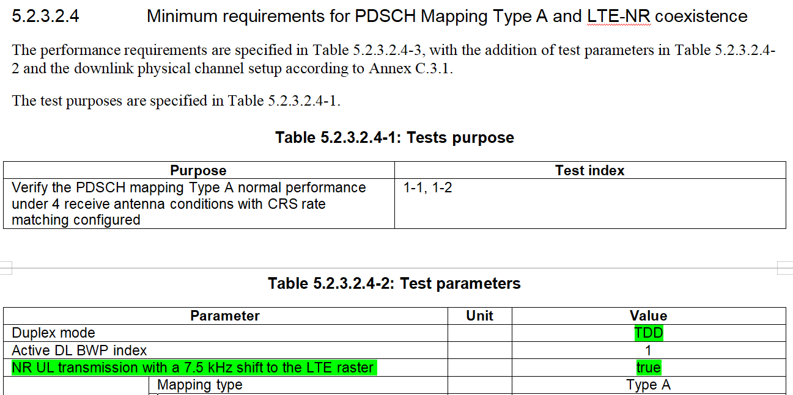
Background - RAN4 TS 38.101-4 (1/2)
In 38.101-4-fb0 (2021-09), there are demod requirements for FDD DSS with 7.5kHz shift
5.2.2 2RX requirements/5.2.2.1 FDD/5.2.2.1.4 Minimum requirements for PDSCH Mapping Type A and LTE-NR coexistence
5.2.3 4RX requirements/5.2.3.1 FDD/5.2.3.1.4 Minimum requirements for PDSCH Mapping Type A and LTE-NR coexistence
In 38.101-4-g60 (2021-09), besides FDD, there are also demod requirements for TDD DSS with 7.5kHz shift as below
5.2.2 2RX requirements/5.2.2.2 TDD/5.2.2.2.4 Minimum requirements for PDSCH Mapping Type A and LTE-NR coexistence
5.2.3 4RX requirements/5.2.3.2 TDD/5.2.3.2.4 Minimum requirements for PDSCH Mapping Type A and LTE-NR coexistence
Observation 3: Demod requirements for TDD DSS with 7.5kHz shift has been defined since Rel-16 TS 38.101-4.

Slide 6
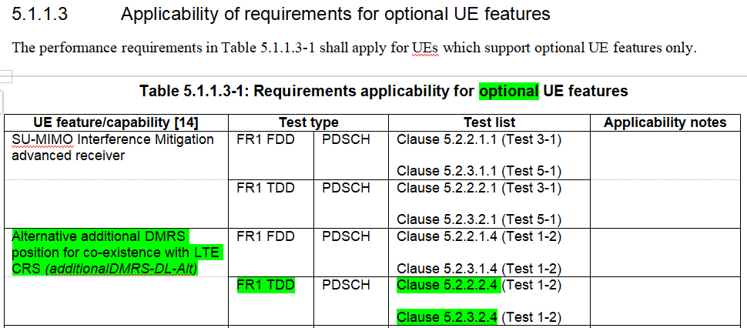
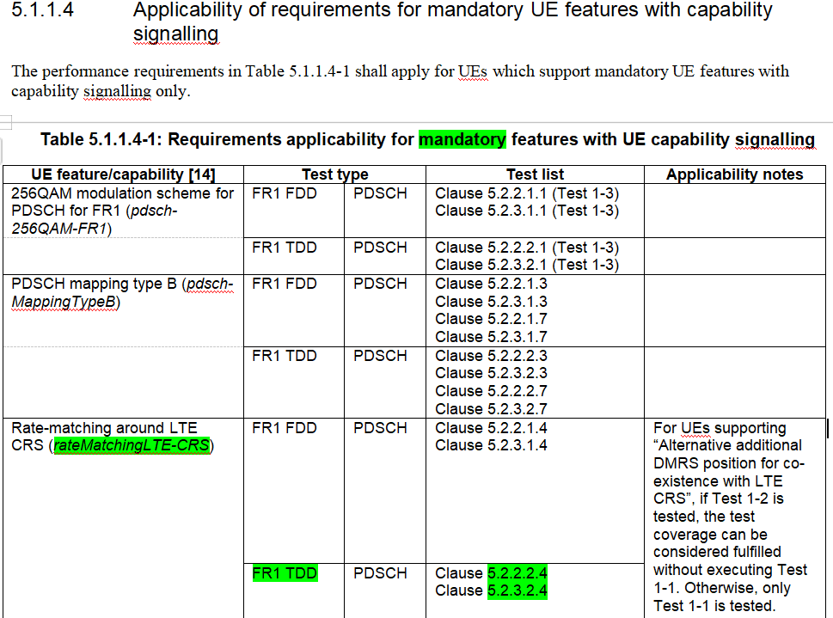
Background - RAN4 TS 38.101-4 (2/2)
Observation 4: As per Section 5.1.1.3 and 5.1.1.4 of Rel-16 TS 38.101-4, “Alternative additional DMRS position for co-existence with LTE CRS (additionalDMRS-DL-Alt)” is optional for DSS, while “Rate-matching around LTE CRS (rateMatchingLTE-CRS)” is mandaroty for DSS.
Notes:
additionalDMRS-DL-Alt
rateMatchingLTE-CRS

Slide 7
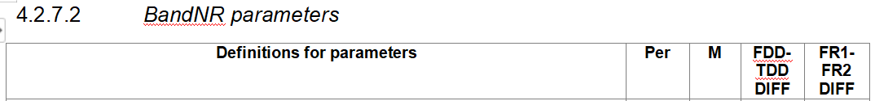
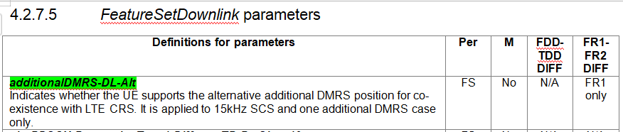
Background - RAN2 TS 38.306
Observation 5: In Rel-15 TS 38.306, “rateMatchingLTE-CRS” has been defined as a madatory per Band NR UE radio access capabiliy “BandNR parameter”.
Observation 6: In Rel-15 TS 38.306, “additionalDMRS-DL-Alt” has been defined as an optional per Feature Set (FS) NR UE radio access capabiliy “FeatureSetDownlink parameter”
Observation 7: “frequencyShift7p5khz” has not been defined as NR UE radio access capabiliy.
Notes:
User Equipment (UE) radio access capabilities

Slide 8
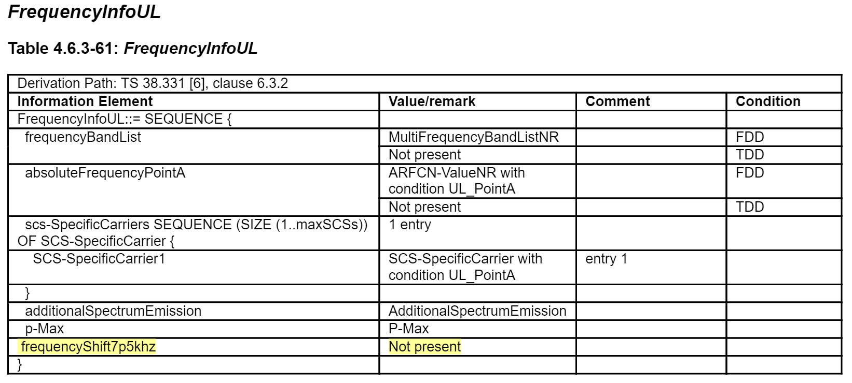
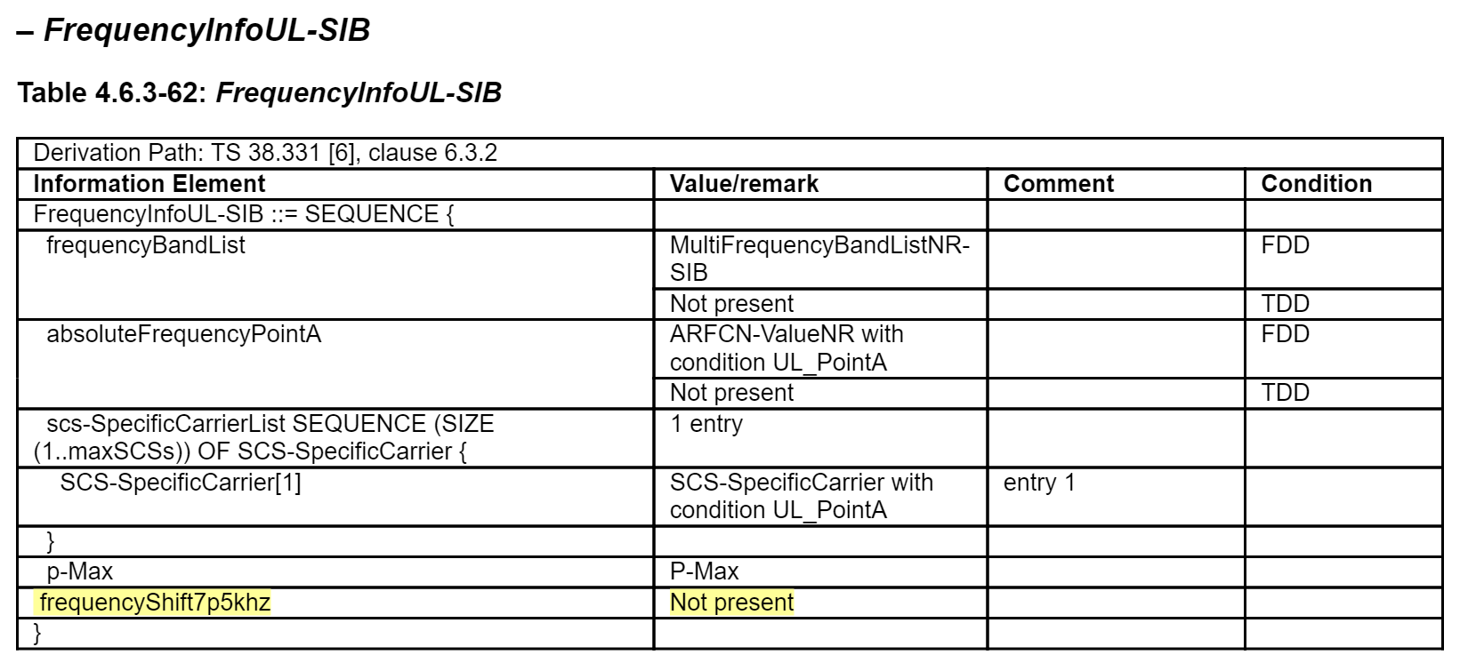
Background - RAN5 TS 38.508-1 (1/2)
In TS 38.508-1, there are DSS related information “frequencyShift7p5khz” as below. However, the Value/remark for “frequencyShift7p5khz” is “Not present”.
Observation 8: For the existing RAN5 specs, unless otherwise stated, the default value/remark for “frequencyShift7p5khz” is “Not present”.

Slide 9
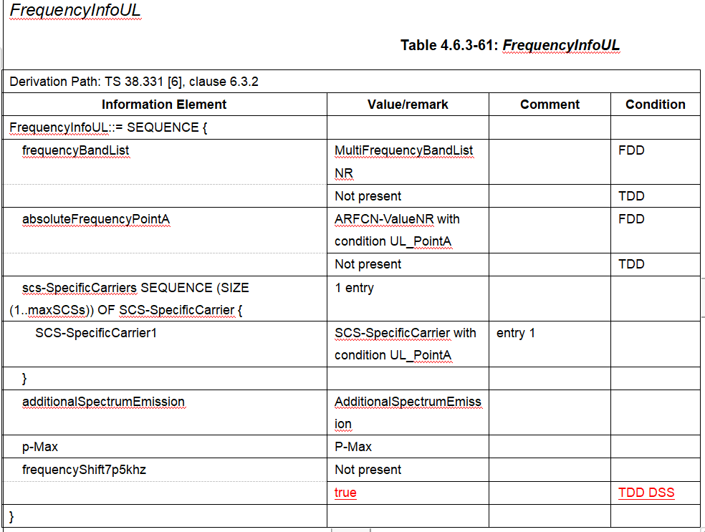
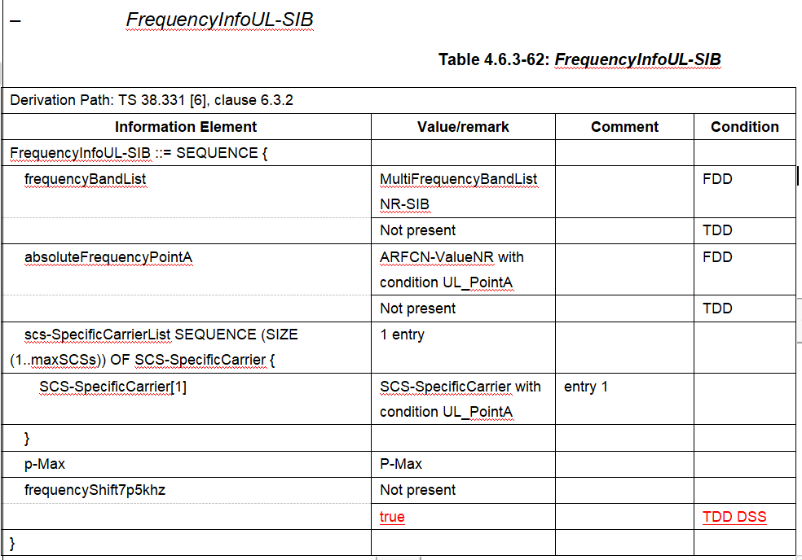
Background - RAN5 TS 38.508-1 (2/2)
Proposal 1: In Table 4.6.3-61 and Table 4.6.3-62 of TS 38.508-1, to add “Value/remark=true” for “frequencyShift7p5khz” under the Condition of “TDD DSS” as below

Slide 10
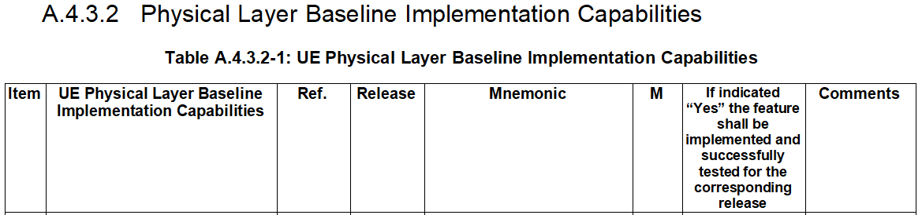
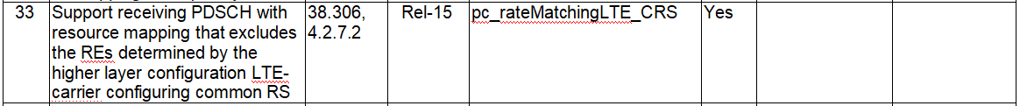
Background - RAN5 TS 38.508-2
Observation 9:
  In TS 38.508-2, there are UE Physical Layer Baseline Implementation Capabilities “pc_additionalDMRS_DL_Al” captured as Rel-15 optional capability.
  In TS 38.508-2, there are UE Physical Layer Baseline Implementation Capabilities “pc_rateMatchingLTE_CRS” captured as Rel-15 mandatory capability.
  In TS 38.508-2, there are no UE Physical Layer Baseline Implementation Capabilities for “frequencyShift7p5khz”.
Notes:
additionalDMRS-DL-Alt
rateMatchingLTE-CRS

Slide 11
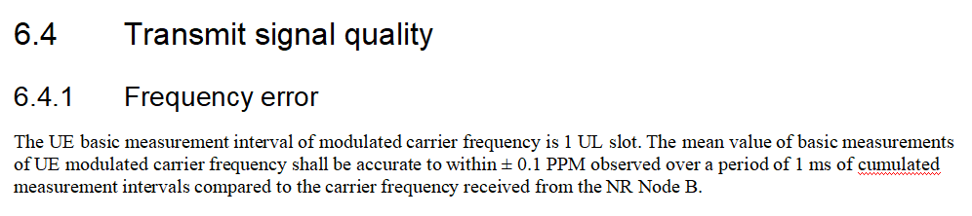
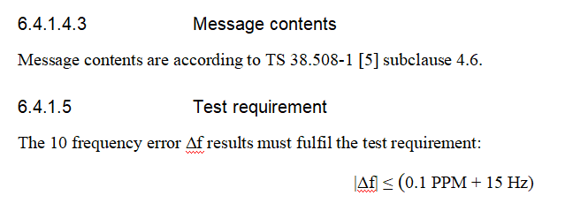
Background - RAN5 TS 38.521-1 (1/2)
Observation 10: In TS 38.101-1, for the “frequencyShift7p5khz” directly impacted requirement “6.4.1 Frequency Error”, there is no limits to the value of “frequencyShift7p5khz” which can be interpreted as requirement “6.4.1 Frequency Error” apply to both “frequencyShift7p5khz=Not present” and “frequencyShift7p5khz=true”.
Observation 11: As per Table 4.6.3-61 and Table 4.6.3-62 in TS 38.508-1, only “frequencyShift7p5khz=Not present” has been covered in the corresponding TC “6.4.1 Frequency Error” in TS 38.521-1 so far, and “frequencyShift7p5khz=true” has NOT been covered yet.

Slide 12
Background - RAN5 TS 38.521-1 (2/2)
In TS 38.521-1, there should be 2 Test Points for TC “Frequency Error” which apply to all the TDD DSS NR bands.
  TP1: “frequencyShift7p5khz=Not present”, to verify the Frequecny Error without FrequencyShift7p5khz
  TP2: “frequencyShift7p5khz=true”, to verify the Frequency Error with FrequencyShift7p5khz. For a UE which has declared to support TDD DSS, to take f=6GHz as an example
    if “frequencyShift7p5khz” has not been supported by UE, the expected test result is |Δf| ≤ (600Hz + 15Hz), while the actual test result will be |Δf| = (600Hz + 15Hz + 7.5kHz), which obviously will fail the test.
    if “frequencyShift7p5khz” has not been well supported by UE, the expected test result is |Δf| ≤ (600Hz + 15Hz), while the actual test result will be |Δf| ≤ (600Hz + 15Hz + (0-7.5kHz) ) OR |Δf| ≤ (600Hz + 15 Hz + (>7.5kHz) ), which will also have big possibilities to fail the test.
Proposal 2: “frequencyShift7p5khz=true” should be added into TC “Frequency Error” as additional test point to verify the UE can meet the “Frequency Error” well enough. The corresponding changes can be handled under the Rel-15 WI “5G system with NR and LTE”.

Slide 13
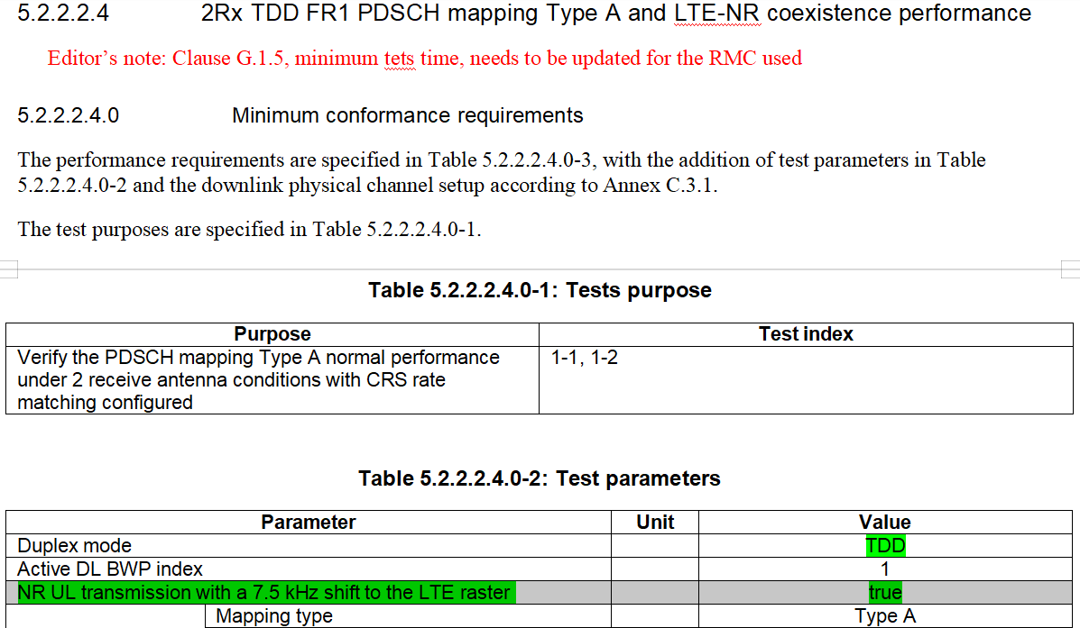
Background - RAN5 TS 38.521-4
In 38.521-4-90 (2021-09), there are demod test case for TDD with 7.5kHz shift as below
5.2.2 2RX requirements/5.2.2.2 TDD/5.2.2.2.4 2Rx TDD FR1 PDSCH mapping Type A and LTE-NR coexistence performance
  5.2.2.2.4.0 Minimum conformance requirements
  5.2.2.2.4_1 2Rx TDD FR1 PDSCH Mapping Type A and LTE-NR coexistence performance - 4x2 MIMO with baseline receiver for both SA and NSA
Observation 12: The feature of “TDD NR UL transmission with a 7.5kHz shift to the LTE raster” can be tested as mandaroty requirement since Rel-16 by TC 5.2.2.2.4_1 of TS 38.521-4.

Slide 14
Background - RAN5 TS 38.522 (1/3)
In 38.522-h20 (2021-09), there is demod TC “5.2.2.2.4_1” for TDD with 7.5kHz shift as below
“C016y” can be interpreted as >>> IF NR TDD AND (NG-RAN NR OR EN-DC OR NE-DC OR NGEN-DC) AND Support alternative additional DMRS position for co-existence with LTE CRS AND NOT UE TDD 4Rx in FR1 THEN R ELSE N/A
Observation 13: “Rate-matching around LTE CRS” has not been reflected in “Condition” C016y for demod TC “5.2.2.2.4_1” in TS 38.522.
Proposal 3: In TS 38.522, “Condition” C016y for demod TC “5.2.2.2.4_1” shall be revised to include “Rate-matching around LTE CRS” also and should be handled under the Rel-16 RAN5 WI “NR_perf_enh-UEConTest (UID-890048) ”
Notes:
R5-217529 from QC/Vijay, jumbo TS 38.522 CR for“NR_perf_enh-UEConTest (UID-890048) ”
Anritsu/Setsu: R5-217440 for TS 38.521-4,

Slide 15
Background - RAN5 TS 38.522 (2/3)
from 38.521-h21
Observation 14: The existing D008 in TS 38522-h20 can not reflect the TDD DSS NR bands properly. Before introducing TDD DSS for n34 and n39, n48/n90/n38 have already been added into Section “5.4.2 Channel raster”, so these existing TDD NR bands should be reflected in the “Tested Bands Selection Criteria” for demod TC “5.2.2.2.4_1” in TS 38.522.
Proposal 4: A new “Tested Bands Selection Criteria” should be defined for demod TC “5.2.2.2.4_1” in TS 38.522 to indicate the applied existing NR TDD bands as below. The changes can be handled under the Rel-15 WI “5G system with NR and LTE (UID - 760087)”.
Notes:
The corresponding work can be done under the Rel-15 WI “5G system with NR and LTE (UID - 760087)”

Slide 16
Background - RAN5 TS 38.522 (3/3)
Observation 15: Besides the existing TDD NR bands in TS 38.521-h21(2021-09), the newly introduced n34 and n39 should also been added into the “Tested Bands Selection Criteria” D00X for demod TC “5.2.2.2.4_1” in TS 38.522.
Proposal 5: In TS 38.522, the “Tested Bands Selection Criteria” for demod TC “5.2.2.2.4_1” should be revised to add n34 and n39 under the future Rel-17 RAN5 WI “DSS_LTE_B34_NR_Bn34_LTE_B39_NR_Bn39-UEConTest” as below.
Notes:
The corresponding work can be done under the Rel-15 WI “5G system with NR and LTE (UID - 760087)”

Slide 17
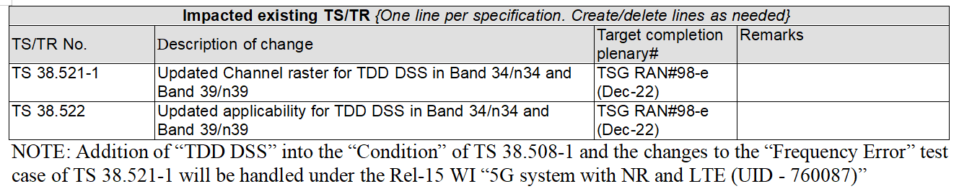
Which RAN5 specs will be impacted by the DSS Conformance Testing for B34/n34 and B39/n39?
Proposal 6: In R5-217505 “New WID - UE Conformance Test Aspects - LTE/NR spectrum sharing in Band 34/n34 and Band 39/n39”, the following RAN5 specs need to be captured into the table of “impacted existing TS” to cater for the DSS Conformance Testing for B34/n34 and B39/n39

Slide 18
Reference
[1] RP-211509 New WID on LTE/NR spectrum sharing in Band 34/n34 and Band 39/n39, 3GPP TSG-RAN Meeting #92-e, 14 – 18 June 2021; CMCC
[2] RP-211996 New WID on LTE/NR spectrum sharing in Band 34/n34 and Band 39/n39, 3GPP TSG-RAN Meeting #93-e, 13 – 17 September 2021; CMCC
[3] RP-211995 Status report for LTE/NR spectrum sharing in Band 34/n34 and Band 39/n39 WI; 3GPP TSG-RAN Meeting #93-e, 13 – 17 September 2021; CMCC
[4] R4-2115088 Introduction of the UL 7.5kHz shift for NR TDD band n34 and n39, 3GPP TSG-WG4 Meeting #100e, 16 – 27th August 2021, Apple Inc., CMCC
[5] R4- 2115087 Introduction of the UL 7.5kHz shift for NR TDD band n34 and n39, 3GPP TSG-WG4 Meeting #100e, 16 – 27th August 2021, Apple Inc., CMCC
[6] R4-2114376 Introduction of the UL 7.5kHz shift for NR TDD band n34 and n39, 3GPP TSG-WG4 Meeting #100e, 16 – 27th August 2021, Apple Inc.,

Slide 19
Thank you!

