Slide 1
RAN4#109 meeting schedule
3GPP TSG-RAN WG4 Meeting #109
Chicago, US, November 13 – 17, 2023
Agenda Item: 2
RAN4 Chair: Xizeng Dai
Vice Chair: Gene Fong, Shan Yang

Slide 2
Monday
Venue Time | RAN4 Main Salon A5 | RAN4 RRM Salon A3 | RAN4 BDaT Salon A4 | Ad hoc room#1 Salon C7/8 | Ad hoc room#2 4F
9:00-9:20 | 1. Opening of the meeting 2. Approval of the agenda 3. Letters / reports from other groups / meetings [150] NR_LTE_Rel-18_feature_list #1
9:30-10:30 | Spectrum related [115] NR_700800900_combo_enh AI7.30 (17) [113] LTE_NR_Other_WI AI7.14, 7.15, 7.23~7.27 (23) [122] HPUE_LTE_FDD_B14 AI9.5 (8) | [206] FR2_multiRx_part1 (34) [207] FR2_multiRx_part2 (28) | BSRF [302] NR_ATG_BSRF (8) [303] NR_FR1_lessthan_5MHz_BW_BSRF (15) NTN [308] NR_NTN_enh_Part1 (6) | Main Ad-hoc: [140] NR_cov_enh2_part1 Chaired by Xiang Gao (Huawei) | RRM Ad-hoc: R18 MGs enhancement WI Chaired by Ato Yu (MediaTek)
11:00-12:30 | [118] US_900MHz AI7.33 (17) [119] NR_bands_n31_n72 AI7.34 (20) [108] LTE_NR_HPUE_FWVM AI7.16 (6) [109] HPUE_Basket_EN-DC AI7.17 (9) [110] HPUE_Basket_Intra-CA_TDD AI7.18, 7.19 (2) [111] HPUE_Basket_inter-CA_SUL AI7.20 (21) | [210] NR_MG_enh2_part1 (45) [211] NR_MG_enh2_part2 (40) | NTN [309] NR_NTN_enh_Part2 (19) [310] NR_NTN_enh_Part3 (10) [337] LS_BSRF_RAN_task (6) | Main Ad-hoc: [135] FS_NR_LPWUS Chaired by Ruixin Wang (Vivo) | RRM Ad-hoc: R18 NR FR2 multi-Rx chain WI, Chaired by Qian Yang (vivo)
12:30-14:00 | Lunch break
14:00-15:30 | [112] HPUE_Basket_FDD AI7.21, 7.22 (20) [117] NR_FDD_ULn28_DLn75_n76 AI7.32 (16) Non-spectrum related [129] FR2_enh_req_Ph3_part2 AI8.6.2 (14) | [213] NonCol_intraB_ENDC_NR_CA (13) [218] FS_NR_LPWUS (8) [235] IoT_NTN_enh (18) Coffee break discussion: [217] NR_FR1_lessthan_5MHz_BW | Repeater/IAB [311] NR_netcon_repeater_RF (21) [312] NR_netcon_repeater_RFConformance (6) [313] NR_mobile_IAB_RF (8) | RRM Ad-hoc: Chaired by Qiming Li NR_Mob_enh2_part2 | Bdat Ad-hoc: [334] NR_FR1_TRP_TRS_enh Chaired by Ruixin Wang (vivo) 15:30 – 16:00 Coffee break discussion [322] NR_FR1_lessthan_5MHz_BW_demod Chaired by Dimitri Gold (Nokia)
16:00-19:00 | [128] FR2_enh_req_Ph3_part1 AI8.6, 8.6.1, 8.6.3 (14) [130] FR2_multiRx_UERF_part1 AI8.7.1(16) [142] NR_MIMO_evo_DL_UL_UERF AI8.29, 8.29.1 (22) | 16:00-17:30 [228] NR_MIMO_evo_DL_UL (37) 17:30-19:00 [219] NR_pos_enh2_part1 (47) [220] NR_pos_enh2_part2 (30) [221] NR_pos_enh2_part3 (17) | Demod 16:00 – 17:00 [316] RF_FR1_enh2_Demod (32) BDaT Ad-hoc 17:00 – 18:00 [310] NR_NTN_enh_Part3 Chaired by Haijie Qiu (Samsung) 18:00 – 19:00 [309] NR_NTN_enh_Part2 Chaired by Dominique Everaere (Ericsson) | Main Ad hoc #1: [136] FS_NR_AIML_air Chaired Vali (Qualcomm) | RRM ad-hoc: 16:00-17:20 R18 NR Positioning Chaired by Muhammad Kazmi (Ericsson) 17:30-19:00 NR_MIMO_evo_DL_UL Chaired by Yanze Fu (Samsung)

Slide 3
Tuesday
Venue Time | RAN4 Main Salon A5 | RAN4 RRM Salon A3 | RAN4 BDaT Salon A4 | Ad hoc room#1 Salon C7/8 | Ad hoc room#2 4F
8:00-10:30 | [131] NonCol_intraB AI8.11.1 (7) [137] NR_pos_enh2_UERF AI8.22.1 (3) [148] NR_LTE_UAV AI8.35, 9.7 (13) [127] NR_channel_raster_enh AI8.4 (14) | [234] Netw_Energy_NR (33) (1hour) [217] NR_FR1_lessthan_5MHz_BW (15) [211] NR_MG_enh2_part2 Cont. RRM Ad-hoc: Chaired by Haijie Qiu NR_NTN_enh (42) (1.5 hour) | Demod [324] NR_NTN_enh_SAN_UE_demod (11) [323] NR_demod_enh3_Part1 (23) | Main Ad-hoc: [124]/[125] FR1_enh2_part1/part2 Chaired by Leo Liu (Huawei) Main Ad-hoc: [126] FR1_enh2_part3 Chaired by Yuta (NTT DOCOMO) | RRM Ad hoc: R18 NR Positioning Chaired by Muhammad Kazmi (Ericsson) (50 min) NR_HST_FR2_enh, Chaired by Jackson (Samsung) (1.5 hour)
11:00-12:30 | [138] NR_MC_enh_UERF AI8.23, 8.23.1/2 (14) [114] NR_3Tx-4Rx_WI AI7.28, 7.29, 8.5 (21) | [223] NR_Mob_enh2_part1 (59) [224] NR_Mob_enh2_part2 (33) | [319] NonCol_intraB_ENDC_NR_CA_Demod (12) [320] NR_HST_FR2_enh_Demod (14) | BdaT Ad-hoc: [311] NR_netcon_repeater_RF Chaired by Fei Xue (ZTE) | RRM Ad-hoc: R18 NR ATG WI, Chaired by Xiaoran Zhang (CMCC)
12:30-14:00 | Lunch break
14:00-15:30 | [143] NR_SL_enh2_UERF_part1 AI8.30, 8.30.1/2/2.1 (25) [144] NR_SL_enh2_UERF_part2 AI8.30.2.2, 8.30.2.4 (10) [145] NR_SL_enh2_UERF_part3 AI8.30.2.3 (9) | [214] NR_HST_FR2_enh_part1 (21) [215] NR_HST_FR2_enh_part2 (5) [225] NR_DualTxRx_MUSIM (58) [222] NR_MC_enh (6) | [327] NR_MIMO_evo_DL_UL_demod (11) [325] NR_cov_enh2_demod (8) [322] NR_FR1_lessthan_5MHz_BW_demod (18) | RRM Ad-hoc: R18 NR FR2 multi-Rx chain WI, Chaired by Qian Yang (vivo) | Main Ad hoc: [128]/[129] FR2_enh_req_Ph3_part1/2 Chaired by Hisashi Onozawa (Nokia)
16:00-19:00 | [123] FS_SimBC AI8.1 (15) [124] FR1_enh2_part1 AI8.3, 8.3.1.1/4 (24) [125] FR1_enh2_part2 AI8.3.1.2 (9) [126] FR1_enh2_part3 AI8.3.1.3 (14) 18:30 – 19:00 [150] NR_LTE_Rel-18_feature_list #2 | 16:00-17:30 [211] NR_MG_enh2_part2 Cont. [217] NR_FR1_lessthan_5MHz_BW (15) RRM Ad-hoc: Chaired by Haijie Qiu NR_NTN_enh (42) (1.5 hour) 17:30-19:00 RRM Ad-hoc: NR_Mob_enh2_part1 Chaired by Qiming Li (Apple) | [326] NR_netcon_repeater_Demod (7) [317] NR_RF_FR2_req_Ph3_Demod (16) 18:00 – 19:00 Continuation of other BDaT topics or reserve for ad-hoc | BDaT Ad-hoc: [305] FS_NR_duplex_evo_Part1 [306] FS_NR_duplex_evo_Part2 [307] FS_NR_duplex_evo_Part3 Chaired by Jackson Wang (Samsung) | BDat Ad-hoc: 16:00 – 17:30 [333] FS_NR_FR2_OTA_enh Chaired by Bin Han (Qualcomm) 17:30 – 19:00 [335] NR_MIMO_OTA_enh Chaired by Xuan Yi (CAICT)

Slide 4
Wednesday
Venue Time | RAN4 Main Salon A5 | RAN4 RRM Salon A3 | RAN4 BDaT Salon A4 | Ad hoc room#1 Salon C7/8 | Ad hoc room#2 4F
8:00-10:30 | [136] FS_NR_AIML_air AI8.21 (40) | [227] NR_netcon_repeater (1) [216] NR_ATG (14) [231] NR_redcap_enh (4) [208] NR_RRM_enh3_part1 (35) [209] NR_RRM_enh3_part2 (11) [236] Reply_LS (22) | BS [304] NR_LTE_EMC_enh (19) [307] FS_NR_duplex_evo_Part3 (13) | RRM Ad-hoc: R18 NR Positioning Chaired by Muhammad Kazmi (Ericsson) | BDaT Ad-hoc: [318] NR_FR2_multiRX_DL_Demod Chaired by Jahidur Rahman (Qualcomm)
11:00-12:30 | NTN spectrum + UE RF [116] LTE_NR_NTN_LSband AI7.31 (12) [120] IoT_NTN_extLband AI9.3 (8) [121] IoT_NTN_FDD_LS_band AI9.4 (10) | [232] NR_SL_relay_enh (13) [212] NR_BWP_wor (24) | BS [306] FS_NR_duplex_evo_Part2 (5) [305] FS_NR_duplex_evo_Part1 (13) | Main Ad-hoc: [141] NR_cov_enh2_part2 Chaired by Johannes Hejselbaek (Nokia) | RRM Ad-hoc: [202] [203] [204] R17 and R18 Maintenance Chaired by Yang Tang (Apple)
12:30-14:00 | Lunch break
14:00-15:30 | [139] NR_NTN_enh_UERF AI8.26.5 (25) | RRM Ad-hoc: Chaired by Yang Tang [229] NR_SL_enh2_part1 (11) [230] NR_SL_enh2_part2 (11) | OTA [335] NR_FR1_TRP_TRS_enh (33) [334] FS_NR_FR2_OTA_enh (22) | RRM Ad-hoc: R18 Network Energy Saving chaired Li Zhang (Huawei) | Main Ad hoc: [142] NR_MIMO_evo_DL_UL_UERF Chaired by Taekhoon Kim (Samsung)
16:00-19:00 | Non-spectrum related (cont) [147] Netw_Energy_NR AI8.34, 8.34.1/2 (8) [140] NR_cov_enh2_part1 AI8.27, 8.27.1.1 (21) [141] NR_cov_enh2_part2 AI8.27.1.2 (17) | 16:00-17:30 [226] NR_NTN_enh (42) 17:30-19:00 RRM Ad-hoc: NR_Mob_enh2 Chaired by Qiming Li (Apple) | OTA [336] NR_MIMO_OTA_enh (29) 18:00 – 19:00 Continuation of other BDaT topics or reserve for ad-hoc | BDaT Ad hoc: [315] Demod_Maintenance Chaired by Axel Mueller | Main Ad-hoc: [104] NR_Baskets_Part_1 Chaired by Dominique Brunel (Skyworks)

Slide 5
Thursday
Venue Time | RAN4 Main Salon A5 | RAN4 RRM Salon A3 | RAN4 BDaT Salon A4 | EAd hoc room#1 Salon C7/8 | Ad hoc room#2 4F
8:00-10:30 | [135] FS_NR_LPWUS AI8.20, 8.20.1/2/3 (13) Reply LS [149] NR_reply_LS_UE_RF AI11 (22) | [233] NR_mobile_IAB (6) Ad-hoc minutes: [229] [230] NR_SL_enh2 [206] [207] FR2_multiRx [234] Netw_Energy_NR [223] [224] NR_Mob_enh2 [219] [220] [221] R18 NR Positioning | Demod [321] NR_ATG_Demod (21) [330] Netw_Energy_NR_demod (7) [328] NR_SL_enh2_demod (4) | Main Ad-hoc: [130] FR2_multiRx_UERF_part1 Chaired by Sumant (Qualcomm) | Main Ad hoc: Reserved
11:00-12:30 | [132] NR_ATG_UERF_part1 AI8.13, 8.13.1/2 (4) [133] NR_ATG_UERF_part2 AI8.13.3 (14) [134] NR_FR1_lessthan_5MHz_BW AI8.14, 8.14.1/2 (6) [146] NR_redcap_enh_UERF AI8.31, 8.31.1 (8) Basket WI [104] NR_Baskets_Part_1 AI7.1 (23) [105] NR_Baskets_Part_2 AI7.3~7.8 (55) [106] NR_Baskets_Part_3 AI7.9~7.13 (89) [107] LTE_Baskets AI9.1 (4) | Ad-hoc minutes: [228] NR_MIMO_evo_DL_UL Return to | Demod [329] NR_mobile_IAB_demod (4) [318] NR_FR2_multiRX_DL_Demod (26) | Main Ad hoc #2: [136] FS_NR_AIML_air Chaired Vali (Qualcomm) | RRM Ad-Hoc: 1）Maintenance_up_to_R16 (45 min) Chaired by Li Zhang 2）R18 IoT NTN enh, Chaired by Hsuanli Lin (MediaTek) (45 min)
12:30-14:00 | Lunch break
14:00-15:30 | Maintenance [101] Upto_R16_UERF_maintenance AI4.1 (133) [102] R17_UERF_maintenance AI5.1, 5.2.1, 5.3 (58) [103] R18_UERF_maintenance AI6.1, 6.2, 6.2.1, 6.2.4.1.2, 6.3 (26) | Ad-hoc minutes: [201] Maintenance_up_to_R16 (95) [202] [203] [204] Maintenance_R17_R18 (156) [235] IoT_NTN_enh | Demod [331] NR_DSS_enh (7) [332] IoT_NTN_Demod (15) BS [314] IoT_NTN_SANRF (2) | RRM ad-hoc: Reserved | BDaT Ad-hoc: [323] NR_demod_enh3_Part1 Chaired by Manasa Raghavan (Apple)
16:00-19:00 | Early return to [150] NR_LTE_Rel-18_feature_list 1hr Others if ready | Return to 18:00-19:00 RRM Ad-Hoc: [225] NR_DualTxRx_MUSIM (including the coordination of MUSIM and MG CRs), Chaired by Xusheng Wei (vivo) | Maintenance [301] BSRF_Maintenance (57) [315] Demod_Maintenance (25) Early return to

Slide 6
Friday
Venue Time | RAN4 Main Salon A5 | RAN4 RRM Salon A3 | RAN4 BDaT Salon A4 | Ad hoc room#1 Salon C7/8 | Ad hoc room#2 4F
8:00-10:30 | Return to | Return to | Return to
11:00-12:30 | Return to | Return to | Return to
13:30-15:00 | Return to (final round) | Return to (final round) | Return to (final round)
15:00-16:00 | 13 Revision of the Work Plan 14 Any other business 15 Close of the meeting

Slide 7
Appendix

Slide 8
General Aspects
The face-to-face meeting will take place during November 13th ~ November 17th, 2023.
  Three sessions in three separate rooms: Main, RRM, BSRF_Demod_test(BDaT). GoToWebinar (GTW) conference calls will be set each session. And the two-way remote participant can be supported. TOHRU will be used. A number of ad hoc sessions will be arranged (see Slide #7).
  Moderator will be designated to provide the summary for a topic before the meeting. In online discussions, session chairs will handle topics based on the moderator summary. Moderator does not need update the summary by collecting comments during the meeting.
  Deadline for Tdoc request & submission deadline: November 3rd (Friday) 2023, 23:59 UTC.
  Other deadlines can be found in the following slides.
One picture of meeting flows. See details in the corresponding slides.
For chairs
For moderator
For delegates
Pre-meeting (Nov 6~10)
Quiet Period
1st round (Nov 13~16)
2nd round (Nov 16~17)
Quiet Period
Post-meeting process ( Nov 20~23)
Mon
Tue
Wed
Thu
Fri
Sat/Sun
Mon
Tue
Wed
Thu
Fri
Sat/Sun
Mon
Tue
Wed
Thu
Tdoc number request & submission
Slide #3/4
NWM flag process Slide #16
Moderator trigger nwm: feedback maintenance & spectrum related
Flag maintenance & spectrum @nwm
WF/CR template
Draft TS/TR
Slide #9
Slide #15
Pre-RAN Action
MCC 3GU parsing tool
Slide #18/21
Slide #10/11
Slide #18
Topic Moderator & summary: slide #5
Moderator assignment before Mon
Draft summary for topics
Summary review & comments
Formal tdoc of summary submission by Friday
Rel-18 feature list/UE capability
Online discussions &
GTW conference call
Upload CR for maintenance 2:30pm on Thursday
TOHRU
Tdoc request (new&revision)
Upload tdocs (10.10.10.10) &
How to access contributions
Rel-18 feature list/UE capability
List of email threads for post-meeting
Submission of tdoc of post-meeting
Comments
Approve tdocs for post-meeting
Slide #23
Slide #7
Slide #12
Post-meeting process: slide #14
Initial list for block approval for basket
Deadline for flag for block approval
updated list for block approval
Slide #8
Registration
Slide #17
Slide #13
Basket WIs Block approval: slide #6
Meeting schedule & Ad hoc chair assignment
Update of meeting notes per day
Tdoc allocation
Check-in
Slide #13
Provided before meeting
Slide #22
Meeting room
Slide #8
Quiet Period (0:00 am ~ 7:00 am meeting venue Local time
No email are expected in RAN4 reflector

Slide 9
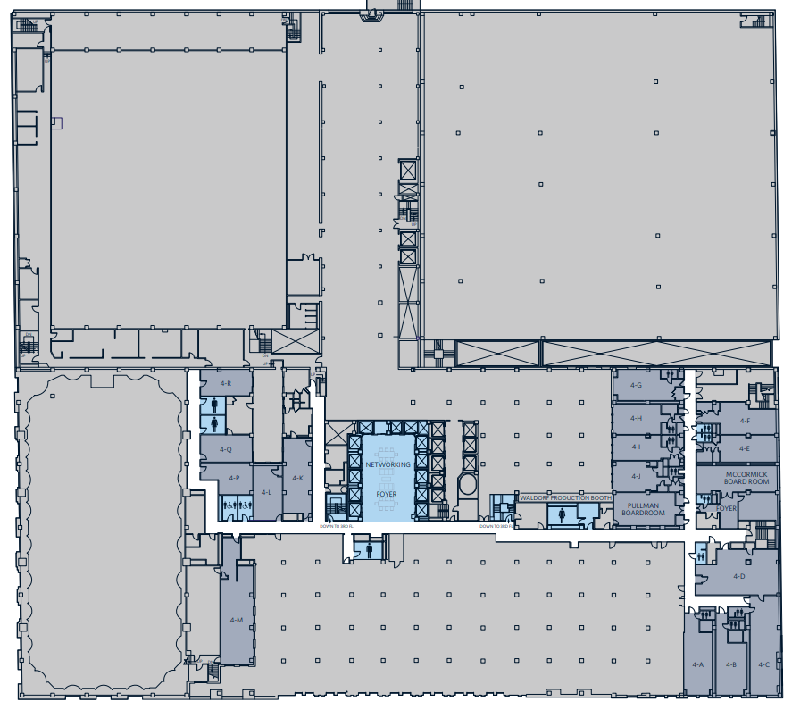
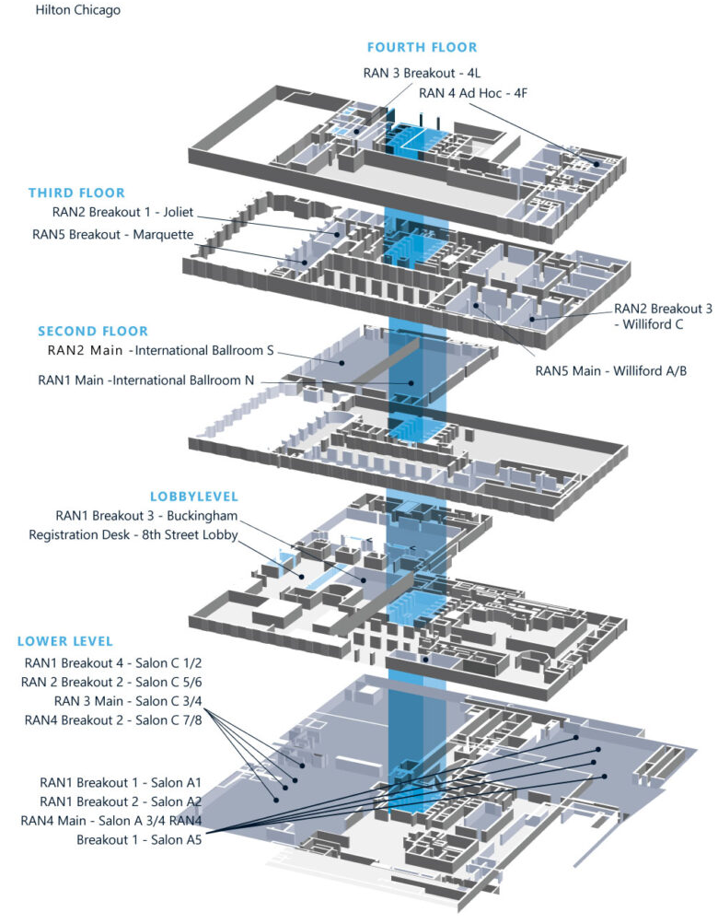

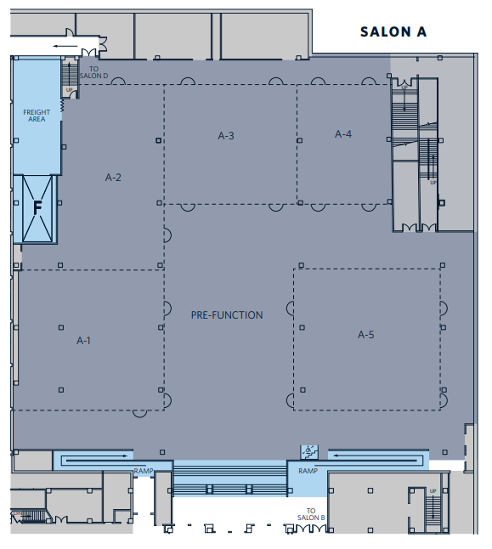
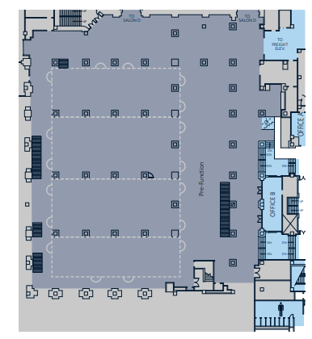
Meeting rooms
    RAN4 meeting rooms: @ Hilton Chicago Lower level + 4th floor
  Main Session: Salon A5 (240)
  RRM Session: Salon A3 (150)
  BDaT Session: Salon A4 (100)
  Ad hoc room #1: Salon C 7/8 (80)
  Ad hoc room #2: 4F (24)
Ad hoc Room#2
RRM session
BDaT session
Ad hoc Room#1
Main session

