Slide 1

3GPP RAN3
New Tie and Scarf Launch

Slide 2
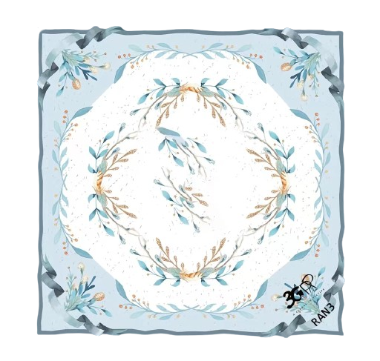
RAN3 - Scarves
New R19 Features
Pattern with Standardization
Chosen for you from hundreds of alternatives
Premium 3GPP RAN3 Logo
May the standardization spirit be with us
Better suited for our learned friends
Best Accessories
Crafted by “high-standard” silk
Capture the audience’s attention in various occasions

Slide 3
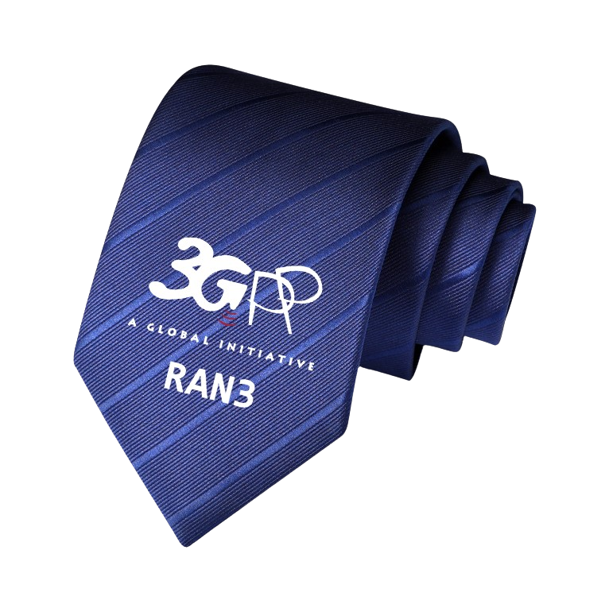
RAN3 - Tie
New R19 Features
Exquisite Textile Craftsmanship
Blue stripe technique shows both composure and enthusiasm
Premium 3GPP RAN3 Logo
May the standardization spirit be with us
Better suited for our learned friends
The Most Adaptable Size
Empowered by big data and AI, the length and width of this tie is just right for most people

Slide 4

Proposal1
Proposal2
Welcome more and more new companies and delegates to join RAN3 and make contributions!
My heart-felt thanks to ZTE as sponsor to make this new Tie and Scarf Launch possible!
Release 19 is a backward compatible version. They can be applied to any occasion, including “RAN3 Tie and Scarf Day” in RAN plenary meeting.
Hope the blue gift contributes to keeping all RAN3 delegates calm and wise during the meeting.

