Slide 1

Changes to the Working Procedures
Attendance at ordinary e-meetings now counts towards accrual and maintenance of voting rights.
The new rules apply for future meetings starting from TSG#95-e (i.e. starting with the March 2022 Plenaries). Past e-meetings do not count towards voting rights.
A delegate is deemed to have attended a given meeting if they confirm their participation by checking in. If a delegate does not check in during the meeting, it shall be assumed that the individual did not attend.
Please note that the delegates need to check in themselves between the start and the end of the meeting.

Slide 2
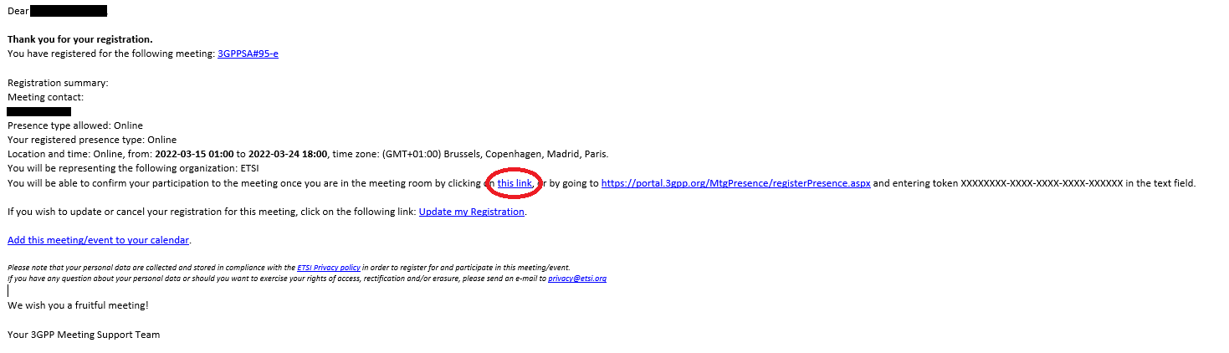
How to check-in to a meeting ? (1)
Option 1: Through registration email, direct link (only if you registered after the 22nd February, 12:00 CET)

Slide 3
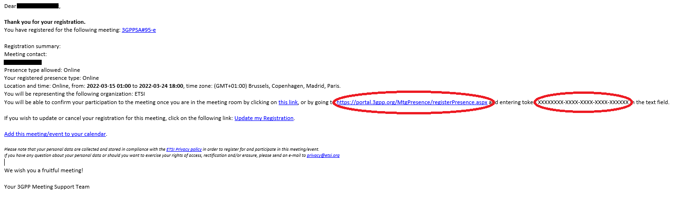
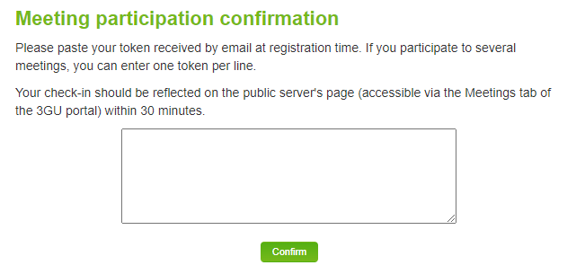
How to check-in to a meeting ? (2)
Option 2: Through registration email, copy/paste token into the registration link (if you registered after the 22nd February, 12:00 CET)

Slide 4
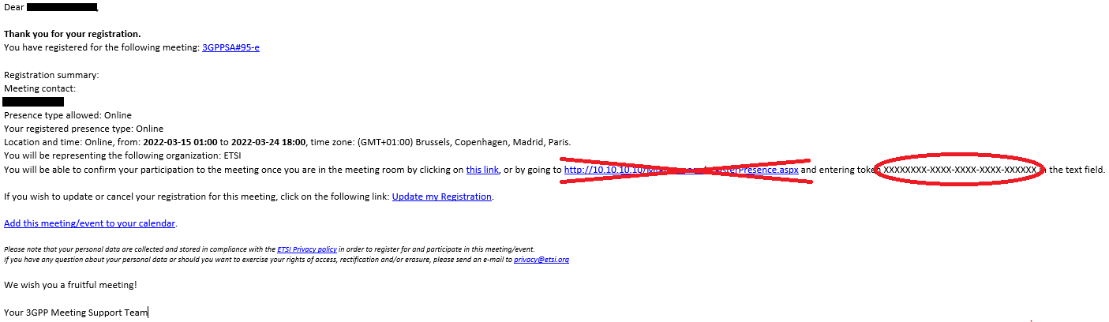
How to check-in to a meeting ? (3)
Option 2-Bis: Through registration email, copy/paste token into the registration link (if you registered before the 22nd February at, 12:00 CET)
Do not click the link in the email. Instead enter the following URL in a browser: https://portal.3gpp.org/MtgPresence/registerPresence.aspx
Then paste the token received by email.

Slide 5
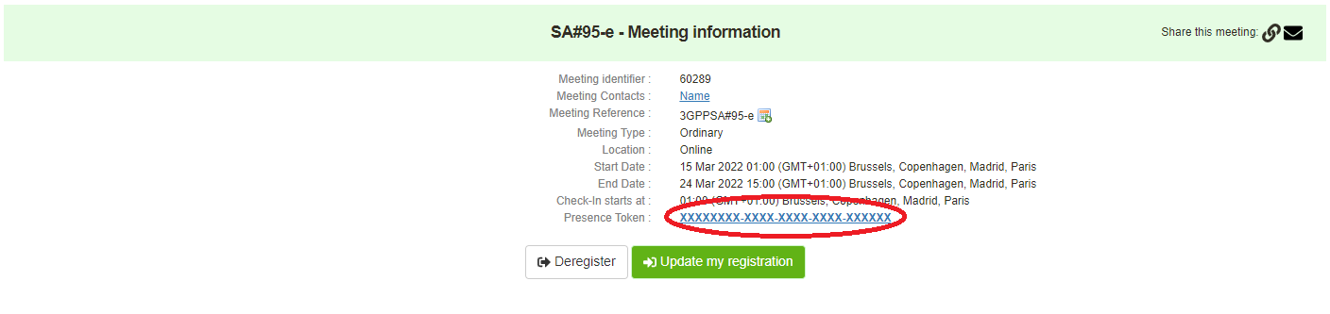
How to check-in to a meeting ? (4)
Option 3: Through the 3GU portal (You need to be logged in)
  Click on the meeting you wish to check-in to:
  then, click on “Presence Token” link:

Slide 6
How to check-in to a meeting ? (5)
All three options work for both electronic and face to face meetings
The delegates need to check in themselves between the start and the end of the meeting. If a delegate submits their token outside of the meeting’s dates/times, their participation will not be taken into account.

