Slide 1
April 2024 Meeting locations
Changsha - China
ETSI MCC

Slide 2
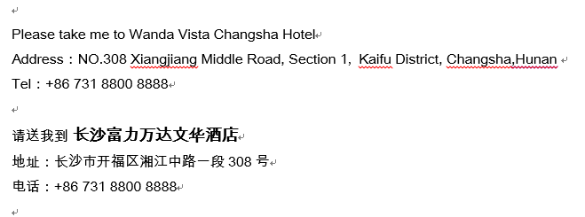
RAN1
  RAN1#116-bis Meeting will be held in Wanda Vista Changsha
  Transport information:

Slide 3
RAN2
  RAN2#125-Bis Meeting will be held in Wyndham Grand Plaza Royale Furongguo Changsha
  Transport information:
Please take me to Wyndham Grand Plaza Royale Furongguo Changsha Address: No. 106, Section 2, Furong Middle Road, Furong District, Changsha, Hunan province, China. TEL：+86 731 8868 8888 请送我到长沙芙蓉国温德姆至尊豪廷大酒店 地址: 中国湖南省长沙市芙蓉区芙蓉中路2段106号 电话: +86 731 8868 8888

Slide 4
RAN3
  RAN3#123-Bis Meeting will be held in Sheraton Changsha Hotel
  Transport information:
Please take me to Sheraton Changsha Hotel Address: No. 478, Section 1, Furong Zhong Road Changsha, Hunan, China TEL：+86 731 8488 8888 请送我到长沙运达喜来登酒店 地址: 中国湖南省长沙市开福区芙蓉中路一段478号运达国际广场 电话: +86 731 8488 8888

Slide 5
RAN4
  RAN4#110-Bis Meeting will be held in Hilton Changsha Riverside
  Transport information:
Please take me to Hilton Changsha Riverside Address: No.1100 Section Three, Xiaoxiang North Road, Yuelu District, Changsha，Hunan T: +86 731 8830 8888 请送我到 长沙世茂希尔顿酒店 地址：长沙市岳麓区潇湘北路三段1100号 电话： +86 731 8830 88888

Slide 6
SA2 – SA5 – SA6
  SA2#162, SA5#154 and SA6#60 meetings will be held in Kempinski Hotel Changsha
  Transport information:
Please take me to Kempinski Hotel Changsha Address:NO.419 Shaoshan Middle Road Yuhua District,Changsha Tel: +86 731 8463 3333 请送我到 长沙顺天凯宾斯基酒店 地址：长沙市雨花区韶山中路419号 电话： +86 731 8463 3333

Slide 7
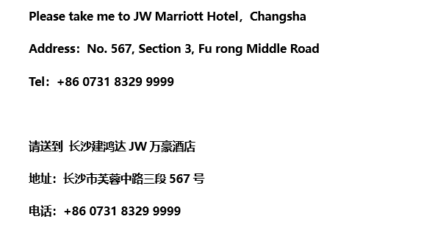
CT1 – CT3 – CT4
  CT1#148, CT3#134 and CT4#122 meetings will be held in JW Marriott Hotel Changsha
  Transport information:

