Slide 1
Summary and Way forward of AIML KI#2 UC#1
China Mobile

Slide 2
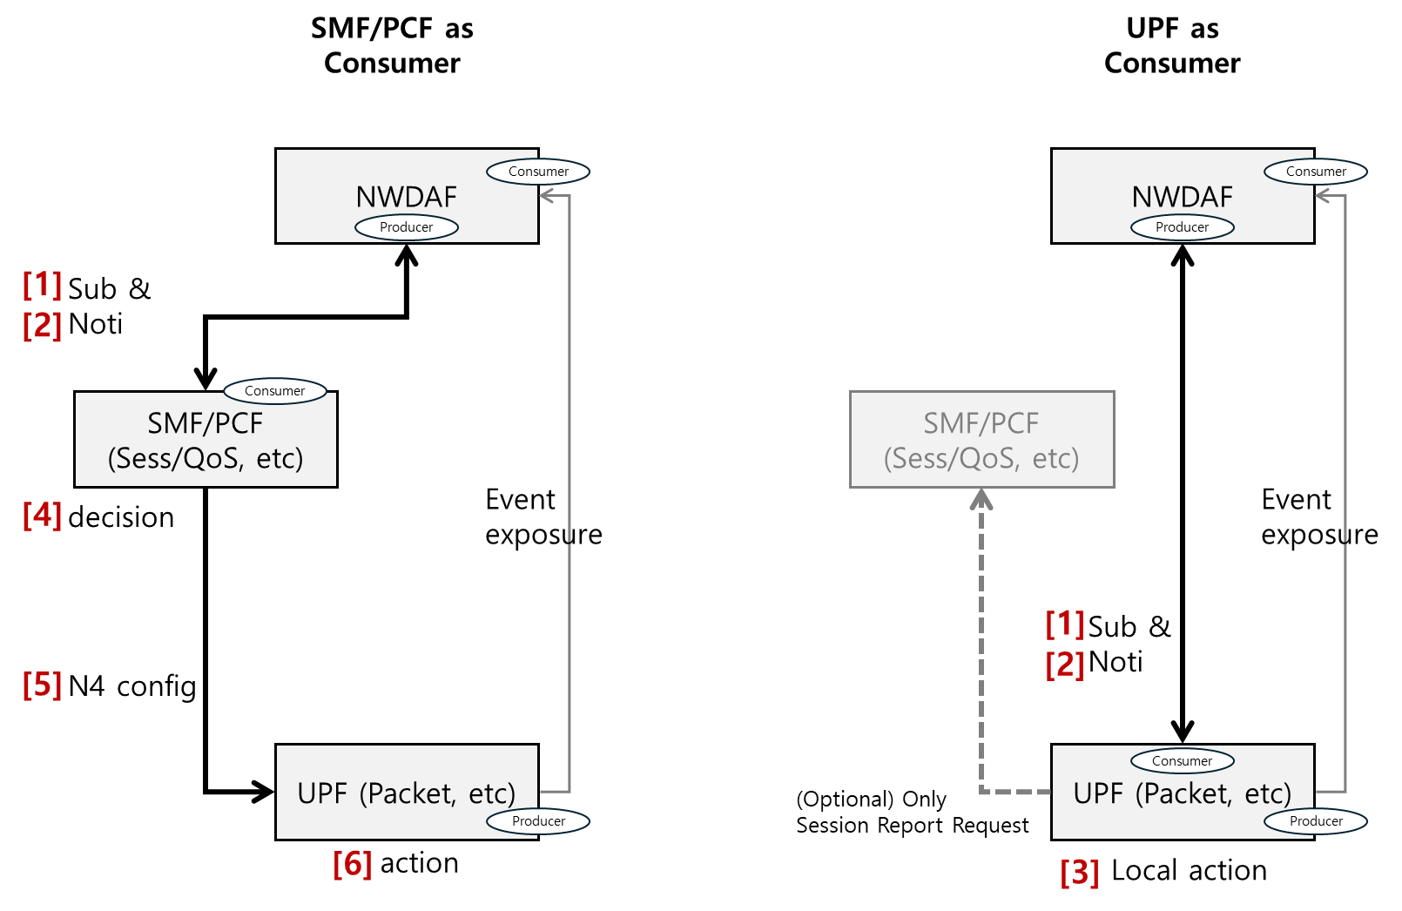
UPF as Analytics consumer?
The overall Agreed Principles for KI#2 UC#1 from last meeting are relatively stable.
Controversial point #1: Whether UPF can be the Analytics consumer:
Yes: SK Telecom, AT&T, China Mobile, China Telecom, Deutsche Telekom, KDDI, Verizon, CATT, ETRI, ZTE, Samsung, Nokia (co-signers of S2-25010045, try to add more details of UPF act as Analytics consumer)
No: Huawei and Ericsson (co-signers of S2-2501722, delete all descriptions related to UPF as Analytics consumer, include agreed principles in last meeting)

Slide 3
UPF as Analytics consumer?
Agreed principles captured in TR in last meeting:
- UPF as consumer of NWDAF analytics may for instance take the following actions:
- Downlink traffic suppression (e.g., selective packet dropping or rate limitations).
- adjust packet processing resources.
NOTE 1: UPF will only receive Analytics with reduced Output (i.e. type of abnormal traffic and traffic descriptor). UPF has operator-configured policies corresponding to the types of abnormal traffic, that can be activated for the received traffic descriptor. This does not apply on PDU-session level.
Way forward: UPF can be the Analytics consumer, discuss whether new details can be added.

Slide 4
Unresolved issues from last meeting
What is the meaning of traffic pattern and whether there is a need to add a new identifier for a traffic pattern or not
(Traffic pattern ID is suggested by Nokia’s S2-2510061)
Nokia: Object any conclusion this meeting and need further discussion
Way forward: not pursued.
Whether use existing event or enhance existing event or some new events of SMF/UPF for Analytics input
Reuse existing event: Ericsson’s S2-2510204
Enhance event exposure of UPF but leave the details to normative: SK Telecom, AT&T, China Mobile, China Telecom, Deutsche Telekom, KDDI, Verizon, CATT, ETRI, ZTE, Samsung, Nokia (co-signers of S2-25010045)
Postpone to normative: Nokia’s S2-2510061
Way forward: The event exposure of UPF/SMF can be enhanced, details of enhancement can be discussed in normative phase. A note can be added in the conclusion to reflect the way forward.

Slide 5
Unresolved issues from last meeting
Whether the actions in the UPF on node level are provisioned at UPF via SMF or via operator policies using OAM, or both.
Way forward: Both options can be captured in the conclusion, details can be developed in normative phase.

Slide 6
Some new proposals to KI#2 UC#1
Whether UPF can obtain ML Model from NWDAF and new mechanism for NWDAF inference.
- The NWDAF may generate Analytics on abnormal user plane traffic using UPF input, this input includes the option that UPF performs inference using a local ML model, then report the inference results to NWDAF, the output of the local ML model at UPF are used as input of the ML model in the NWDAF.
NOTE 3: The local ML Model at UPF is an implementation option, how to train the ML Model or how to provision the ML Model is out of the scope of this study. (Proposed by Ericsson’s S2-2510204)
Nokia/Huawei/ZTE/(Samsung?) negative DCM support this
Way forward: TBD
Add AF and OAM as Analytics consumer:
- OAM as consumer of NWDAF analytics could configure SMF and/or UPF to block abnormal traffic or to increase capacity for legitimate traffic peaks.
An AF as consumer of NWDAF analytics and data source could take action to correct abnormal traffic. For instance, in an enterprise network or IoT deployments, an (IOT) server to control abnormal traffic to/from (IoT) devices or to reconfigure some mis-configured devices. (Proposed by Nokia’s S2-2510061)
Nokia :OK
Way forward: All the OAM stuff feasibility need to coordinate with SA5 and therefore can be postponed to normative phase. AF can be the Analytics consumer and take action to correct abnormal traffic.

