Slide 1
Mapping with SA1 Charging Requirement
(SA5 163# CH)
Chen Shan Huawei

Slide 2
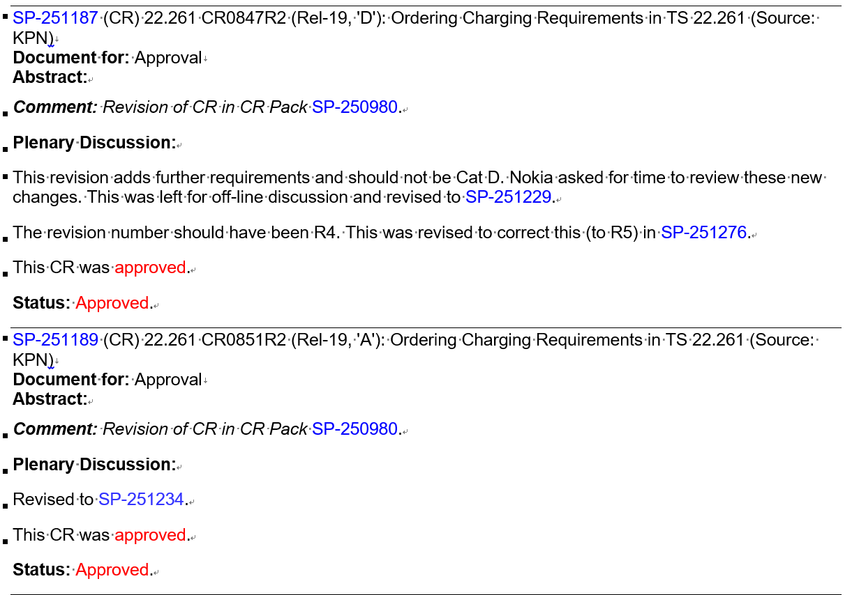
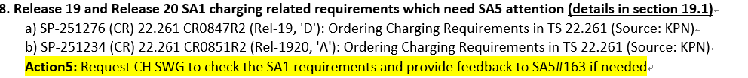
Background
SA1 TS 22.261 addresses the charging requirement of the different services/features.
Based on the DRAFT Meeting Report for SP meeting: #SP-109 Ordinary meeting, the proposal to consolidate charging requirements under clause 9 in TS 22.261 has been approved.

Slide 3
SA1 Charging Requirements Mapping
TS 22.261 | TS 32.240
Rel-19 Charging Requirements | Rel-19 Charging Mechanism
9.1 General | middle tier charging TSs
9.2 5G LAN-type Service | 6.2 5G LAN-type service charging
9.3 5G Timing Resiliency | middle tier charging TSs (Time based Charging) 6.4 5GS TSN services charging
9.4 Satellite Access | 6.5 Satellite related charging
9.5 Energy efficiency as a Service Criteria | 6.6 Energy related charging
9.6 NG-RAN Sharing | 6.7 Network sharing charging
9.7 Minimization of Service Interruption | 6.X Disaster roaming charging
9.8 Personal IoT Networks and Customer Premises Networks | No Plan 6.10 5GS UAS charging???
9.9 AI/ML model transfer in 5GS | 6.9 Exposure Services Charging
9.10 Providing Access to Local Services | 6.3 5G Edge computing services charging
9.11 Mobile base station relays | No Plan
9.12 5G wireless sensing service | potential Rel-20
9.13 Ambient power-enabled IoT | 6.8 Ambient IoT Charging
9.14 Mobile Metaverse Services | NG RTC Charging
9.15 Traffic steering and switching over two 3GPP access networks | middle tier charging TSs

Slide 4
General charging requirements
 | SA1 Charging Requirements | SA5 WID | Status
TS 22.261 9.1 General | The 5G core network shall support collection of all charging information on either a network or a slice basis. | TS 32.255/32.256 | Available
 | The 5G core network shall support collection of charging information for alternative authentication mechanisms. | ?
 | The 5G core network shall support collection of charging information associated with each serving MNO when multi-network connectivity is used under the control of the home operator. | Network sharing? | Available
 | The 5G core network shall support charging for services/applications in an operator’s Service Hosting Environment. | ?
 | The 5G core network shall support charging for content delivered from a content caching application. | ?
 | The 5G core network shall support collection of charging information based on the access type (e.g. 3GPP, non-3GPP, satellite access). | TS 32.255/32.256 | Available
 | The 5G core network shall support collection of charging information based on the slice that the UE accesses. | TS 32.255/32.256 | Available
 | The 5G system shall be able to generate charging information regarding the used radio resources e.g. used frequency bands. | No
 | The 5G core network shall support collection of charging information based on the capacity and performance metrics. | TS 28.201 | Available
 | The 5G system shall be able to support an indirect network connection even when the UE is in E-UTRAN or NG-RAN overage. | TS 32.255 | Available
 | The 5G system shall be able to support mechanisms to differentiate charging information for traffic carried over satellite backhaul. | TS 32.255 | Available
 | For service function chaining (see clause 10) the collection of charging information associated to the use of service functions and the chain of service functions requested by third parties shall be supported. | NO
 | The 5G system shall be able to support collection of charging information for a group of UEs, e.g. UEs of a AI/ML FL group. | TS 32.254 | Available
 | The 5G system shall be able to support charging mechanism for multiple UE exchange data for the same service using the direct device connection. | ProSe Charging? | Available

Slide 5
Charging requirements of Energy efficiency as a Service Criteria
 | SA1 Charging Requirements | SA5 WID | Status
TS 22.261 6.15a.2 Energy related information as a service criteria | Subject to operator’s policy, the 5G system shall support a means to associate energy consumption information with charging information based on subscription policies for services without QoS criteria. | EnergySys_CH Charging aspects for energy efficiency of network slice | R19 Available
 | Subject to operator’s policy, the 5G system shall support a mechanism to perform energy consumption credit limit control for services without QoS criteria. NOTE 1: The result of the credit control is not specified by this requirement.
 | The 5G system shall provide a mechanism to include Energy related information as part of charging information. | EnergySys_CH Charging aspects for energy efficiency of network slice | R19 Available
 | Subject to operator’s policy and regulatory requirements, the 5G network shall be able to trigger charging events corresponding to an impacted UE when degrading performance of services with QoS criteria (e.g. to a lower bitrate) in order to achieve energy saving.
TS 22.261 6.15a.3 Support of different energy states | The 5G system shall support different charging mechanisms based on the different energy states of network elements and network functions.
TS 22.261 6.15a.6 Network actions leveraging energy efficiency as a service criteria | Subject to regulatory requirements and operators’ policies, the 5G system shall enable an operator to temporarily serve UEs of other operators within a geographical area for the purpose of saving energy of the other operators. NOTE 3: It is assumed that the 5G system can collect charging information associated with serving UEs of other operators. | Roaming Charging | From R15 support HR roaming, From R17, support LBO

Slide 6
Charging requirements of NG-RAN Sharing
 | SA1 Charging Requirements | SA5 WID | Status
TS 22.261 Clause 9.6 NG-RAN Sharing | The 5G core network shall be able to support collection of charging information associated with a UE accessing a Shared NG-RAN using Indirect Network Sharing, which refers to the resource usage of hosting operator’s core network. | NetShare_CH Charging aspects for indirect network sharing | R19 Available
 | NOTE: When Shared NG-RAN is a shared satellite NG-RAN, the charging information can include the information specific to the shared satellite NG-RAN, e.g. the location of UE, involved satellites. | NetShare_CH Charging aspects for indirect network sharing 5GSAT_Ph3-CH Charging aspects of Satellite Backhaul in 5GS | R19 Available
 | The 5G network shall be able to collect charging information for a UE accessing a Shared NG-RAN using Indirect Network Sharing in Disaster Condition. | ?

Slide 7
Charging requirements of Minimization of Service Interruption
 | SA1 Charging Requirements | SA5 WID | Status
TS 22.261 9.7 Minimization of Service Interruption | 3GPP system shall be able to collect charging information for a Disaster Inbound Roamer with information about the applied disaster condition. | MINT_Ph2-CH Charging enhancement for disaster roaming | R19 Available

Slide 8
Charging requirements of Personal IoT Networks and Customer Premises Networks
 | SA1 Charging Requirements | SA5 WID | Status
TS 22.261 6.38.2.8 Charging | The 5G system shall support charging data collection for data traffic to/from individual UEs in a CPN or PIN (i.e., UEs behind the PIN Element with Gateway Capability or eRG and/or PRAS).
 | The 5G system shall be able to generate charging data that can differentiate between backhaul for the PRAS and other data traffic over the same access.

Slide 9
Charging requirements of AI/ML model transfer in 5GS
 | SA1 Charging Requirements | SA5 WID | Status
TS 22.261 9.9 AI/ML model transfer in 5GS | The 5G system shall be able to support charging mechanisms for multiple UEs exchanging data for the same service using the direct device connection (e.g. for AI-ML applications).

Slide 10
Charging requirements of Providing Access to Local Services
 | SA1 Charging Requirements | SA5 WID | Status
TS 22.261 6.41.2.8 Charging | The 5G system shall be able to collect charging information for the use of localized services at the hosting network and provide the charging records to UEs’ home operators based on localized service agreements and charging policies provided by the service providers of localized services. | Edge Computing supported (???)

Slide 11
Charging requirements of Mobile base station relays
 | SA1 Charging Requirements | SA5 WID | Status
TS 22.261 6.42.2 Requirements | The 5G system shall be able to identify and differentiate UEs’ traffic carried via a mobile base station relay and collect charging information, including specific relay information (e.g. geographic location served by the relay).

Slide 12
Charging requirements of 5G wireless sensing service
 | SA1 Charging Requirements | SA5 WID | Status
TS 22.137 5.2.5 Charging | The 5G system shall be able to support charging for the 5G wireless sensing service (e.g., considering sensing KPIs, duration).

Slide 13
Charging requirements of Ambient power-enabled IoT
 | SA1 Charging Requirements | SA5 WID | Status
TS 22.369 5.2.5 Charging | The 5G system shall be able to collect charging information in a suitable way for using Ambient IoT services on per Ambient IoT device basis or a group of Ambient IoT devices (e.g., total number of communications per charging period).
 |  | AmbientIoT-CH Charging for Ambient power-enabled Internet of Things (AIoT Charging via NEF for the API invocation) | R19 Available

Slide 14
Charging requirements of Mobile Metaverse Services
 | SA1 Charging Requirements | SA5 WID | Status
TS 22.156 8.2.1 Localized mobile metaverse service | [R-8.2.1-001] The 5G system shall be able to collect charging information for the actions related to spatial anchors, where a third party creates, deletes, or modifies a spatial anchor or associated service information. NOTE: It is assumed that exposure of network anchors and associated service information can be a service provided by a network operator to third parties.
 | [R-8.2.1-002] The 5G system shall support the collection of charging information associated with the exposure of a spatial map or derived localization information to authorized third parties.
 | [R-8.2.1-003] The 5G system shall support the collection of charging information associated with the production or modification of a spatial map on behalf of an authorized third party.
 | [R-8.2.1-004] The 5G system shall support the collection of charging information associated with exposing spatial location service information to authorized third parties.
 | [R-8.2.1-005] The 5G system shall be able to collect charging information associated with distribution of third party mobile metaverse media to one or more subscribers.
8.2.2 Avatar-based real-time communication | [R-8.2.2-001] The 5G system shall support collection of charging information associated with initiating and terminating avatar call. | NG_RTC_Ph2-CH | Rel19 Available
 | [R-8.2.2-002] The 5G system shall be able to collect charging information for transcoding services associated with avatar call. | NG_RTC_Ph2-CH | Rel19 Available
8.2.3 Digital asset management | [R-8.2.3-001] The 5G system shall be able to collect charging information per UE or per application, related to the use of digital assets associated with a user (e.g., typically a human user with a certain subscription). | NG_RTC_Ph2-CH | Rel19 Available
 | [R-8.2.3-002] The 5G system shall be able to collect charging information per UE for managing the digital assets associated with a user (e.g., typically a human user with a certain subscription) or a third party. NOTE: A third party who has digital assets could be an enterprise customer having service level agreement with the operator. | NG_RTC_Ph2-CH | Rel19 Available

Slide 15
Charging requirements of Traffic steering and switching over two 3GPP access networks
 | SA1 Charging Requirements | SA5 WID | Status
TS 22.261 9.15 Traffic steering and switching over two 3GPP access networks | Subject to HPLMN policy and network control, the 5G system shall be able to collect charging information related to traffic steering and/or switching of a DualSteer device’s user data across two 3GPP access networks.
 | NOTE 1: Charging information should be collected for both 3GPP access networks; in case the two 3GPP access networks belong to different PLMNs, or a PLMN and NPN, a proper business/roaming agreement among network operators is assumed. | Supporting in the basic charging mechanism | From R15

Slide 16
Discussion
Up to Release 19, the most of charging requirements specified in SA1 TS 22.261 already have corresponding charging mechanism specified in the charging specifications of SA5 Charging Group. Some charging aspect for the service/features gaps remain.
  Lack of volunteer (SA5 Charging Group individuals members ) or commercial drive for the service/features .e.g. Mobile Metaverse Services
  Lack of the unified understanding for the charging requirements. e.g. Energy efficiency as a Service Criteria (energy consumption credit limit control )
From Release 20, how to manage the charging requirements specified in SA1 TS and SA5 TS?
  Update and align the charging requirements through LS between SA1 and SA5
  Submit the correction CRs on the charging requirements of SA1 by individuals members .
  individuals members interested in the SA1 charging requirements are encouraged to submit new SID/WID proposals under SA5 (Prefered).

Slide 17
Thank you!

