Slide 1
6G OAM Study Planning
6G OAM Study rapporteurs:
Bahar Sadeghi (AT&T), Pengxiang Xie (ZTE)

Slide 2
Agenda
SA5 6G OAM Study Timeline
Proposal for Moderator Roles for Selected Topics
Submission Topic Identification
Topic Prioritization for SA June Checkpoint

Slide 3



6G OAM Study Timeline
SA5#164
Nov
SA5#165
Feb
SA5#166
Apr
SA5#167
May
SA5#168
Aug
SA5#169
Oct
SA5#170
Nov
SA5#171
Feb
SA5#172
Apr
SA5#173
May
Planned:
SA5 OAM SID Approval
Start of 6G Study
CP#1: Stability check per WT, coord. w/ other WGs (if needed)
CP#2:
Stability check of WTs and finalize mgmt. scenarios
Last meeting for new solution proposals
CP#3:
Check per WT, coord. w/ other WGs (if needed)
TBD whether to complete 6G study at SA5#171 or SA5#173
CP#4: conclusion and WID approval
We are here
Status:

Slide 4
Agenda
SA5 6G OAM Study Timeline
Proposal for Moderator Roles for Selected Topics
  Goal is to increase the efficiency of Study, specially for controversial topics
  The group is asked to review the proposal and provide input
  If decided to adopt the concept of moderator, the process will start from SA5#166
Submission Topic identification
Topic Prioritization for SA June Checkpoint

Slide 5
Moderator Role (1/3)
Moderate the discussions on ‘moderated topic’ and drive to agreement by the following:
  Alternative 1: Identify all contributions under the moderated topic, consolidate them into 1 pCR prior to the meeting, which means that there will be only one (consolidated) document treated during the meeting
    Benefits of handling one document per topic per meeting
      Eases review of submissions
      Shifts the focus of discussions on specific technical issues rather than documents and authorship
      Helps avoid approval of contradicting texts; improves the time management and handling of many submissions during the meeting
    Drawbacks/challenges
      Deciding which contributions belong to which topics. Potential for partial disagreements preventing approval of any version of the pCR
  Alternative 2: Identify controversial and overlapping contributions under the moderated topic and consolidate them into 1 consolidated contribution prior to the meeting; the consolidated contribution will be treated to facilitate efficient discussion, and the “source” contributions will only be treated -if necessary- upon request
  Note: It is TBD whether the Topic Moderator decides which alternative approach to take based on the submitted contributions per meeting or the alternative approach is pre-determined.

Slide 6
Moderator Role (2/3)
Expectation on moderator:
  Create a pCR prior to the meeting consolidating the related contributions
    Moderator for UCs consolidates management scenarios and make sure they exclude technical descriptions (Key Issues/technical requirements) and solutions
    Consolidate the contributions into one or more key issues
    Consolidate the contributions into solutions addressing similar requirements/topics
  Offline work with companies to harmonize as much as possible in between and before the meetings
    The consolidated contribution should include analysis on the commonalities and differences among the related contributions
    Identify solution variants per topic, one clause per solution variant
    Should include the list of pCRs sourced in the consolidated contribution
    Shared by the moderator with the group by Wednesday in the review week before the meeting
  [optional] Update SA5 on the progress of other WGs (Applicable for Moderator for topics with dependency on other WGs, e.g. Data management)

Slide 7
Moderator Role (3/3)
Moderated Topics:
  Starting with the following Moderated Topics:
    Management Scenario consolidation (WT 2.1/2.2)
    Architecture (WT1)
    Data Management (WT 1.6/2.3.7)
  Depending on the progress of different topics, additional moderated topics may be added as decided by the group
Moderators Selection
  Open for volunteers per topic, please contact SA5 leadership if you are interested to the take the moderator role

Slide 8
Agenda
SA5 6G OAM Study Timeline
Proposal for Moderator Roles for Selected Topics
Submission Topic Identification
Topic Prioritization for SA June Checkpoint

Slide 9
Submission Topic Identification
In order to assist with pre-processing of the documents before the meeting it is needed to have clear and consistent way to identify the topic the contributions belong to/address
The authors are asked to indicate the topic by use of the related WT from the SID in the Comments Section
  WT1.1 to WT1.8, WT2.1 to WT2.12, and WT3.
  Example: This contribution targets WT X, includes proposed new management scenario for xxxx.

Slide 10
Agenda
SA5 6G OAM Study Timeline
Proposal for Moderator Roles for Selected Topics
Submission Topic Identification
Topic Prioritization for SA June checkpoint
  Rel-20 SA5 checkpoints plan

Slide 11
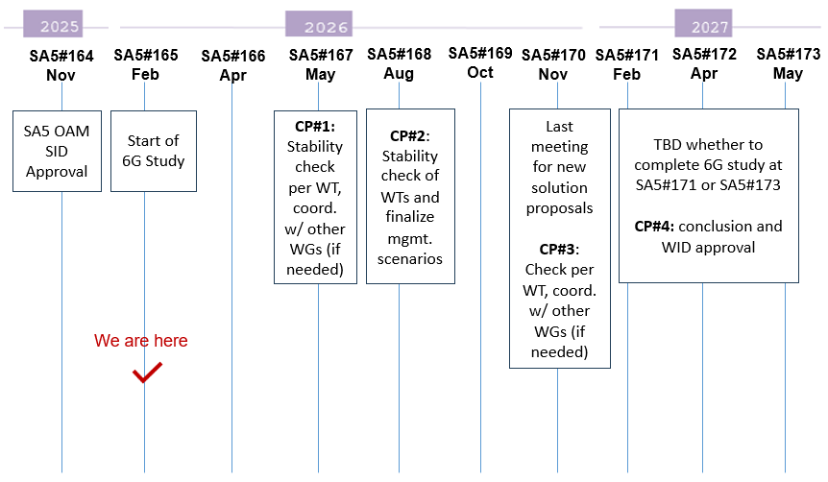
Release 20 6G timeline with SA5
CP1 Jun. 2026 (SA5#167):
Stability check per WTs & Dependency with SA2
SA5 shall have something on the table to analyze the dependency with other WGs before June 2026

Slide 12
Topic prioritization for June checkpoint
Topics with cross-WG dependency:
  Data Management -> SA checkpoint in June
  Note: There maybe additional topics for prioritization based on the discussion and group consensus
Prioritized topics
  Require sufficient information for coordination/discussion with other WGs by checkpoint
  Companies are encouraged to submit contributions towards the prioritized topics
  Contribution under such topics are prioritized and allocated meeting time earlier in the week in support of achieving agreement during the week
Suggested plan for Data Management
  Feb. meeting (SA5#165): management scenarios if any, key issues and requirements
  April & May meetings (SA5#166 & #167): requirements and solutions

Slide 13
The following slides added as part of the revision

Slide 14
Proposal 1 for SA5#166
Prioritized topics:
  Architectural principles
  High-level management scenario
  Data Management Framework
  Autonomous Agents
    terminology, management scenarios, requirements
  Knowledge/Semantics Management
    terminology, management scenarios, requirements
Companies are encouraged to focus submissions on the above topics
Submissions on other topics will only be treated if time allows

Slide 15
Proposal 2 for SA5#166
Moderated topics:
  Architectural principles
  High-level management scenario
  Data Management Framework
  Autonomous Agents
  Knowledge/Semantics Management
Moderator to announce tdoc numbers to be consolidated by Tuesday before meeting SA5#166.
Moderator to share the consolidated document with the group by Wednesday before the meeting SA5#166.
Moderator encouraged to do offline synch w/ authors to ensure the consolidated document captures their input (no additional calls to be scheduled)
Interested in the role? Please email the SA5 leadership

Slide 16
Backup Slides
Proposals endorsed in S5-255660 (SA5#164)

Slide 17
S5-255660 Endorsed in SA5#164
Proposal 1:
To ensure that 6G OAM day one features have sufficient discussions on solutions and conclusions, it is necessary to set a finalized time for new use cases and requirements:
- Overview and Use cases should be fully discussed before September 2026.
- New requirements should finalised by December 2026.
- Potential solutions by March 2027, with the TR concluding no later than June 2027.
NOTE: The timing may be adjusted to sync with SA2 and overall 3GPP 6G time plan.
Proposal 2:
Introduce checkpoints to align with SA2 and RAN studies:
December 2026: discussion on how to split WIDs/SIDs based on SID conclusions and other WG requirements.
Additional checkpoints with SA1, SA2 and RAN2/RAN3, with timing depending on topics needing alignment.
NOTE: Rapporteurs should provide recommendations on which topic and timing for checkpoint on a case-by-case basis, the checkpoints timing may be adjusted according to the overall 6G work progress and could be coordinated by Rapporteurs with Chairs.

