Slide 1
Rel-20 SA5 Work Planning
Dallas, USA, 17 - 21 November 2025
Zou Lan, 3GPP SA5 Chair, HUAWEI

Slide 2
Content
Release 20
  SA5 time plan
    5GA
    6G
  Release selection & rapporteur expectation
  TU planning

Slide 3
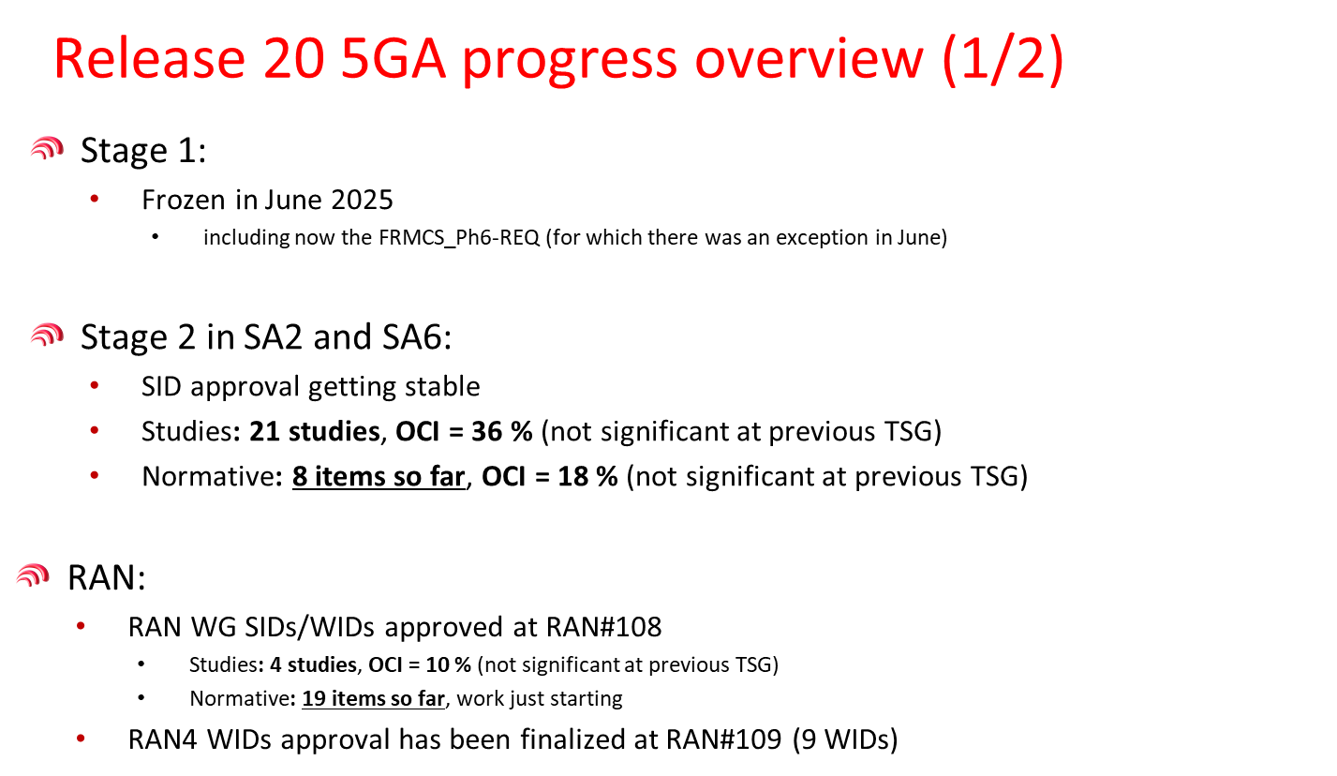
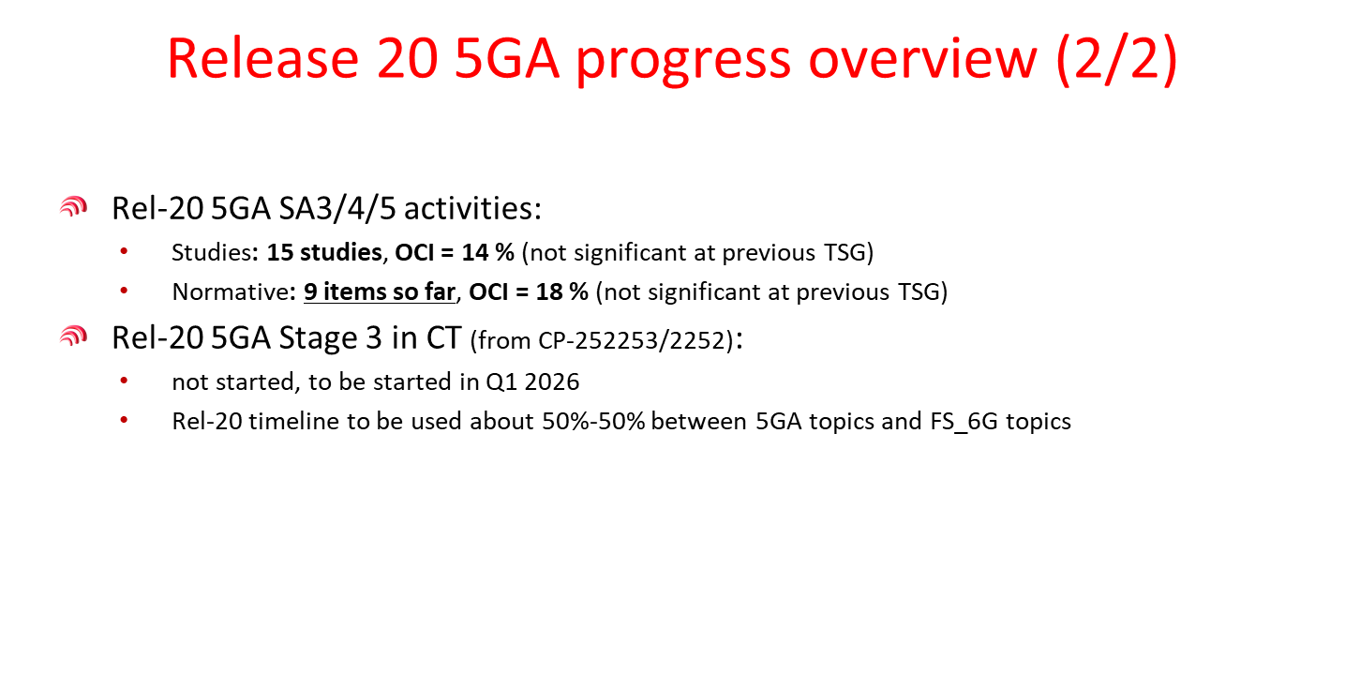
SA#109 information: Overall 5GA Workplan

Slide 4



SA5 Rel-20 Capacity Summary
SA5 capacity :
  Max TUs : 124 (OAM) / 80 (Charging)
    Additional buffer TUs: 61(OAM)/40(CH)
  Max number of SIs/WIs: 10~15 (OAM) / 6~10 (Charging)
    Note: one feature made up of SI+WI is counted as one item
  Max TUs per Feature: 12~8 TU
  Adopt 1:1 on TU allocation portion of 5GA part/6G part in Rel-20
Assumptions
  Start: Jun 2025, End: Mar 2027 (21 months)
  One track for OAM and One track for Charging
  Number of meetings: 10
  Expected total TUs per meeting (for all releases)(with Q5 included): 18.5 (OAM) / 12 (Charging)
  Total TUs (for all releases): 185 (OAM) / 120 (Charging)
  TUs for maintenance of past releases: 35 (OAM) / 20 (Charging)

Slide 5

Release 20 5GA timeline with SA5
Release 20 5GA timeline
Note: All starting dates are indicative
2024
2025
2026
2027
①
OAM/CH prime feature:
It’s recommended to take max 6~9 months for study phase if normative work is planned for Rel-20.
Start of Rel-20 prime study: right after Jun.2025 (SA#108/SA5#161)
End of Rel-20 prime normative:
Dec.2026 (SA#114/SA5#170)
OAM/CH supporting to network feature(SA5 is ready to support network features pending the availability of inputs from other WGs)
All supporting studies/normative WIDs to be agreed no later than May.2026 (SA5#167) and target for approval in Jun.2026 (SA#112).
Start of Rel-20 supporting study (if needed): right after Jun.2026 (SA#112/SA5#167)
End of Rel-20 supporting normative: Mar.2027 (SA#115/SA5#171)
TSGs
#113
#114
#102
#103
#104
#105
#106
#107
#108
#109
#110
#111
#112
#115
#116
Dec.
Mar.
Jun.
Sep.
Dec.
Mar.
Jun.
Sep.
Dec.
Mar.
Jun.
Sep.
Dec.
Mar.
Jun
SA1 5GA SID definition
SA1 5GA Studies + Norm 80%
100%
St.2 SID def.
St. 2 (SA2, SA6, …) 5GA St.+Norm 80%
100%
②
RAN WG SID def.
RP Content def.
RAN4 C.def.
Workshops
5GA RAN & SA
RAN1
RAN Completion (RAN2/3/4core)
RAN4 Perf
St.3 SID def. TBD
Stage 3 5GA St + Norm
5GA ASN.1 & Open APIs
OAM/CH Prime
SID def.
SA5 (5GA OAM/CH Prime) management St.+Norm Stage1/2/3
3GPP SA5
Timeline
Workshops 5GA SA5
①
OAM/CH Supporting
SID def.(if needed)
SA5 (OAM/CH Stage 2/Stage3 supporting) SA&RAN (SA5)
②
Now
(updated SA5 based on SP-251191)

Slide 6
SA5 Rel-20 5GA topics (TU Budget)
OAM | Rel-20 5GA topics | Planned TU
1 | Intent driven management enhancement | 8
2 | AIML management enhancement | 8
3 | NDT enhancement | 4
4 | SBMA enhancement | 8
5 | Energy efficiency enhancement | 5
6 | MDA enhancement | 4
7 | Data Management enhancement | 4
8 | MExpo enhancement | 4
9 | CCL enhancement | 4
10 | AdNRM | 4
11 | PM/KPI/Trace/MDT/QoE/SON enhancement | 5
12 | NWDAFM | 2
13 | XR management | 2
14 | Unified Management interface for Multi-RAT support | 5
SA5#163 | Life Cycle Management (LCM) of NF Deployment (wait for SA approval) | 4
SA5#164 | Management for SECHAND (wait for SA approval) | 1
SA5#164 | Study on Management aspects of Integrated Sensing and Communication (wait for SA approval) | 3
Total TU |  | 67->71->75
CH | Rel-20 5GA topics | Planned TU
1 | Charging Aspects of CAPIF | 1
2 | 5GA roaming charging reliability enhancement | 6
3 | Charging aspects for XRM | 5
SA5#163 | SID on 5GA Charging aspects of ISAC (endorsed) | 8
SA5#163 | Charging aspects of next generation real time communication services phase 3 (endorsed) | 4
SA5#164 | Charging enhancements of next generation real time communication services phase 2 (wait for SA approval) | 4
SA5#164 | Study on 5GA Charging aspects of integrated sensing and communications (wait for SA approval) | 8
SA5#164 | Study on Charging Aspects of satellite access phase 4 (wait for SA approval) | 8
Total TU |  | 12->24->32
Reminder: TU planning for 5GA OAM has exceeded the original TU planning budget (62TUs), either we will take some TU from 6G or some prioritization needs to be done for 5GA.

Slide 7
Update of SA5 5GA Rel-20 ongoing WI/SI progress
Unique_ID | Name | Acronym | Start | Finish | Completion | % New | Hyperlink | Impacted_TSs_and_TRs | Change or comment
1090013 | Study on Charging Aspects of 6G System | FS_6G_CH | 2025/9/9 | 2027/3/3 | 0% |  | SP-251218
1080012 | Study on AIML management phase 3 | FS_AIML_MGT_Ph3 | 2025/6/5 | 2026/3/3 | 0% |  | SP-250867 | 28.882
1080005 | Study on energy efficiency and energy saving aspects of 5G Advanced | FS_Energy_Ph4_OAM | 2025/6/5 | 2026/3/3 | 0% |  | SP-251025 | 28.885
1080006 | Study on intent driven management services for mobile network phase 4 | FS_IDMS_MN_Ph4 | 2025/6/5 | 2026/3/3 | 15% |  | SP-250861 | 28.881
1080007 | Study on Management Data Analytics (MDA) phase 4 | FS_eMDAS_Ph4 | 2025/6/5 | 2026/3/3 | 15% |  | SP-250862 | 28.886
1080008 | Study on Service Based Management Architecture enhancement phase 4 | FS_SBMA_Ph4 | 2025/6/5 | 2026/3/3 | 0% |  | SP-250863 | 28.884
1080009 | Study on Enhanced exposure of management services | FS_EnExpo | 2025/6/5 | 2026/3/3 | 0% |  | SP-250864 | 28.888
1080010 | Study for Data management phase 3 | FS_MADCOL_Ph3 | 2025/6/5 | 2026/3/3 | 2% |  | SP-250865 | 28.887
1080011 | Study on management aspects of Network Digital Twins phase 2 | FS_NDT_Ph2 | 2025/6/5 | 2026/3/3 | 0% |  | SP-250866 | 28.883
1080013 | Study on Closed Control Loop Management phase 2 | FS_CCLM_Ph2 | 2025/6/5 | 2026/3/3 | 0% |  | SP-250868 | 28.889
1080015 | 5G performance measurements/KPIs and Trace/MDT/QoE | PM_KPI_Trace_MDT_QoE-OAM | 2025/6/5 | 2026/9/9 | 5% |  | SP-250879 | 28.552; 28.554; 28.532; 28.558; 32.404; 32.421; 32.422; 32.423; 28.404; 28.405; 28.406; 28.622; 28.623; 28.541
1080017 | Management Aspects related to NWDAF phase 3 | NWDAF_Ph3-OAM | 2025/6/5 | 2026/6/6 | 30% |  | SP-251026 | 28.541; 28.552; 28.554
1080018 | 5G Advanced NRM features phase 4 | AdNRM_Ph4-OAM | 2025/6/5 | 2026/12/12 | 10% |  | SP-251024 | 28.540; 28.541; 28.622; 28.623; 32.160
1090010 | Study on 5GA roaming charging reliability enhancement | FS_RoamRE_CH | 2025/9/10 | 2026/3/3 | 0% |  | SP-251203
1090011 | Study on Unified Management interface for Multi-RAT support | FS_UMMR_OAM | 2025/9/10 | 2026/9/9 | 0% |  | SP-251204
1020010 | Study on Cloud Aspects of Management and Orchestration | FS_Cloud_OAM | 2024/1/3 | 2025/9/9 | 95% |  | SP-241566 |  | Completion date to be updated.
1090012 | Charging Aspects for XRM phase 2 | XRM_PH2-CH | 2025/9/10 | 2027/6/6 | 99% |  | SP-251214 | 32.255; 32.291; 32.298
1080016 | OAM support for Extended Reality and Media service (XRM) phase 2 | XRM_Ph2-OAM | 2025/6/5 | 2026/6/6 | 99% |  | SP-250880 | 28.540; 28.541; 28.552; 28.554
1080014 | Study on Charging Aspects of CAPIF phase 3 | FS_CAPIF_Ph3_CH | 2025/6/5 | 2026/3/3 | 96% |  | SP-250869 | 28.891

Slide 8
SA5 Rel-20 5GA Content Definition steps
Following SA content definition steps guidance in SP-241738 :
Discussion and Guidance for Rel-20 5GA Scope: The content proposals for SA5 Rel-20 5GA being discussed during the SA5 Rel-20 5GA Workshop in January and February.
  The potential topics include a list of prime and supporting topics for SA5 Rel-20 5GA.
  Maximum total number of SID/WID for OAM/CH Rel-20 is 15/10 and 1:1 TU allocation portion of 5GA part/6G part in Rel-20 estimates will be taken into account.
    Number of 5GA topics for OAM
      Maximum 62 TUs available (e.g. roughly max 8 with TU allocation per topic 8 TUs)
      46 TUs for OAM Prime, 16 TUs for network supporting based on Rel-19 TU usage experience (consumed TU ratio of prime and supporting are around 3:1)
    Number of 5GA topics for CH
      Maximum 40 TUs available (e.g. max 5 with TU allocation per topic 8 TUs)
    All the topics shall be technically ready before Tuesday 20 May, 2025 (SA5#161) to be in the list for prioritization.
    Prioritization is targeted to be done in SA5#161 if needed.
  Note1: One feature made up of SI+WI is counted as one item
  Note2: Small network support features (mini WIDs) are not counted in the maximum number. One Mini WID will allocate maximum 2 TUs.
Moderated Email Discussions: Moderated Email Discussions to develop SID/WID details corresponding to the Rel-20 5GA topics identified in the prime/supporting feature list. The focus will be on defining technical objectives, work tasks, and estimated budgets for each task. These discussions are planned to start after SA5#159. Further prioritization, if necessary, will be handled in SA5#160/SA5#161 (for the first package) and SA5#166/ SA5#167(for the second package) .
Approval of Selected Rel-20 5GA SID/WID (first package): Companies may submit the SID/WID to SA5#160/#161 for WG agreement. SA5 targets to submit WID/SIs to SA#108 for approval. Ideally, the Rel-20 5GA SID/WID for approval at this step should have no dependencies on Rel-20 work in RAN and SA. SID/WID for approval should follow the guidance on Rapporteurship (see SP-230746). Part of WG capacity will be allocated during the first step approval process.
WG commences Rel-20 5GA SI/WI Work: After the approval of the SID/WID at SA#108, SA5 will start working on the approved SID/WID during Q3 meetings.
Check point for prioritization: prioritization discussion in SA5#165 may be needed depends on the TU usage status.
Final Approval of Rel-20 5GA SID/WID (second package): This represents the second and final step in the approval process for the Rel-20 5GA content definition. Companies may submit additional SID/WID to SA5#166/#167 for WG agreement. SA5 targets to submit the second package of WID/SIs to SA#112 for approval. The Rel-20 5GA SID/WID for approval at this step should be mainly the network support features to Rel-20 work in RAN and SA. SID/WID for approval should follow the guidance on Rapporteurship (see SP-230746).

Slide 9
Content
Release 20
  SA5 time plan
    5GA
    6G
  Release selection & rapporteur expectation
  TU planning

Slide 10
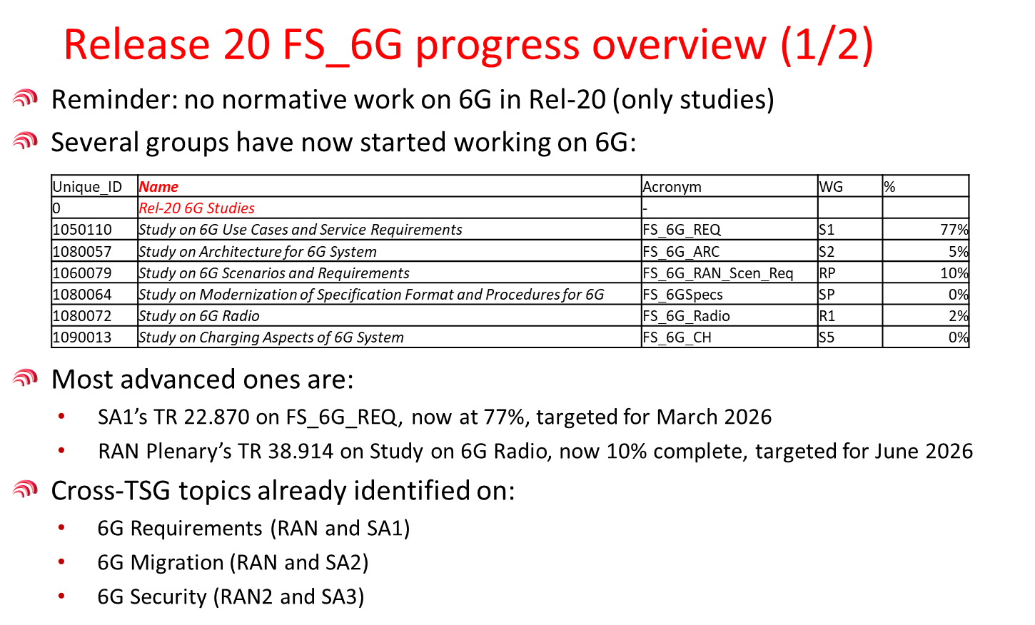
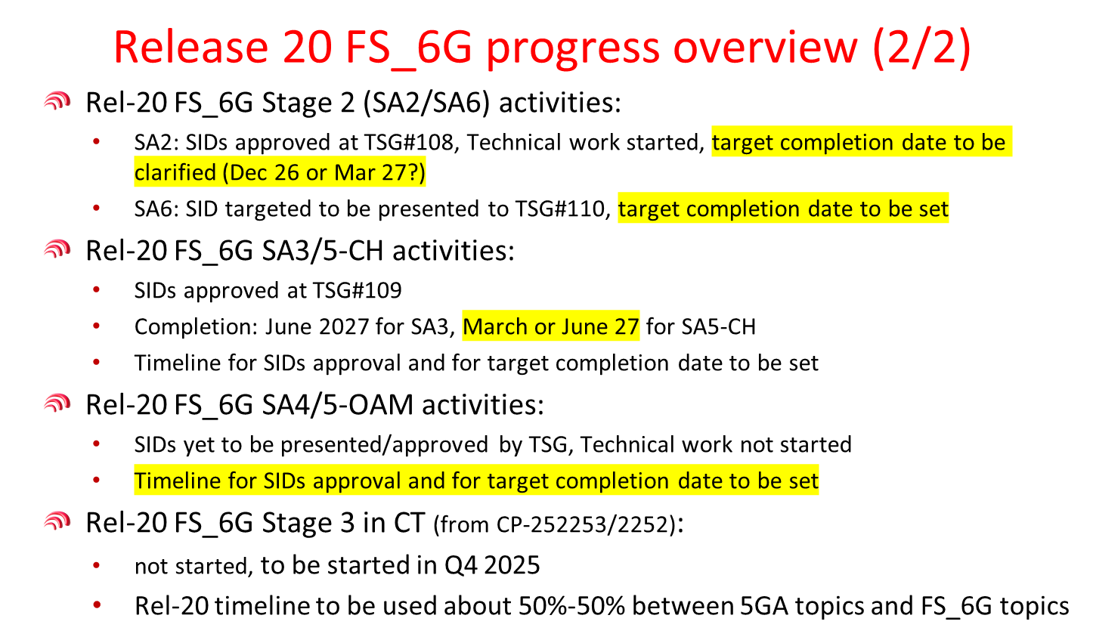
SA#109 information: Overall 6G Workplan

Slide 11

Release 20 6G timeline with SA5
Release 20 (FS) 6G timeline
Note: All starting dates are indicative
2024
2025
2026
2027
TSGs
#113
#114
#102
#103
#104
#105
#106
#107
#108
#109
#110
#111
#112
#115
#116
Dec.
Mar.
Jun.
Sep.
Dec.
Mar.
Jun.
Sep.
Dec.
Mar.
Jun.
Sep.
Dec.
Mar.
Jun
SA5 6G SI Rel-20:
Start of Rel-20 study: Sep.2025 (SA#109/SA5#163)
End of Rel-20 study: Mar.2027 (SA#115/SA5#171) or Jun.2027 (SA#116/SA5#172)
Note: Check point on Mar. 2026(SA#111/SA5#165) for 6G end time and future 6G workplan
SA1 6G SID def.
SA1 6G Study(ies)
Workshop SA1 on IMT-2030 use cases
RP IMT-2030 disc.
RP ITU Study
RP 6G Study(ies)
Workshop 6G TSGs
SA2 & RAN WGs 6G SID def.
SA2 6G Study(ies)
or
RAN1 6G Study(ies)
RAN2/3/4 6G Study(ies)
SA3/4/5/6 6G SID def. TBD
SA3/4/5/6 6G Study(ies)TBD
Stage 3 6G Study(ies)
Workshops 6G SA5
CT & St. 3 6G SID def.
TBD
SA5 6G SID def.
SA5 6G Study(ies)
or
3GPP SA5
Timeline
SA5 OAM 6G SID def
Check point 6G SA5
Now
(updated SA5 based on SP-251191)

Slide 12
Release 20 6G SA5 Checkpoint Plan
2025
2026
2027
TSGs
#109
#110
#111
#112
#113
#114
#115
#116
Sep.
Dec.
Mar.
Jun.
Sep.
Dec.
Mar.
Jun.
_____
FS_6G_OAM/FS_6G_CH
SA5 CH SID approved
Target SA5 OAM SID approval
CP#1: Stability check per WT, coord. with other WGs (if needed)
CP#2: Stability check of WTs and target to finalize majority new use cases.
Last meeting for new solution proposals
CP#3: Check per WT coord. with other WGs (if needed)
TBD whether to complete 6G study at SA5#171 or SA5#173:
CP#4: conclusion and WID approval.
SA5 6G Norm.
TBD
SA5#165
Feb.
SA5#167
May
SA5#169
Oct.
SA5#171
Feb.
SA5#173
May
SA5#164
Nov.
SA5#166
Apr.
SA5#168
Aug.
SA5#170
Nov.
SA5#172
Apr.

Slide 13
Rel-20 Potential Source of 6G Requirements for SA5
NGMN/
GSMA OPG&WSOLU/
TMF
Verticals (5G-ACIA, AECC…)
3GPP SA1
SA2/RAN2/RAN3
SA5 contributions
Operational/
Charging requirements
Management exposure requirements
3GPP Service management/ Charging requirements
Management
/Charging support requirements
Management/Charging
Prime & support requirements
SA5 – Management, Orchestration and Charging

Slide 14
SA5 Rel-20 6G topics (TU Budget)
OAM | Rel-20 6G topics | Planned TU
1 | Study on 6G Management and Orchestration (wait for SA approval) | 62->49
Total TU
CH | Rel-20 5GA topics | Planned TU
1 | Study on Charging Aspects of 6G System | 28
Total TU |  | 28

Slide 15
Content
Release 20
  SA5 time plan
    5GA
    6G
  Release selection & rapporteur expectation
  TU planning

Slide 16
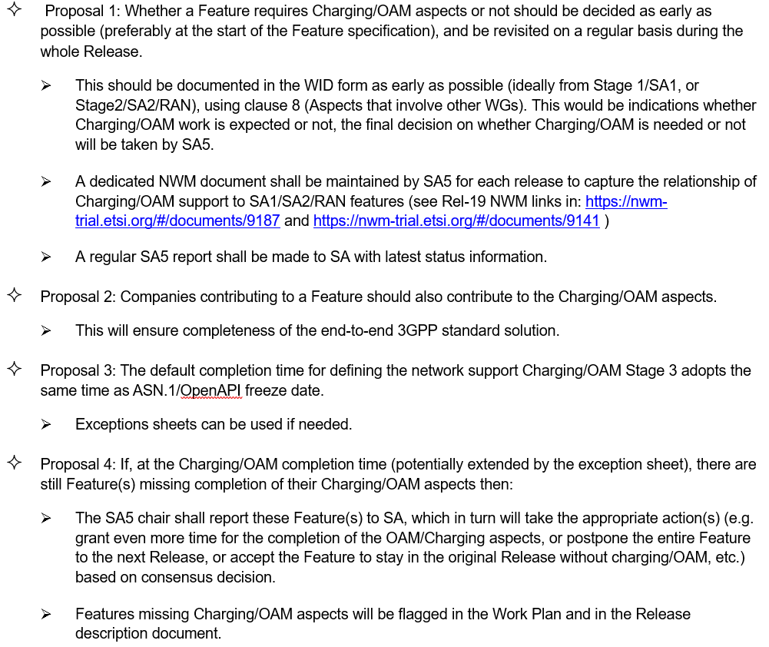
Selecting release for Charging/OAM aspects proposals endorsed in SA#108
Selecting the Release for Charging/OAM aspects (SP-250888): 4 proposals are endorsed. (details in SA report section 5.1) Action1: Request SA5 companies to follow the endorsed guidelines for future SA5 work.
SA#108 report in: https://www.3gpp.org/ftp/tsg_sa/TSG_SA/TSGS_108_Prague_2025-06/Report

Slide 17
Expectation of SA5 rapporteur role
Expectation of SA5 rapporteur role:
  Actively contribute and facilitate the progress of the WI/SI, coordinate the discussion within SA5 and with external groups if necessary
  Prepare tdoc sequence list and tdoc grouping suggestion before the meeting
  Provide inputs to TU planning/TU consumption for each meeting.
  Provide timely progress report in NWM before closing plenary with clear highlights for external readers with references to the WID/SID objectives.
  Implement any necessary draftCR/draft TR/draft TS and facilitate the email approval of draftCR/draft TR/draft TS
  Moderate the breakout sessions/offline calls and provide summary report
  Refer to TR 21.900 clause 6.3.2 for Role of the work item rapporteur and 4.1.2 Role of the specification rapporteur
  Be familiar with 3GPP drafting rules as specified in TR 21.801.
If you agree with the expectation above, please provide the nomination for the new WIDs/SIDs (one company one email please send the nominee’s name for Rel-20 SID/WID directly to SA5 chair and SA Chair, rather than sharing it on the SA reflector):
  Please consider the guidance (bullet 2/3/4/5) provided in Rel-19 Rapporteurship document SP-230746 from SA.
  Indicate if the nomination is for the role of Primary Rapporteur.
  Indicate if the nomination is for the role of Secondary Rapporteur.
  The work responsibility of Primary/Secondary Rapporteurs shall be clearly described if there are proposals for co-rapporteurs.
  Note： While operating in Rapporteurs roles, delegates are expected to carry out their assigned duties with impartiality and in the interests of 3GPP, and regular participation to SA5 f2f meeting is a must for commitment to the rapporteur role

Slide 18
Content
Release 20
  3GPP SA background information
  3GPP SA5 general information
  SA5 time plan
    5GA
    6G
  TU planning

Slide 19
SA5 calendar with OAM TU (one track)
Assumption:
Every day = 5 sessions (TUs), total TU in 1 ordinary meeting (exclude closing plenary TUs) = 18.5 TUs
Time | Monday | Tuesday | Wednesday | Thursday | Friday (Closing plenary)
Q0 (8:00~8:55) (If needed) | NA | Breakout (opt.) | Breakout (opt.) | Breakout (opt.) | Closing plenary Start at 8:30am (may change depends on the host restriction)
Q1 (9:00 - 10:30) | Plenary Session#1 (1TU) [Single Stream] | Stream#1 (1TU) | Stream#1 (1TU) | Stream#1 (1TU) | Closing plenary
10:30 - 11:00 | Morning Coffee Break | Morning Coffee Break | Morning Coffee Break | Morning Coffee Break | Morning Coffee Break
Q2 (11:00 - 12:30) | Stream#1 (1TU) | Stream#1 (1TU) | Stream#1 (1TU) | Stream#1 (1TU) | Closing plenary
12:30 - 14:00 | Lunch | Lunch | Lunch | Lunch | Lunch
Q3 (14:00 - 15:30) | Stream#1 (1TU) | Stream#1 (1TU) | Stream#1 (1TU) | Stream#1 (1TU) | Closing plenary
15:30 - 16:00 | Afternoon Coffee Break | Afternoon Coffee Break | Afternoon Coffee Break | Afternoon Coffee Break | Afternoon Coffee Break
Q4 (16:00 - 17:30) | Stream#1 (1TU) | Stream#1 (1TU) | Stream#1 (1TU) | Revision session | Closing plenary
17:30 - 17:40 | Break | Break | Break | Break | Break
Q5 (17:40 – 19:10) | Stream#1 (1TU) | Stream#1 (0.5 TU) Stop around 18:45 Social evening | Stream#1 (1TU) | Revision session

Slide 20
TU Budget for SA5 OAM
Assumptions for SA5 OAM :
  6 ordinary meeting per year.
  Rel-20 spans 21 months for SA5 (with early start of studies) = 10 meetings
  1 Session = 1.5 hour time window
  Max 5 sessions per meeting day
  1 Stream = 1 TU (Time Unit)
  1 TU is time (i.e., 1.5 hours) spent to discuss/handle technical contributions.
  Revisions/Drafting/offline conference call are not counted for the TU estimates.
  OAM revision sessions normally planned to be in Thursday Q4 and Q5 (initial assump.)
  Statistics:
    1 parallel (OAM) stream per session => 18.5 TUs per meeting (incl. 2 TUs as buffer) = 185
    Assume Maintenance + Buffer = 33% => ~ 61 TU
    Resulting total TUs avail. f. SI/WI: 10 meetings x 18.5 sessions = 185 TU minus 61 => 124 TU
    With 15 SI/WI => Average 8 TU per SI/WI (0.8/meeting).

Slide 21
SA5 Rel-20 OAM TU planning (Jan.2025~Mar.2027)
Assumptions:
Every meeting day = 5 quarters (= 5 TUs)
Total TUs per meeting = 18.5 TUs
  Buffer = 2 TUs
  OAM = 16.5 TUs
    Maintenance CRs + remaining Rel-19 work (TU allocation will decrease over time )
    Rel-21 preparation work (TU allocation will be zero at the beginning and will increase over time )
    All remaining time is available for Rel-20 SIDs / WIDs
Total TUs allocated to Rel-20 SIDs / WIDs = 124 TUs
 | Maintenance+R18/R19 | R19 | R20 | R21 preparation | Buffer (revision session)
Jan.2025~Jun.2025: SA5#159~#161 (3 meetings) (5GA OAM/CH Prime SID def.) | 1.5 TU*3 meetings= 4.5 TU (CRs) | 13 TU*3 meetings= 39 TU | 2 TU*3 meetings = 6 TU | NA | 2 TU*3=6 TU
Jun.2025~Sep.2025: SA5#162 (1 meeting) (Rel-19 stage-3 freeze, first meeting for Rel-20 6G OAM/CH SID def.) | 1.5 TU (CRs) | 13 TU | 2 TU | NA | 2 TU
Oct.2025~Dec.2026: SA5#163~#169 (7 meetings) (OAM/CH Prime stage-3 freeze) SA5#165~#167 (3 meetings) (5GA OAM/CH Supporting SID def.) | 2.5 TU*7 meetings= 17.5 TU (CRs) | NA | 14 TU*7 meetings = 98 TU | NA | 2 TU*7=14 TU
Jan. 2027~Mar.2027: SA5#170~#171 (2 meetings) (5GA OAM/CH Supporting stage-3 freeze) (6G study completion) | 1.5 TU*2 meetings = 3 TU (CRs) | NA | 12 TU*2 meetings = 24 TU | 3 TU*2 meetings = 6 TU | 2 TU*2=4 TU
Total=185 TU | 22 TU | 13 TU | 124 TU | 6TU | 20 TU

Slide 22
SA5 calendar with CH TU (one track)
Assumption:
Every day = 5 sessions (TUs), total TU in 1 ordinary meeting (exclude closing plenary and offline TUs) = 12 TUs
Time | Monday | Tuesday | Wednesday | Thursday | Friday (Closing plenary)
Q0 (8:00~8:55) (If needed) |  | Breakout (opt.) | Breakout (opt.) |  | Closing plenary Start at 8:30am (may change depends on the host restriction)
Q1 (9:00 - 10:30) | Plenary Session#1 (1TU) [Single Stream] | Stream#1 (1TU) | Stream#1 (1TU) | Revision session | Closing plenary
10:30 - 11:00 | Morning Coffee Break | Morning Coffee Break | Morning Coffee Break | Morning Coffee Break | Morning Coffee Break
Q2 (11:00 - 12:30) | Stream#1 (1TU) | Stream#1 (1TU) | Stream#1 (1TU) | Revision session | Closing plenary
12:30 - 14:00 | Lunch | Lunch | Lunch | Lunch | Lunch
Q3 (14:00 - 15:30) | Stream#1 (1TU) | Stream#1 (1TU) | Offline session | CH Closing | Closing plenary
15:30 - 16:00 | Afternoon Coffee Break | Afternoon Coffee Break | Afternoon Coffee Break | Afternoon Coffee Break | Afternoon Coffee Break
Q4 (16:00 - 17:30) | Stream#1 (1TU) | Stream#1 (1TU) | Offline session | CH Closing | Closing plenary
17:30 - 17:40 | Break | Break | Break | Break | Break
Q5 (17:40 – 19:10) | Stream#1 (1TU) | Social evening | Offline session (Opt.) | CH Closing(Opt.)

Slide 23
TU Budget for SA5 CH
Assumptions for SA5 CH :
  6 ordinary meeting per year.
  Rel-20 spans 21 months for SA5 (with early start of studies) = 10 meetings
  1 Session = 1.5 hour time window
  Max 5 sessions per meeting day
  1 Stream = 1 TU (Time Unit)
  1 TU is time (i.e., 1.5 hours) spent to discuss/handle technical contributions.
  Revisions/Drafting/offline conference call are not counted for the TU estimates.
  CH revision sessions normally planned to be in Thursday Q1 and Q2 (initial assump.),CH closing plenary planned to be in Thursday Q3 and Q4.
  Detail statistics:
    1 (CH) stream per session => 12 TUs per meeting (incl. 2 TUs as buffer) = 120
    Assume Maintenance + Buffer = 33% as in SA2 => ~ 40 TU
    Resulting total TUs avail. f. SI/WI: 10 meetings x 10 sessions = 120 TU minus 40 => 80 TU
    With 10 SI/WI => Average 8 TU per SI/WI (0.8/meeting).
  Note: TU capacity for CH could be extended if more topics are proposed.

Slide 24
SA5 Rel-20 CH TU planning (Jan.2025~Mar.2027)
Assumptions:
Every meeting day = 5 quarters (= 5 TUs)
Total TUs per meeting = 12 TUs
  Buffer = 2 TUs
  CH = 10 TUs
    Maintenance CRs + remaining Rel-19 work (TU allocation will decrease over time )
    Rel-21 preparation work (TU allocation will be zero at the beginning and will increase over time )
    All remaining time is available for Rel-20 SIDs / WIDs
Total TUs allocated to Rel-20 SIDs / WIDs = 80 TUs
 | Maintenance+R18/R19 | R19 | R20 | R21 preparation | Buffer (revision session)
Jan.2025~Jun.2025: SA5#159~#161 (3 meetings) (5GA OAM/CH Prime SID def.) | 1.5 TU*3 meetings= 4.5 TU (CRs) | 7.5 TU*3 meetings= 22.5 TU | 1 TU*3 meetings = 3 TU | NA | 2 TU*3=6 TU
Jun.2025~Sep.2025: SA5#162 (1 meeting) (Rel-19 stage-3 freeze, first meeting for Rel-20 6G OAM/CH SID def.) | 1.5 TU (CRs) | 6.5 TU | 2 TU | NA | 2 TU
Oct.2025~Dec.2026: SA5#163~#169 (7 meetings) (OAM/CH Prime stage-3 freeze) SA5#165~#167 (3 meetings) (5GA OAM/CH Supporting SID def.) | 1.5 TU*2 meetings+ 1 TU*5 meetings = 8 TU (CRs) | NA | 8.5 TU*2 meetings + 9 TU *5 meetings = 62 TU | NA | 2 TU*2=4 TU
Jan. 2027~Mar.2027: SA5#170~#171 (2 meetings) (5GA OAM/CH Supporting stage-3 freeze) (6G study completion) | 1 TU*2 meetings = 2 TU (CRs) | NA | 8 TU*2 meetings = 16 TU | 1 TU*2 meetings = 2 TU | 2 TU*2=4 TU
Total=120 TU | 11.5 TU | 6.5 TU | 80 TU | 2 TU | 20 TU

Slide 25
Thank you!

Slide 26
SA5 Rel-20 5GA candidate topics (NWM Links)
Rel-20 5GA OAM Support topics
Rel-20 5GA OAM Prime topics
No | Topic | Topic Moderator | NWM Link
14 | ISAC management | Bangqiu Ruan (ZTE) | 9054
15 | NWDAFM | Zhen Li (China Telecommunications) | 9049
16 | AdNRM | Sean(Nokia) | 9053
17 | XR management | Xiepengxiang (ZTE) | 9138
18 | PM/KPI | Chenxiumin (China Telecom) | 9139
No | Topic | Topic moderator | NWM Link
1 | AIML management enhancement | Hassan Al-kanani (NEC) yizhi(Intel) | 9047
2 | Energy efficiency enhancement | Srilakshmi (Nokia) | 9027
3 | Intent driven management enhancement | Xu Ruiyue (Huawei), Mark Scott (Ericsson) | 9063
4 | NDT enhancement | Yushuang Hu (CMCC) | 9052
5 | CCL enhancement | Deepanshu Gautam (Samsung) /Stephen(Nokia) | 9040
6 | SBMA enhancement | Kai Zhang (Huawei) | 9037
7 | Cloud-native management and orchestration | Guangjing Cao (CMCC) | 9051
8 | MDA enhancement | Brendan Hassett (Huawei) | 9036
9 | Knowledge-assisted management / Semantics – Based Network Management | Zhaoning Wang (China Unicom) /Deepanshu(Samsung) | 9034
10 | Mexpo enhancement | Winnie Nakimuli (Nokia) | 9044
11 | MADCOL/Data Management | Sreekumar Pothera Kalloor (Nokia) | 9046
12 | Trace/MDT/QoE/SON enhancement | Robert Petersen (Ericsson) | 9029
13 | Security Monitoring | Balazs Lengyel (Ericsson) | 9059
Rel-20 5GA CH Prime topics
No | Topic | Topic Moderator | NWM Link
19 | Charging reliability enhancement (failure handling) | Yimeng Deng (Huawei) | 9057
Rel-20 5GA CH Support topics
No | Topic | Topic Moderator | NWM Link
20 | CAPCH | João Rodrigues (Nokia) | 9062

Slide 27
SA5 Rel-20 6G NWM Links
6G OAM：https://nwm-trial.etsi.org/#/documents/9204
6G CH：https://nwm-trial.etsi.org/#/documents/9209

