Slide 1
3GPP TSG SA WG 1 Meeting #113
9-13 February 2026, Goa, India
S1-261xxx
Discussion on new 6G WID
Agenda item: TBD
Document for: Discussion
Source: Huawei

Slide 2
Summary of Use Cases and PRs in TR 22.870 v1.1.0.
Clause number | # of Use Cases | # of PRs
5 System and Operational Aspects
5.2 Interworking with legacy systems | 1 | 3
5.3 Support of non-3GPP access | 1 | 4
5.4 Support for legacy service requirements | 2 | 2
5.5 Security for 6G | 10 | 30
5.6 Resilience | 6 | 7
5.7 6G enhancements of legacy/existing services and capabilities | 10 | 17
5.8 Sustainability and Energy Efficiency | 9 | 17
5.9 Network Aspects | 11 | 20
5.10 Device Support | 1 | 1 + 1 (KPIs)
6 AI | 62 | 155 + 5 (KPIs)
7 Integrated Sensing and Communication | 27 | 31 + 17 (KPIs)
8 Ubiquitous Connectivity | 21 | 30 + 8 (KPIs)
9 Immersive Communication | 19 | 36 + 10 (KPIs)
10 Massive Communication | 2 | 5 + 1 (KPIs)
11 Further Use Cases on Industry and Verticals | 30 | 39 + 20 (KPIs)
12 Other Use Cases | 4 | 9
13 Other Considerations | 1 | 2

Slide 3
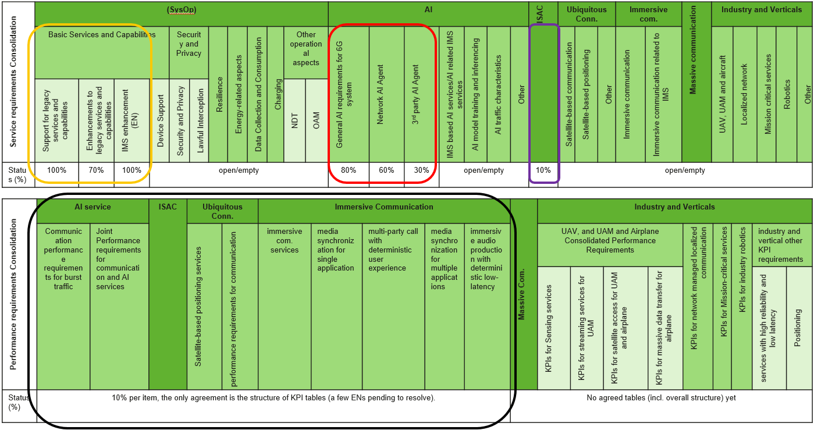
Ongoing Consolidation (TR 22.870 v1.1.0.) requires significant work…

Slide 4
On 6G new WID …
Prerequisites:
At SA1#113, the majority of the time assigned to 6G should be dedicated to ongoing consolidation work (FS_6G_REQ, TR 22.870);
The consolidation work should sufficiently capture 6G new services/features/requirements as agreed in the potential requirements, which are well included in S1-254490;
Ongoing consolidation should continue to use rapporteurs’ pCRs as baseline, incl.:
CPR Table 14.1.1-1 legacy support | CPR Table 14.1.5-1 (Data Collection & Consumption) | CPR Table 14.1.8-1 General AI requirements for 6G system | CPR Table 14.1.11-1 (Satellite-based communication) | AI KPIs (bursty traffic KPIs, low-latency inference KPIs)
CPR Table 14.1.1-2 (Enhancements to legacy services and capabilities) | PCR Table 14.1.6-1 (Charging) | CPR Table 14.1.8-2 Network AI agent | CPR Table 14.1.11-2 (Satellite-based positioning) | ISAC KPIs
CPR Table 14.1.1-3 (Device Support) | CPR Table 14.1.4-1 (Energy-related Aspects) | CPR Table 14.1.8-3 3rd party AI Agent | CPR Table 14.1.11-3 (Other Aspects) -- Ubiquitous | Immersive com. KPIs
Table 14.1.1-4: Non-AI or Immersive related IMS enhancements | CPR Table 14.1.7-1 (NDT) | CPR Table 14.1.8-4 IMS based AI services AI related IMS services | CPR Table 14.1.12-1 (Immersive communication) | Ubiquitous con. KPIs (positioning, communication)
CPR Table 14.1.2-1 (Security & Privacy) | CPR Table 14.1.7-2 (OAM) | CPR Table 14.1.8-5 AI model training and inferencing | CPR Table 14.1.12-2 (Immersive communication related to IMS) | Massive com. KPIs
CPR Table 14.1.2-2 (Lawful Interception) | CPR Table 14.1.10-1 (ISAC) | CPR Table 14.1.8-6 AI traffic characteristics | CPR Table 14.1.12-3 (Immersive Other) | Industry and Verticals KPIs
CPR Table 14.1.3-1 (Resilience) | CPR Table 14.1.13-1 Massive Communication | CPR Table 14.1.8-7 Other | CPR Table 14.1.14 vertical and industry (incl. 5 sub-tables)
New 6G WID is expected to:
accurately reflect the conclusions of the study (FS_6G_REQ)
Provide a clear justification for the WID by summarizing the current status and key outcomes of the consolidation
Elaborate Objectives that sufficiently reflect consolidation structures in the TR 22.870, namely the primary structure and outstanding secondary structures (the latter applies to big items such as: SysOp, AI, Industry and Verticals, etc.)
A good start is half success, the aim is to reach consensus on a good-quality WID comprehensively addressing all key aspects, and ensure no significant parts are overlooked.

Slide 5
Thank You!

