Slide 1
RAN4#117 meeting Arrangements and Guidelines
3GPP TSG-RAN WG4 Meeting #117
Dallas, USA, Nov. 17-21, 2025
R4-2520002
RAN4 Chair: Yang Tang
Vice Chair: Gene Fong, Shan Yang

Slide 2
General Aspects
The face-to-face meeting will take place during 17-21 Nov. 2025.
  Three sessions in three separate rooms: Main session, RRM/Demod/OTA session and RF/NTN session
  2-Way GoToWebinar (GTW) conference calls will be set each session and [1]-way MS teams will be set for ad hoc in the best effort way. A number of ad hoc sessions will be arranged (refer to meeting schedule).
  6G feature lead and 5GA moderator will be designated to provide the summary for a topic before the meeting. In online discussions, session chairs will handle topics based on the feature lead/moderator summary.
  Deadline for Tdoc request & submission deadline: Fri. 07 Nov. 2025 11:55pm UTC

Slide 3
Schedule
For chairs
For moderator
For delegates
Pre-meeting week
Quiet Period
Meeting week
Quiet Period
Post-meeting week
Fri
Sat/Sun
Mon
Tue
Wed
Thu
Fri
Sat/Sun
Mon
Tue
Wed
Thu
Fri
Sat/Sun
Mon
Tue
Wed
Thu
NWM flag process Slide #9
Moderators trigger nwm for maintenance before Sunday
Flag for maintenance @nwm
WF/CR template
Draft TS/TR
WF/CR rules Slide #19
Pre-RAN Action
MCC 3GU parsing tool
TR/TS rules Slide #20/21
Slide #23
Topic Moderator & summary: slide #15
Online discussions &
GTW conference call (US/China meeting)
Upload CR for maintenance 2:30pm on Thursday
TOHRU (US/China meeting)
Tdoc request (new&revision)
Upload tdocs (10.10.10.10) &
How to access contributions
FL/Moderator assignment before Mon
Draft summary for topics
Summary review & comments
Formal tdoc of summary submission by Saturday
GTW Slide #17
List of email threads for post-meeting
Submission of tdoc of post-meeting
Comments
Approve tdocs for post-meeting
Registration
Initial list for block approval for basket
Deadline for flag for block approval
Updated list for block approval
Tohru Slide #06
Post-meeting process: slide #08
Tdoc request Slide #13/14
Tdoc number request & submission
Basket WIs Block approval: slide #7
Meeting schedule & Ad hoc chair assignment
Provided before meeting
Update of meeting notes per day
Tdoc allocation
Check-in
Register/check-in Slide #10
Slide #5
Meeting room
Quiet Period (0:00 am ~ 7:00 am meeting venue Local time
No email are expected in RAN4 reflector
  Before 10.11.2025 (Monday): Session chairs will provide the list of topics with 6G feature lead and 5GA moderator assignments.
  12.11.2025 (Wednesday), 17:00 UTC: Feature leads/Moderators provide the initial summary for a topic.
  13.11.2025 (Thursday), 12:00 UTC: Deadline for companies review of initial summary.
  14.11.2025 (Friday), 17:00 UTC: Feature leads/Moderators submit the formal tdoc of summary for a topic.
  16.11.2025 (Sunday): Session chairs share the initial meeting notes taking moderators summary in consideration.
  In online discussions, session chairs will handle topics based on the feature leads/moderator summary.

Slide 4
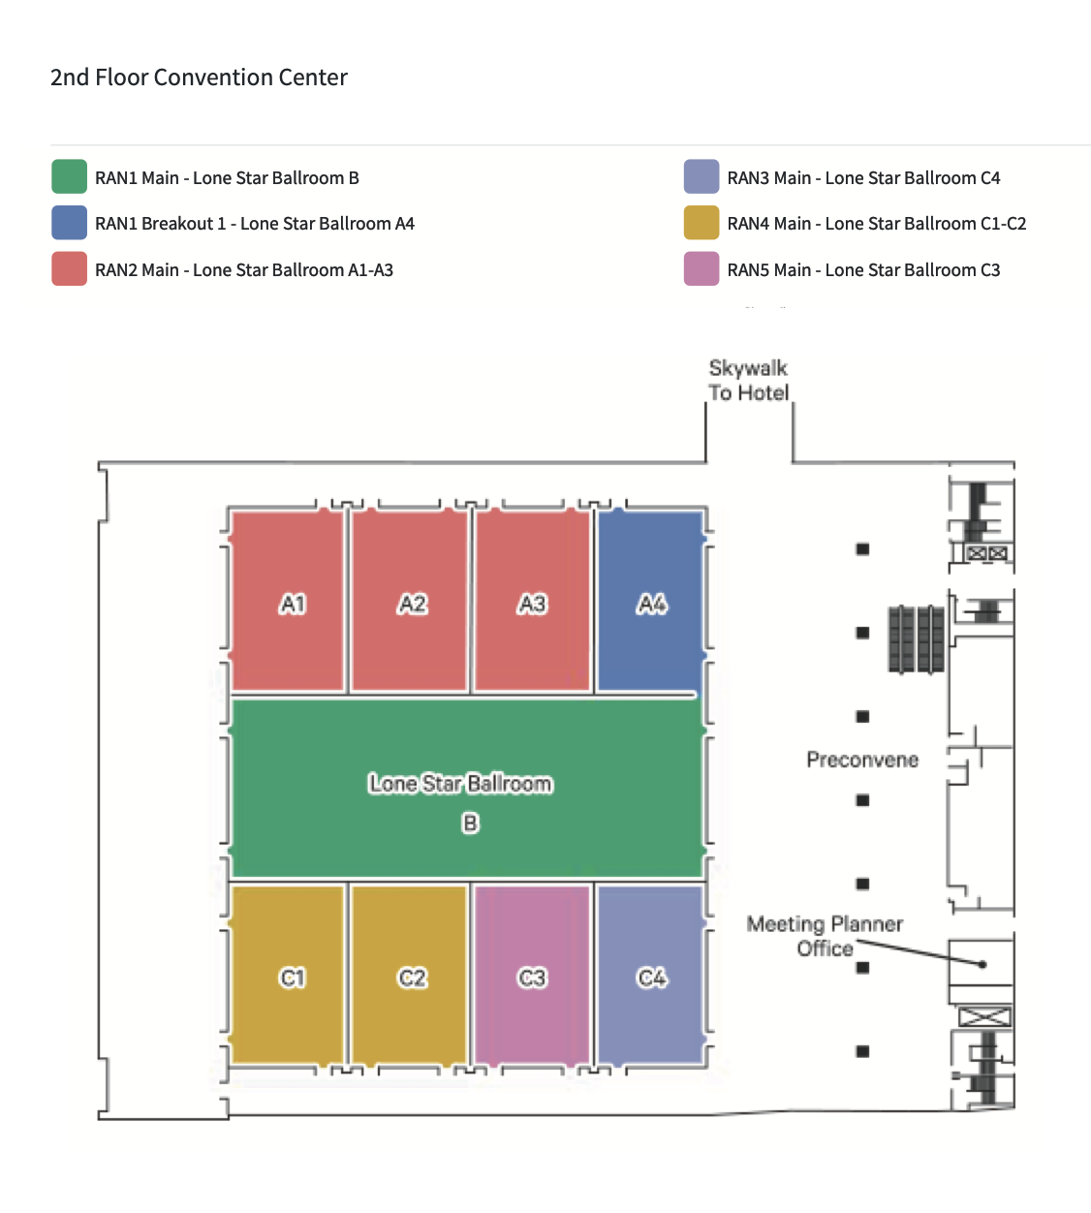
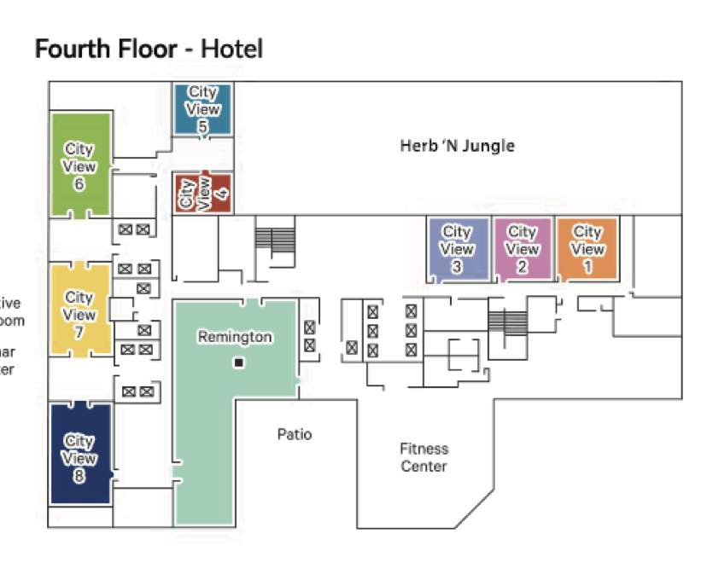
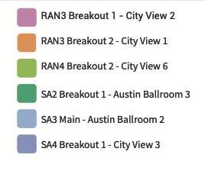
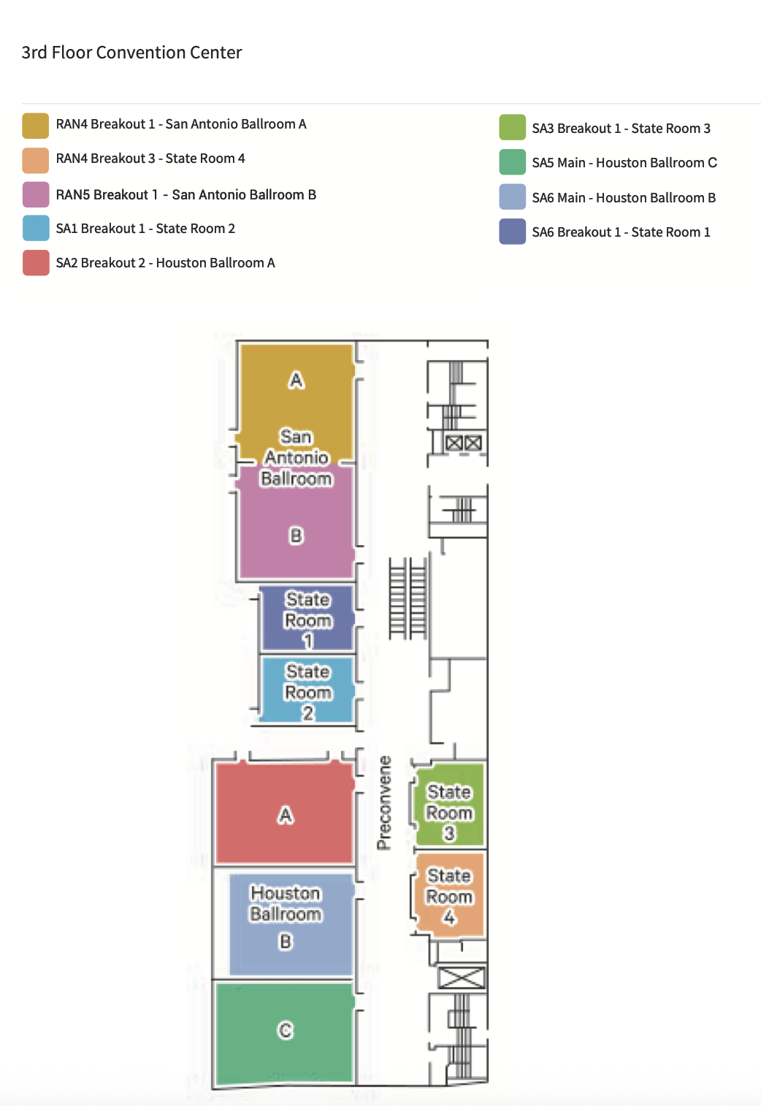
Meeting rooms for RAN4#117
RF/NTN
RRM/demod/OTA
Sky bridge (aprox.5m by walk)
Ad-hoc
Hotel
Main session
RAN4 session | Room | Location
Main | Long star ballroom C1-C2 | 2nd floor, Convention center
RRM/demod/OTA (RAN4 breakroom 1) | San Antonio ballroom A | 3rd floor, Convention center
BS RF/UE RF/NTN (RAN4 breakroom 2) | City view 6 | 4th floor, Hotel
Ad-hoc (RAN4 breakroom 3) | State Room 4 | 3rd floor, Convention center
Convention center

Slide 5
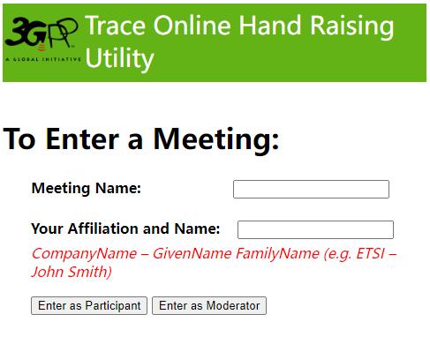
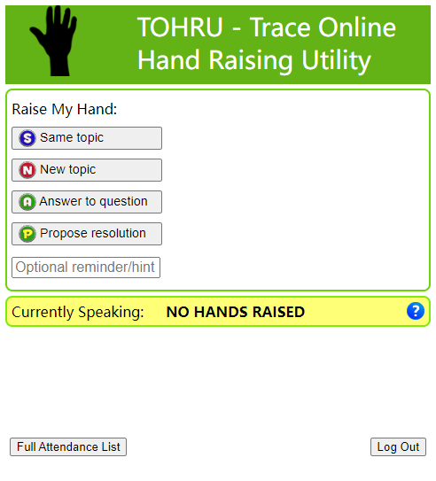
Guidance of TOHRU for GTW
  TOHRU (Trace Online Hand Raising Utility) will be used
  3GPP TOHRU will be used in this meeting for three online sessions.
  Hyperlink: https://tohru.3gpp.org/
  Together with the invitation for the GotoWebinar MCC provides you with a "Meeting name" individually after your registeration.
  Meeting name (TOHRU Meeting IDs):
    Main session: RAN4_Main
    RRM session: RAN4_RRM
    BSRF_Demod_testing session: RAN4_BDAT
    NOTE: Ad hoc session: MS teams will be provided.
  Enter your name
    <represented company>, <first name> <family name>
    e.g.: XY Telecom - Peter Mustermann
  Need to manually push "Refresh Queue" or use "Automatically refresh queue every 3 seconds", since this is different from the original TOHRU tool.
  The other buttons are similar as the previous external TOHRU tool.
  Please find references at
  https://www.3gpp.org/ftp/TSG_RAN/WG4_Radio/TSGR4_109/Invitation/TSG_RAN4%23109_GTW_TOHRU_guidance_v3.docx

Slide 6
Basket WIs Block approval
Draft CRs/TPs for basket WIs will be handled following procedures/timelines below.
Procedures and timelines
  12.11.2025 (Wednesday): Basket WI moderators will provide a list of contributions for flagging.
  14.11.2025 (Friday), 17:00 UTC: Flag deadline. Companies can use the basket email thread title and specific reason(s) for flag in the email, e.g.,
  17.11.2025 (Monday): Basket WI moderators will provide the updated list of contributions in which
    Those that were not flagged will be considered as "agreeable”.
    Those that were flagged will be revised. The authors are encouraged to share the revisions as soon as possible for further comments.
  18-21.11.2025 (Tuesday ~ Friday): The flagged tdocs will be discussed and addressed during the meeting.
    Ad hoc session(s) may be scheduled pending on Chair arrangement.
    Online time slots will be scheduled to make decisions for each tdocs and for the discussions of open issues if needed.
  25.11.2025 (Tuesday), 17:00 UTC: Updated TRs/draft TSs, big CR/big draft CRs, and revised WID (for ordinary meeting) need be available for post-meeting email process.
    No technique discussions are expected during post-meeting process.
Tdoc | Title | Reason for discussion | Source company
R4-25xxxxx | xxxx | xxxx | xxxx

Slide 7
Post-meeting email process procedures/timelines
Tdocs under post-meeting email process:
  Big draft CRs for Rel-19 on-going WIs.
  Big draft CRs/TRs for Rel-19 basket WIs.
  Other tdocs/topics based on Chairs guidance.
Procedures and timelines:
  24.11.2025 (Monday), 17:00 UTC: Session chairs will provide the list of tdocs for post-meeting email process.
  25.11.2025 (Tuesday), 17:00 UTC: Authors of tdocs need share the drafts and submit them into inbox for review.
  27.11.2025 (Thursday), 13:00 UTC: Companies provided comments if any and author should provide necessary revisions.
  27.11.2025 (Thursday), 17:00 UTC: Based on the summary, session chair will announce decisions.
  Other guidance:
  We would like to remind all delegated to upload all Cat A draft CRs/CRs timely. In case Cat A draft CRs/CRs are not available before close of post-meeting approval on 25.11.2025 (Tuesday) 17:00 UTC, the respective CRs may be postponed and not implemented.
  Delegates are strongly encouraged to participate in review on Big CRs during post-meeting email process procedures.

Slide 8
NWM flag process
  Because a large numbers of CRs/contributions are submitted for early release maintenance and some spectrum related topics, we would like to improve the efficiency to handle those tdoc-s in face-to-face meeting
  Previously only after tdocs are handled online in the first round, the proponents can know who have comments. And there may be no comments for some CRs, which can be directly endorsed/agreed and actually no online time would be needed.
  For those tdocs on which companies have comments, earlier offline discussions would be helpful to save online time in face-to-face meeting.
  The proponent(s) should know which companies have comment and then have offline discussion with them earlier.
  So we would like to provide a scheme to help the proponents/moderators identify which companies will have comments or concerns.
  NWM flag process: Use NWM tool to trigger early offline discussions
  Before 16.11.2025 (Sunday): For topic threads which need nwm flag process, moderators will provide the NWM link, where delegates can flag the tdocs/CRs with brief reasons
    NWM flag process is just for maintenance and some spectrum related items with many CRs.
    Format of NWM would be simple.
      Only the tdoc numbers and titles are listed.
  By 18.11.2025 (Tuesday), 18:00 (local time): Delegates flag the tdocs in the list
    Flag process would be simple.
      Fill in the feedback form with a brief description of reason, like “Company A flag R4-2xxxxxx because XYX”，or with delegate name who flags tdoc like “Company A Aaron flags R4-2xxxxxx because XYZ”.
      The purpose is to let the proponents know who they need to talk to.
    Please refer to the following document for NWM tool at https://www.3gpp.org/ftp/tsg_ran/WG4_Radio/TSGR4_106bis-e/Invitation/TSG_RAN4%23106-bis-e_NWM_guidance.docx

Slide 9
Register and check-in
  The registration deadline for f2f participants and remote access is Fri 07.11.2025 11:55pm UTC
  Changes to the working procedures and please refer to updated 3GPP working procedure (especially F.2) for more details
  Attendance at ordinary meetings now counts towards accrual and maintenance of voting rights.
  The new rules apply for future meetings starting from meetings after TSG#95-e. Past e-meetings do not count towards voting rights.
  A delegate is deemed to have attended a given meeting if they confirm their participation by check in. If a delegate does not check in during the meeting, it shall be assumed that the individual did not attend.
  Please note that the delegates need to check in themselves between the start and the end of the meeting.
  For face-to-face (ordinary) meeting, please check in via 10.10.10.10 during the meeting
  Remote participants will not be able to check in for RAN4 meeting when it is a face-to-face (ordinary) meeting.
  No voting rights will be accrued through remote participants.
  For e-meeting, please follow the guidance below to check in
  Option 1: Through registration email, click the direct link (only if you registered after the deadline of registration for this meeting)
  Option 2: Through registration email, copy/paste token into the registration link (if you registered after the deadline of registration for this meeting)
  Option 2-Bis: Through registration email, copy/paste token into the registration link (if you registered before the deadline of registration for this meeting)
  Option 3: Through the 3GU portal (You need to be logged in)
    Click on the meeting you wish to check-in to
    then, click on “Presence Token” link
  Note: although the date of registration to a given meeting is not the cut-off date when the new rules start to apply, it is still expected for delegates to register before the deadline of registration to be eligible to take part in the GTW conference calls.

Slide 10
Thanks!
Wish you a successful RAN4 meeting

Slide 11
APPENDIX

Slide 12
Tdoc number request & submission
Tdoc which is requested and/or submitted after deadline will not be treated. (the following guidance applies if the corresponding agenda(s) are set)
  Please refer to RAN4 Meeting Efficiency Improvements (R4-2114691) for tdoc submission and handling, where the principle is applied up to Rel-19.
  Formal CRs/big CRs/TP/Revised WIDs are expected in this ordinary meeting. Please follow additional restrictions in the frozen agenda.
  Deadline for a new band combination request: Same deadline as RAN4 Tdoc submission
  No request of adding new band combinations into basket WIs will be handled for bis-meeting and ad hoc meeting.
  No new band combination is allowed to be requested after the deadline
    It is allowed to only correct the missing fallback and add more supporting companies for the proposed band combinations.
  For all the maintenance agendas, please submit formal CRs in the ordinary meeting or draft CRs in the bis meeting,
  Companies should submit the Cat-F CRs/draft CRs with the corresponding Cat-A CRs/draft CRs in the same agenda to ensure that the CRs/draft CRs can be easily tracked. If no Cat-A CRs/draft CRs were submitted in the same agenda, the CRs/draft CRs may just be endorsed or postponed.
  For easily tracking the changes, it expected that one batch of CRs/draft CRs (Cat-F/A/…) should just cover a single topic rather than multiple topics, and please use the exact same title for the Cat A as for the Cat F. Multiple batches of draft CRs/CRs per company in the lowest agenda are allowed.
  If there is NOT a dedicated agenda for individual WI, when reserving tdoc number and submitting contributions, please add (WI_code) in the beginning of titles for both discussion files and CRs/draft CRs to facilitate handling of moderators and session chairs.
  In the ordinary meeting preceded by a bis meeting,
    The formal CRs corresponding to the endorsed draft CR or the formal CRs endorsed in bis meeting should be re-submitted.
    If further change(s) were needed on top of the endorsed CR/draft CR in the bis meeting, the new CR/draft CR should be based on the latest version of specifications and to capture the agreed CRs/endorsed draft CRs in the previous bis meeting with change marks in the new CR.
  Note that only CRs with essential corrections may be formally agreed by Chair and session chairs. Please see more details in slide #22 and 23.

Slide 13
Tdoc number request & submission (cont.)
  For the on-going Rel-19 WIs, the big (draft) CR approach applies and basically the draft CRs are expected to submit
  For all the non-spectrum SI/WIs,
    The draft CRs will be submitted according to the work split and towards the end of release based on the work plan
      It is encouraged that companies discuss and agree on the work splitting first before preparing the draft CR or CRs.
      Rapporteur shall provide RAN4 work plan prior to the start of the actual work.
    The big draft CRs can be endorsed to merge all the endorsed draft CRs for further review in the post-meeting process, and the formal big CRs are expected to be agreed in the meetings towards the end of the WI.
    The formal big CRs shall be submitted only by the assigned companies according to work split. The other companies are expected to submit draft CRs based on the latest version of specifications and keeping the change marks for all the changes in the previous meeting(s).
    TPs can be submitted/approved each meeting according to work split and merged into draft TR for agreement in the post-meeting process.
  For all the spectrum related WIs,
    Rapporteur needs reserve the tdoc numbers for revised WID/draft TR/big CRs before each ordinary meeting or reserve the tdoc numbers for draft TR/big draft CRs before each bis meeting, and merge all the endorsed or approved tdocs properly during the post-meeting process.
    The draft CRs/TPs from companies can be submitted each meeting.
    The big CRs can be agreed each ordinary meeting for the basket WIs even at the early state of the release.
  For each individual agenda of all WI/SI-s, the limit of submitted tdoc follows the principle in RAN4 Meeting Efficiency Improvements (R4-2114691)
    Maximum one discussion paper per lowest level agenda item (AI) per company/organization in principle.
  Please use title starting with "Big CRs …”or "Draft Big CR" when you reserve a Tdoc number for a big CRs to facilitate work of MCC.
  When WIs/SIs are to be closed in the upcoming RAN plenary, the rapporteur needs get the TR number from MCC before the WG meeting and reserve the tdoc numbers for draft TR/TS to merge all the agreements.

Slide 14
Topic Moderator & summary
List of topics will be provided by session chair
  A thread number will be assigned for each topic, e.g., [117][10x] XXX for main session.
  MCC will create the sub-folder for each topic thread in /inbox/drafts.
    Role of moderators
  Moderator is a neutral technical competent facilitator of discussion and is expected to provide summaries timely and impartially, and try their best way to drive progress.
  Moderator should provide the technical summary to sufficiently categorize the technical proposals, suggest the discussion points and possible way forward if any.
    A template for the moderator summary can be found in https://www.3gpp.org/ftp/tsg_ran/WG4_Radio/TSGR4_115/Templates/Topic%20Summary%20template%20-%20RAN4_2025.docx
  Moderator is expected to drive the progress based on the consensus and continue organizing the discussions in the 2nd round if there are concerns received from companies.
  Tdoc of a moderator summary is sourced as“Moderator (company name)”.
  Online discussions will be organized based on the moderator summary topic by topic + presentation of the selected contributions (very limited number of contributions).
  Delegates do not need write comments in the summary document and moderator does not need update the summary during the meeting.

Slide 15
6G Feature Lead & summary
List of topics will be provided by session chair
  A thread number will be assigned for each topic, e.g., [117][10x] XXX for main session.
  MCC will create the sub-folder for each topic thread in /inbox/drafts.
    Role of Feature Lead
  Drafting the pre-meeting summary including outlining/categorizing the proposals and recommending the discussion points and the prioritization.
  Leading the related offline and AH discussion during the meeting subject to session chairs’ consent and schedule arrangement.
  Maintaining the post-meeting “running” WF/summary, including all key agreements and decisions in the past meetings and the key relevant agreements from other WG.
  Tdoc of a feature lead summary is sourced as“Feature lead (company name)”.

Slide 16
Online discussion & GTW conference call
1-way GTW conference calls for three online sessions and 1-way MS teams for ad hoc sessions will be set.
  Remote participating is allowed and participants will be able to listen. No comment is allowed for the remote participants.
  Please register timely to be eligible to take part in the GTW conference calls.
During online discussions
  Session chairs will organize discussions based on the moderator summary topic by topic + presentation of the selected contributions, if needed.
  Tdocs for approval including CR/draftCR/TP/draft TS/draft TR/LS-out will be handled online.
  WF will be allocated by session chairs only during the online discussions
    Please do not reserve Tdoc number for WF before the meeting.
  Ad hoc sessions
  Ad hoc sessions will be scheduled by session chairs for detailed technique discussions for (a) special topics.
  Ad hoc chairs will be designated by session chairs and the ad hoc minutes with recommendation are expected after ad hoc sessions.
  Offline discussions
  The sub-folder for each topic will be created by MCC in the inbox folder
    Companies can use the sub-folder to upload the new tdocs and/or revised tdocs, including WF/CR/draft CR/TPs…
  No official email discussion will be arranged for each topic
    If the authors of a WF/draft CR/CR/TP/LSout or other delegates want to trigger the offline discussions by email, please use the subject of [117][xxx] XXX for Main/RRM/BSRF_Demod_Test(BDaT) sessions, where XXX corresponds to topic name.

Slide 17
Tdoc request & allocation during the meeting
During the meeting, the tdoc number for revision or new tdoc will be allocated by session chairs according to the requests
  Based on the online discussions, session chairs will allocate tdoc numbers with help of MCC.
  During coffee break, the delegates can request the tdoc from session chairs in person. Please do not send email to request tdoc numbers, because it is inconvenient for session chairs to check and reply the email timely during the face-to-face meeting.
  Email thread like “[1xx][X00] XXX_Session - tdoc request”WON´T be used for tdoc request and allocation since it is difficult for session chairs to handle email during face-to-face meeting.
For basket WIs, maintenance or other special topics, session chairs will allocate the Tdoc number for revision or new tdocs based on the recommendation in the topic moderators´ summary.
For TEI, if you plan to trigger a new topic which has no corresponding WI code and have to submit CR(s) with TEI-xx as the work item code for this topic, please contact session Chairs first, because TEI topics are under monitoring by RAN
  Please submit the CRs by providing a TEI identifier and include it in the title of CRs.
    Example of TEI identifier: [n77_Canada], which should be put in the tail of the tdoc title, e.g., UE RF requirements for … [n77_Canada]
    TEI identifier should be provided for all the CRs with TEI18/TEI17 as WI code, otherwise the CRs cannot be approved officially
    If CRs correspond to the previous release but the agreement in the group is to change it from Rel-18/17, the WI code of the previous release WID plus TEI18/TEI17 should be used as WI code, e.g., Work item code: NR_pos_enh-Core, TEI18, for which no TEI identifier is needed.
    If TEI17 Cat-F CR was approved, the WI code for its Rel-18 Cat-A CR should be TEI17 rather than TEI18.
  The first CRs of one TEI topic to introduce a new should be prepared as Cat-B CRs. The CRs which correct the specification for the previous TEI topics should be submitted as Cat-F or Cat-A. In theory the TEI Cat-F CR is supposed to correct the functionality of previous TEI Cat-B CR(s).
  Please refer to RP-240858 for the detailed rule of TEI.
  Proponents of TEI CRs shall explicitly check during the quarter that all relevant work is completed in all RAN WGs before asking approval from RAN plenary. (Conclusions of RP-241618)

Slide 18
CR/WF submission
  The latest CR-Form template can be found at
  http://www.3gpp.org/ftp/Information/All_Templates
  By using the official CR coversheet template you ensure that only official 3GPP styles go into your CR (For an insight into the styles please review the latest 3GPP drafting rules 21.801).
  CR submissions with reference to the original CR/TP/TR, etc with the values that CR is going to correct
  To make reader easily review CR, it is expected that the author(s）provide the reference to the original CR/TP/TR, which captures the values that CR is to correct. The reference is expected to provide in the cover page of CR.
  3GU tool
  There is a tool in 3GU which allows you to use the 3GU automatic pre-filled coversheet, so no need to fill in by hand all the CR details every time:
  If you go to the tdoc listing in 3GU (not the Excel Tdoc list but the "online" listing of Tdocs), and select a CR (the spectacles logo), and if that CR is not yet uploaded, there is a small logo next to the "Status: reserved" field which says "(Download prefilled cover page)".
  Using the 3GU automatic pre-filled coversheet can also make sure your data in 3GU must match your coversheet data.
  New clauses
  You are encouraged to used "other comments" on the CR coversheet to provide additional information for where you would like a new clause to be placed in the spec, if you have a preference.
  Others
  Companies are encouraged to write the CR based on the sequential order of clauses affected.
  Please use the appropriate bullet styles.
  The WF template is provided in the server https://www.3gpp.org/ftp/tsg_ran/WG4_Radio/TSGR4_113/Templates
  The clean version of final formal WF Tdoc is expected. No green highlighted is expected.

Slide 19
Correctly preparation for TR and TS
  Capture the new TR/TS in the table for“New specifications”in the approved WID/SID
  Keep the TS/TR number as 3Y.XXX, e.g., 38.xxx for NR.
  Usually for SID, the title of TR is the same as the title of SID.
  Rapporteur and numbers for TR/TS
  Please contact with WG Chair to decide the rapporteur for TR/TS.
  Please contact WG secretary for TR/TS number after WID/SID capturing new TS/TR is approved in RAN and before submission to RAN for approval.
  Update draft TR/TS in WG meetings
  Before formally approved in RAN plenary, the draft TR/TS is maintained by rapporteur in WG. TP is expected to be used to add or change technique contents for draft TR/TS.
  The rapporteur of draft TR/TS is expected to merge all the approved TPs and provide the updated draft TR/TS in the next meeting.
  The version number for the draft TR/TS should start with v.0.X.0, e.g., v.0.1.0, and X will increase meeting by meeting.
  Submission and formally approve TR/TS to RAN plenary
  According to the target date, the draft TR/TS is expected to be submitted to RAN plenary for information and/or approval.
  Only the rapporteur of TR/TS is able to reserve tdoc number and upload tdoc for RAN plenary.
  Before submitting TR/TS to RAN plenary, please provide the drafts to RAN MCC to perform 3GU upload checker.
  When submitting TR/TS, please use the template provided by RAN secretary. The template includes both presentation cover and specifications. Please put presentation cover and specifications in one zip file with proper tdoc number.
    Please find example in https://www.3gpp.org/ftp/Information/All_Templates (presentation cover).
  Please use version number v1.0.0 for the firs time submission to RAN plenary (for information or for one-step approval), and use version number v.2.0.0 for the second time (e.g., for formal approval after submission for information in the previous RAN).

Slide 20
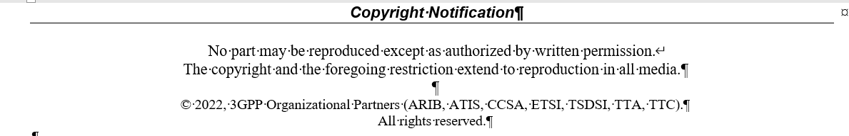
Correctly preparation for TR and TS (cont.)
  CR for formally approved TR/TS
  After formally approved, TR/TS is under control of MCC. Please use CR for any kinds of change for TR/TS.
  Update of copyright date in draft TR/TS
  Please update the date of draft TR/TS. The example is given below.
2025

Slide 21
How to upload and access contributions
Upload/download tdocs during the meeting
  10.10.10.10 as local server in F2F, which will be sync-up by MCC to https://www.3gpp.org/ftp/Meetings_3GPP_SYNC/RAN4
Folder access | Before the meeting | Up to end of Pre-meeting, during the F2F meeting, and post-meeting | Comments
https://www.3gpp.org/ftp/tsg_ran/WG4_Radio/TSGR4_117/Inbox/ | Used for the upload of documents (same as during an e-meeting) | Used the same as during an e-meeting for pre-meeting and post-meeting contributions | As usual, the meeting contributions are to be uploaded to 3GU till Deadline For the pre-meeting contributions, the FTP server can be used for uploading Topic summaries, etc. into the inbox MCC will backup all available files from FTP server to the local FTP server (10.10.10.10) and provide the credentials required to access the local FTP server remotely when they become available by ETSI IT. The FTP server should be used again during post-meeting. MCC will backup all available files from local FTP server (10.10.10.10) to the FTP server after the F2F meeting close and before the 3GPP local WIFI have been dismantled.
FTP local server (10.10.10.10) |  | Used by F2F participants in the meeting location. | The local FTP server (10.10.10.10) is used by both F2F delegates (once connected to the 3GPP local WIFI) and remote participants (note: not until the credentials required to access the local FTP server remotely becomes available by ETSI IT) The upload of any documents during the F2F meeting should be done using the local FTP server (10.10.10.10)
The credentials that is required to access the local FTP server 10.10.10.10 remotely to remote participants. |  | Should only be used by remote participants.
https://www.3gpp.org/ftp/Meetings_3GPP_SYNC/RAN4/ |  | Used for any delegate who would like to only read contributions | Please note that the Meetings_3GPP_SYNC/RAN4 server is always provided as read only and delegates are not able to upload contributions to this server. The RAN4 sync server has a delay and occurs around every 10 minutes Access to the RAN4 sync server does not start until the meeting set-up have been done by ETSI IT. The RAN4 sync server access starts before the start of the meeting. The RAN4 sync server stops after the meeting close and the 3GPP local WIFI have been dismantled

Slide 22
MCC 3GU parsing tool
  MCC 3GU parsing tool will be used to identify the problem of CR, especially for CR cover page. The CR which does not pass the MCC 3GU parsing tool will not be included in the CR pack for RAN plenary formal approval.
  Before the meeting starts, the author and MCC will receive the feedback of checking via MCC 3GU parsing tool, and based on the information shared by author or MCC the Session chairs or MCC will handle the problem identified by the tool
  The revision may or may not be needed to fix the problem depending on the Session chairs guidance.
    For some draft CRs, the revision may not be urgent before the online treatment.
  During the meeting, session chairs may not have information on whether the revised CRs pass the MCC 3GU parsing tool or not, so the problem of CR parsing will be fixed in the post-meeting email process.
  At the beginning of the post-meeting process, the Session chairs will provide the list of the revised CRs which did not pass the MCC 3GU parsing tool checking and need be further revision.

Slide 23
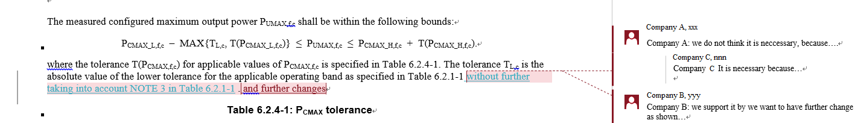
Other guidelines
    According to the agreement in RAN4#112bis, please follow the agreement below for the format of contributions
  RAN4 consensus is that the outdated (.doc/.xls/.ppt) formats is not expected to be used for RAN4 contribution submission.
Notes on email
  Each email thread needs to use a clear and consistent thread title for easy tracking (the thread title will be announced)
    E.g., if not done appropriately, after a while an email thread may become something like:
      RE: xxxx
      RE: RE: xxxx
      回复:RE: xxxx
      [External] RE: xxxx … etc.
      which makes it very hard to track. PLEASE fix it to RE: xxxx!
    Some instruction how to get“RE:”in word:
      https://www.extendoffice.com/documents/outlook/4495-outlook-reply-subject-prefix.html
  Please follow above naming nomenclature when providing your comments on Tdoc for revised WFs/CRs/LS, …for other easy tracking.
    For CR/draft CR, provide comments for CRs by adding New comments and suggested changes with Markup in revised CRs

Slide 24
Other guidelines (cont.)
    Guidance for Tdoc “type”, ”For”and other information when you request a tdoc
Tdoc to be requested | Type | For | Other information
Discussion paper | Discussion | Discussion
Paper with proposals to be approved | Other | Approval
Way forward | Other | Approval
(Reply) LS on …. | LS out | Approval | Release, Related WIs, Reply to (if available), to, CC
CR on… | CR | Agreement | Release, Spec (latest version), Version, Related WIs, Is revision of (if it is a revision of previous agreed CR), CR category
Big CR on … | CR | Agreement | Release, Spec (latest version), Version, Related WIs, Is revision of (if it is a revision of previous agreed CR), CR category
Draft CR on… | draftCR | Endorsement | Release, Spec (latest version), Version, Related WIs, CR category
Draft big CR on … | draftCR | Endorsement | Release, Spec (latest version), Version, Related WIs, CR category
TP for … | pCR | Approval | Release, Spec (latest version), Version, Related WIs
TR 3x.xxx… | draft TR | Agreement | Release, Spec (latest version), Version, Related WIs
(New) TS 3x.xxx | draft TS | Agreement | Release, Spec (latest version), Version, Related WIs

Slide 25
Additional information for CR and essential corrections of a CR (I)
    To control the workload of maintenance work and to allocate more time for Rel-19 and Rel-20 work, it is expected that only CRs with essential changes will be agreed in the future meetings
  Essential corrections include: complete references, remove [ ], resolve TBDs, stabilize parameters and references
    The CRs for other actions will be judged for agreement case by case
  The CRs with WI code of NR_newRAT-Core will be reviewed more strictly.
  Encourage companies to review CRs carefully

Slide 26
Additional information for CR and essential corrections of a CR (II)
    The title of the formal CR in 3GU and the title of the formal CR on the CR coversheet should be the same. Be mindful to ensure that what is put in 3GU and what is on the CR coversheet is the same.
    On the tdoc number:
      The tdoc number should be the last piece of text at the top row of the CR cover sheet.
      The tdoc number should not have extra spaces before or after the hyphen separating R4-25XXXXX (Note: 25XXXXX is to be replaced by the tdoc number allocated) and the tdoc number.
    The specification number should not include “TS” and only the specification number.
    The CR number should not include < >, please only put the CR number.
    The revision should only include the revision number, otherwise put – , to represent null.
    The current version should be the version of the specification in alignment with the release. Ex. If it is a CR for Rel-18, make sure the specification version on the CR coversheet reflects the current version of it. In addition, make sure it is the same as in 3GU.
    Remove changes-on-changes from BIG CRs.
    Do not use colored fonts, highlighting, or underlining to show changes in a CR, please use revision marks only.
    Existing clauses/notes in a specification should not be renumbered. If a clause or a note is no longer needed, it should be voided.
    Do not leave MS Word comments in the final CR version.
    Keep the modified clauses in the correct numerical order in a CR.
    (For more details into the styles please see the latest 3GPP drafting rules 21.801: https://portal.3gpp.org/desktopmodules/Specifications/SpecificationDetails.aspx?specificationId=552)

