Slide 1
Early-CSI vs. MG

Slide 2
Status
Scenario | When early-CSI report is performed | When HO/LTM is completed | If MG is applied before HO completion, whether early CSI can be reported | If MG is applied upon HO completion, whether early CSI can be reported
RACH-less | First PUSCH for complete message | First UL grant for the C-RNTI of the same HARQ process, or First DL assignment for the C-RNTI | No | Yes
2-Step CFRA | MSGA | RACH completion (MSGB) | Unclear based on current 321 | Yes
2-Step CBRA | After MSGB | RACH completion (MSGB) | No | No
4-Step CFRA | UL grant in RAR | RACH completion (MSG2) | No | No
4-Step CBRA | After MSG4 | RACH completion (MSG4) | No | No

Slide 3
WF
WF1: R2 only try to clarify whether early-CSI is allowed for MSG-A, otherwise no change to the spec at all.
  Q: whether early CSI should be transmitted for the MSG-A case.
  [QC] we can have a NOTE to exempt CSI in the first bullet. [OPPO] if we want to enable early-CSI during the gap, we have to check with R4. [Apple, Ericsson, NEC, CATT, ZTE, Lenovo] we prefer this. [QC] fine with this WF. [SS] OK with this WF.
WF2: Allow early CSI report during the MG, send LS to R4 to ask if any concern.
  [SS] this way is easier, for us to benefit from early-CSI. [Nokia] Same view.

Slide 4
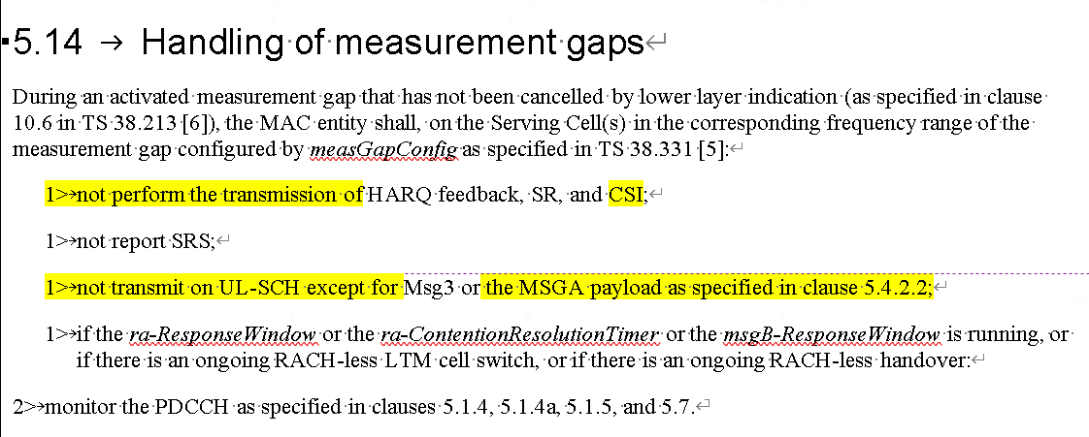
WF
[Apple, vivo] add a NOTE, saying MSG-A can contain early-CSI. [SS] the first bullet has to be modify to except early-CSI. [Nokia] why not normative text, merged with third bullet? [Apple] is there a term for early-CSI in MAC? [OPPO] we can check afterwards. [QC] adding R1 reference?
..or the MSGA payload (including early CSI report, as specified in 38.21x [xx] ) as specified…

Slide 5
Annex

Slide 6
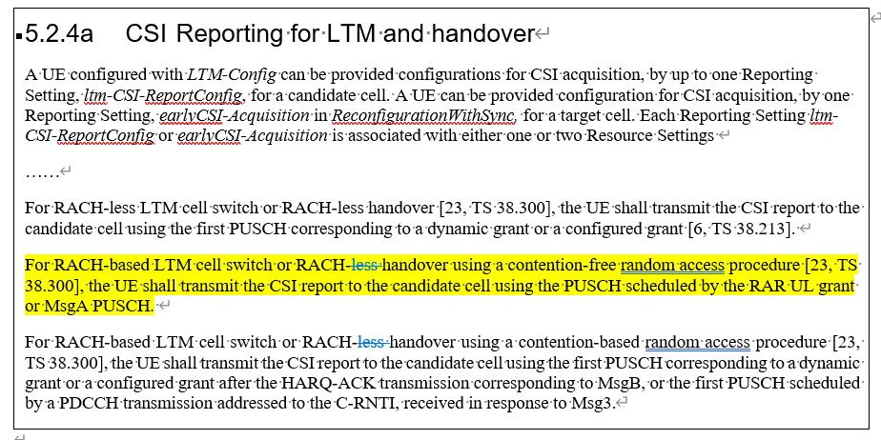
R1 Spec regarding the UL grant usage for early-CSI

Slide 7
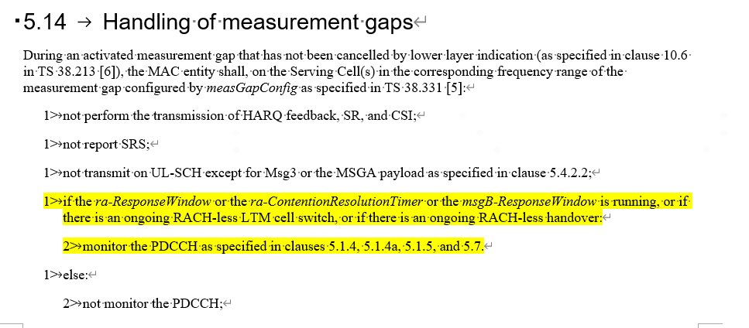
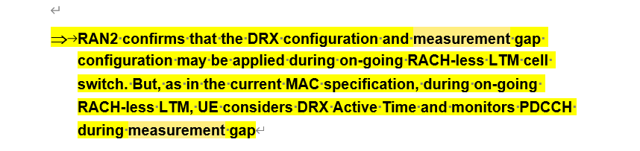
R2 Spec/Agreement regarding the MG activation timing

