Slide 1
Early-CSI vs. MG

Slide 2
Status
Scenario | When early-CSI report is performed | When HO/LTM is completed | If MG is applied before HO completion, whether early CSI can be reported | If MG is applied upon HO completion, whether early CSI can be reported
RACH-less | First PUSCH for complete message | First UL grant for the C-RNTI of the same HARQ process, or First DL assignment for the C-RNTI | No | Yes
2-Step CFRA | MSGA | RACH completion (MSGB) | Unclear based on current 321 | Yes
2-Step CBRA | After MSGB | RACH completion (MSGB) | No | No
4-Step CFRA | UL grant in RAR | RACH completion (MSG2) | No | No
4-Step CBRA | After MSG4 | RACH completion (MSG4) | No | No

Slide 3
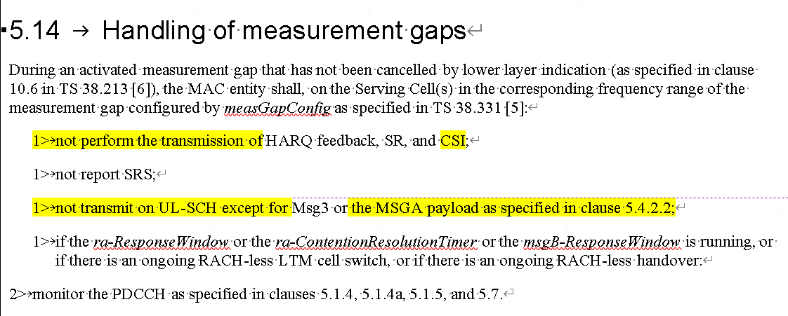
WF
?? R2 only try to clarify whether early-CSI is allowed for MSG-A, otherwise no change to the spec at all.

Slide 4
Annex

Slide 5
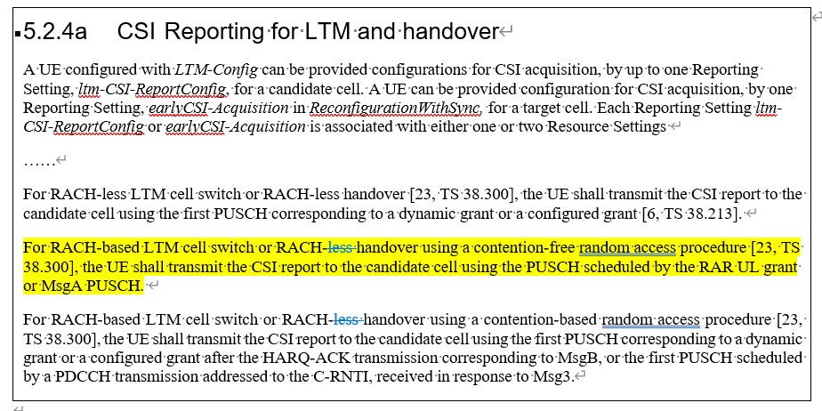
R1 Spec regarding the UL grant usage for early-CSI

Slide 6
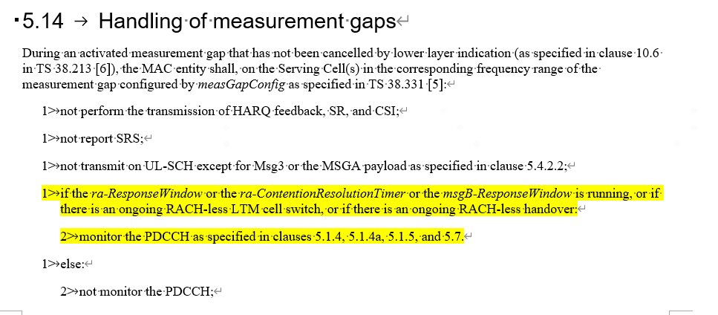
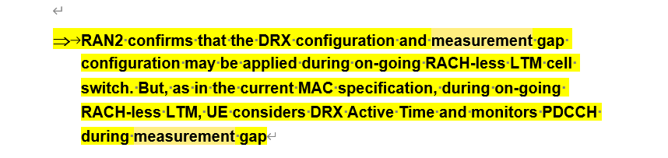
R2 Spec/Agreement regarding the MG activation timing

