Slide 1
Report of [AT133][104][MOB] Early-CSI vs. MG
3GPP TSG-RAN WG4 Meeting #133
Gothenburg, Sweden, Feb. 09-13, 2026
R2-2601147
Email Rapporteur (OPPO)

Slide 2
Proposal
Proposal 1: Clarify in MAC Spec that
  1>not transmit on UL-SCH except for Msg3 or the MSGA payload (including CSI Reporting for LTM and handover, as specified in clause 5.2.4a in TS 38.214 [7]) as specified in clause 5.4.2.2;

Slide 3
Annex

Slide 4
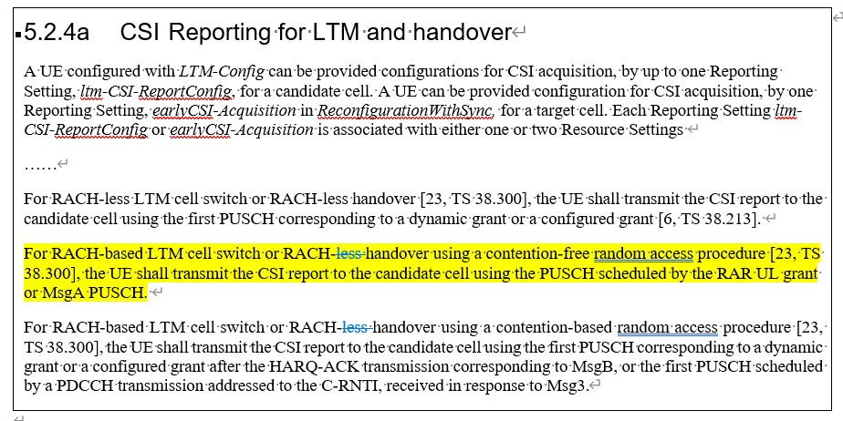
R1 Spec regarding the UL grant usage for early-CSI

Slide 5
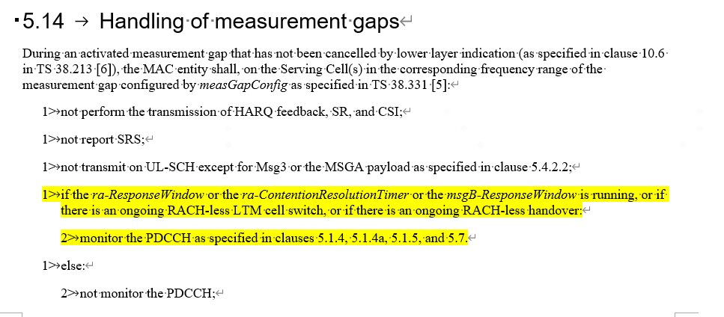
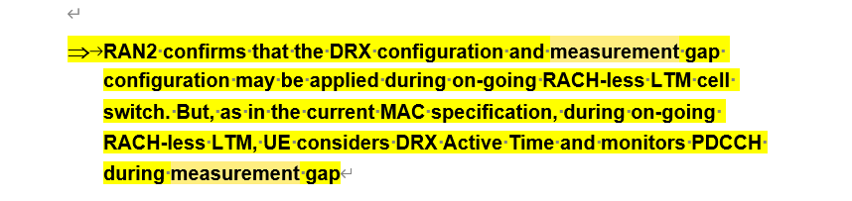
R2 Spec/Agreement regarding the MG activation timing

Slide 6
Status
Scenario | When early-CSI report is performed | When HO/LTM is completed | If MG is applied before HO completion, whether early CSI can be reported | If MG is applied upon HO completion, whether early CSI can be reported
RACH-less | First PUSCH for complete message | First UL grant for the C-RNTI of the same HARQ process, or First DL assignment for the C-RNTI | No | Yes
2-Step CFRA | MSGA | RACH completion (MSGB) | Unclear based on current 321 | Yes
2-Step CBRA | After MSGB | RACH completion (MSGB) | No | No
4-Step CFRA | UL grant in RAR | RACH completion (MSG2) | No | No
4-Step CBRA | After MSG4 | RACH completion (MSG4) | No | No

