Slide 1
3GPP Standards Update
Adrian Scrase
Head of 3GPP Mobile
Competence Centre

Slide 2
The Role of 3GPP
Maintenance and evolution of Radio Technologies: GSM, GPRS, W-CDMA, UMTS, EDGE, HSPA and LTE
Maintenance and evolution of the related Core Network and Systems Architecture
Organizational Partners are Regional and National Standards Bodies;
2
2

Slide 3
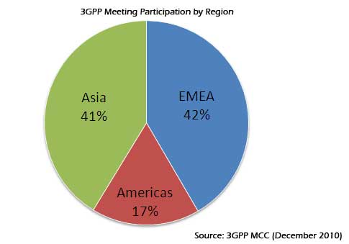
3GPP Specification Groups
Over 350 Companies participate through their membership of one of the 6 Partners
Plenary meetings each quarter (Next time is TSG#51, Kansas City, March 2011)
Over 150 meetings (including Working Groups) in 2010
3

Slide 4
3GPP Specification Groups
4

Slide 5
Spanning the Generations...
GSM 1G
Analog technology.
Deployed in the 1980s.
GSM 2G
Digital Technology.
First digital systems.
Deployed in the 1990s.
New services such as SMS
and low-rate data.
Primary technologies
include IS-95 CDMA and
GSM.
3G ITU’s IMT-2000 required 144
kbps mobile, 384 kbps
pedestrian, 2 Mbps indoors
Primary technologies
include CDMA2000 1X/EVDO, WiMAX,
and UMTS-HSPA.
4G ITU’s IMT-Advanced
requirements include ability to
operate in up to 40 MHz radio
channels and with very high
spectral efficiency.
No technology meets
requirements today.
IEEE 802.16m and LTE
Advanced being designed
to meet requirements.
3GPP Specified Radio Interfaces
2G radio: GSM, GPRS, EDGE
3G radio: WCDMA, HSPA, LTE
4G radio: LTE Advanced
3GPP Core Network
2G/3G: GSM core network
3G/4G: Evolved Packet Core (EPC)
3GPP Service Layer
GSM services
IP Multimedia Subsystem (IMS)
Multimedia Telephony (MMTEL)
Support of Messaging and other OMA functionality
Emergency services and public warning
Etc.
Text adapted from 3G Americas White Paper, September 2010
5

Slide 6
3GPP Evolution
“
The role of 3GPP is to act as a glue that binds the eco-system together, which can mean that there needs to be some throttle on the rate of change so that 3GPP produces standards at the rate that they can be assimilated in the market...
...The challenge is to keep the system moving forward with a clear vision against the different needs and focus of the – ever expanding - mobile community...
...The broadening of the scope of 3GPP systems has been done in such a way as to make 3GPP one of the strongest standards bodies in the world. One of the major achievements of the project has been in forging good relationships with other standards makers, this has been vital to the success of 3GPP.
Radio Interfaces
Higher Data Throughput
Lower Latency
More Spectrum Flexibility
Improved CAPEX and OPEX
IP Core Network
Support of non-3GPP Accesses
Packet Only Support
Improved Security
Greater Device Diversity
Service Layer
More IMS Applications (MBMS, PSS, mobile TV now IMS enabled)
Greater session continuity
”
Extracts from a video interview with Stephen Hayes, 3GPP SA Chairman, Ericsson Inc.
See www.3gpplive.org
6

Slide 7
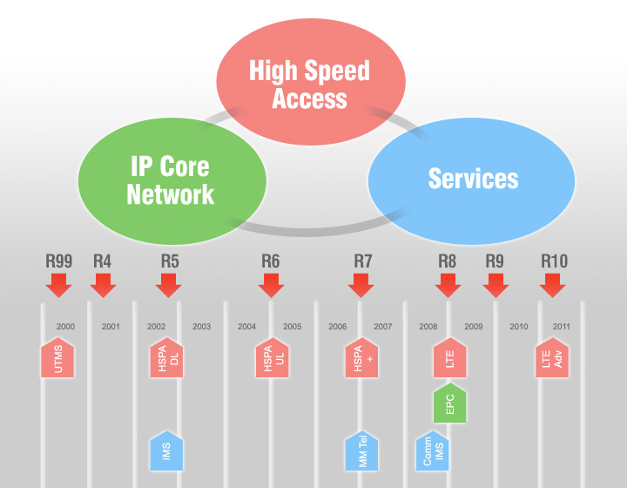
Building by Release
Release 11
Interworking - 3GPP EPS and fixed BB accesses, M2M, Non voice emergency communications, 8 carrier HSDPA, Uplink MIMO study
Release 99: Enhancements to GSM data (EDGE). Majority of deployments today are based on Release 99. Provides support for GSM/EDGE/GPRS/WCDMA radio-access networks.
Release 10 LTE-Advanced meeting the requirements set by ITU’s IMT-Advanced project.
Also includes quad-carrier operation for HSPA+.
Release 4: Multimedia messaging support. First steps toward using IP transport in the core network.
Release 9: HSPA and LTE enhancements including HSPA dual-carrier operation in combination with MIMO, EPC enhancements, femtocell support, support for regulatory features such as emergency user-equipment positioning and Commercial Mobile Alert System (CMAS), and evolution of IMS architecture.
Release 5: HSDPA. First phase of Internet Protocol Multimedia Subsystem (IMS). Full ability to use IP-based transport instead of just Asynchronous Transfer Mode (ATM) in the core network.
Release 6: HSUPA. Enhanced multimedia support through Multimedia Broadcast/Multicast Services (MBMS). Performance specifications for advanced receivers. Wireless Local Area Network (WLAN) integration option. IMS enhancements. Initial VoIP capability.
Release 8: HSPA Evolution, simultaneous use of MIMO and 64 QAM. Includes dual-carrier HSPA (DC-HSPA) wherein two WCDMA radio channels can be combined for a doubling of throughput performance. Specifies OFDMA-based 3GPP LTE.
Defines EPC.
Release 7: Evolved EDGE. Specifies HSPA+, higher order modulation and MIMO. Performance enhancements, improved spectral efficiency, increased capacity, and better resistance to interference. Continuous Packet Connectivity (CPC) enables efficient “always-on” service and enhanced uplink UL VoIP capacity, as well as reductions in call set-up delay for Push-to-Talk Over Cellular (PoC). Radio enhancements to HSPA include 64 Quadrature Amplitude Modulation (QAM) in the downlink DL and 16 QAM in the uplink. Also includes optimization of MBMS capabilities through the multicast/broadcast, single-frequency network (MBSFN) function.
Text adapted from 3G Americas White Paper, September 2010
7

Slide 8
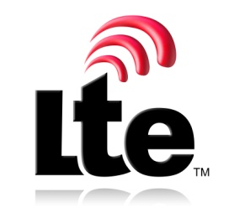
3GPP LTE Release 8 / Release 9
A new radio interface specified in Release 8 and enhanced in Release 9
Provides:
Broadband data throughput:
Downlink target 3-4 times greater than HSDPA Release 6
Uplink target 2-3 times greater than HSUPA Release 6
Significantly reduced latency
High mobility
The basis for 17 commercial launches (as at 12 Jan)
64 commercial launches expected by end of 2012
125 operators publicly committed to launch
LTE set to be the mobile broadband technology
8

Slide 9
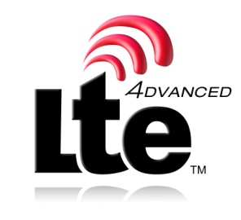
LTE-Advanced Release 10
Not a new technology as such, but a point of maturity along the LTE evolution path. LTE Advanced provides:
Support for wider Bandwidth (Up to 100MHz)
Downlink transmission scheme
Improvements to LTE by using 8x8 MIMO
Data rates of 100Mb/s with high mobility and 1Gb/s with low mobility
Uplink transmission scheme
Improvements to LTE
Data rates up to 500Mb/s
Relay functionality
Improving cell edge coverage
More efficient coverage in rural areas
CoMP (coordinated multiple point transmission and reception)
Downlink coordinated multi-point transmission
Uplink coordinated multi-point reception
Local IP Access (LIPA) & Enhanced HNB to allow traffic off-load
9

Slide 10
IMT-Advanced LTE-Advanced is the 3GPP submission for the ITU’s IMT-Advanced system
Study Item, “LTE-Advanced” approved in 3GPP - Mar 2008 ✓
LTE-Advanced Requirements (TR 36.913) - Jun 2008 ✓
LTE-Advanced “Early Submission” made to ITU-R - Sep 2008 ✓
“Complete Technology Submission” to ITU-R - Jun 2009 ✓
“Final submission” to ITU-R - Oct 2009 ✓
Evaluation Process “Final Decision” by ITU-R - Oct 2010 ✓
Completion of LTE-Advanced specifications by 3GPP - Mar 2011
10

Slide 11
3GPP Release 11
Release 11 completion date set for September 2012
Many new Features expected:
Support BroadBand forum Accesses Interworking
Advanced IP Interconnection of Services
System Improvements to Machine-Type Communications
Unstructured Supplementary Service Data (USSD) simulation service in IMS
SRVCC aspect of enhancements for Multimedia Priority Service
Network Provided Location Information for IMS
SIPTO Service Continuity of IP Data Session
LIPA Mobility and SIPTO at the Local Network
QoS Control Based on Subscriber Spending Limits
Optimized Service Charging and Allocation of Resources in IMS whilst Roaming
Non Voice Emergency Services
Interworking between Mobile Operators using the Evolved Packet System and Data Application Providers
Service Awareness and Privacy Policies
VPLMN Autonomous CSG Roaming
EEA3 and EIA3 (new Encryption & Integrity EPS security Algorithms)
Specification of Protection against Unsolicited Communication for IMS
Codec for Enhanced Voice Services
Network-Based Positioning Support in LTE
LTE Advanced Carrier Aggregation of Band 4 and Band 17
LTE Advanced Carrier Aggregation of Band 4 and Band 13
Eight carrier HSDPA
UE demodulation performance requirements under multiple-cell scenario for 1.28Mcps TDD
Uplink Transmit Diversity for HSPA
http://www.3gpp.org/ftp/Specs/html-info/FeatureListFrameSet.htm
11

Slide 12
3GPP Release12
Release 12 content not yet defined, but Study Items (SI) in Release 11 indicate where specification work is likely
Study on IMS based Peer-to-Peer Content Distribution Services
Study on IMS based Peer-to-Peer Content Distribution Services (Stage 2)
Study on Non Voice Emergency Services
Study on UICC/USIM enhancements
Study on Alternatives to E.164 for Machine-Type Communications
Study on enhancements for Machine-Type Communications (MTC)
Study on Support for 3GPP Voice Interworking with Enterprise IP-PBX
Study on IMS Network-Independent Public User Identities
Study on Integration of Single Sign-On (SSO) frameworks with 3GPP networks
Study on Security aspects of Integration of Single Sign-On (SSO) frameworks with 3GPP networks
Study on Core Network Overload solutions
Study on Continuity of Data Sessions to Local Networks
Study on Non-MTC Mobile Data Applications impacts
Study on System Enhancements for Energy Efficiency
Study on Solutions for GSM/EDGE BTS Energy Saving
Study on Coordinated Multi-Point operation for LTE
Study on UE Application Layer Data Throughput Performance
Study on Uplink MIMO
Study on HSDPA Multipoint Transmission
Study on Inclusion of RF Pattern Matching as a positioning method in the E-UTRAN
http://www.3gpp.org/ftp/Specs/html-info/FeatureListFrameSet.htm
12

Slide 13
Mobile/Mobile Convergence
3GPP LTE is a point of convergence, to unite the world’s operators on a common technology platform
CDMA Development Group (CDG) join 3GPP as a Market Representation Partner in 2009
CDMA operators are planning their evolution to LTE. Some have already deployed LTE (e.g., Verizon)
TD-SCDMA Forum paved the way for LTE TDD mode in China. LTE unites both FDD and TDD communities.
13

Slide 14
Fixed/Mobile Convergence
Many operators have both fixed and mobile assets
3GPP is working with Broadband Forum (BBF) to support convergence using 3GPP EPC
3GPP is working with the Telecom Management Forum (TMF) on converged management of fixed and mobile networks
Clear focus on traffic offload: Local IP Access (LIPA), IP Flow Mobility and Seamless Offload (IFOM) and Selected IP Traffic Offload (SIPTO).
14

Slide 15
Public Safety Convergence
Public Safety Agencies (APCO, NENA, NPSTC) announced in 2009 that LTE meets their requirements
The FCC has now mandated the use of LTE for public safety to ensure interoperable communications
15

Slide 16
Machine Type Communications
Work started on Machine Type Communications in 3GPP Release 10
14 MTC Features identified
Low Mobility
Time Controlled
Time Tolerant
Packet Switched (PS) Only
Small Data Transmissions
Mobile Originated Only
Infrequent Mobile Terminated
MTC Monitoring
Priority Alarm Message (PAM)
Secure Connection
Location Specific Trigger
Network Provided Destination for Uplink Data
Infrequent Transmission
Group Based MTC Features
In Release 10, 3GPP focusing on the general functionality required to support these features
Overload control (Radio Network Congestion use case, Signalling Network Congestion use case and Core Network Congestion use case)
Addressing
Identifiers
Subscription control
Security
16

Slide 17
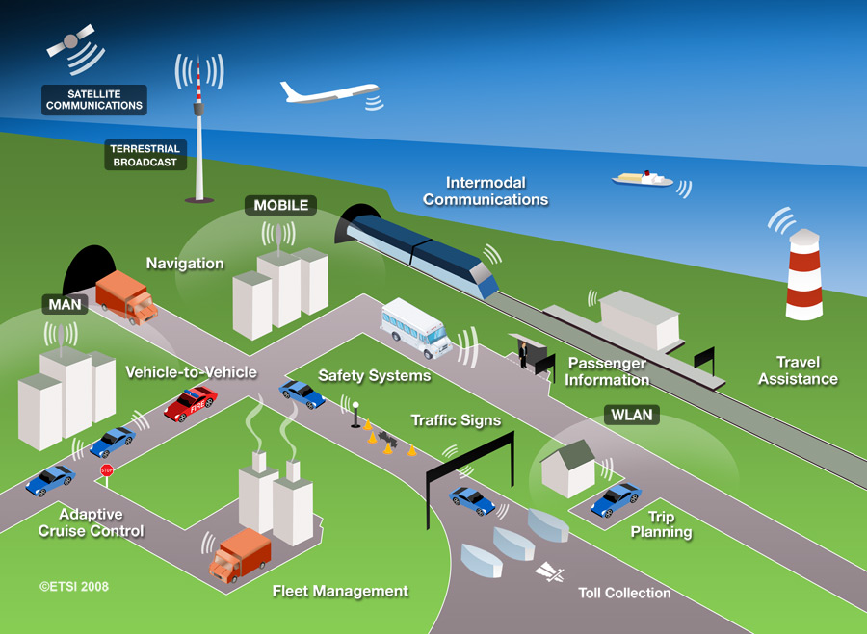
Building Economies of Scale
Machine-to-machine
Intelligent Transport Systems
Smart Grids
Smart Cards, eCommerce, USB, High Speed Interface
mHealth
RFID
Femto cells (Home NodeB)
Multi-Standard Radio (MSR-BS)
17

Slide 18
Conclusions
3GPP LTE is the major enabler for mobile broadband
EDGE and HSPA remain hugely successful
Industrial input to 3GPP is solid and growing
The first commercial LTE Networks have been launched, providing valuable feedback to the standardization process
LTE-Advanced will enable new services & innovation beyond 3GPP Release 10, providing an evolution path for the next decade
3GPP LTE will unite communities, resulting in the economies of scale which are essential for our industry
18

Slide 19
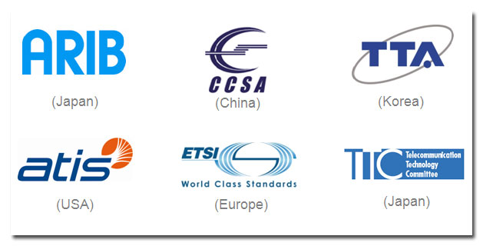
is...
www.3gpp.org

