Slide 1
3GPP Technology Areas
These slides present a possible approach to making 3GPP technology more accessible, particularly to “outsiders”.
The slides take the form of a (short) series of mocked-up screen shots from the 3GPP web (or portal). There is no attempt at achieving the final aesthetics!
Now click on to see the first slide ...

Slide 2

3GPP Technology Areas
Page:
technology_areas_home/
Step 1 – search for technology area by keyword
Search for:
Search for
car, road vehicle, self-driving, autonomous
Enter free text keyword(s) or keyphrase(s).
Separate each keyword / keyphrase with a comma or semi-colon.
You can use AND, AND NOT, OR with round brackets () to group keywords / keyphrases.
The user navigates from the menu to the Technology Area home page. There he enters some free text terms (here called keywords or keyphrases). Some initial manual work will need to be undertaken to establish a meaningful set of keywords and keyphrases and to match them to a “small” set of “technology areas”. It is anticipated that there could be several hundred of these areas.

Slide 3

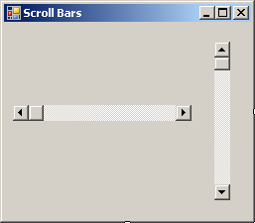
3GPP Technology Areas
Page:
technology_areas_home/search_results
Step 2 – search results
Search for:
car, road vehicle, self-driving, autonomous, trains, drones
Enter free text keyword(s) or keyphrase(s).
Separate each keyword / keyphrase with a comma or semi-colon.
You can use AND, AND NOT, OR with round brackets () to group keywords / keyphrases. Default is to return areas associated with any of the keywords / keyphrases.
Matching technology area(s):
vehicle-to-vehicle (V2V)
vehicle-to-anything (V2X)
self-organizing / self-optimizing networks (SON)
railway communications
non-terrestrial systems (balloons, aircraft, UAV, satellite)
Internet of Things (IOT), Machine-Machine (M2M)
...
...
Select chosen area to see lists of work items, reports, specifications, ... associated with this technology area.

Slide 4
3GPP Technology Areas
Page:
technology_areas_home/search_results
Step 2 – search results
Search for:
car, road vehicle, self-driving, autonomous, trains, drones
Enter free text keyword(s) or keyphrase(s).
Separate each keyword / keyphrase with a comma or semi-colon.
You can use AND, AND NOT, OR with round brackets () to group keywords / keyphrases. Default is to return areas associated with any of the keywords / keyphrases.
Matching technology area(s):
vehicle-to-vehicle (V2V)
vehicle-to-anything (V2X)
self-organizing / self-optimizing networks (SON)
railway communications
non-terrestrial systems (balloons, aircraft, UAV, satellite)
Internet of Things (IOT), Machine-Machine (M2M)
...
...
Select chosen area to see lists of work items, reports, specifications, ... associated with this technology area.
The user is presented with a list of technology areas associated with his chosen keywords / keyphrases. He will select one (and only one) for expansion.

Slide 5

3GPP Technology Areas
Page:
technology_areas_home/search_results/document-download
Step 3 – download documents for technology area:
vehicle-to-anything (V2X)
Studies and normative work items
Technical Reports and Specifications
Change Requests (approved)
Rel-14
Support for V2V services based on ...*
36.101
User Equipment (UE) radio transmis...
36.101
CR 4326 Rel-14 – V2V power imbala...
Rel-14
LTE support for V2X services (V2XLTE*
36.785
Vehicle to Vehicle (V2V) services bas...
36.101
CR 4698 Rel-14 – Correction of RE...
Rel-15
Study on evaluation methodology o..*
---
---
---
---
Rel-15
Study on security aspects for LTE su...
---
---
---
---
...
...
...
...
...
...
...
...
...
...
...
...
...
...
...
...
Rel-16
Study on application layer support f...
Rel-16
Study on Improvement of V2X Servi...
Rel-17
Application layer support for V2X se...
* indicates complete
Click to download all work-item-related documents (WIDs, status reports) in this area
Click to download latest version of all specs in all Releases
Click to download all approved CRs for all specs in this area

Slide 6
3GPP Technology Areas
The user is presented with three lists of documents associated with his chosen technology area:
work items (only top-level WIs are shown)
TRs and TSs
CRs
And he can now choose what to do next ...
Page:
technology_areas_home/search_results/document-download
Step 3 – download documents for technology area:
vehicle-to-anything (V2X)
Studies and normative work items
Technical Reports and Specifications
Change Requests (approved)
Rel-14
Support for V2V services based on ...*
36.101
User Equipment (UE) radio transmis...
36.101
CR 4326 Rel-14 – V2V power imbala...
Rel-14
LTE support for V2X services (V2XLTE*
36.785
Vehicle to Vehicle (V2V) services bas...
36.101
CR 4698 Rel-14 – Correction of RE...
Rel-15
Study on evaluation methodology o..*
---
---
---
---
Rel-15
Study on security aspects for LTE su...
---
---
---
---
...
...
...
...
...
...
...
...
...
...
...
...
...
...
...
...
Rel-16
Study on application layer support f...
Rel-16
Study on Improvement of V2X Servi...
Rel-17
Application layer support for V2X se...
* indicates complete
Click to download all work-item-related documents (WIDs, status reports) in this area
Click to download latest version of all specs in all Releases
Click to download all approved CRs for all specs in this area

Slide 7


3GPP Technology Areas
Page:
technology_areas_home/search_results/document-download
Step 3 – download documents for technology area:
vehicle-to-anything (V2X)
Studies and normative work items
Technical Reports and Specifications
Change Requests (approved)
Rel-14
Support for V2V services based on ...*
36.101
User Equipment (UE) radio transmis...
36.101
CR 4326 Rel-14 – V2V power imbala...
Rel-14
LTE support for V2X services (V2XLTE*
36.785
Vehicle to Vehicle (V2V) services bas...
36.101
CR 4698 Rel-14 – Correction of RE...
Rel-15
Study on evaluation methodology o..*
---
---
---
---
Rel-15
Study on security aspects for LTE su...
---
---
---
---
...
...
An icon could take the user to a static page for the selected technology area. This would be an article explaining the services offered by this area and could contain as much or as little technical, historical, political, etc, information as desired.
Care would need to be taken that this page be maintained in an up to date state as more work items are embraced by the technology. This, of course, requires manual effort.
...
...
...
...
...
...
...
...
...
...
...
...
...
...
Rel-16
Study on application layer support f...
Rel-16
Study on Improvement of V2X Servi...
Rel-17
Application layer support for V2X se...
* indicates complete
Click to download all work-item-related documents (WIDs, status reports) in this area
Click to download latest version of all specs in all Releases
Click to download all approved CRs for all specs in this area

Slide 8
3GPP Technology Areas
Note that in the context of this service, a “work item” is considered to consist of the top level item and all its subordinate building blocks and work tasks. Selecting a particular work item (see later) will offer all specs and CRs associated with that work item tree.

Slide 9
3GPP Technology Areas
He can click one of the three icons for the system to push to him the complete zipped set of documents of one of the three lists
Page:
The user can click one of the three icons for the system to push to him the complete zipped set of documents of one of the three lists.
technology_areas_home/search_results/document-download
Step 3 – download documents for technology area:
vehicle-to-anything (V2X)
Studies and normative work items
Technical Reports and Specifications
Change Requests (approved)
Rel-14
Support for V2V services based on ...*
36.101
User Equipment (UE) radio transmis...
36.101
CR 4326 Rel-14 – V2V power imbala...
Rel-14
LTE support for V2X services (V2XLTE*
36.785
Vehicle to Vehicle (V2V) services bas...
36.101
CR 4698 Rel-14 – Correction of RE...
Rel-15
Study on evaluation methodology o..*
---
---
---
---
Rel-15
Study on security aspects for LTE su...
---
---
---
---
...
...
...
...
...
...
...
...
...
...
...
...
...
...
...
...
Rel-16
Study on application layer support f...
Rel-16
Study on Improvement of V2X Servi...
Rel-17
Application layer support for V2X se...
* indicates complete
Click to download all work-item-related documents (WIDs, status reports) in this area
Click to download latest version of all specs in all Releases
Click to download all approved CRs for all specs in this area

Slide 10
3GPP Technology Areas
Or he can click on a particular work item to download only the latest WID, WI status (or WI summary if available).
Page:
technology_areas_home/search_results/document-download
Step 3 – download documents for technology area:
vehicle-to-anything (V2X)
Studies and normative work items
Technical Reports and Specifications
Change Requests (approved)
Rel-14
Support for V2V services based on ...*
36.101
User Equipment (UE) radio transmis...
36.101
CR 4326 Rel-14 – V2V power imbala...
Rel-14
LTE support for V2X services (V2XLTE*
36.785
Vehicle to Vehicle (V2V) services bas...
36.101
CR 4698 Rel-14 – Correction of RE...
Rel-15
Study on evaluation methodology o..*
---
---
---
---
Rel-15
Study on security aspects for LTE su...
---
---
---
---
...
...
...
...
...
...
...
...
...
...
...
...
...
...
...
...
Rel-16
Study on application layer support f...
Rel-16
Study on Improvement of V2X Servi...
Rel-17
Application layer support for V2X se...
* indicates complete
Click to download all work-item-related documents (WIDs, status reports) in this area
Click to download latest version of all specs in all Releases
Click to download all approved CRs for all specs in this area

Slide 11
3GPP Technology Areas
If the user selects just one work item in the previous step, the specs and CRs tables could dynamically update to show only the specs and CRs pertaining to that work item.
Page:
technology_areas_home/search_results/document-download
Step 3 – download documents for technology area:
vehicle-to-anything (V2X)
Studies and normative work items
Technical Reports and Specifications
Change Requests (approved)
Rel-14
Support for V2V services based on ...*
36.101
User Equipment (UE) radio transmis...
36.101
CR 4326 Rel-14 – V2V power imbala...
Rel-14
LTE support for V2X services (V2XLTE*
36.785
Vehicle to Vehicle (V2V) services bas...
36.101
CR 4698 Rel-14 – Correction of RE...
Rel-15
Study on evaluation methodology o..*
---
---
---
---
Rel-15
Study on security aspects for LTE su...
---
---
---
---
...
...
...
...
...
...
...
...
...
...
...
...
...
...
...
...
Rel-16
Study on application layer support f...
Rel-16
Study on Improvement of V2X Servi...
Rel-17
Application layer support for V2X se...
* indicates complete
Click to download all work-item-related documents (WIDs, status reports) in this area
Click to download latest version of all specs in all Releases
Click to download all approved CRs for all specs in this area

Slide 12
3GPP Technology Areas
He can click on a particular spec to download its latest available version.
Page:
technology_areas_home/search_results/document-download
Step 3 – download documents for technology area:
vehicle-to-anything (V2X)
Studies and normative work items
Technical Reports and Specifications
Change Requests (approved)
Rel-14
Support for V2V services based on ...*
36.101
User Equipment (UE) radio transmis...
36.101
CR 4326 Rel-14 – V2V power imbala...
Rel-14
LTE support for V2X services (V2XLTE*
36.785
Vehicle to Vehicle (V2V) services bas...
36.101
CR 4698 Rel-14 – Correction of RE...
Rel-15
Study on evaluation methodology o..*
---
---
---
---
Rel-15
Study on security aspects for LTE su...
---
---
---
---
...
...
...
...
...
...
...
...
...
...
...
...
...
...
...
...
Rel-16
Study on application layer support f...
Rel-16
Study on Improvement of V2X Servi...
Rel-17
Application layer support for V2X se...
* indicates complete
Click to download all work-item-related documents (WIDs, status reports) in this area
Click to download latest version of all specs in all Releases
Click to download all approved CRs for all specs in this area

Slide 13
3GPP Technology Areas
Or he can click on a particular CR to download the document containing it.
Page:
technology_areas_home/search_results/document-download
Step 3 – download documents for technology area:
vehicle-to-anything (V2X)
Studies and normative work items
Technical Reports and Specifications
Change Requests (approved)
Rel-14
Support for V2V services based on ...*
36.101
User Equipment (UE) radio transmis...
36.101
CR 4326 Rel-14 – V2V power imbala...
Rel-14
LTE support for V2X services (V2XLTE*
36.785
Vehicle to Vehicle (V2V) services bas...
36.101
CR 4698 Rel-14 – Correction of RE...
Rel-15
Study on evaluation methodology o..*
---
---
---
---
Rel-15
Study on security aspects for LTE su...
---
---
---
---
...
...
...
...
...
...
...
...
...
...
...
...
...
...
...
...
Rel-16
Study on application layer support f...
Rel-16
Study on Improvement of V2X Servi...
Rel-17
Application layer support for V2X se...
* indicates complete
Click to download all work-item-related documents (WIDs, status reports) in this area
Click to download latest version of all specs in all Releases
Click to download all approved CRs for all specs in this area

Slide 14
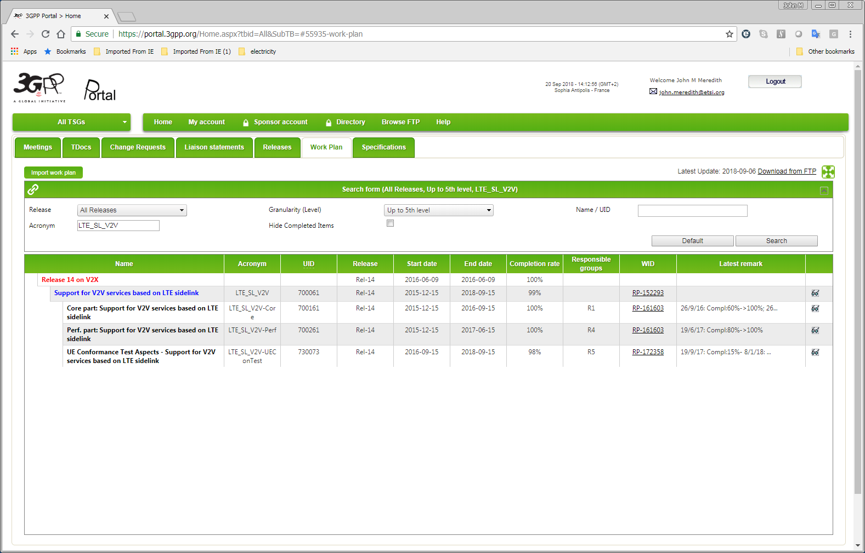
3GPP Technology Areas
The user can also click on an icon (not shown) against each work item to be taken to the Work Plan tab on the portal where the full expansion of that work item tree (all levels) is displayed, giving access to a lot of fine detail, should he need it.
(This requires development work with the portal.)
Page:
technology_areas_home/search_results/document-download
Step 3 – download documents for technology area:
vehicle-to-anything (V2X)
Studies and normative work items
Technical Reports and Specifications
Change Requests (approved)
Rel-14
Support for V2V services based on ...*
36.101
User Equipment (UE) radio transmis...
36.101
CR 4326 Rel-14 – V2V power imbala...
Rel-14
LTE support for V2X services (V2XLTE*
36.785
Vehicle to Vehicle (V2V) services bas...
36.101
CR 4698 Rel-14 – Correction of RE...
Rel-15
Study on evaluation methodology o..*
---
---
---
---
Rel-15
Study on security aspects for LTE su...
---
---
---
---
...
...
...
...
...
...
...
...
...
...
...
...
...
...
...
...
Rel-16
Study on application layer support f...
Rel-16
Study on Improvement of V2X Servi...
Rel-17
Application layer support for V2X se...
* indicates complete
Click to download all work-item-related documents (WIDs, status reports) in this area
Click to download latest version of all specs in all Releases
Click to download all approved CRs for all specs in this area

Slide 15
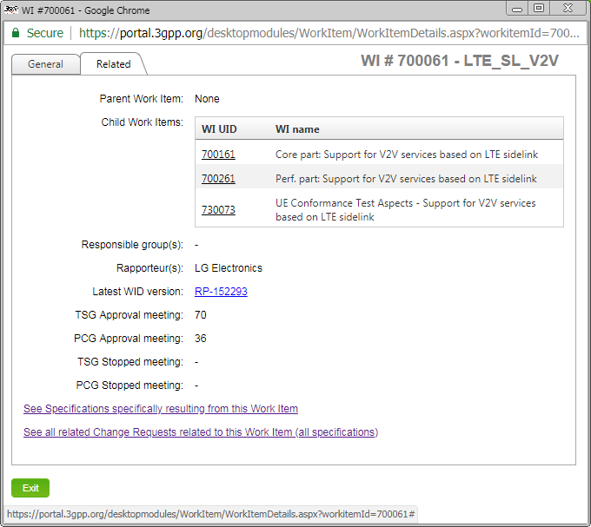
3GPP Technology Areas
Clicking on the top level work item will open the home page for that work item.
Page:
technology_areas_home/search_results/document-download
Step 3 – download documents for technology area:
vehicle-to-anything (V2X)
Studies and normative work items
Technical Reports and Specifications
Change Requests (approved)
Rel-14
Support for V2V services based on ...*
36.101
User Equipment (UE) radio transmis...
36.101
CR 4326 Rel-14 – V2V power imbala...
Rel-14
LTE support for V2X services (V2XLTE*
36.785
Vehicle to Vehicle (V2V) services bas...
36.101
CR 4698 Rel-14 – Correction of RE...
Rel-15
Study on evaluation methodology o..*
---
---
---
---
Rel-15
Study on security aspects for LTE su...
---
---
---
---
...
...
...
...
...
...
...
...
...
...
...
...
...
...
...
...
Rel-16
Study on application layer support f...
Rel-16
Study on Improvement of V2X Servi...
Rel-17
Application layer support for V2X se...
* indicates complete
Click to download all work-item-related documents (WIDs, status reports) in this area
Click to download latest version of all specs in all Releases
Click to download all approved CRs for all specs in this area

Slide 16
3GPP Technology Areas
An additional tab can be provided on the work item page, showing data (automatically) scraped from the latest WID, status report, and summary documents.
In addition, there could be an additional tab containing manually entered free text – effectively a “static page” of helpful information on this work item. (Normally this would only be created for top-level work items.)
Page:
technology_areas_home/search_results/document-download
Step 3 – download documents for technology area:
vehicle-to-anything (V2X)
Studies and normative work items
Technical Reports and Specifications
Change Requests (approved)
Rel-14
Support for V2V services based on ...*
36.101
User Equipment (UE) radio transmis...
36.101
CR 4326 Rel-14 – V2V power imbala...
Rel-14
LTE support for V2X services (V2XLTE*
36.785
Vehicle to Vehicle (V2V) services bas...
36.101
CR 4698 Rel-14 – Correction of RE...
Rel-15
Study on evaluation methodology o..*
---
---
---
---
Rel-15
Study on security aspects for LTE su...
---
---
---
---
...
...
...
...
...
...
...
...
...
...
...
...
...
...
...
...
Rel-16
Study on application layer support f...
Rel-16
Study on Improvement of V2X Servi...
Rel-17
Application layer support for V2X se...
* indicates complete
Click to download all work-item-related documents (WIDs, status reports) in this area
Click to download latest version of all specs in all Releases
Click to download all approved CRs for all specs in this area

Slide 17
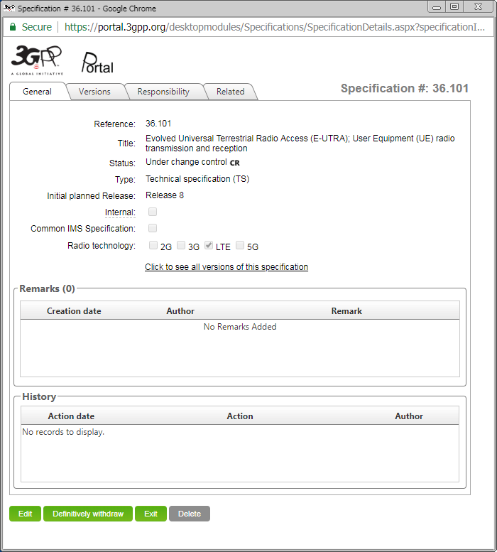
3GPP Technology Areas
Similarly, the user can click an icon against an entry in the specs table to be taken to that spec’s home page on the portal.
Page:
technology_areas_home/search_results/document-download
Step 3 – download documents for technology area:
vehicle-to-anything (V2X)
Studies and normative work items
Technical Reports and Specifications
Change Requests (approved)
Rel-14
Support for V2V services based on ...*
36.101
User Equipment (UE) radio transmis...
36.101
CR 4326 Rel-14 – V2V power imbala...
Rel-14
LTE support for V2X services (V2XLTE*
36.785
Vehicle to Vehicle (V2V) services bas...
36.101
CR 4698 Rel-14 – Correction of RE...
Rel-15
Study on evaluation methodology o..*
---
---
---
---
Rel-15
Study on security aspects for LTE su...
---
---
---
---
...
...
...
...
...
...
...
...
...
...
...
...
...
...
...
...
Rel-16
Study on application layer support f...
Rel-16
Study on Improvement of V2X Servi...
Rel-17
Application layer support for V2X se...
* indicates complete
Click to download all work-item-related documents (WIDs, status reports) in this area
Click to download latest version of all specs in all Releases
Click to download all approved CRs for all specs in this area

Slide 18
3GPP Technology Areas
And finally, the user can click on an icon against an entry in the CR table to be taken to the Change Request tab of the portal to obtain a list of all approved CRs to that spec relating to the work item tree(s) in question.
(This requires development work on the portal.)
Page:
technology_areas_home/search_results/document-download
Step 3 – download documents for technology area:
vehicle-to-anything (V2X)
Studies and normative work items
Technical Reports and Specifications
Change Requests (approved)
Rel-14
Support for V2V services based on ...*
36.101
User Equipment (UE) radio transmis...
36.101
CR 4326 Rel-14 – V2V power imbala...
Rel-14
LTE support for V2X services (V2XLTE*
36.785
Vehicle to Vehicle (V2V) services bas...
36.101
CR 4698 Rel-14 – Correction of RE...
Rel-15
Study on evaluation methodology o..*
---
---
---
---
Rel-15
Study on security aspects for LTE su...
---
---
---
---
...
...
...
...
...
...
...
...
...
...
...
...
...
...
...
...
Rel-16
Study on application layer support f...
Rel-16
Study on Improvement of V2X Servi...
Rel-17
Application layer support for V2X se...
* indicates complete
Click to download all work-item-related documents (WIDs, status reports) in this area
Click to download latest version of all specs in all Releases
Click to download all approved CRs for all specs in this area

Slide 19
3GPP Technology Areas
A note on documents pushed in bulk to the user ...
The tables of the preceding slides showing work items, specs and CRs must show, on each line, the relevant filenames of the document in question, because the user cannot otherwise associate a file with a work item’s WID, status report, or summary.
Similarly, although slightly less cryptic, the filename of a spec version is not always easy to match to a given spec and version, and a CR’s filename may not be easy to match to the spec and CR number.
This aspect is particularly important if the user elects to download all documents relating to a particular technology area: those documents might number many hundreds or even thousands.

Slide 20
3GPP Technology Areas
The end
Any questions?

