Slide 1
Rel-19 SA5 work planning SA5#162, Goteborg, Sweden, 25 - 29 August 2025
Zou Lan, 3GPP SA5 Chair, HUAWEI
Thomas Tovinger, 3GPP SA5 Vice-Chair, ERICSSON
Anatoly Andrianov, 3GPP SA5 Vice-Chair, NOKIA
Gerald Görmer, SA5 Charging SWG Chair, MATRIXX Software

Slide 2
Content
Release 19
Release 19 timeline, progress and relation with other WGs
SA5 WIs/SIs topic overview

Slide 3
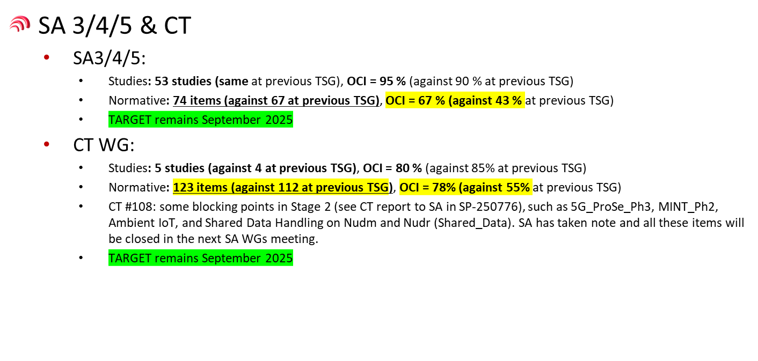
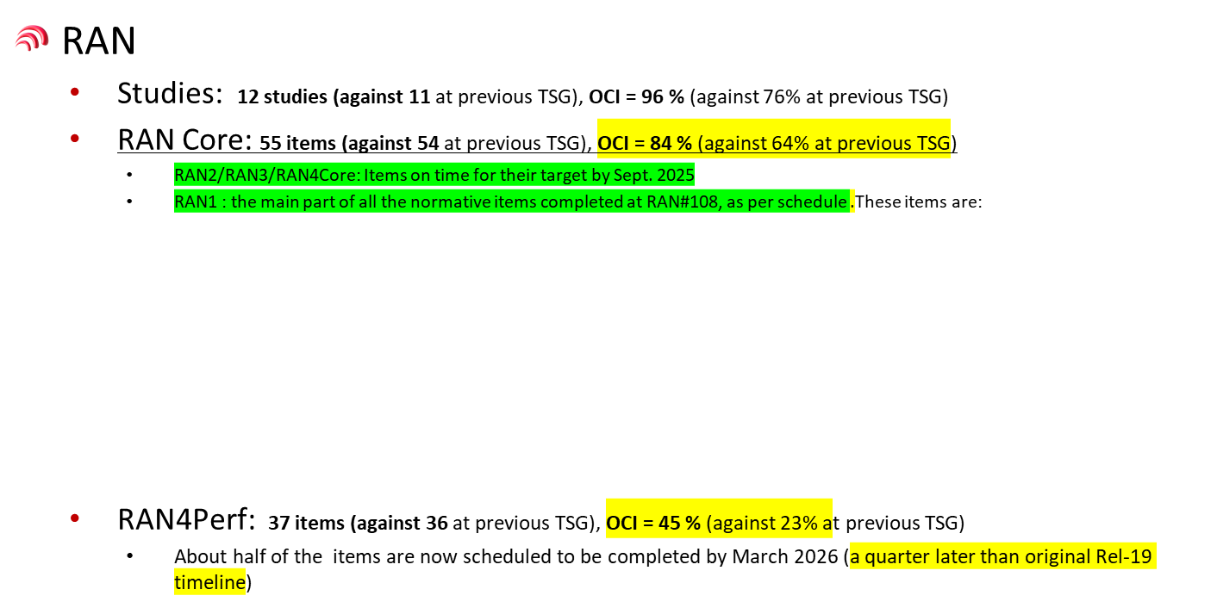

Rel-19 Progress overview in SA#108
OCI = Overall Completion Index
Reference：SP-250890

Slide 4
Release 19 timeline– figure with SA5 (Based on SA timeline)
Release 19 timeline
2023
2024
2025
2026
TSGs
#99
#100
#101
#102
#103
#104
#105
#106
#107
#108
#109
#110
#111
#112
Mar.
Jun.
Sep.
Dec.
Mar.
Jun.
Sep.
Dec.
Mar.
Jun.
Sep.
Dec.
Mar.
Jun.
OAM:
Dec 2024: conclude Rel-19 studies which plan to have corresponding normative work in Rel-19.
Sep 2025: conclude all Rel-19 work items.
CH:
Mar 2025: conclude Rel-19 studies which plan to have corresponding normative work in Rel-19.
Sep 2025: conclude all Rel-19 work items
Note: Studies can continue until Sep.2025 if no corresponding normative work is planned for Rel-19.
SA1 Stage 1 80%
100%
Management requirements (SA5)
RAN Rel-19 workshop
RAN Content def.
RAN4
content def.
3GPP SA5
Time plan
SA Rel-19
Workshop
St.2 Content approval
Stage 2 (SA2, SA6,…) Normative
Stage 2 (SA5) Normative supporting SA&RAN
RAN1
RAN Completion (RAN2/3/4core)
RAN4_Perf
Stage 3 (CT & SA including SA5)
ASN.1 & Open APIs
Now
Group members are welcome to contact SA5 Chair offline for any opinions on the time plan

Slide 5
Rel-19 work progress before SA5#162
Reminder: All Rel-19 work shall be 100% completed no later than SA5#162 (Aug.2025), the work tasks which need more time for discussion should be
Ask for 3 months exception (if possibility to reach agreement is high)
Postponed, submitted to Rel-20 plan for approval if needed
Unique_ID | Name | Acronym | Release | ResourceNames | Start | Finish | %Complete
1060007 | Energy efficiency and energy saving aspects of 5G networks and services | Energy_OAM_Ph3 | Rel-19 | S5 | Sat 01/03/25 | Tue 09/09/25 | 70%
1060011 | AI/ML Management Phase 2 | AIML_MGT_Ph2 | Rel-19 | S5 | Sat 01/03/25 | Tue 09/09/25 | 52%
1060008 | Management Aspects of RedCap features | NR_RedCap_OAM | Rel-19 | S5 | Sat 01/03/25 | Tue 09/09/25 | 90%
1070014 | Charging aspects of satellite access Phase 3 | 5GSAT_Ph3-CH | Rel-19 | S5 | Wed 26/03/25 | Fri 06/06/25->9/9/2025 | 90%
1060017 | Management of Network Sharing Phase 3 | NetShare_OAM_Ph3 | Rel-19 | S5 | Thu 30/01/25 | Fri 06/06/25->9/9/2025 | 95%
1070015 | Charging aspects of CAPIF | CH_CAPIF_EXT | Rel-19 | S5 | Wed 26/03/25 | Tue 09/09/25 | 70%
1080019 | Converged Charging aspects of CAPIF Phase 3 | CAPIF_Ph3_con-CH | Rel-19 | S5 | Thu 05/06/25 | Tue 09/09/25 | 0%
1060009 | Enhanced OAM for management service exposure to external consumers through CAPIF | MExpo | Rel-19 | S5 | Sat 01/03/25 | Tue 09/09/25 | 80%
1040012 | CHF Segmentation | CHFSeg | Rel-19 | S5 | Wed 12/06/24 | Tue 09/09/25 | 90%
1050033 | Data management regarding subscriptions and reporting | Data_SREP | Rel-19 | S5 | Sat 28/12/24 | Tue 09/09/25 | 40%
1070016 | Charging aspects of next generation real time communication services phase 2 | NG_RTC_Ph2-CH | Rel-19 | S5 | Wed 26/03/25 | Tue 09/09/25 | 70%
1070017 | Charging for Uncrewed Aerial Systems Phase 3 | UAS_Ph3-CH | Rel-19 | S5 | Wed 26/03/25 | Tue 09/09/25 | 45%
1070020 | Charging aspects for Multi-Operator Core Network (MOCN) Network Sharing | CH_MOCN_NetShare | Rel-19 | S5 | Wed 26/03/25 | Tue 09/09/25 | 75%
1060006 | Service Based Management Architecture enhancement phase 3 | SBMA_Ph3 | Rel-19 | S5 | Sat 01/03/25 | Tue 09/09/25 | 90%
1060014 | Management Data Analytics phase 3 | eMDAS_Ph3 | Rel-19 | S5 | Sat 01/03/25 | Tue 09/09/25 | 85%
1060005 | Management aspects of Network Digital Twins | NDT | Rel-19 | S5 | Sat 01/03/25 | Tue 09/09/25 | 95%
1020010 | Study on Cloud Aspects of Management and Orchestration | FS_Cloud_OAM | Rel-19 | S5 | Wed 03/01/24 | Tue 09/09/25 | 90%
1050032 | Management of planned configurations | PlanM | Rel-19 | S5 | Wed 04/09/24 | Tue 09/09/25 | 75%
1060010 | Closed Control Loop Management | CCLM | Rel-19 | S5 | Sat 01/03/25 | Tue 09/09/25 | 80%
1020025 | Data management phase 2 | MADCOL_Ph2 | Rel-19 | S5 | Wed 03/01/24 | Tue 09/09/25 | 88%->98%
1020026 | 5G performance measurements and KPIs phase 4 | PM_KPI_5G_Ph4 | Rel-19 | S5 | Wed 03/01/24 | Tue 09/09/25 | 90%
1020028 | Subscriber and Equipment Trace and QoE collection management | TraceQoE_OAM | Rel-19 | S5 | Wed 03/01/24 | Tue 09/09/25 | 80%
1060015 | Management of IAB nodes | NR_MOBILE_IAB_OAM | Rel-19 | S5 | Sat 01/03/25 | Tue 09/09/25 | 70%

Slide 6
Summary of SA5 Rel-19 management support to SA2 features
Feedback are welcome in NWM link: https://nwm-trial.etsi.org/#/documents/9140 : SA5 Rel-19 management support to SA2 features mapping table
Acronym | OAM (TS 28.533 with 5G OAM specifications information) | CH (TS 32.240 5G Charging specifications information)
5GSAT_Ph3_ARCH | NTN_OAM_Ph2 (China Unicom/CATT): Configuration management: TS 28.541/TS 28.540 | 5GSAT_Ph3_CH (CATT): TS 32.251/32.260
NG_RTC_Ph2 | No need for extra OAM support | NG_RTC_Ph2_CH (CMCC): TS 32.260
XRMPh2 | PM_KPI_5G_Ph4 (China telecom): Performance measurements: TS 28.552 Note: Enhanced NRM/PM support to be addressed in Rel-20 5GA XRM work item (ZTE) | Charging support to be addressed in Rel-20 5GA work item (China telecom)
MPS4msg | No need for extra OAM support | (CH indicated in SA2 WID), No need for extra CH support
VMR_Ph2 | AdNRM_Ph3(Samsung): Configuration management: TS 28.541/TS 28.540 Note: enhancement NRM support to be addressed in Rel-20 AdNRM_Ph4-OAM | (CH indicated in SA2 WID), No need for extra CH support
5G_ProSe_Ph3 | AdNRM_Ph3 (CATT): Configuration management: TS 28.541/TS 28.540 Note: performance measurements/KPIs to be addressed in Rel-20 PM_KPI_Trace_MDT_QoE-OAM | 5G_ProSe_Ph3_CH (China Telecom): TS 32.277
UIA_ARC | No need for extra OAM support | (CH indicated in SA2 WID), No need for extra CH support
eEDGE_5GC_Ph3 | No need for extra OAM Configuration support Note: performance measurements/KPIs to be addressed in Rel-20 PM_KPI_Trace_MDT_QoE-OAM | (CH indicated in SA2 WID), No need for extra CH support
UAS_Ph3 | Note: performance measurements/KPIs to be addressed in Rel-20 PM_KPI_Trace_MDT_QoE-OAM | UAS_Ph3_CH (CMCC): TS 32.255/32.256
UPEAS_Ph2 | AdNRM_Ph3: (Huawei): Configuration management: TS 28.541/TS 28.540, Note: performance measurements/KPIs to be addressed in Rel-20 PM_KPI_Trace_MDT_QoE-OAM | (CH indicated in SA2 WID), No need for extra CH support
5G_Femto | Note: configuration management to be addressed In scope of Rel-20 AdNRM_Ph4-OAM | No need for extra CH support
MASSS | AdNRM_Ph3: Configuration management: TS 28.541, PM_KPI_5G_Ph4(ATSSS): Performance measurements/KPIs:TS 28.552/554 | No need for extra CH support
AIML_CN | AIML_MGT_Ph2 (NEC/Intel): AIML management: TS 28.105 NWDAF_OAM_Ph2 (China Telecom): TS 28.552/28.541 | Note: Potential to be addressed in Rel-20 (China Telecom)
EnergySys | Energy_OAM_Ph3 (Nokia/Samsung): Energy information NRM: TS 28.310 Energy consumption and efficiency measurements/KPIs: 28.552/28.554 | EnergySys_CH(Huawei): TS 28.201/28.202
TEI19_NetShare | NetShare_OAM_Ph3 (China Unicom): Management of network sharing: TS 32.130/28.541/28.552 | NetShare_CH (Ericsson): TS 32.130/28.201/32.255
AmbientIoT | AdNRM_Ph3 (Huawei/Samsung): Configuration management: TS 28.541/TS 28.540 Note: performance measurements/KPIs potentially to be addressed in Rel-20 PM (China Unicom) | AmbientIoT_CH (Huawei): TS 32.254

Slide 7
Summary of SA5 Rel-19 management support to RAN1/2/3 features
Feedback are welcome in NWM link: https://nwm-trial.etsi.org/#/documents/9141 :SA5 Rel-19 management support to RAN1/RAN2/RAN3 feature
Acronym | OAM
NR_MIMO_Ph5-Core | No need for extra OAM support
Netw_Energy_NR_enh-Core | No need for extra OAM support
NR_AIML_air-Core | AIML_MGT_Ph2 (NEC/Intel): AIML management: TS 28.105
NR_duplex_evo-Core | No need for extra OAM support
NR_LPWUS-Core | No need for extra OAM support
IoT_NTN_TDD-Core | No need for extra OAM support
NR_MC_enh2-Core | No need for extra OAM support
LTE_terr_bcast_Ph2-Core | No need for extra OAM support
Ambient_IoT_Solutions-Core | AdNRM_Ph3 (Huawei): Configuration management: TS 28.540/28.541
NR_Mob_Ph4-Core | PM_KPI_5G_Ph4: Performance measurements/KPIs:TS 28.552/28.554 AdNRM_Ph3: Configuration management: TS 28.540/28.541
NR_NTN_Ph3-Core | NTN_OAM_Ph2: Configuration management: TS 28.541/TS 28.540 Performance measurements: TS 28.552
IoT_NTN_Ph3-Core | NTN_OAM_Ph2: Configuration management: TS 28.541/TS 28.540
NR_XR_Ph3-Core | No need for extra OAM support
LTE_TN_NR_NTN_mob-Core | NTN_OAM_Ph2: Configuration management: TS 28.541/TS 28.540
NR_SL_relay_multihop-Core | No need for extra OAM support
LCS_BDS_B2b_LTE_NR-Core | No need for extra OAM support
LCS_NAVIC_L1_SPS_NR_LTE-Core | No need for extra OAM support
NR_ENDC_SON_MDT_Ph4-Core | PM_KPI_5G_Ph4: Performance measurements/KPIs: TS 28.552/28.554 AdNRM_Ph3: configuration management: TS 28.541/TS 28.540 TraceQoE_OAM: TS 28.422
NR_WAB_5GFemto | AdNRM_Ph3 (Huawei): configuration management: TS 28.541/TS 28.540
NR_AIML_NGRAN_enh-Core | AIML_MGT_Ph2(NEC/intel): AIML management: TS 28.105 Energy_OAM_Ph3 (Nokia/Samsung): Energy cost mapping rule: TS 28.541 Continuous MDT (Ericsson/CATT/Nokia/Huawei/ZTE): TS 28.622/32.422/32.423
RAN1
RAN2
RAN3

Slide 8
SA5 Rel-19 topics relation to other WGs (OAM)
Abbreviation | Acronym | SA5 Specs | SA1 | SA2 | SA3 | SA4 | SA6 | RAN1 | RAN2 | RAN3 | CT3 | CT4 | Other related groups
AIML | AIML_MGT_Ph2 | TS 28.105, TS 28.541 | AIML_MT_Ph2(R19) TS 22.261 | AIML_CN(R19) TS 23.288, TS 23.501 |  |  |  | NR_AIML_air-Core (R19), TR 38.843 |  | NR_AIML_NGRAN_enh-Core(R19) TS 28.105, TS 38.300, TS 38.423, TS 38.413 |  |  | 3GPP SA (TR 22.850)
MDA | eMDAS_Ph3 | TS 28.104
IDM | IDMS_MN_Ph3 | TS 28.312 |  |  |  |  |  |  |  |  |  |  | GSMA/CAMARA/ETSI ZSM/TMF
CCL | CCLM | TS 28.567 |  |  |  |  |  |  |  |  |  |  | ETSI ZSM
NDT | NDT | TS 28.561 |  |  |  |  |  |  |  |  |  |  | ETSI ZSM
CMO | FS_Cloud_OAM |  |  |  |  |  |  |  |  |  |  |  | ETSI NFV
MSEC | FS_SECM
SBMA | SBMA_Ph3 | TS 28.533
PTM | PlanM | TS28.572
MADCOL | MADCOL_Ph2 | TS 28.537,TS 28.622,TS 28.623
SREP | Data_SREP | TS 28.622, TS 28.623
PM | PM_KPI_5G_Ph4 | TS 28.552, TS 28.554 |  | XRMPh2 (R19) TS 23.501, TS 23.502; TS 23.503, TS 23.316 |  |  |  |  | NR_Mob_Ph4-Core (R19) TS 38.300, TS 37.340, TS 38.423, TS 38.331 | NR_ENDC_SON_MDT_Ph4-Core(R19) TS 38.300, TS 38.401, TS 38.473, TS 38.413, TS 37.340, TS 38.423
AdNRM | AdNRM_Ph3 | TS 28.541, TS 28.540 |  | VMR_Ph2 (R19) TS 23.501, TS 23.502, 23.273 5G_ProSe_Ph3 (R19) TS 23.304 AmbientIoT (R19) TS 22.261 UPEAS_Ph2(R19) TS 23.501 MASSS (R19) TS 23.501 |  |  |  | Ambient_IoT_Solutions-Core(R19) TS 38.291, TS 38.391, TS 38.191, TS 38.194, TS 38.195 | NR_Mob_Ph4-Core(R19) TS 38.300, TS 37.340, TS 38.423, TS 38.331 | NR_ENDC_SON_MDT_Ph4-Core (R19) TS 38.300, TS 38.401, TS 38.473, TS 38.413, TS 37.340, TS 38.423 NR_WAB_5GFemto(R19) TS 28.541, TS 28.540, TS 38.300, TS 38.413, TS 38.423, TS 38.410, TS 38.401 |  | SBIProtoc19 (R19) | GSMA (GST)
TMQ | TraceQoE_OAM | TS 32.422, TS 32.423, TS 28.622, TS 28.623 |  |  |  |  |  |  |  | NR_ENDC_SON_MDT_Ph4-Core (R19) TS 38.300, TS 38.401, TS 38.473, TS 38.413, TS 37.340, TS 38.423 |  | X
NTNM | NTN_OAM_Ph2 | TS 28.541, TS 28.540 |  | FS_5GSAT_Ph3_ARCH(R19) TS 23.501, TR 23.700-29 |  |  |  |  | NR_NTN_Ph3-Core(R19) TS 38.300, TS 38.413 IoT_NTN_Ph3-Core(R19) TS 36.300, TS 36.413 LTE_TN_NR_NTN_mob(R19) TS 36.300, TS 36.306, TS 36.331
IABM | NR_mobile_IAB_OAM | TS 28.315, TS 28.541, TS 28.540 |  |  |  |  |  |  |  | NR_mobile_IAB-Core(R18) TS 38.174, TS 38.300, TS 38.401
RedcapM | NR_RedCap_OAM | TS 28.552, TS 28.541, TS 28.540 |  | NR_REDCAP_Ph2(R18) TS 23.501, TS 23.502, TS 28.876 |  |  |  | NR_redcap_enh-Core (R18) TS 38.300, TS 38.423, TS 38.413, TS 38.331
NWDAFM | NWDAF_OAM_Ph2 | TS 28.552, TS 28.541 |  | eNA_Ph 2 (R17), TS 23.288
NSM | NetShare_OAM_Ph3 | TS 32.130 | TS 22.261 | TEI19_NetShare(R19), TS 23.501, TS 23.502
EE | Energy_OAM_Ph3 | TS 28.310, TS 28.541, TS 28.540, TS 28.552, TS 28.554 | TS 22.261 (EE as a service) | EnergySys (R19)j, TS 23.501, TS 23.502, TS 23.503 |  |  |  |  |  | NR_AIML_NGRAN_enh-Core (R19) TS 38.300, TS 38.423, TS 38.413 |  |  | NGMN/ETSI NFV/ETSI EE/ITU-T SG5
Mexpo | Mexpo | TS 28.579 | TS 22.261 (EE as a service) |  | TS 33.222 (CAPIF) |  | TS 23.222(CAPIF) |  |  |  | TS 29.222 (CAPIF) |  | GSMA OPG/CAMARA/TMF
MonStra | Monstra-OAM | TS 28.560 | TS 22.261-6.51 (MonStra)
The content of this slides is to be updated based on working progress

Slide 9
SA5 Rel-19 topics relation to other WGs (CH)
Abbreviation | Acronym | SA1 | SA2 | SA6 | CT1 | CT3 | CT4 | Other related groups
SATCH | 5GSAT_Ph3_CH | 5GSAT_Ph3 (R19) (TS 22.261) | 5GSAT_Ph3_ARCH (TS 23.501; TS 23.502; TS 23.503; TS 23.682; TS 23.228; TS 23.401 ) | 5GSAT_Ph3_App (TS 23.558; TS 23.434; TS 23.289)
CAPCCH | CAPIF_Ph3_con-CH |  |  | CAPIF_Ph3 (TS 23.222)
RTCCH | NG_RTC_Ph2_CH |  | NG_RTC_Ph2?? (TS 23.228; TS 23.502 ) FS_NG_RTC_Ph2 (TR 23.700-77)
UASCH | UAS_Ph3_CH | ID_UAS(R17) (TS 22.125) UAS_Ph3 (R19) (TS 22.125) | ID_UAS (R17) (23.501; 23.502; 23.503; 23.401) UAS_Ph2 (R18) (TS23.256; TS 23.502; TS 23.503) UAS_Ph3 (R19) (TS 23.256; TS 23.288; TS 23.502) | UASAPP_Ph3 (R19) (TS 23.255; TS 23.434) | ID_UAS（R17） (TS 24.501; TS 24.301; TS 24.008; TS 27.007) UAS_Ph2（R18) (TS 24.588; TS 24.578; TS 24.501; TS 23.122; TS 24.587; TS 27.007) UASAPP_Ph3 (R19) (TS 27.007; TS 24.257) | ID_UAS（R17） (TS 29.256; TS 29.502; TS 29.503; TS 29.504; TS 29.505; TS 29.510; TS 29.518; TS 29.571; TS 29.274) UAS_Ph2（R18) (TS 29.255; TS 29.513; TS 29.522; TS 29.525） UASAPP_Ph3 (R19) (TS 29.257) | ID_UAS（R17） (TS 29.522; TS 29.122; TS 29.512) UAS_Ph2（R18) (TS 29.256; TS 23.008; TS 29.503; TS 29.505; TS 29.510; TS 29.518; TS 29.571）
RAGCH | Ranging_SL_CH | Ranging (R18) (TS 22.261) | Ranging_SL(R18) (23.304; 23.287; 23.273; 23.502; 23.503 ; 23.586) |  | Ranging_SL (R18) (24.501; 24.554; 24.555; 24.571; 24.587; 24.588; 24.514) | Ranging_SL (R18) (29.513; 29.122; 29.522; 29.591; 29.525; 29.519) | Ranging_SL (R18) (24.080; 29.503; 29.504; 29.505; 29.510; 29.515; 29.518; 29.571; 29.572; 29.586)
EESCH | EnergySys_CH | EnergyServ (R19) (TS 22.261) | FS_EnergySys (R19) (TR 23.700-66)
NSCH | NetShare_CH | NetShare (R19) (TS 22.261) | TEI19_NetShare (R19) (TS 23.501; TS 23.502 ) |  | TEI19_NetShare (24.501) |  | TEI19_NetShare (29.502; 29.503; 29.509; 29.510; 29.531)
PROCH | 5G_ProSe_Ph3_CH |  | 5G_ProSe_Ph3 (R19)
AIOCH | AmbientIoT-CH | AmbientIoT (R19) (TS 22.261) | AmbientIoT-ARC (R19) (23.501; 23.502; 23.369) |  |  | AmbientIoT-CT (R19) (TS 29.522)
The content of this slides is to be updated based on working progress

Slide 10

Rel-19 SA5 Management and Orchestration cooperation with other groups (for SA5 internal use)
3GPP Internal Cooperation:
1. SA1: Management related requirements
2. SA2: EE, AIML, NWDAF, CN NF management
3. SA3: OAM Security
4. SA4: QoE data collection
5. SA6: MEC, Exposure
6. CT: Trace, OpenAPI stage3 coordination
7. RAN1: AIML,EE
8. RAN2: Measurements, MDT, QoE
8. RAN3: SON, EE, data collection, AIML, RAN NF management, Trace,MDT, QoE
time
SA1
Requirements
SA5 OAM
Stage 1
Stage 1
GSMA/
CAMARA/ETSI ZSM/
ETSI EE/
ETSI NFV/
ITU-T SG2/SG5/SG13/
TMF/
ONAP/
O-RAN
RAN
Radio Access
Stage 2
SA2
Architecture
SA3
Security
SA4
Media
SA5 OAM
Stage 2
SA6
Apps/MC
3GPP External Cooperation:
1. GSMA: OPG requirements, slicing
2. CAMARA: support of service API
3. ETSI ZSM: management architecture, intent, closed loop control
4. ETSI EE/ITU-T SG5: EE
5. ITU-T SG2/SG13: intent, AIML, slicing
6. ETSI NFV: virtualization, cloud native
7. TMF: Autonomous networks level and evaluation, intent
8. ONAP/O-RAN: reuse SA5 specifications where appropriate
Stage 3
CT – Protocols & Coding
SA5 OAM
Stage 3
Note: the topics for cooperation are not exhaustive.

Slide 11
Leaders’ recommendation for SA5 work improvement
Provide opportunities for more involvement from 3GPP companies (esp. from operators) to SA5 work in general
Potential enhancement solutions:
SA5 to consider always collocating SA5 with other SA WGs as much as possible in 2026 onwards. This could allow the maximum possibilities for companies who like to share the standard delegation resources across multiple SA WGs.
Dedicated timeslot in SA5 plenary could be planned for operators’ presentation to share their opinions/expectations upon request.
Improve the SA5 technical visibility and work planning on TSG level, involving SA5 in early discussion of every release. Plan the management work considering close relationship with the new network features developed by other WGs more efficiently.
Potential enhancement opportunities:
Early involvement and planning of SA5 work in each release, closely monitor the progress of SA2 and RAN groups to provide the necessary management features as early as possible.
SA5 to regularly report the progress of management support to network features in SA meetings, with the goal of getting wider inputs about important management features.
As SA5 also provides management support to RAN features, the management support to RAN network features should also be shared to RAN WGs and get inputs from RAN in regular basis.

Slide 12
Content
Release 19
Release 19 timeline, progress and relation with other WGs
SA5 WIs/SIs topic overview

Slide 13
Overview of Rel-19 SA5 OAM topics (full list)
22 topics including: 14 OAM prime features and 8 OAM support to network features (in red background). 16 topics completed the study, 5 normative WI completed, 16 ongoing normative WIs.
 |  | Abbr. | Acronym | Title | UID | rapp | Tdoc | TS/TR | Type
Intelligence and Automation | 1 | AIML | FS_AIML_MGT_Ph2 | Study on AI and ML management phase 2 | 1020007 | Intel, NEC | SP-231780 | TR 28.908 | SID
 |  |  | -> AIML_MGT_Ph2 | AI/ML management phase 2 | 1060011 | NEC, Intel | SP-241944 | TS 28.105/552/554/541 | WID
 | 2 | MDA | FS_eMDAS_Ph3 | Study on Management Data Analytics (MDA) – Phase 3 | 1020019 | Huawei | SP-231726 | TR 28.866 | SID
 |  |  | -> eMDAS_Ph3 | Management Data Analytics phase 3 | 1060014 | Huawei | SP-241947 | TS 28.104 | WID
 | 3 | IDM | FS_IDMS_MN_Ph3 | Study on intent driven management services for mobile networks phase 3 | 1020008 | Huawei, Ericsson | SP-231737 | TR 28.914 | SID
 |  |  | -> IDMS_MN_Ph3 | Intent driven management services for mobile network phase 3 | 1060013 | Huawei, Ericsson | SP-241946 | TS 28.312 | WID
 | 4 | CCL | FS_CCLM | Study on Closed Control loop management | 1020009 | Samsung, Nokia | SP-231735 | TR 28.867 | SID
 |  |  | -> CCLM | Closed Control Loop Management | 1060010 | Samsung, Nokia | SP-241943 | TS 28.567/535/536/622/32.161 | WID
 | 5 | NDT | FS_NDT | Study on Management aspect of Network Digital Twin | 1020018 | CMCC | SP-231727 | TR 28.915 | SID
 |  |  | -> NDT | Management aspects of Network Digital Twins | 1060005 | CMCC | SP-241938 | TS 28.561 | WID
Management Architecture and Mechanisms | 6 | CMO | FS_Cloud_OAM | Study on cloud aspects of management and orchestration | 1020010 | CMCC | SP-241566 | TR 28.869 | SID
 | 7 | MSEC | FS_SECM | Study on Enablers for Security Monitoring | 1020016 | Nokia | SP-231736 | TR 28.870 | SID
 | 8 | SBMA | FS_SBMA_Ph3 | Study on SBMA enhancement phase 3 | 1020011 | Huawei, Ericsson | SP-231725 | TR 28.871 | SID
 |  |  | ->SBMA_Ph3 | Service Based Management Architecture enhancement phase 3 | 1060006 | Huawei, Ericsson | SP-241939 | TS 28.533/… | WID
 | 9 | PTM | FS_PlanM | Study on Plan management | 1020033 | Nokia, Ericsson | SP-231721 | TR 28.872 | SID
 |  |  | -> PlanM | Management of planned configurations | 1050032 | Nokia | SP-241379 | TS 28.572 | WID
 | 10 | MADCOL | MADCOL_Ph2 | Data Management phase 2 | 1020025 | Nokia | SP-250116 | TS 28.622 | WID
 | 11 | SEPM | FS_Data_SREP | Study on data management, regarding subscriptions and reporting | 1020012 | Ericsson | SP-231732 | TR 28.873 | SID
 |  |  | -> Data_SREP | Data management, regarding subscriptions and reporting | 1050033 | Ericsson | SP-241380 | 28.537/28.550/28.532/32.421/32.422/32.423/28.404/28.405/28.622/28.623 | WID
 | 12 | PM | PM_KPI_5G_Ph4 | 5G performance measurements and KPIs phase 4 | 1020026 | China Telecom, ZTE | SP-250511 | TS 28.552/554 | WID
 | 13 | AdNRM | AdNRM_Ph3 | 5G Advanced NRM features phase 3 | 1020027 | Nokia, Huawei | SP-250123 | TS 28.541/622 | WID
 | 14 | TMQ | TraceQoE_OAM | Subscriber and Equipment Trace and QoE collection management | 1020028 | Ericsson | SP-250115 | TS 32.422/405 | WID
 | 15 | NTNM | FS_ NTN_OAM_Ph2 | Study on Management Aspects of NTN Phase 2 | 1020013 | China Unicom, CATT | SP-231733 | TR 28.874 | SID
 |  |  | ->NTN_OAM_Ph2 | Management Aspects of NTN Phase 2 | 1060016 | China Unicom, CATT | SP-241949 | TS 28.541/552/554/658/662/540/530 | WID
 | 16 | IABM | FS_NR_mobile_IAB_OAM | Study on Management of IAB Nodes | 1020014 | Ericsson | SP-231729 | TR 28.875 | SID
 |  |  | -> NR_mobile_IAB_OAM | Management of IAB nodes | 1060015 | Ericsson | SP-241948 | TS 28.541/540/531/314/315 | WID
 | 17 | RedcapM | FS_NR_RedCap_OAM | Study on management aspects of RedCap feature | 1020017 | China Unicom, Asiainfo | SP-231734 | TR 28.876 | SID
 |  |  | ->NR_RedCap_OAM | Management Aspects of RedCap features | 1060008 | China Unicom, Asiainfo | SP-241941 | TS 28.540/541/552/554 | WID
 | 18 | NWDAFM | FS_NWDAF_OAM_Ph2 | Study on Enhancement of Management Aspects related to NWDAF Phase 2 | 1020020 | China Telecom | SP-231724 | TR 28.877 | SID
 |  |  | -> NWDAF_OAM_Ph2 | Enhancement of Management Aspects related to NWDAF Phase 2 | 1050031 | China Telecom | SP-241378 | 28.552/28.541 | WID
 | 19 | NSM | FS_NetShare_OAM_Ph3 | Study on Management of Network Sharing Phase 3 | 1020015 | China Unicom | SP-231731 | TR 28.878 | SID
 |  |  | ->NetShare_OAM_Ph3 | Management of Network Sharing Phase 3 | 1060017 | China Unicom, China Telecom | SP-241950 | TS 28.552/32.130/28.541 | WID
Support of New Services | 20 | EE | FS_Energy_OAM_Ph3 | Study on energy efficiency and energy saving aspects of 5G networks and services | 1020021 | Huawei, Samsung | SP-231723 | TR 28.880 | SID
 |  |  | ->Energy_OAM_Ph3 | Energy efficiency and energy saving aspects of 5G networks and services | 1060007 | Huawei, Samsung | SP-241940 | TS 28.310/622/623/541/554/104 | WID
 | 21 | Mexpo | FS_MExpo | Study on Enhanced OAM for management exposure to external consumers | 1020022 | Nokia | SP-231728 | TR 28.879 | SID
 |  |  | ->MExpo | Enhanced OAM for management service exposure to external consumers through CAPIF | 1060009 | Nokia | SP-241942 | TS 28.579 | WID
 | 22 | MonStra | Monstra-OAM | Management for MonStra | 1060012 | Vodafone, Ericsson | SP-241945 | TS 28.560 | WID

Slide 14
Overview of Rel-19 SA5 OAM topics (ongoing SI+ All WIs)
22 topics including: 14 OAM prime features and 8 OAM support to network features (in red background).
5 normative WI completed, 16 ongoing normative Wis, 1 ongoing study.
 |  | Abbr. | Acronym | Title | UID | rapp | Tdoc | TS/TR | Type
Intelligence and Automation | 1 | AIML | AIML_MGT_Ph2 | AI/ML management phase 2 | 1060011 | NEC, Intel | SP-241944 | TS 28.105/552/554/541 | WI
 | 2 | MDA | eMDAS_Ph3 | Management Data Analytics phase 3 | 1060014 | Huawei | SP-241947 | TS 28.104 | WI
 | 3 | IDM | IDMS_MN_Ph3 | Intent driven management services for mobile network phase 3 | 1060013 | Huawei, Ericsson | SP-241946 | TS 28.312 | WI
 | 4 | CCL | CCLM | Closed Control Loop Management | 1060010 | Samsung, Nokia | SP-241943 | TS 28.567/535/536/622/32.161 | WI
 | 5 | NDT | NDT | Management aspects of Network Digital Twins | 1060005 | CMCC | SP-241938 | TS 28.561 | WI
Management Architecture and Mechanisms | 6 | CMO | FS_Cloud_OAM | Study on cloud aspects of management and orchestration | 1020010 | CMCC | SP-241566 | TR 28.869 | SI
 | 8 | SBMA | SBMA_Ph3 | Service Based Management Architecture enhancement phase 3 | 1060006 | Huawei, Ericsson | SP-241939 | TS 28.533/… | WI
 | 9 | PTM | PlanM | Management of planned configurations | 1050032 | Nokia | SP-241379 | TS 28.572 | WI
 | 10 | MADCOL | MADCOL_Ph2 | Data Management phase 2 | 1020025 | Nokia | SP-250116 | TS 28.622 | WI
 | 11 | SREP | Data_SREP | Data management, regarding subscriptions and reporting | 1050033 | Ericsson | SP-241380 | 28.537/28.550/28.532/32.421/32.422/32.423/28.404/28.405/28.622/28.623 | WI
 | 12 | PM | PM_KPI_5G_Ph4 | 5G performance measurements and KPIs phase 4 | 1020026 | China Telecom, ZTE | SP-250511 | TS 28.552/554 | WI
 | 13 | AdNRM | AdNRM_Ph3 | 5G Advanced NRM features phase 3 | 1020027 | Nokia, Huawei | SP-250123 | TS 28.541/622 | WI
 | 14 | TMQ | TraceQoE_OAM | Subscriber and Equipment Trace and QoE collection management | 1020028 | Ericsson | SP-250115 | TS 32.422/405 | WI
 | 15 | NTNM | NTN_OAM_Ph2 | Management Aspects of NTN Phase 2 (update WID for SA approval) | 1060016 | China Unicom, CATT | SP-250514 | TS 28.541/552/554/658/662/540/530 | WI
 | 16 | IABM | NR_mobile_IAB_OAM | Management of IAB nodes | 1060015 | Ericsson | SP-241948 | TS 28.541/540/531/314/315 | WI
 | 17 | RedcapM | NR_RedCap_OAM | Management Aspects of RedCap features | 1060008 | China Unicom, Asiainfo | SP-241941 | TS 28.540/541/552/554 | WI
 | 18 | NWDAFM | NWDAF_OAM_Ph2 | Enhancement of Management Aspects related to NWDAF Phase 2 | 1050031 | China Telecom | SP-241378 | 28.552/28.541 | WI
 | 19 | NSM | NetShare_OAM_Ph3 | Management of Network Sharing Phase 3 | 1060017 | China Unicom, China Telecom | SP-241950 | TS 28.552/32.130/28.541 | WI
Support of New Services | 20 | EE | Energy_OAM_Ph3 | Energy efficiency and energy saving aspects of 5G networks and services | 1060007 | Huawei, Samsung | SP-241940 | TS 28.310/622/623/541/554/104 | WI
 | 21 | MExpo | Mexpo | Enhanced OAM for management service exposure to external consumers through CAPIF | 1060009 | Nokia | SP-241942 | TS 28.579 | WI
 | 22 | MonStra | Monstra-OAM | Management for MonStra | 1060012 | Vodafone, Ericsson | SP-241945 | TS 28.560 | WI

Slide 15
SA5 Rel-19 OAM TU planning (Jan.2024~Sep.2025)
Assumptions:
Every meeting day = 5 quarters (= 5 TUs)
Total TUs per meeting = 18.5 TUs
Buffer = 2 TUs
OAM = 16.5 TUs
Maintenance CRs + remaining Rel-18 work (TU allocation will decrease over time )
Rel-20 preparation work (TU allocation will be zero at the beginning and will increase over time )
All remaining time is available for Rel-19 SIDs / WIDs
Total TUs allocated to Rel-19 SIDs / WIDs = 124 TUs
 | Maintenance+R18 | R19 | R20 preparation | Buffer (revision session)
Jan.2024~Mar.2024 SA5#153 (1 meeting) (Last meeting for Rel-18) | 1.5 TU (CR)+13 TU (Rel-18)=14.5 TU | 2 TU | NA | 2 TU
Apr. 2024~Dec.2024: SA5#154~#158 (5 meetings) | 2.5 TU*5 meetings = 12.5 TU (CRs) | 14 TU*5 meetings= 70 TU | NA | 2 TU*5=10 TU
Jan.2025~Sep.2025: SA5#159~#162 (4 meetings) | 1.5 TU*4 meetings= 6 TU (CRs) | 13 TU*4 meetings= 52 TU | 2 TU*4 meetings = 8 TU | 2 TU*4=8 TU
Total=185 TU | 33 TU | 124 TU | 8 TU | 20 TU

Slide 16
SA5 meeting statistics (Rel-19 OAM topics)
Topics | Total Submitted tdocs | total agreed tdocs
AIML | 357 | 128
MADCOL | 52 | 32
SEPM | 32 | 19
PM | 109 | 64
AdNRM | 92 | 70
TMQ | 39 | 27
NTNM | 89 | 81
IABM | 24 | 22
RedcapM | 61 | 45
NWDAFM | 38 | 30
NSM | 49 | 48
MDA | 134 | 107
EE | 153 | 76
Mexpo | 102 | 61
MonstraM | 15 | 9
IDM | 174 | 132
CCL | 160 | 108
NDT | 196 | 89
CMO | 203 | 80
MSEC | 7 | 6
SBMA | 124 | 79
PTM | 63 | 57
Observation: AIML/CMO/NDT/IDM/CCL/EE/MDA/SBMA are top 8 contribution topics in Rel-19

Slide 17
Overview of Rel-19 CH topics
12 CH topics including: 4 CH prime feature (in white background) and 13 CH support to network features (in red background)
8 normative features in progress, 5 normative WIDs completed and 4 SIDs completed (marked in green color).
 | Abbr. | Acronym | Title | UID | Rapp | Tdoc | TS/TR | Type
1 | CHSEG | CH_FSeg | WID on CHF Segmentation | 1040012 | Verizon | SP-250122 | TS 32.290/291 | WI
2 | SATCH | FS_5GSAT_Ph3_CH | SID on Charging aspects of satellite access Phase 3 | 1040014 | CATT | SP-240980 | TR 28.846 | SI
 |  | 5GSAT_Ph3-CH | WID on Charging aspects of satellite access Phase 3 | 1070014 | CATT | SP-250365 | TS32.240/251/255/257/260/291/298 | WI
3 | CAPCH/ CAPCCH | FS_CAPIF_Ph2_CH | SID on Charging Aspects of CAPIF | 1040015 | Nokia | SP-240981 | TR 28.849 | SI
 |  | CH_CAPIF_EXT | WID on Charging aspects of CAPIF | 1070015 | Nokia | SP-250366 | TS32.240/254/291/298 | WI
 |  | CAPIF_Ph3_con-CH | WID on Converged Charging Aspects of CAPIF Phase 3 | 1080014 | Nokia | SP-250509 | TS 32.254/291/298 | WI
4 | RTCCH | FS_NG_RTC_Ph2_CH | SID on Charging aspects of next generation real time communication services phase 2 | 1040016 | CMCC | SP-240982 | TR 28.851 | SI
 |  | NG_RTC_Ph2-CH | WID on Charging aspects of next generation real time communication services phase 2 | 1070016 | CMCC | SP-250513 | TS32.254/255/260/291/298 | WI
5 | UASCH | FS_UAS_Ph2_CH | SID on Charging aspects of Uncrewed Aerial Vehicle | 1040017 | CMCC | SP-240983 | TR 28.853 | SI
 |  | UAS_Ph2-CH | WID on Charging for Uncrewed Aerial Systems Phase 2 | 1070017 | CMCC | SP-250512 | TS32.240/255/256/291/298 | WI
6 | RAGCH | Ranging_SL-CH | WID on Charging Aspects of Ranging and Sidelink Positioning | 1040013 | China Telecom | SP-241002 | TS 32.240/290/ 271/291/298 | WI
7 | EESCH | EnergySys-CH | WID on Charging Aspects for Energy Efficiency of network slice | 1040018 | Huawei | SP-250124 | TS 28.201/202 TS 32.240/291/298 | WI
8 | NSCH | NetShare-CH | WID on Charging enhancement for indirect network sharing | 1040019 | Ericsson | SP-241004 | TS 32.240/255/256 | WI
9 | PROCH | 5G_ProSe_Ph3-CH | WID on Charging Aspects for 5G ProSe Phase 3 | 1050030 | China Telecom | SP-241377 | TS 32.277/291/298 | WI
10 | LCSCH | CH_5G_eLCS_Ph3 | WID on Charging Aspects of 5GC LoCation Services | 1070019 | China Telecom | SP-250370 | TS32.271/290/291/298 | WI
11 | AIOCH | AmbientIoT-CH | WID on Charging for Ambient power-enabled Internet of Things | 1070018 | Huawei | SP-250369 | TS32.240/254/291/298 | WI
12 | CHNSH | CH_MOCN_NetShare | Charging aspects for Multi-Operator Core Network (MOCN) Network Sharing | 1070020 | Ericsson | SP-250510 | TS28.101/32.130/240/254/291/298 | WI

Slide 18
SA5 Rel-19 CH TU planning (May.2024~Sep.2025)
Assumptions:
Every meeting day = 5 quarters (= 5 TUs)
Total TUs per meeting = 15.5 TUs
Buffer = 2 TUs
CH = 13.5 TUs
Maintenance CRs + remaining Rel-18 work (TU allocation will decrease over time )
Rel-20 preparation work (TU allocation will be zero at the beginning and will increase over time )
All remaining time is available for Rel-19 SIDs / WIDs
Total TUs allocated to Rel-19 SIDs / WIDs = 83 TUs
 | Maintenance+R18 | R19 | R20 preparation | Buffer (revision session)
May. 2024: SA5#155 (1 meeting) | 2.5 TU*1eetings = 2.5 TU (CRs) | 6 TU*1 meetings= 6 TU 5 TU: Rel-19 topic discussion | NA | 2 TU*4=8 TU
July. 2024~Dec.2024: SA5#156~#158 (3 meetings) | 2.5 TU*3 meetings = 7.5 TU (CRs) | 11 TU*3 meetings= 33 TU | NA | 2 TU*4=8 TU
Jan.2025~Sep.2025: SA5#159~#162 (4 meetings) | 1.5 TU*4 meetings= 6 TU (CRs) | 11 TU*4 meetings= 44 TU | 1 TU*4 meetings = 4 TU | 2 TU*4=8 TU
Total= 124 TU | 16 TU | 83 TU | 4 TU | 16 TU

Slide 19
Thank you!

Slide 20
Annex
Release 19
Expectation of SA5 rapporteur role
SA5 TU planning & statistics

Slide 21
Chair’s recommendation on Rel-19 work
Encourage companies and delegates to keep positive and collaborative attitude, be creative, open-minded to capture multiple potential solutions in the study.
Focus the efforts on the comparison and evaluation between multiple solutions and provide concrete conclusion at the end of the study.
3GPP standardization focuses on the interoperability in multi-vendor environment.
SA5’s work is an important component in a large eco-system. Rapporteurs and interested companies are encouraged to keep close track of the technical progress of related discussion within 3GPP and SDOs outside of 3GPP. Progress presentations on dedicated technical topics are welcome to keep SA5 updated.
Chair would be happy to help on:
Coordinate joint meetings if needed based on the working progress
Coordinate SA5 highlights inputs and tech articles in ETSI website
Represent SA5 and promote SA5 achievement in external fora

Slide 22
Expectation of SA5 rapporteur role
Expectation of SA5 rapporteur role:
Actively contribute and facilitate the progress of the WI/SI, coordinate the discussion within SA5 and with external groups if necessary
Prepare tdoc sequence list and tdoc grouping suggestion before the meeting
Provide inputs to Rel-19 TU planning/TU consumption for each meeting.
Provide timely progress report in NWM before closing plenary with clear highlights for external readers with references to the WID/SID objectives.
Implement any necessary draftCR/draft TR/draft TS and facilitate the email approval of draftCR/draft TR/draft TS
Moderate the breakout sessions/offline calls and provide summary report
Refer to TR 21.900 clause 6.3.2 for Role of the work item rapporteur and 4.1.2 Role of the specification rapporteur
Be familiar with 3GPP drafting rules as specified in TR 21.801.
If you agree with the expectation above, please provide the nomination for the new WIDs/SIDs (one company one reply email please):
Please consider the guidance (bullet 2/3/4/5) provided in Rel-19 Rapporteurship document SP-230746 from SA.
Indicate if the nomination is for the role of Primary Rapporteur.
Indicate if the nomination is for the role of Secondary Rapporteur.
The work responsibility of Primary/Secondary Rapporteurs shall be clearly described if there are proposals for co-rapporteurs.
Note： While operating in Rapporteurs roles, delegates are expected to carry out their assigned duties with impartiality and in the interests of 3GPP, and regular participation to SA5 f2f meeting is a must for commitment to the rapporteur role

Slide 23
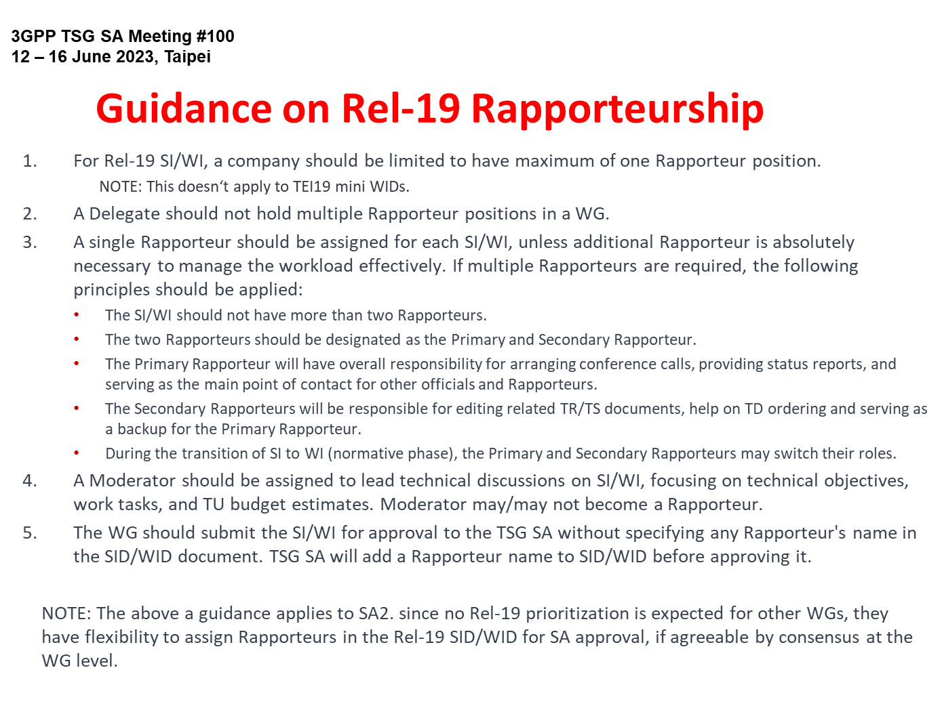
Reference: SP-230746
Note: The first bullet does not applicable to SA5.

Slide 24
Reference From TR 21.900 on rapporteur roles
4.1.2 Role of the specification rapporteur
The role of the rapporteur is to:
- Serve as Editor (following the guidance of the WG) until the specification is placed under change control.
- Deliver a clean specification to the MCC for editorial clean-up before submission for TSG approval to come under change control.
and, in co-operation with MCC, to:
- Review all CRs to the specification prior to agreement in the Working Group. This includes identifying and resolving clashes.
- Oversee the technical quality of the specification.
- Explain the specification to any other group (WG, TSG, inside or outside 3GPP), where appropriate.
- Serve as focal point for technical questions.
6.3.2 Role of the work item rapporteur
Every Work Item shall have a rapporteur. The rapporteur should be selected from regular attendees of the primary responsible Group and shall be selected from supporting companies. The role of the rapporteur is to:
- Monitor the progress of the work in all WGs for the WI.
- Report to the responsible WG and produce a report to the WG plenary on progress.
- Provide feedback to allow the work plan to be updated.
- Keep the WI sheet up-to-date.
- Identify the completion of the WI.
NOTE: Updates of WI sheets require approval by the responsible WG/TSG.

Slide 25
Annex
Release 19
Expectation of SA5 rapporteur role
SA5 TU planning & statistics

Slide 26
SA5 TU planning & statistics
OAM uses TU to facilitate the Rel-19 discussion.
Based on the collection of opinions in CH SWG from SA5#153, so far there is no need to use TU for CH time management in Rel-19 because of no expected need for prioritization process. This will be re-evaluated once Rel-19 Charging topics are identified.

Slide 27
Template for TU estimation
Moderators are requested to provide the following TU estimation based on the proposed objectives
Work Task ID | TU Estimate (Study) | TU Estimate (Normative) | RAN Dependency (Yes/No/Maybe) | SA Dependency (Yes/No/Maybe) | Non-3GPP Dependency
WT-1 | 1 | 1 | No | Maybe | No
WT-2
WT-3
TU estimates and dependencies
Total TU estimates for the study phase: ?
Total TU estimates for the normative phase: ?
Total TU estimates: 6

Slide 28
SA5 Rel-19 OAM TU statistics (Study phase)
 | Planned TU (study phase) | Bonus TU | Total TU
AIML | 6.2 | 5.7 | 11.9
MDA | 4.7 | 0.33 | 5.03
IDM | 4 | 3.76 | 7.76
CCL | 6.4 | 1 | 7.4
NDT | 3.3 | 2.5 | 5.8
CMO | 6.6 | 6.26 | 12.9
EE | 5 | 3.7 | 8.7
MExpo | 4.55 | 2.7 | 7.25
1. The following topics used TU is very close to planned TU:
AIML/IDM/NDT/adNRM/PM/TMQ/EE/Monstra
2. The following topics taking advantage of BONUS TU, they are mainly OAM prime topics:
AIML/IDM/CMO/NDT/EE/Mexpo/CCL/MDA
3. Using the topics which used BONUS TU as example, average TU for decent study for a topic should be around 8~10 TU, adding TU in normative phase, 10~15 TU per topic would be desired.

Slide 29
SA5 calendar with OAM TU (one track)
Assumption: Every day = 5 sessions (TUs), total TU in 1 ordinary meeting (exclude closing plenary TUs) = 18.5 TUs
Time | Monday | Tuesday | Wednesday | Thursday | Friday (Closing plenary)
Q0 (8:00~8:55) (If needed) | NA | Breakout (opt.) | Breakout (opt.) | Breakout (opt.) | Closing plenary Start at 8:30am (may change depends on the host restriction)
Q1 (9:00 - 10:30) | Plenary Session#1 (1TU) [Single Stream] | Stream#1 (1TU) | Stream#1 (1TU) | Stream#1 (1TU) | Closing plenary
10:30 - 11:00 | Morning Coffee Break | Morning Coffee Break | Morning Coffee Break | Morning Coffee Break | Morning Coffee Break
Q2 (11:00 - 12:30) | Stream#1 (1TU) | Stream#1 (1TU) | Stream#1 (1TU) | Stream#1 (1TU) | Closing plenary
12:30 - 14:00 | Lunch | Lunch | Lunch | Lunch | Lunch
Q3 (14:00 - 15:30) | Stream#1 (1TU) | Stream#1 (1TU) | Stream#1 (1TU) | Stream#1 (1TU) | Closing plenary
15:30 - 16:00 | Afternoon Coffee Break | Afternoon Coffee Break | Afternoon Coffee Break | Afternoon Coffee Break | Afternoon Coffee Break
Q4 (16:00 - 17:30) | Stream#1 (1TU) | Stream#1 (1TU) | Stream#1 (1TU) | Revision session | Closing plenary
17:30 - 17:40 | Break | Break | Break | Break | Break
Q5 (17:40 – 19:10) | Stream#1 (1TU) | Stream#1 (0.5 TU) Stop around 18:45 Social evening | Stream#1 (1TU) | Revision session

Slide 30
TU Budget for SA5 OAM
Assumptions for SA5 OAM :
6 ordinary meeting per year.
Rel-19 spans 21 months for SA5 (with early start of studies) = 10 meetings
1 Session = 1.5 hour time window
Max 5 sessions per meeting day
1 Stream = 1 TU (Time Unit)
1 TU is time (i.e., 1.5 hours) spent to discuss/handle technical contributions.
Revisions/Drafting/offline conference call are not counted for the TU estimates.
OAM revision sessions normally planned to be in Thursday Q4 and Q5 (initial assump.)
1 parallel (OAM) stream per session => 18.5 TUs per meeting (incl. 2 TUs as buffer) = 185
Assume Maintenance + Buffer = 33% as in SA2 => ~ 61 TU
Resulting total TUs avail. f. SI/WI: 10 meetings x 18.5 sessions = 185 TU minus 61 => 124 TU
With 21 SI/WI => Average 6 TU per SI/WI (0.6/meeting).

Slide 31
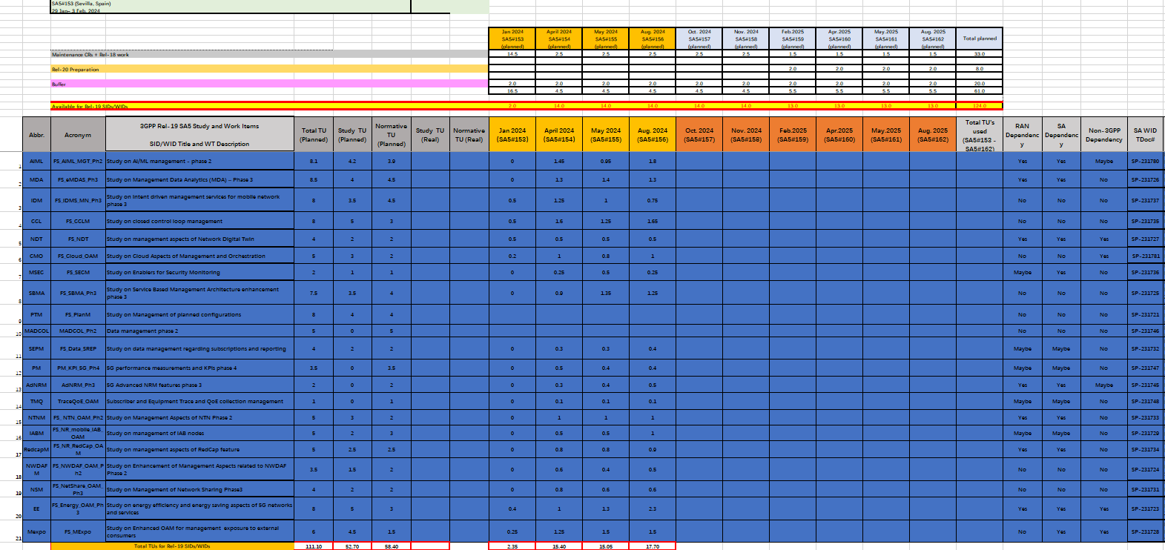
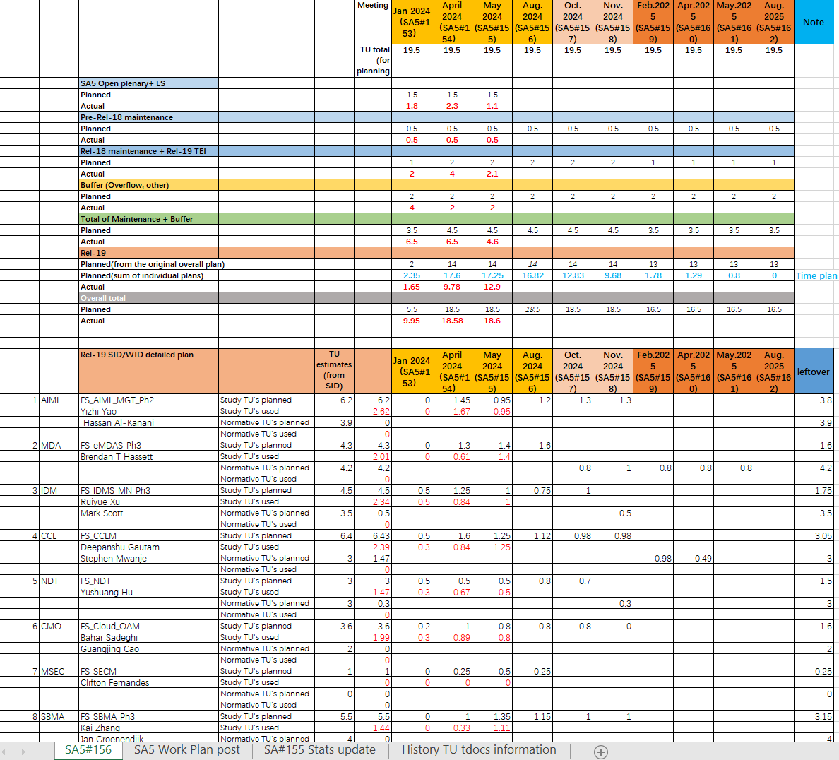
Sample of OAM TU planning and statistics
TU planning: to be proposed by rapporteurs and agreed by the group
TU statistics: to be filled by chair based on the time consumed after each meeting
This is an example to illustrate TU planning and statistics

Slide 32
SA5 calendar with CH TU (one track)
Assumption: Every day = 5 sessions (TUs), total TU in 1 ordinary meeting (exclude closing plenary TUs) = 15.5 TUs
Time | Monday | Tuesday | Wednesday | Thursday | Friday (Closing plenary)
Q0 (8:00~8:55) (If needed) |  | Breakout (opt.) | Breakout (opt.) |  | Closing plenary Start at 8:30am (may change depends on the host restriction)
Q1 (9:00 - 10:30) | Plenary Session#1 (1TU) [Single Stream] | Stream#1 (1TU) | Stream#1 (1TU) | Revision session | Closing plenary
10:30 - 11:00 | Morning Coffee Break | Morning Coffee Break | Morning Coffee Break | Morning Coffee Break | Morning Coffee Break
Q2 (11:00 - 12:30) | Stream#1 (1TU) | Stream#1 (1TU) | Stream#1 (1TU) | Revision session | Closing plenary
12:30 - 14:00 | Lunch | Lunch | Lunch | Lunch | Lunch
Q3 (14:00 - 15:30) | Stream#1 (1TU) | Stream#1 (1TU) | Stream#1 (1TU) | CH Closing | Closing plenary
15:30 - 16:00 | Afternoon Coffee Break | Afternoon Coffee Break | Afternoon Coffee Break | Afternoon Coffee Break | Afternoon Coffee Break
Q4 (16:00 - 17:30) | Stream#1 (1TU) | Stream#1 (1TU) | Stream#1 (1TU) | CH Closing | Closing plenary
17:30 - 17:40 | Break | Break | Break | Break | Break
Q5 (17:40 – 19:10) | Stream#1 (1TU) | Stream#1 (0.5 TU) Stop around 18:45 Social evening | Stream#1 (1TU) | CH Closing(Opt.)

Slide 33
TU Budget for SA5 CH
Assumptions for SA5 CH :
6 ordinary meeting per year.
Rel-19 spans 18 months for SA5 (with early start of studies) = 8 meetings
1 Session = 1.5 hour time window
Max 5 sessions per meeting day
1 Stream = 1 TU (Time Unit)
1 TU is time (i.e., 1.5 hours) spent to discuss/handle technical contributions.
Revisions/Drafting/offline conference call are not counted for the TU estimates.
CH revision sessions normally planned to be in Thursday Q1 and Q2 (initial assump.),CH closing plenary planned to be in Thursday Q3 and Q4.
1 (CH) stream per session => 15.5 TUs per meeting (incl. 2 TUs as buffer) = 124
Assume Maintenance + Buffer = 33% as in SA2 => ~ 41 TU
Resulting total TUs avail. f. SI/WI: 9 meetings x 15.5 sessions = 124 TU minus 41 => 83 TU
=> Recommended MAX no. of SI/WI = 14
With 14 SI/WI => Average 6 TU per SI/WI (0.75/meeting).

