Slide 1
Discussion on modelling options to support Energy cost mapping rule
Nokia

Slide 2
Background
SA5 received a LS from RAN3 (S5-235036 (R3-233515): LS on AI/ML for NG-RAN Energy Saving Energy Cost index) with the following request:
  The Energy Cost (the node level measured Energy Consumption index) provides a representation of the energy consumption at an NG-RAN node.
  NG-RAN nodes exchange the Energy Cost with neighbouring NG-RAN nodes upon request.
  The Energy Cost is encoded as an index, normalized by rules provided by OAM.
  RAN3 assumes that these rules shall be the same at least for all neighbouring NG-RAN nodes within the area where a request on Energy Cost reporting is triggered by a NG-RAN node.
  Based on this, it is required that NG-RAN nodes are configured with a unified rule to map the Energy Cost value of NG-RAN node to a measurement of consumed energy ensuring normalization of the exchanged Energy Cost information.
Discussion paper (S5-243433 : Discussion Paper on RAN3 NGRAN Energy Saving based on Energy Cost) endorsed in SA5#155 to support the following:
  OAM Requirement No. 1: the 3GPP management system shall enable the Operator to provision the unified “Energy Consumption – to – Energy Cost” mapping rule for all the gNBs pertaining to the area/group.
  OAM Requirement No. 2: the 3GPP management system shall enable the Operator to configure the time interval within which the gNBs should average their actual energy consumption values.
A grouping of gNBs is required for configuring the unified mapping rule for energy cost.

Slide 3
Observations
In the past the main way to group something was via association (e.g., name-containment) under SubNetwork.
During the work on Network Slicing topic, the limitation of name-containment was identified (“single parent” rule, leading to the situation where an MOI cannot be member of two groups unless these two groups are hierarchically related).
In order to solve this problem (which was critical roadblock for management of Network Slicing), the concept of generic collection (outside of the name-containment) was introduced.
Due to the importance with Network Slicing topic, it was decided to name the new IOC “NetworkSliceSubnet”, i.e. the name used to promote the (critical) use for Network Slicing, but not to limit its usage to network slice.
This construct named NetworkSliceSubnet supports unlimited (not bound by name-containment rules) grouping of anything (that inherits from ManagedFunction) for a purpose (any purpose that can be expressed as a “profile”).
For supporting the requirement from RAN3, there is a similar problem, i.e., group gNBs for energy saving purpose. The concept/requirement is similar to the need that was seen in the network slicing topic.

Slide 4
Options for modelling
Option #1: Re-use existing generic collection IOC, i.e., NetworkSliceSubnet
  Supports (also) having a group with multiple purposes (slicing expressed as a sliceProfile, energy saving expressed as energySavingProfile)
Option #2: Introduce NGRANEnergySavingGroup inherited from Top
  Unique grouping IOCs will be created for every purpose, e.g., if energy savings to be supported in the 5GC …
Option #3: Introduce class representing generic collection (i.e., GenericCollection), and inherit all specific collection classes (i.e., NetworkSliceSubnet, EnergySavingsGroup, any other grouping class in future) from this class.
  Does not support groups having multiple purposes (the same set of members will have to be repeated in two groups, one for slicing purpose, one for energy savings purpose).

Slide 5
Proposal – Option #1
Existing IOC is re-used.
No impacts to inheritance and relationships (no UML changes required).
Add a new profile for energy saving purpose into NetworkSliceSubnet IOC.
See: S5‑242457 Rel-18 CR TS 28.541 Add support for Energy Cost mapping rule

Slide 6
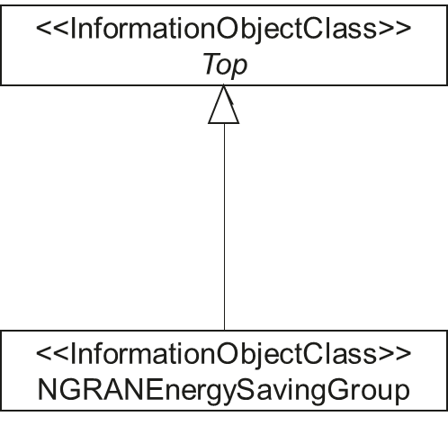
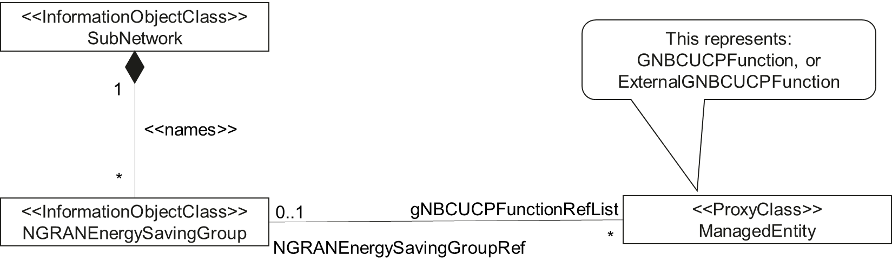
Proposal – Option #2
See CR S5‑242580 Introduce NRM definitions for NG-RAN energy saving based on energy cost – Stage 2

Slide 7
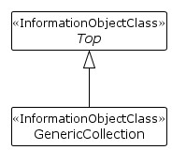
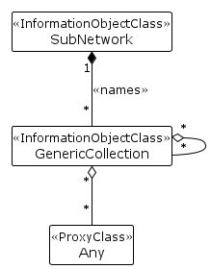
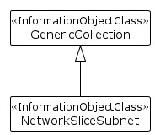
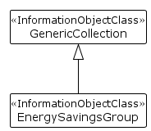
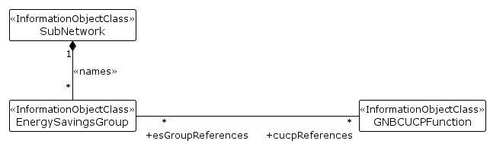
Proposal – Option #3
Introduce a new class GenericCollection.
  With attribute UserLabel conveying the purpose of the grouping.
Update NetworkSliceSubnet IOC inheritance from Top to GenericCollection IOC
Define a new IOC for grouping objects for energy saving purpose as EnergySavingsGroup, inherited from GenericCollection IOC.
EnergySavingsGroup should be extensible in future to group other objects, example cells or NFs.
Inheritance and Relationship:
NetworkSliceSubnet IOC
Inheritance and Relationship : GenericCollection IOC
Inheritance and Relationship : EnergySavingGroup IOC

Slide 8
Proposal for Endorsement
Select option #1 as way forward

Slide 9
Thank you!

