Slide 1
Overview of RAN Rel18 Package
Rajavelsamy R

Slide 2
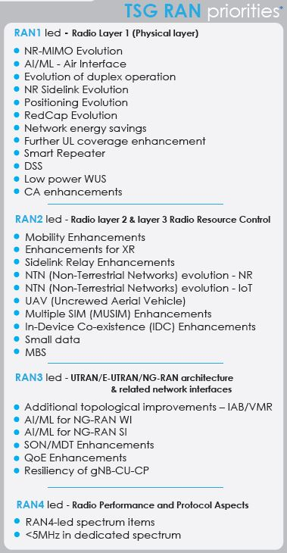
R18 overview
Release 18 features from TSG#94
  28 RAN lead items
Ref: SP-211589: TSG RAN#94-e Highlights
( Excerpt : https://www.3gpp.org/ftp/Inbox/Marcoms/Relase_18_features_tsg94_v09.pdf)

Slide 3
RAN R18 Package: RAN1-led Projects
12 in total
Tdoc# | Title | SA3 Involvement
RP-213598 | MIMO Evolution for Downlink and Uplink | No
RP-213599 | Study on Artificial Intelligence (AI)/Machine Learning (ML) for NR Air Interface | No
RP-213591 | Study on Evolution of NR Duplex Operation | No
RP-213678 | NR sidelink evolution | No
RP-213588 | Study on expanded and improved NR positioning | No
RP-213661 | Study on further NR RedCap UE complexity/cost reduction | No
RP-213554 | Study on network energy savings | No
RP-213579 | Further NR coverage enhancements | No
RP-213700 | Study on NR Network-Controlled Repeaters | Yes
RP-213575 | Enhancement of NR Dynamic spectrum sharing (DSS) | No
RP-213645 | Study on low-power Wake-up Signal and Receiver for NR | No
RP-213577 | Multi-carrier enhancements for NR | No

Slide 4
RAN R18 Package: RAN2-led Projects
10 in total
Tdoc# | Title | SA3 Involvement
RP-213565 | Further NR Mobility Enhancements | No
RP-213587 | Study on XR Enhancements for NR | No
RP-213585 | NR sidelink relay enhancements | Yes
RP-213690 | NR NTN (Non-Terrestrial Networks) enhancements | Yes
RP-213596 | IoT NTN enhancements | No
RP-213600 | NR Support for UAV | No
RP-213584 | Dual Tx/Rx MUSIM | No
RP-213589 | In-Device Co-existence (IDC) enhancements for NR and MR-DC | No
RP-213583 | Mobile Terminated-Small Data Transmission (MT-SDT) for NR | No
RP-213568 | Enhancements of NR Multicast and Broadcast Services | No

Slide 5
RAN R18 Package: RAN3-led Projects
5 in total
Tdoc# | Title | SA3 Involvement
RP-213601 | Mobile IAB | No
RP-213602 | Artificial Intelligence (AI)/Machine Learning (ML) for NG-RAN | Yes
RP-213553 | Further enhancement of data collection for SON (Self-Organising Networks)/MDT (Minimization of Drive Tests) in NR and EN-DC | No
RP-213594 | Enhancement on NR QoE management and optimizations for diverse services | No
RP-213677 | Study on enhancement for resiliency of gNB-CU | No

Slide 6
RAN R18 Package: RAN4-led Projects
1 in total
Tdoc# | Title | SA3 Involvement
RP-213603 | NR support for dedicated spectrum less than 5MHz for FR1 | No

Slide 7
Thank you!

