Slide 1
Authorization of NF service consumers for data access via DCCF
Discussion paper on alignment with CT4
German Peinado – Nokia

Slide 2
LS C4-225161
LS on Authorization of NF service consumers for data access via DCCF (CT4 #113, Toulouse, November 2022)
CT4 identified missalignments between requirements specified in TS 29.510 and in Annex X of TS 33.501 on authorization of NF service consumers (e.g. NWDAF) for data access via DCCF
NRF
NWDAFc
SCP
DCCF
SCP
NWDAFp

Slide 3
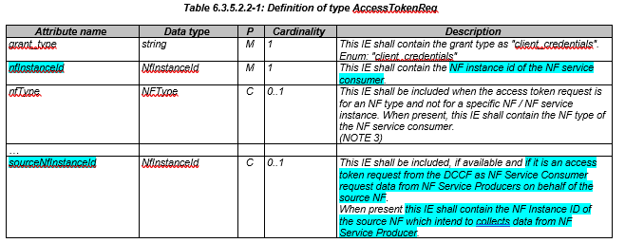
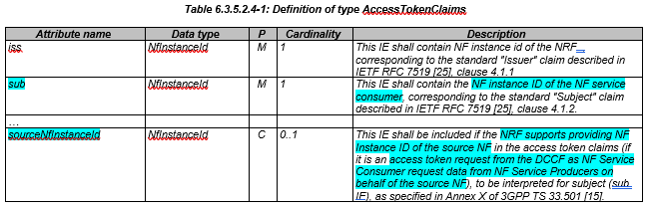
CT4 – TS 29.510 (clauses 6.3.5.2.2, 6.3.5.2.4)
Observation:
Stage 3 specs have been built based on the following SA2 principle, whereby an intermediate NF service consumer subscribes to an NF service producer on behalf of another NF service consumer
Figure 7.1.2-3: "Subscribe-Notify" NF Service illustration 2

Slide 4
CT4 – Approach and requirements
NRF
NWDAFc
SCP
DCCF
SCP
NWDAFp
nfInstanceId IE: DCCF (intermediate NF consumer)
SourceNfInstanceId: NWDAFc (source)
From Rel.15 onwards: intermediary authorization (nfInstanceId IE in the access token request and subject claim in the access token to indicate the NF Instance ID of the intermediary, i.e. DCCF)
From Rel.17 onwards: source and intermediary authorization (sourceInstanceId IE in the access token request and access token claims to indicate the NF instance ID of the source, i.e. NWDAFc)
Assumption: NFp (Rel-15/16) is able to authorize (by configuration) DCCF (defined in Rel-17) to access its services (generic issue).
REQUIREMENTS:
For backwards compatibility issues CT4 would require the definition of a new header, that would contain the CCA of the source NF (NWDAFc), ignored by pre-release 17 NF producers. The DCCF would forward the NWDAF CCA in the new header towards the NFp, and e.g., NFp in rel.16 would simply accept the request w/o knowing the source of the request, i.e., DCCF is authorized, not the source

Slide 5
SA3 TS 33.501 – Annex X (clause X.2)
The NF Instance ID of DCCF is included in a different IE than source NF so that Rel-16 NRF will ignore the new IE.
If NRF is from Rel.16 or earlier, it does *not* validate whether the DCCF is authorized to receive the requested service
with NF Service Consumer Instance (subject), and an additional access token claim containing the identity of DCCF

Slide 6
SA3 – Approach and requirements
NRF
NWDAFc
SCP
DCCF
SCP
NWDAFp
nfInstanceId IE: NWDAFc (source)
Additional IE: DCCF instance ID
From Rel.16 onwards: Source authorization (the source NF (NWDAFc) is authorized, but not the intermediary (DCCF), by pre-release 17 NRF. CCA of NWDAFc is used for authentication)
(Note. Rel.15 NFp would not support these call flows)
From Rel.17 onwards: Source and intermediary authorization.
REQUIREMENTS:
DCCF works as a proxy to request the access token on behalf of the NWDAFc, the NRF validates whether the NWDAFc is authorized to receive the requested service, while ignoring the DCCF in case of pre-release 17 NRF.
CT4 would require the definition a new attribute to be used in the access token request and claims for the DCCF use case to include the NF instance ID of DCCF.
Since DCCF may include as well an additional CCA for authentication, CT4 would require the definition of a new header to convey both DCCF and NWDAFc CCAs.

Slide 7
Summary
OPTION 1) Align SA3 specs with CT4 specs
For Rel 16: Authorization of the intermediary (DCCF) directly connected to the producer.
For Rel 17 onwards:
  Attribute for NF source authorization - sourceInstanceId IE
  New header for backwards compatibility (CCA of the source NF, e.g., NWDAFc)
OPTION 2) Align CT4 specs with SA3 specs
For Rel 16: Authorization of the NF source (NWDAFc)
For Rel 17 onwards:
  New attribute (to be defined) specific for DCCF use case
  New header for DCCF CCA

