Slide 1
3GPP Broadband Communication Applied to New Sectors
Erik Guttman
Chairman of 3GPP SA
Samsung Electronics Co., Ltd.

Slide 2
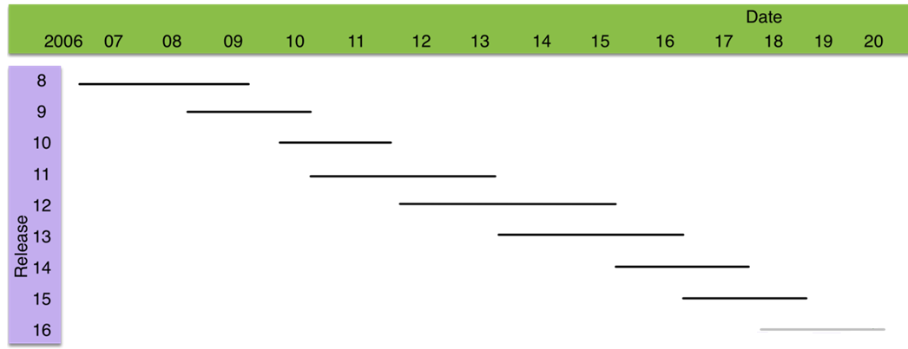
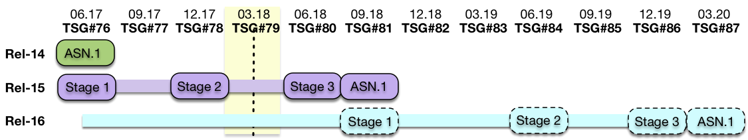
3GPP Status Overview
5G Phase 1: Rel-15, 5G Phase 2: Rel-16, IMT-2020 Submission: 12.19

Slide 3
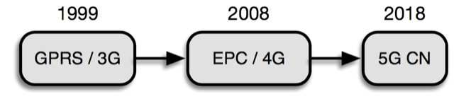
3GPP Broadband Communication Overview
Evolution with backward compatibility
Mobility and service continuity
Continuing development of RAN and CN to support ever higher data rates
New 5G broadband capabilities (URLLC, mIoT)

Slide 4
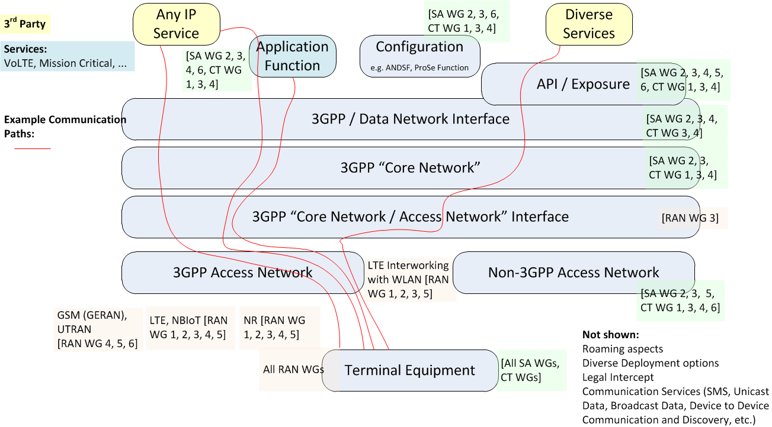
3GPP Broadband
● enTV feature
increases broadcast
range for LTE eMBMS
● FS_5GSAT studies
Satellite Access in 5G

Slide 5
New Sectors & 3GPP SMARTER Work
3GPP has worked with verticals in the past
  Broadcast, Mission Critical, Vehicle, IoT
5G will accellerate and intensify this
SMARTER foresees intensified work in new business areas not yet addressed by the Enhanced Packet System – e.g. more demanding KPIs, offering efficiencies and increased control and flexibility.

Slide 6
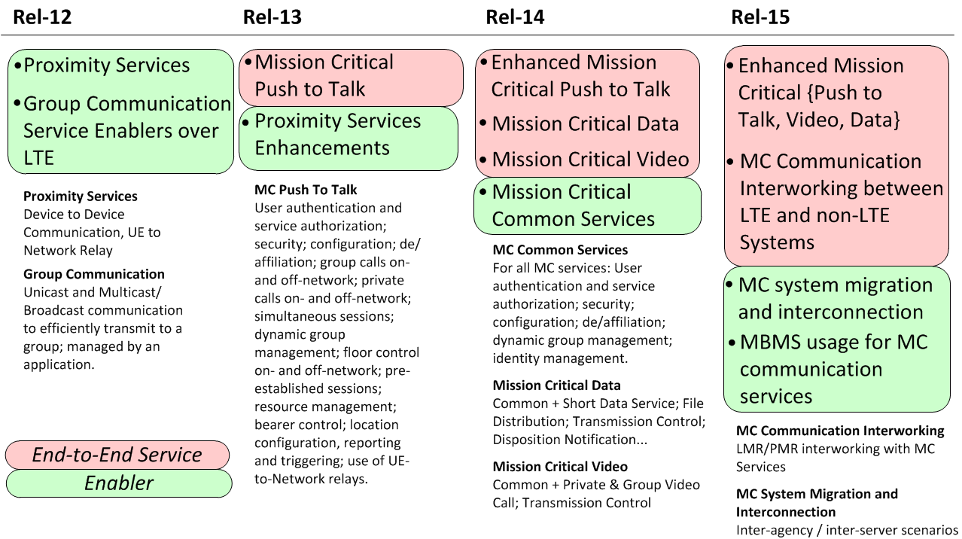
Case Study: Critical Communications

Slide 7
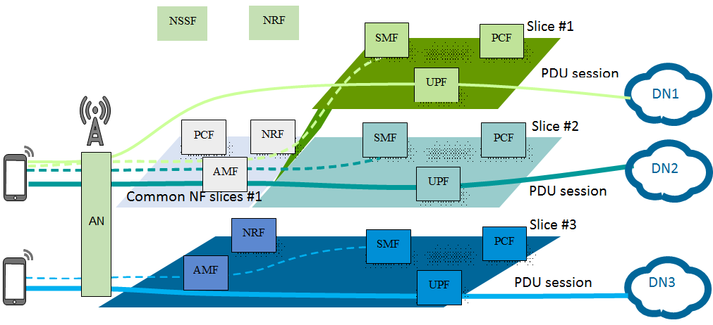
Progress on Network Slicing

Slide 8
Security (SA3) Aspects
Key mission: secure the service and infrastructure to meet business goals and regulations
  End to end aspects (e.g. IMS signalling security)
  Radio aspects (RRC security)
  Network aspects (Mobility support, roaming aspects)
  Service aspects (Mission Critical)
  Legal Intercept
Additional tasks
  Privacy (For all aspects, both per regulatory requirements and protection of user privacy)
  Security Assurance (Expectations for delivery of secure products)
  Coordinated Vulnerability Disclosure

Slide 9
Thank you for your attention.

