Slide 1
3GPP Technology Areas
These slides present a possible approach to making 3GPP technology more accessible, particularly to “outsiders”.
The slides take the form of a (short) series of mocked-up screen shots from the 3GPP web (or portal). There is no attempt at achieving the final aesthetics!
Now click on to see the first slide ...

Slide 2

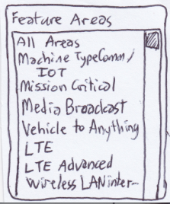
3GPP Technology Areas
Page:
technology_areas_home/
Step 1 – search for technology area by keyword
Search for:
Search for
car, road vehicle, self-driving, autonomous
Enter free text keyword(s) or keyphrase(s).
Separate each keyword / keyphrase with a comma or semi-colon.
You can use AND, AND NOT, OR with round brackets () to group keywords / keyphrases.
The user navigates from the menu to the Technology Area home page. There he enters some free text terms (here called keywords or keyphrases). Some initial manual work will need to be undertaken to establish a meaningful set of keywords and keyphrases and to match them to a “small” set of “technology areas”. It is anticipated that there could be several hundred of these areas.
c
EAG: When we discussed the areas
we would support, we imagined that
we would at first use the areas listed
in the WP as a start. There are not
many of these.
I imagine we
could also
provide a drop
box for these
in addition to
accepting
keywords…

Slide 3

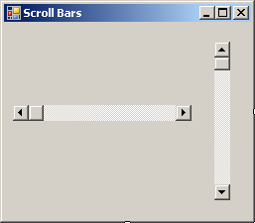
3GPP Technology Areas
Page:
technology_areas_home/search_results
Step 2 – search results
Search for:
car, road vehicle, self-driving, autonomous, trains, drones
Enter free text keyword(s) or keyphrase(s).
Separate each keyword / keyphrase with a comma or semi-colon.
You can use AND, AND NOT, OR with round brackets () to group keywords / keyphrases. Default is to return areas associated with any of the keywords / keyphrases.
Matching technology area(s):
vehicle-to-vehicle (V2V)
vehicle-to-anything (V2X)
self-organizing / self-optimizing networks (SON)
railway communications
non-terrestrial systems (balloons, aircraft, UAV, satellite)
Internet of Things (IOT), Machine-Machine (M2M)
...
...
Select chosen area to see lists of work items, reports, specifications, ... associated with this technology area.

Slide 4
3GPP Technology Areas
Page:
technology_areas_home/search_results
Step 2 – search results
Search for:
car, road vehicle, self-driving, autonomous, trains, drones
Enter free text keyword(s) or keyphrase(s).
Separate each keyword / keyphrase with a comma or semi-colon.
You can use AND, AND NOT, OR with round brackets () to group keywords / keyphrases. Default is to return areas associated with any of the keywords / keyphrases.
Matching technology area(s):
vehicle-to-vehicle (V2V)
vehicle-to-anything (V2X)
self-organizing / self-optimizing networks (SON)
railway communications
non-terrestrial systems (balloons, aircraft, UAV, satellite)
Internet of Things (IOT), Machine-Machine (M2M)
...
...
Select chosen area to see lists of work items, reports, specifications, ... associated with this technology area.
The user is presented with a list of technology areas associated with his chosen keywords / keyphrases. He will select one (and only one) for expansion.

Slide 5

3GPP Technology Areas
EAG: I like the results listing you provide,
though I believe that more metadata or context is needed to understand each table.
Page:
technology_areas_home/search_results/document-download
Step 3 – download documents for technology area:
vehicle-to-anything (V2X)
Studies and normative work items
Technical Reports and Specifications
Change Requests (approved)
Rel-14
Support for V2V services based on ...*
36.101
User Equipment (UE) radio transmis...
36.101
CR 4326 Rel-14 – V2V power imbala...
Rel-14
LTE support for V2X services (V2XLTE*
36.785
Vehicle to Vehicle (V2V) services bas...
36.101
CR 4698 Rel-14 – Correction of RE...
Rel-15
Study on evaluation methodology o..*
---
---
---
---
Rel-15
Study on security aspects for LTE su...
---
---
---
---
...
...
...
...
...
...
...
...
...
...
...
...
...
...
EAG: Thanks for thinking of
how to address my suggestion
of ’download all.’
...
...
Rel-16
Study on application layer support f...
Rel-16
Study on Improvement of V2X Servi...
Rel-17
Application layer support for V2X se...
* indicates complete
c
EAG: Again, listing specs & CRs would
benefit from context – e.g. first
choose feature, then spec, then its CRs…
EAG: The names of our
studies/work items do not
indicate what stage / scope.
Click to download all work-item-related documents (WIDs, status reports) in this area
Click to download latest version of all specs in all Releases
Click to download all approved CRs for all specs in this area

Slide 6
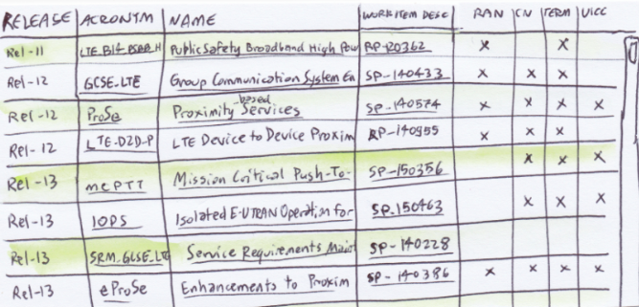
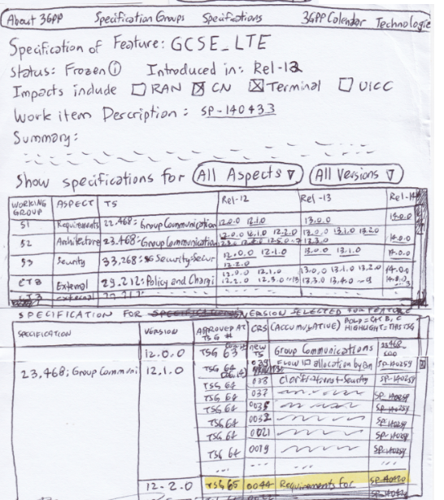
EAG: In my mock up, I tried to show all the
Public safety work we had done up to Rel-13.
(left) The point is to provide more info than just the name of the feature and the release #.
EAG: On the right is my mocked up result
if the user were to click on GCSE_LTE. I know
at this point the IT Improvements report will
not contain specific recommendations to
provide a per feature (WID) static page.
Still: I present my ideas regarding that here.
(see the figure to the right)
The first table includes a representation of
all work done on GCSE_LTE, broken down by
WG, listing specifications affected, and 3GPP
releases supported (with a list of specs).
If you click on a spec – it opens a CR browser
(the second table, below).
Individual CRs or specs can be downloaded,
or ’all.’

Slide 7
3GPP Technology Areas
The user is presented with three lists of documents associated with his chosen technology area:
work items (only top-level WIs are shown)
TRs and TSs
CRs
And he can now choose what to do next ...
Page:
technology_areas_home/search_results/document-download
Step 3 – download documents for technology area:
vehicle-to-anything (V2X)
Studies and normative work items
Technical Reports and Specifications
Change Requests (approved)
Rel-14
Support for V2V services based on ...*
36.101
User Equipment (UE) radio transmis...
36.101
CR 4326 Rel-14 – V2V power imbala...
Rel-14
LTE support for V2X services (V2XLTE*
36.785
Vehicle to Vehicle (V2V) services bas...
36.101
CR 4698 Rel-14 – Correction of RE...
Rel-15
Study on evaluation methodology o..*
---
---
---
---
Rel-15
Study on security aspects for LTE su...
---
---
---
---
...
...
...
...
...
...
...
...
...
...
...
...
...
...
...
...
Rel-16
Study on application layer support f...
Rel-16
Study on Improvement of V2X Servi...
Rel-17
Application layer support for V2X se...
* indicates complete
Click to download all work-item-related documents (WIDs, status reports) in this area
Click to download latest version of all specs in all Releases
Click to download all approved CRs for all specs in this area

Slide 8


3GPP Technology Areas
Page:
technology_areas_home/search_results/document-download
Step 3 – download documents for technology area:
vehicle-to-anything (V2X)
Studies and normative work items
Technical Reports and Specifications
Change Requests (approved)
Rel-14
Support for V2V services based on ...*
36.101
User Equipment (UE) radio transmis...
36.101
CR 4326 Rel-14 – V2V power imbala...
Rel-14
LTE support for V2X services (V2XLTE*
36.785
Vehicle to Vehicle (V2V) services bas...
36.101
CR 4698 Rel-14 – Correction of RE...
Rel-15
Study on evaluation methodology o..*
---
---
---
---
Rel-15
Study on security aspects for LTE su...
---
---
---
---
...
...
An icon could take the user to a static page for the selected technology area. This would be an article explaining the services offered by this area and could contain as much or as little technical, historical, political, etc, information as desired.
Care would need to be taken that this page be maintained in an up to date state as more work items are embraced by the technology. This, of course, requires manual effort.
...
...
...
...
...
...
...
...
...
...
...
...
...
...
Rel-16
Study on application layer support f...
Rel-16
Study on Improvement of V2X Servi...
Rel-17
Application layer support for V2X se...
* indicates complete
Click to download all work-item-related documents (WIDs, status reports) in this area
Click to download latest version of all specs in all Releases
Click to download all approved CRs for all specs in this area

Slide 9
3GPP Technology Areas
Note that in the context of this service, a “work item” is considered to consist of the top level item and all its subordinate building blocks and work tasks. Selecting a particular work item (see later) will offer all specs and CRs associated with that work item tree.

Slide 10
3GPP Technology Areas
He can click one of the three icons for the system to push to him the complete zipped set of documents of one of the three lists
Page:
The user can click one of the three icons for the system to push to him the complete zipped set of documents of one of the three lists.
technology_areas_home/search_results/document-download
Step 3 – download documents for technology area:
vehicle-to-anything (V2X)
Studies and normative work items
Technical Reports and Specifications
Change Requests (approved)
Rel-14
Support for V2V services based on ...*
36.101
User Equipment (UE) radio transmis...
36.101
CR 4326 Rel-14 – V2V power imbala...
Rel-14
LTE support for V2X services (V2XLTE*
36.785
Vehicle to Vehicle (V2V) services bas...
36.101
CR 4698 Rel-14 – Correction of RE...
Rel-15
Study on evaluation methodology o..*
---
---
---
---
Rel-15
Study on security aspects for LTE su...
---
---
---
---
...
...
...
...
...
...
...
...
...
...
...
...
...
...
...
...
Rel-16
Study on application layer support f...
Rel-16
Study on Improvement of V2X Servi...
Rel-17
Application layer support for V2X se...
* indicates complete
Click to download all work-item-related documents (WIDs, status reports) in this area
Click to download latest version of all specs in all Releases
Click to download all approved CRs for all specs in this area
EAG: I suggest a bit more context info would
help to decide whether to ‘get all’ – especially for specs and CRs. See my next comments.

Slide 11
3GPP Technology Areas
Or he can click on a particular work item to download only the latest WID, WI status (or WI summary if available).
Page:
technology_areas_home/search_results/document-download
Step 3 – download documents for technology area:
vehicle-to-anything (V2X)
Studies and normative work items
Technical Reports and Specifications
Change Requests (approved)
Rel-14
Support for V2V services based on ...*
36.101
User Equipment (UE) radio transmis...
36.101
CR 4326 Rel-14 – V2V power imbala...
Rel-14
LTE support for V2X services (V2XLTE*
36.785
Vehicle to Vehicle (V2V) services bas...
36.101
CR 4698 Rel-14 – Correction of RE...
Rel-15
Study on evaluation methodology o..*
---
---
---
---
Rel-15
Study on security aspects for LTE su...
---
---
---
---
...
...
...
...
...
...
...
...
...
...
...
...
...
...
...
...
Rel-16
Study on application layer support f...
Rel-16
Study on Improvement of V2X Servi...
Rel-17
Application layer support for V2X se...
* indicates complete
Click to download all work-item-related documents (WIDs, status reports) in this area
Click to download latest version of all specs in all Releases
Click to download all approved CRs for all specs in this area

Slide 12
3GPP Technology Areas
If the user selects just one work item in the previous step, the specs and CRs tables could dynamically update to show only the specs and CRs pertaining to that work item.
Page:
technology_areas_home/search_results/document-download
Step 3 – download documents for technology area:
vehicle-to-anything (V2X)
Studies and normative work items
Technical Reports and Specifications
Change Requests (approved)
Rel-14
Support for V2V services based on ...*
36.101
User Equipment (UE) radio transmis...
36.101
CR 4326 Rel-14 – V2V power imbala...
Rel-14
LTE support for V2X services (V2XLTE*
36.785
Vehicle to Vehicle (V2V) services bas...
36.101
CR 4698 Rel-14 – Correction of RE...
Rel-15
Study on evaluation methodology o..*
---
---
---
---
Rel-15
Study on security aspects for LTE su...
---
---
---
---
...
...
...
...
...
...
...
...
...
...
...
...
...
...
...
...
Rel-16
Study on application layer support f...
Rel-16
Study on Improvement of V2X Servi...
Rel-17
Application layer support for V2X se...
* indicates complete
EAG: This iterative selection process is very
useful and I think intuitive. I suggest some more
data for the first table – esp. the WG as an indication of the scope of the spec.
Click to download all work-item-related documents (WIDs, status reports) in this area
Click to download latest version of all specs in all Releases
Click to download all approved CRs for all specs in this area

Slide 13
3GPP Technology Areas
He can click on a particular spec to download its latest available version.
Page:
technology_areas_home/search_results/document-download
Step 3 – download documents for technology area:
vehicle-to-anything (V2X)
Studies and normative work items
Technical Reports and Specifications
Change Requests (approved)
Rel-14
Support for V2V services based on ...*
36.101
User Equipment (UE) radio transmis...
36.101
CR 4326 Rel-14 – V2V power imbala...
Rel-14
LTE support for V2X services (V2XLTE*
36.785
Vehicle to Vehicle (V2V) services bas...
36.101
CR 4698 Rel-14 – Correction of RE...
Rel-15
Study on evaluation methodology o..*
---
---
---
---
Rel-15
Study on security aspects for LTE su...
---
---
---
---
...
...
...
...
...
...
...
...
...
...
...
...
...
...
...
...
Rel-16
Study on application layer support f...
Rel-16
Study on Improvement of V2X Servi...
Rel-17
Application layer support for V2X se...
* indicates complete
Click to download all work-item-related documents (WIDs, status reports) in this area
Click to download latest version of all specs in all Releases
Click to download all approved CRs for all specs in this area

Slide 14
3GPP Technology Areas
Or he can click on a particular CR to download the document containing it.
Page:
technology_areas_home/search_results/document-download
Step 3 – download documents for technology area:
vehicle-to-anything (V2X)
Studies and normative work items
Technical Reports and Specifications
Change Requests (approved)
Rel-14
Support for V2V services based on ...*
36.101
User Equipment (UE) radio transmis...
36.101
CR 4326 Rel-14 – V2V power imbala...
Rel-14
LTE support for V2X services (V2XLTE*
36.785
Vehicle to Vehicle (V2V) services bas...
36.101
CR 4698 Rel-14 – Correction of RE...
Rel-15
Study on evaluation methodology o..*
---
---
---
---
Rel-15
Study on security aspects for LTE su...
---
---
---
---
...
...
...
...
...
...
...
...
...
...
...
...
...
...
...
...
Rel-16
Study on application layer support f...
Rel-16
Study on Improvement of V2X Servi...
Rel-17
Application layer support for V2X se...
* indicates complete
Click to download all work-item-related documents (WIDs, status reports) in this area
EAG: For CRs, some metadata would help choose which to download:
does it affect AN, CN, ME, etc.? What category is the CR? (One begins with B and C CRs!)
Click to download latest version of all specs in all Releases
Click to download all approved CRs for all specs in this area

Slide 15
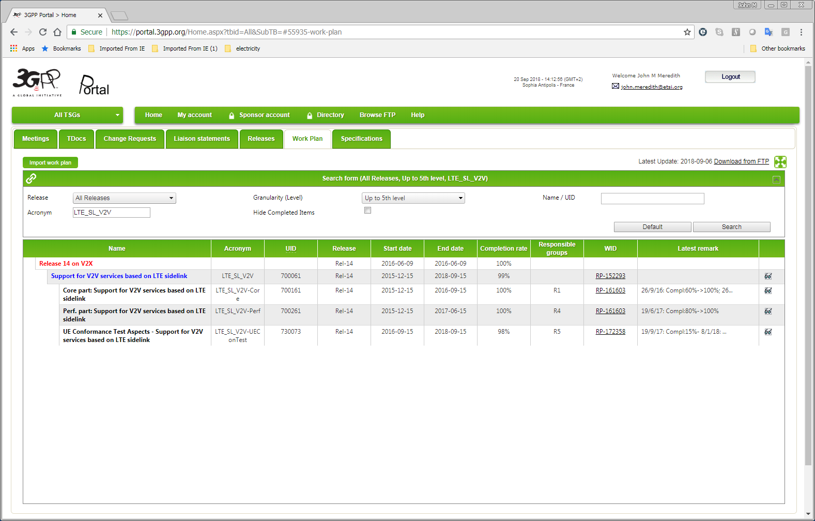
3GPP Technology Areas
The user can also click on an icon (not shown) against each work item to be taken to the Work Plan tab on the portal where the full expansion of that work item tree (all levels) is displayed, giving access to a lot of fine detail, should he need it.
(This requires development work with the portal.)
Page:
technology_areas_home/search_results/document-download
Step 3 – download documents for technology area:
vehicle-to-anything (V2X)
Studies and normative work items
Technical Reports and Specifications
Change Requests (approved)
Rel-14
Support for V2V services based on ...*
36.101
User Equipment (UE) radio transmis...
36.101
CR 4326 Rel-14 – V2V power imbala...
Rel-14
LTE support for V2X services (V2XLTE*
36.785
Vehicle to Vehicle (V2V) services bas...
36.101
CR 4698 Rel-14 – Correction of RE...
Rel-15
Study on evaluation methodology o..*
---
---
---
---
Rel-15
Study on security aspects for LTE su...
---
---
---
---
...
...
...
...
...
...
...
...
...
...
...
...
...
...
...
...
Rel-16
Study on application layer support f...
Rel-16
Study on Improvement of V2X Servi...
Rel-17
Application layer support for V2X se...
* indicates complete
EAG: This is a very nice idea – allowing access
to information if needed, without cluttering
the representation.
Click to download all work-item-related documents (WIDs, status reports) in this area
Click to download latest version of all specs in all Releases
Click to download all approved CRs for all specs in this area

Slide 16
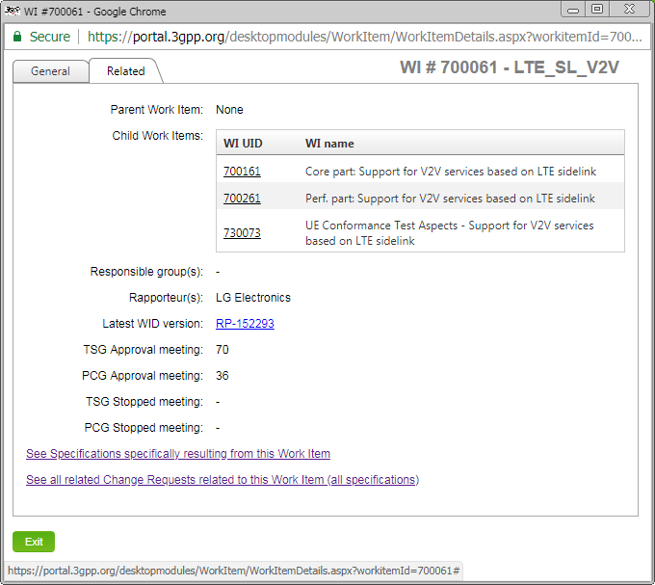
3GPP Technology Areas
Clicking on the top level work item will open the home page for that work item.
Page:
technology_areas_home/search_results/document-download
Step 3 – download documents for technology area:
vehicle-to-anything (V2X)
Studies and normative work items
Technical Reports and Specifications
Change Requests (approved)
Rel-14
Support for V2V services based on ...*
36.101
User Equipment (UE) radio transmis...
36.101
CR 4326 Rel-14 – V2V power imbala...
Rel-14
LTE support for V2X services (V2XLTE*
36.785
Vehicle to Vehicle (V2V) services bas...
36.101
CR 4698 Rel-14 – Correction of RE...
Rel-15
Study on evaluation methodology o..*
---
---
---
---
Rel-15
Study on security aspects for LTE su...
---
---
---
---
...
...
...
...
...
...
...
...
...
...
...
EAG: This collects some metadata in one place.
I suggest other data which is hard to track
with the WIDs – e.g. ‘what enhances this?’
This data is available in other WIDs that refer
back to this one. Also links to the relevant
studies, to other related WIDs, etc. Instead
of relying on navigating of related features with the WP representation: feature linkage in each place.
...
...
...
...
...
Rel-16
Study on application layer support f...
Rel-16
Study on Improvement of V2X Servi...
Rel-17
Application layer support for V2X se...
* indicates complete
Click to download all work-item-related documents (WIDs, status reports) in this area
Click to download latest version of all specs in all Releases
Click to download all approved CRs for all specs in this area

Slide 17
3GPP Technology Areas
An additional tab can be provided on the work item page, showing data (automatically) scraped from the latest WID, status report, and summary documents.
In addition, there could be an additional tab containing manually entered free text – effectively a “static page” of helpful information on this work item. (Normally this would only be created for top-level work items.)
Page:
technology_areas_home/search_results/document-download
Step 3 – download documents for technology area:
vehicle-to-anything (V2X)
Studies and normative work items
Technical Reports and Specifications
Change Requests (approved)
Rel-14
Support for V2V services based on ...*
36.101
User Equipment (UE) radio transmis...
36.101
CR 4326 Rel-14 – V2V power imbala...
Rel-14
LTE support for V2X services (V2XLTE*
36.785
Vehicle to Vehicle (V2V) services bas...
36.101
CR 4698 Rel-14 – Correction of RE...
Rel-15
Study on evaluation methodology o..*
---
---
---
---
Rel-15
Study on security aspects for LTE su...
---
---
---
---
...
...
...
...
...
...
...
...
...
...
...
...
...
...
...
...
Rel-16
Study on application layer support f...
Rel-16
Study on Improvement of V2X Servi...
Rel-17
Application layer support for V2X se...
* indicates complete
EAG: Great! However – I am not sure that it should be a ‘tab.’ This is essential context to understand the feature. I think there should at least be the first few words visible on the high level features page, allowing someone to click to see more.
Click to download all work-item-related documents (WIDs, status reports) in this area
Click to download latest version of all specs in all Releases
Click to download all approved CRs for all specs in this area

Slide 18
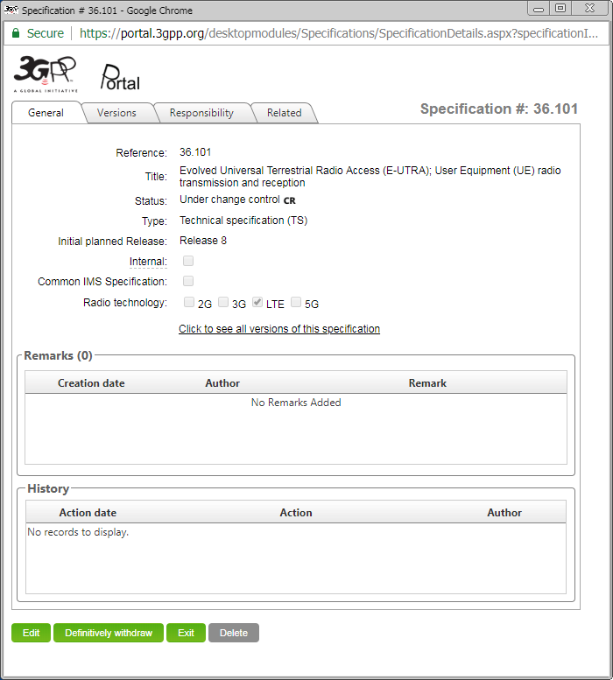
3GPP Technology Areas
Similarly, the user can click an icon against an entry in the specs table to be taken to that spec’s home page on the portal.
Page:
technology_areas_home/search_results/document-download
Step 3 – download documents for technology area:
vehicle-to-anything (V2X)
Studies and normative work items
Technical Reports and Specifications
Change Requests (approved)
Rel-14
Support for V2V services based on ...*
36.101
User Equipment (UE) radio transmis...
36.101
CR 4326 Rel-14 – V2V power imbala...
Rel-14
LTE support for V2X services (V2XLTE*
36.785
Vehicle to Vehicle (V2V) services bas...
36.101
CR 4698 Rel-14 – Correction of RE...
Rel-15
Study on evaluation methodology o..*
---
---
---
---
Rel-15
Study on security aspects for LTE su...
---
---
---
---
...
...
...
...
...
...
...
...
...
...
...
...
...
...
...
...
Rel-16
Study on application layer support f...
Rel-16
Study on Improvement of V2X Servi...
Rel-17
Application layer support for V2X se...
* indicates complete
EAG: Here is where some knowledge would really help. Some users want the 36 series, others only the 23 series. The user’s guide should help give people an idea where to find the resources they need. We can link to the relevant sections of the guide, e.g. here to spec family descriptions.
Click to download all work-item-related documents (WIDs, status reports) in this area
Click to download latest version of all specs in all Releases
Click to download all approved CRs for all specs in this area

Slide 19
3GPP Technology Areas
And finally, the user can click on an icon against an entry in the CR table to be taken to the Change Request tab of the portal to obtain a list of all approved CRs to that spec relating to the work item tree(s) in question.
(This requires development work on the portal.)
Page:
technology_areas_home/search_results/document-download
Step 3 – download documents for technology area:
vehicle-to-anything (V2X)
Studies and normative work items
Technical Reports and Specifications
Change Requests (approved)
Rel-14
Support for V2V services based on ...*
36.101
User Equipment (UE) radio transmis...
36.101
CR 4326 Rel-14 – V2V power imbala...
Rel-14
LTE support for V2X services (V2XLTE*
36.785
Vehicle to Vehicle (V2V) services bas...
36.101
CR 4698 Rel-14 – Correction of RE...
Rel-15
Study on evaluation methodology o..*
---
---
---
---
Rel-15
Study on security aspects for LTE su...
---
---
---
---
...
...
...
...
...
...
...
...
...
...
...
...
...
...
...
...
Rel-16
Study on application layer support f...
Rel-16
Study on Improvement of V2X Servi...
Rel-17
Application layer support for V2X se...
* indicates complete
Click to download all work-item-related documents (WIDs, status reports) in this area
Click to download latest version of all specs in all Releases
Click to download all approved CRs for all specs in this area
EAG: Some metadata columns in the 3rd table would be helpful – e.g. category “B” and “C” are a special and important case. Am I the only one who believes this?

Slide 20
3GPP Technology Areas
A note on documents pushed in bulk to the user ...
The tables of the preceding slides showing work items, specs and CRs must show, on each line, the relevant filenames of the document in question, because the user cannot otherwise associate a file with a work item’s WID, status report, or summary.
Similarly, although slightly less cryptic, the filename of a spec version is not always easy to match to a given spec and version, and a CR’s filename may not be easy to match to the spec and CR number.
This aspect is particularly important if the user elects to download all documents relating to a particular technology area: those documents might number many hundreds or even thousands.
EAG: Getting bulk documents will really save time. While one can click on each CR, where there’s a link on the CR page (e.g. https://portal.3gpp.org/ChangeRequests.aspx?q=1&specnumber=33.163) this becomes impractical when there are lots of CRs. Further that page shows no metadata (e.g. category, tick boxes, etc.) So I have to load every CR to find what I want
if it is not obvious by the CR title.

Slide 21
3GPP Technology Areas
The end
Any questions?
EAG: Thanks very much for your excellent mock up taking into account the IT improvement project input.

