Slide 1
FS_DTAPP R19 proposal and Discussion paper
Shao Weixiang
ZTE Corporation

Slide 2
FS_DTAPP 1/2
Rel-19 SID/WID Proposal Slide Template
Continuation or New Item: New Item for Digital Twin Application enabler
Study Item/Work Item/Both: Study Item
Source of requirements: requirements and use cases from SA1
Expected Output: new TR
Anticipated start date/meeting: Feb. 2024 SA6#59
Target Completion: Dec. 2024 SA#106
Estimated TUs: 7TUs(SID)
Rapporteurship: Shao Weixiang, ZTE Corporation, shao.weixiang@zte.com.cn
Supporting IMs: ZTE Corporation, CALTTA, Nubia, Sanechips, ZONSON, Jetflow, China Telecom

Slide 3
FS_DTAPP 2/2
Rel-19 SID/WID Proposal Slide Template
Description: Digital twin is a real-time representation of physical assets in a digital world (from TS 22.156 3.1). A DT is a virtual replica of a real-world system - a “physical” system - on which operations can be performed (from S5-236839). Digital twins are used to simulate, predict and optimize products and production systems (from TS 22.104 A.2.3.4). DT is important base for metaverse and XR services, which is usage in different domains such as consumer area, enterprise area, industrial area. SA5 has set up new study item on Management aspect of Network Digital Twin. And SA1 requirements are well-suited for application enabler layer.
Goals: Analyze the stage 1 requirements for digital twin , develop key issues and solution recommendations to enable the application layer support for the digital twin services.
Dependency on other working groups: SA2 for system aspects, SA3 for security aspects, SA4 for media aspects and SA5 for management aspects
Impacts to 3GPP/Industry work if this is not accepted into Rel-19: DT is important base for metaverse and XR services, usage in different domains such as consumer area, enterprise area, industrial area will emerge continuously, it is worthwhile to consider how to best anticipate and support the technical challenges for mobile telecommunications standards.

Slide 4
Digital twin related capabilities and requirements in TS22.156
Rel-19 SID/WID Proposal Slide Template
Digital twin
a real-time representation of physical assets in a digital world
require coordination of diverse service data flows of sensor data and media in order to satisfy the needs of a digital twin
The 5G system shall provide a means to associate and coordinate data flows related to one or multiple UEs e.g. associated with the same object in digital twin applications …
The status of the digital twin is determined by sensors …
XR-enabled collaborative and concurrent engineering based on geospatial digital twins
“geospatial” digital twins relate to the concept of adding geospatial information to a digital twin, such as 3D models, precise location and temporal information – enabling for example holographic-type of object animation.
Digital asset
User Identifiers and personal data that are commonly required and represented in a machine-readable format.
the services can benefit from common information, such as avatar parameters and configuration information, so that a user's digital representation is consistent across different applications.
the 5G system shall be able to provide functionality to store digital assets associated with a user, and to remove such digital assets associated with a user.
the 5G system shall provide a means to allow a user to securely access and update their digital assets.
the 5G system shall be able to allow an authorized third party to retrieve the digital asset(s) associated with a user

Slide 5
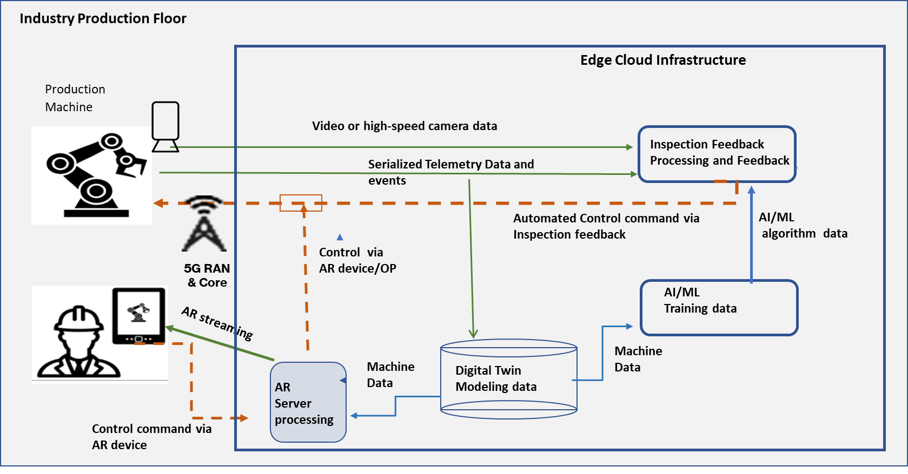
Use case: Inspection in production systems
Capabilities and requirements :
A digital twin is a virtual representation of a product or production systems. Digital twins are used to simulate, predict and optimize products and production systems.
digital twin model’s output to AR, AI/ML, applying algorithm and further processing
Coordinate with AIMLAPP, XRAPP
TS 22.104 A.2.3.4 Inspection in production systems:
Digital twin based production quality maintenance

Slide 6
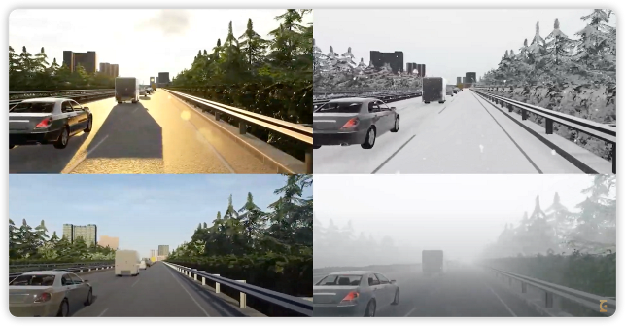
Use case: Mobile Metaverse for 5G-enabled Traffic Flow Simulation and Situational Awareness
Capabilities and requirements :
The physical objects which may use UEs for telecommunication services, their corresponding virtual objects are also capable of interacting with each other and also interact with physical objects via 5GS.
This real-time information may include structured and unstructured data.
not only the physical but also virtual objects need to interact via 5G system and they need to be identified. Interaction means the physical objects deliver real-time status data to digital twin.
based on operator policy with 3rd party, to provide bearer services with corresponding QoS guarantee for both physical and virtual objects as they can be seen as UE for 5GS.
TR 22.856 5.20, Figure 5.2.1-1 Example of Smart Transport Metaverse

Slide 7
Use case: Immersive Tele-Operated Driving in Hazardous Environment
Operating vehicles, lifting devices, or machines in an industrial environment is hazardous when achieved manually and locally by a human. In this use case, it is proposed to leverage 5G to provide an end-to-end system in which a remote user controls a moving device (vehicle, lifting device, robot, etc.) with an immersive cockpit displayed on a virtual reality head-mounted display and haptic gloves for control. Furthermore, the cockpit is complemented with information from the digital twin of the place in where the user operates (e.g., sensors in a factory, type of material around, other moving vehicles or persons).
The use case improves user safety and makes the operations even more accurate by merging additional information from a digital twin.
Capabilities and requirements :
The 5G system shall be able to provide a means to associate data flows related to one or multiple UEs with a single digital twin.
The 5G system shall be able to provide a means to support data flows from one or multiple UEs to update a digital twin.
The 5G system shall be able to support data flows directed towards one or multiple UEs as a result of a change in a digital twin.
The status of the digital twin is determined by sensors in the vehicle's vicinity and carried by the vehicle (from TS 22.156 6.1).
TR 22.856 5.20

Slide 8
SA5 (FS_NDT) S5-236839
The objective of this study will focus on the following aspects:
Define the concepts and terms related to DT and the DT framework in 3GPP management system.
Identify the potential use cases, corresponding requirements and solutions for management and orchestration purposes based on digital twin of the 5G network. (The potential use cases may include: a full perspective of network topology and traffic, verification of network operations, etc.)
According to the identified UC and potential new requirements, make gap analysis with existing MnS and investigate the potential enhancements of MnS.
Note：The internal processes and algorithms inside network functions/elements are proprietary which will not be considered to expose when constructing network digital twin.
Study on management aspects of Network Digital Twin
A Network Digital Twin (NDT) is a DT whose physical counterpart is a communications network, or some part of one. The communications network can include e.g. physical network elements and components, virtualized network functions (VNFs - i.e., network functional elements instantiated as software-based entities), the physical hosts for such VNFs, services and traffic, etc.

Slide 9
Thank You!

