Slide 1
SA6 Rel-19: Discussion on Application Layer support for ATSSS
August, 2023
Lenovo

Slide 2
Outline
Background
Motivation
Potential ATSSS_APP architecture
Potential Objectives

Slide 3
Background
The Access Traffic Steering, Switching, Splitting (ATSSS) feature, as defined in TS 23.501 clause 5.32, enables data traffic to be exchanged between a UE and a UPF over multiple access paths.
Each access path may be using either 3GPP access (such as terrestrial or non-terrestrial NG-RAN) or non-3GPP access (such as WLAN).
In order to enable the ATSSS feature, an MA PDU Session must be established, and configure the UE and UPF with steering rules.
The steering policies are created by the PCF during the MA PDU Session establishment procedure and are employed by the SMF to create "ATSSS rules" for the UE and "Multi-Access Rules (MAR)" for the UPF.
The steering rules indicate how the traffic of the MA PDU Session should be distributed over the available access paths between the UE and the UPF.
Each steering rule contains a “steering functionality” (e.g. MPTCP, MPQUIC, ATSSS-LL) and a “steering mode” (e.g. load-balancing, active-standby, smallest-delay, redundant, etc.)
Simplified architecture of ATSSS as defined in the 3GPP specifications

Slide 4
Motivation
Complexity and impact on 5GC implementations
The implementation of the ATSSS feature in real-world mobile networks is complex because it has a broad network-wide impact. Indeed, the ATSSS feature affects many 5GC network functions, including the UE, UPF, AMF, SMF, PCF, etc. Moreover, it demands non-3GPP interworking functions, such as the N3IWF and the TNGF, to support access paths over non-3GPP access networks.
Implementing the ATSSS feature in practice means carrying out substantial and complex changes to many 5G network functions and supporting also non-3GPP interworking functions and the associated procedures in the UE for communicating with these functions.
We need to investigate a more simplified application-layer ATSSS architecture, which offers the same benefits as the existing ATSSS feature, allowing data traffic to be exchanged over multiple access paths, but it should also (a) be less complex and (b) could support more use cases, e.g. non-3GPP access paths that do not traverse 5GC.
It would create impact for SA6 to investigate how to provide support for an “application-layer ATSSS solution”

Slide 5
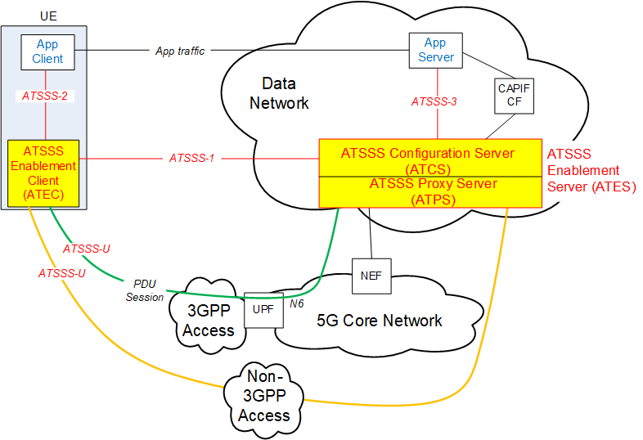
Exemplary ATSSS_APP architecture
In this exemplary architecture, an ATSSS enabler capability will be studied (as new enabler or enhancement of existing ones); as well as possible issues and solutions arising by this new architecture.
Such architecture may include new SA6 logical functionality(-ies):
ATEC: An application-layer function on the UE side, which triggers the establishment of an App-Layer ATSSS (AL-ATSSS) session, receives steering rules and other configuration data, and then transmits data traffic over multiple access paths based on the received steering rules.
ATES: An application-layer function on the network side, which may include an ATSSS Configuration Server (ATCS) functionality and an ATSSS Proxy Server (ATPS) functionality.
The ATCS supports the establishment of AL-ATSSS Sessions requested by UEs (ATCEs) and the generation of steering rules and other configuration data for each AL-ATSSS session.
The ATPS handles the user-plane aspects of an AL-ATSSS Session and forwards downlink data to ATEC via multiple access paths using the steering rules provided by ATCS.
Protocols like MPTCP, MPQUIC, etc. would be used in the ATEC and ATPS for handling communication over multiple access paths.
NOTE: A non-3GPP access path may or may not traverse 5GC

Slide 6
Potential objectives
The objectives of the study are to:
Evaluate the need for an overall application framework/enabling layer architecture and associated requirements to support application-layer Access Traffic Steering, Switching, Splitting (ATSSS-APP) over multiple access networks (3gpp and non-3gpp);
Study architectural and functional implications on existing application enablers (e.g. SEAL, SEALDD) for supporting ATSSS-APP architecture;
Identify key issues based on 1) and 2), develop corresponding functional model and potential solutions (e.g. discovery, multi-access session establishment, application service continuity) to support the implementation of ATSSS-APP, including potential UE and network APIs; and
Investigate possible impacts of application-layer ATSSS for different deployments and business models.

Slide 7
Estimated TU Calculation
Meeting | FS_ATSSS-App (SID) | ATSSS-App (WID)
SA6#56 (Aug-23) | SID Proposal
SA6#57 (Oct-23) | 1 TU
SA6#58 (Nov-23) | 1 TU
SA6#59 (Feb-24) | 1 TU
SA6#60 (Apr-24) | 1 TU | Work item Proposal
SA6#61 (May-24) |  | 0.5 TU
SA6#62 (Aug-24) |  | 0.5 TU
SA6#63 (Oct-24) |  | 0.5 TU
SA6#64 (Nov24) |  | 0.5 TU
Total | 4 TUs | 2 TUs

