Slide 1
Discussion on Integrated Sensing and Communication related work in SA6
Huawei, Hisilicon

Slide 2
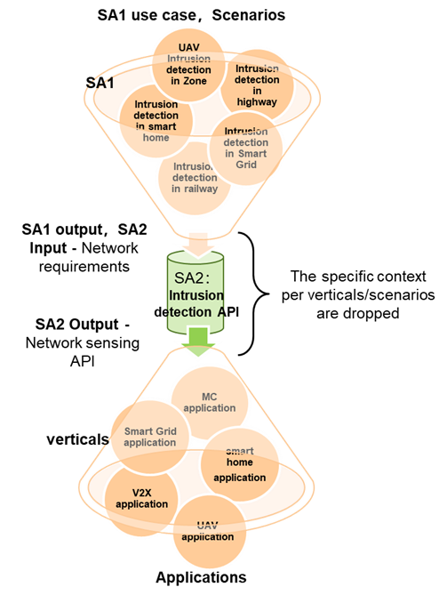
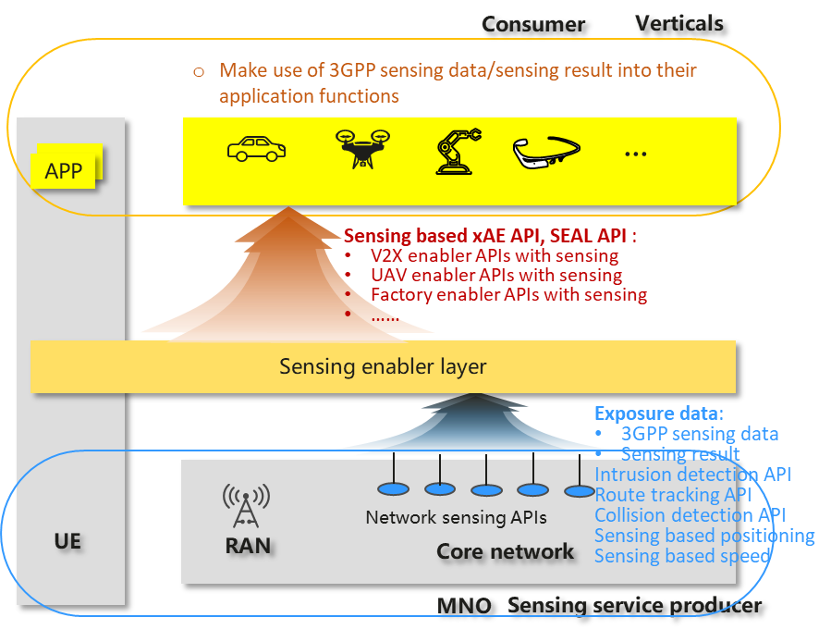
Use cases and business models with SA6 participation
 The Sensing enabler layer will utilize the sensing information exposed from 3GPP network, and optional non-3GPP sensing data from the application domain, to provide value-added service API per vertical application requirements.
 One example for V2X. SA6 will provide the industry a Demo of using network sensing
For autonomous driving, the intrusion detection, traffic detection, location detection, and speed detection provided by SA2 are only the beginning. SA6 integrates application layer data and SA2 perception data to provide automatic lane detection for the application layer after calculation, including: Speed suggestion, Suggested Route, Obstacle and Vulnerable Traffic Participant warning, Green wave speed guidance…
Application
layer
N-3GPP info input
Sensing based Lane-level automatic cruise
Speed suggestion
Suggested Route
Obstacle, Vulnerable Traffic Participant warning
Green wave speed guidance
Congestion report and estimated Dissipation Time result
Camera：traffic light phase and time
SA6
SA6 aggregate Application layer info and SA2 sensing info, then provide
integrated application specific sensing service
Vulnerable Traffic Participant Detection
Detect accumulated water and snow on the road surface
Detect Vehicle density
Traffic info,
weather info
Obstacle identification and location
Obtain the location of vehicles
traffic light phase and time
Obtain the velocity
Slow and fast vehicle detection
SA2
Intrusion
detection API
Traffic detection API
Positioning API
Velocity detection API

Slide 3
Why sensing can be done in SA6?
Potential sensing function in SA6
Functions (e.g. UAV navigation, V2X application enabler functions ) already implemented as Application layer specific function, which can be improved with sensing capability utilization
Application layer already implement some functions such as UAV navigation, geo-fence, drone inspection and so on, which are widely used as application layer functions
By utilizing Sensing function provided by 5GC, those functions could be further enhanced.
Combining of 3GPP and Non-3GPP sensing data, SA6 provide an alternative way where SA2 mechanism doesn’t work:
Whether the Non-3GPP sensing data can be obtained by 5GC depends on 3rd willingness (expose its sensing data to 5GC)
Thus SA6 need to provide a complement way when the Non-3GPP sensing data cannot be obtained by 5GC.

Slide 4
Enabler layer based on SA2 networking exposure API
For autonomous driving, SA6 will utilize the sensing information exposed from 3GPP network, and functions/data from the application domain to provide value-added service API (e.g. Sensing based Lane-level automatic cruise ) per vertical application requirements
Network sensing API from SA2 |  |  | ❶ intrusion detection API | ❷ traffic detection API | ❸ route tracking API | ❹ collision detection API | ❺ positioning API |  velocity detection API
Service API with sensing | Input | Output | Invoke the network sensing API(s) +other SEAL APIs in SA6 +Info collected from UE (e.g., Camera, Radar data)
Sensing based Lane-level automatic cruise | Host UE ID，Lane info | Speed suggestion; Lane change suggestion； High-speed Confluence Passage Assist； Slow and fast Vehicle Warning Obstacle warning Green wave speed guidance Ramp Incoming Control | √ - Detect the A broken car, an accident, any changes in front of the car within the safety distance √ - Vulnerable Traffic Participant Detection √ - Detect accumulated water and snow on the road surface (position, depth) | √ - Detect the traffic √ - Traffic light detection | √ - detect deviations from lane | √ - Monitor the safety distance from surrounding cars √ - Collision warning for vulnerable traffic participants √ - Vehicle collision detection in the reverse direction √ - Obstacle identification and location | √ - Obtain the location of vehicles √ - Obstacle identification and location √ - Detect traffic light phase and timing | √ - Obtain the velocity, heading of the vehicles √ - Slow and fast vehicle detection
Sensing based HDMap service API | Host UE ID, area[O] | Updated dynamic HD map info； Obstacle warning Visibility detection and warning Green wave speed guidance | √ - Detect the A broken car, an accident, any changes in front of the car within the safety distance | √ - Detect the traffic √ - Detect weather √ - Detect traffic light phase and timing | √ - Public transport timetable, √ - estimated arrival time | √ - Monitor the safety distance from surrounding cars | √ - Obtain the location of vehicles √ - Road construction inspection √ - Detect traffic light phase and timing | √ - Obtain the velocity, heading of the vehicles √ - Queuing status at intersections
Sensing based route suggestion | Area/waypoint, preference | Suggested Route； Obstacle warning； Congestion report and estimated Dissipation Time result Ramp Incoming Control | √ - Detect the A broken car, an accident, √ - Detect accumulated water and snow on the road surface (position, depth) | √ - Detect the traffic √ - Detect Vehicle density | √ - Accident vehicle tracking | √ - Collision warning for vulnerable traffic participants √ - Vehicle collision detection in the reverse direction √ - Obstacle identification and location | √ - Accident vehicle positioning √ - Obstacle identification and location | √ - Queuing status at intersections
Sensing based Parking slot mgmt. API | Host UE ID/area | Available parking slot information Recommended Parking Routes Parking charging Collision warning | √ - Detect the available slot | √ - Detect the parking/available number | √ - Detect parking Routes | √ - Collision warning for vulnerable traffic participants and obstacle | √ - Obstacle identification and location √ - Parking duration statistics
S6 service API with sensing（V2X as example)

Slide 5
The relationship with other SA6 works
Study the sensing in a single SI, the SI output can be input into multiple TSs, 23.434, 23.286, 23.256, 23.xxx (new verticals if any)
The other verticals application can make use of the output of sensing SI.

Slide 6
The relationship with SA2
SA6 can work in parallel with SA2, in the way similar to other stage2 inter-working group collaboration (e.g. RAN and SA2)
For SA2 dependency part:
By sending LS to synchronize progress and pending the conclusion after SA2 study concludes.
For Non-SA2 dependency part:
SA6’s solution can be concluded by SA6 itself.

Slide 7
The end

