Slide 1
Clarification about API format of SEALDD service
Niranth (namogh@huawei.com)
Jian Zhang (zhangjian369@huawei.com)
Huawei, Hisilicon

Slide 2
Outline
Background
Benefits of separated API
Separated API in other WGs
Summary

Slide 3
Background
There are controversial points about the API formats (i.e., merged API or separated API) for SEALDD service, when defining the information flow and API in TS 23.433.
Editor's Note: Whether the information flow and API between SEALDD server and VAL server should be merged to one generic API is FFS.
API format #1: merged API
API format #2: separated API
VAL server #1
VAL server #2
VAL server #3
VAL server #1
VAL server #2
VAL server #3
URLLC Event description
Transmission measurement Event description
Storage Event description
Sdd_TransmissionMeasurement API (input parameters: measurement requirements, e.g. latency, bitrate)
Sdd_URLLCTransmission API (input parameters: URLLC traffic descriptors)
Sdd_DataStorage API (input parameters: stored data, access control policy, expiration time)
Sdd_DataDelivery API
SEALDD server
SEALDD server

Slide 4
Benefits of separated API
 | Separated API | Merged API
Charging for different SEALDD services | Different SEALDD feature (such as URLLC service, general service, etc.) may have the different charging ways. For example, the VAL provider may be charged higher when using URLLC service. Using the separated API format, the charging methods according to the different SEALDD services can be provided (e.g. based on the different API invoking times). | Using the merged API format, it is difficult to provide the charging methods that differentiate between SEALDD services
Feature independence | Different SEALDD features (such as URLLC service, storage service, etc.) have the different input parameters. VAL provider (e.g. URLLC) can utilize the separated (i.e., feature-independent) API (e.g. Sdd_ URLLCTransmission API) without needing to know the other unrelated parameters (e.g. Sdd_DataStorage API ). Using the separated API format, the human-readable development documentation can be provided to VAL developer. | Using the merged API format, feature independence cannot be achieve and the documentation for the feature will be complex for the VAL developer as it includes many unrelated parameters information.
Development workload for SEALDD developer | The separated API and merger API have the similar development workload (i.e., code lines) for SEALDD developer, but using the separated API can provide several benefits as listed above.

Slide 5
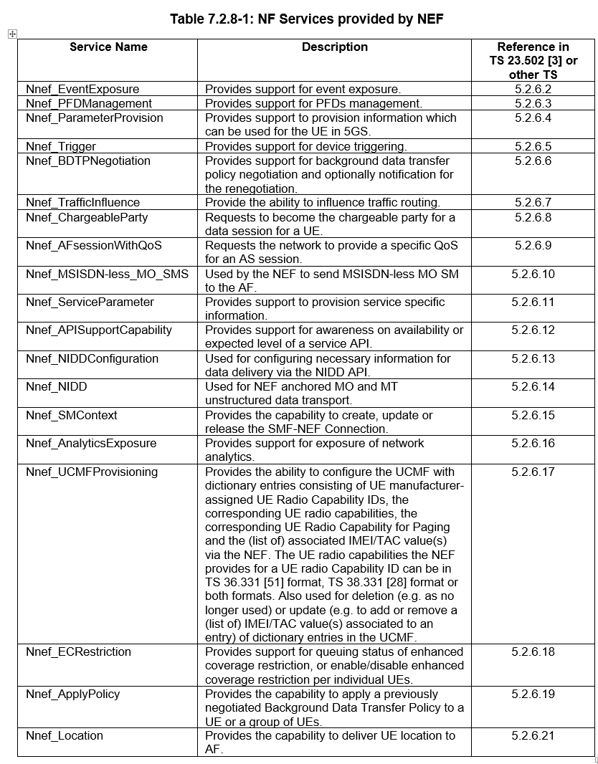
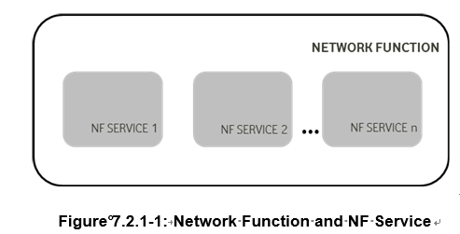
Separated API in other WGs
In clause 7.2.1 of TS 23.501, “Network Functions may offer different capabilities and thus, different NF services to distinct consumers. Each of the NF services offered by a Network Function shall be self-contained, reusable and use management schemes independently of other NF services offered by the same Network Function (e.g. for scaling, healing, etc).”
Conclusion:
In SEALDD, we can define the different APIs (i.e., using the separated API principle like SA2) to describe the different SEALDD features.

Slide 6
Summary
In SEALDD, the separated API between SEALDD server and VAL server should be provided according to the different SEALDD features due to the following reasons:
Enabling the charging mechanism according to the different SEALDD services (e.g. based on the different API invoking times).
Consumption of independent features by the VAL developer without pondering about the unrelated information of the feature resulting from a merged API. Also helps providing more clear API documentation to VAL developer
Consistent with the separated API principle in other WGs (e.g. like the defined NF services in SA2)

